Slide 1
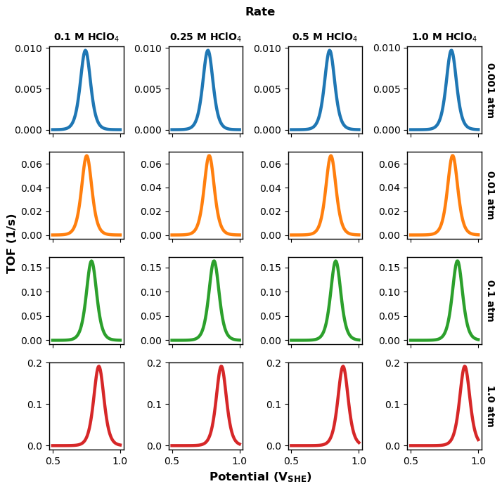
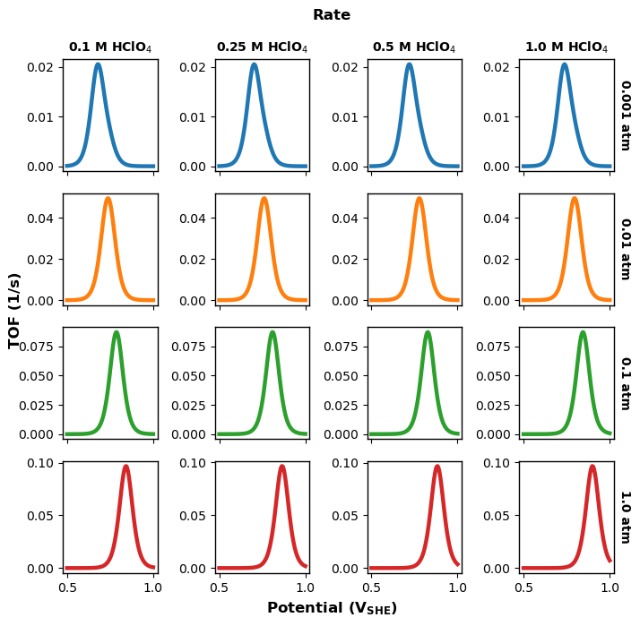
$ΔG_{CO}=−0.1 eV;ΔG_{OH}=0.8 eV;G_{LH}^{act}=0.75 eV$
Single site
$ΔG_{CO}=−0.1 eV;ΔG_{OH}=0.8 eV;G_{LH}^{act}=0.75 eV$
3 site
$ΔG_{CO}=−0.15 eV;ΔG_{OH}=0.75 eV;G_{LH}^{act}=0.8 eV$
$ΔG_{CO}=−0.2 eV;ΔG_{OH}=0.7 eV;G_{LH}^{act}=0.775 eV$

Slide 2
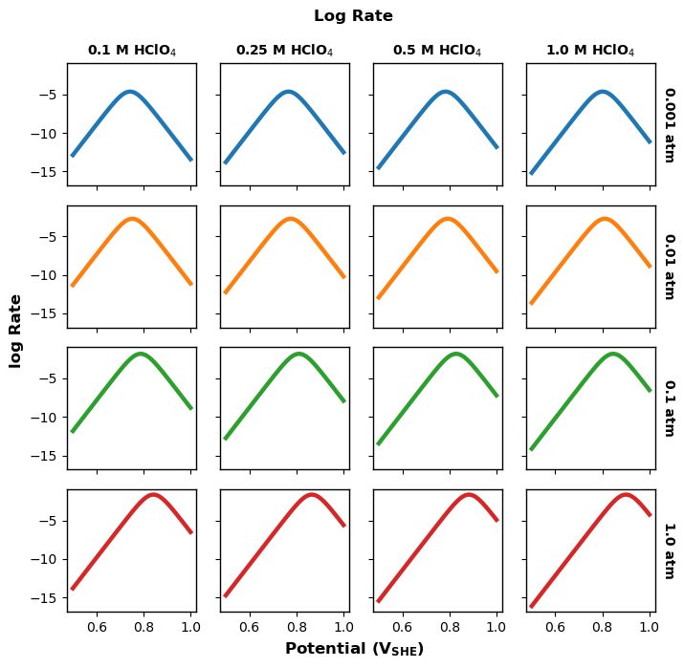
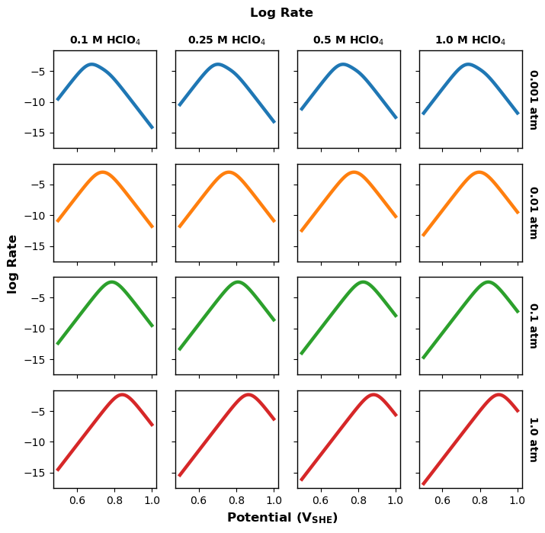
Single site
3 site

Slide 3
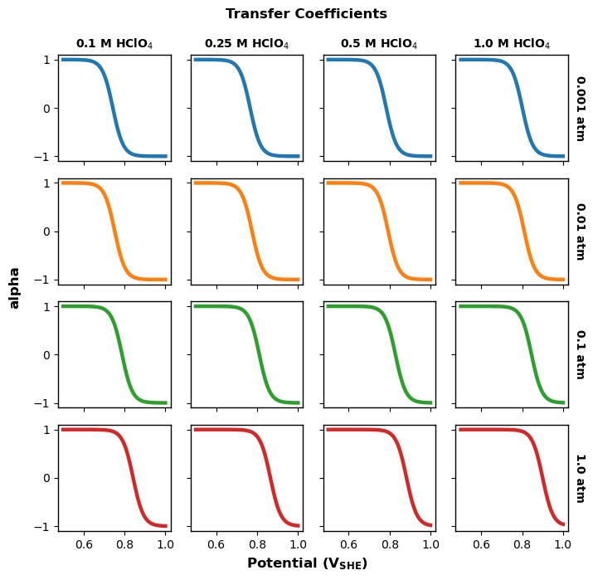
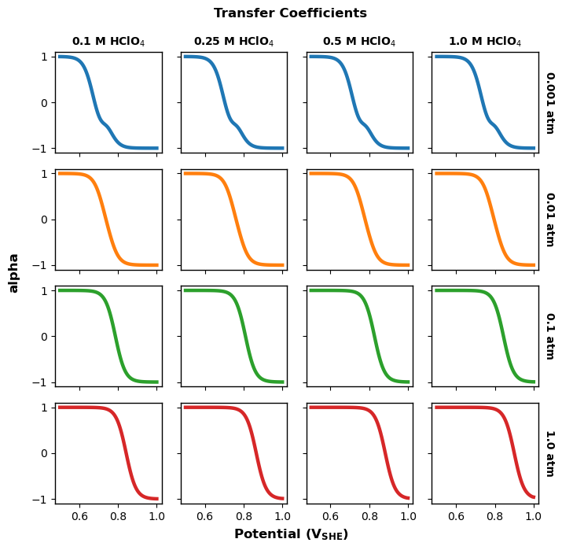
Single site
3 site

Slide 4
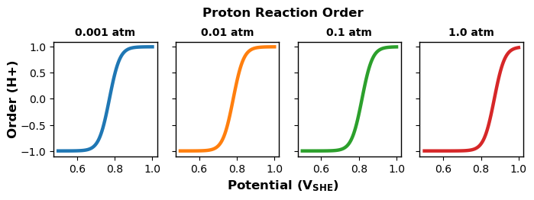
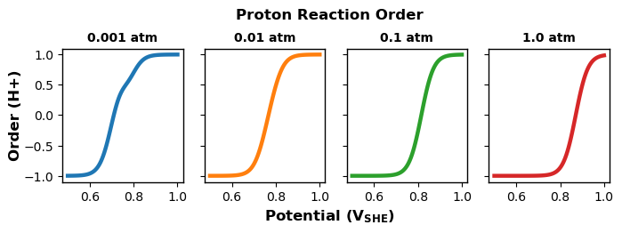
Single site
3 site

Slide 5
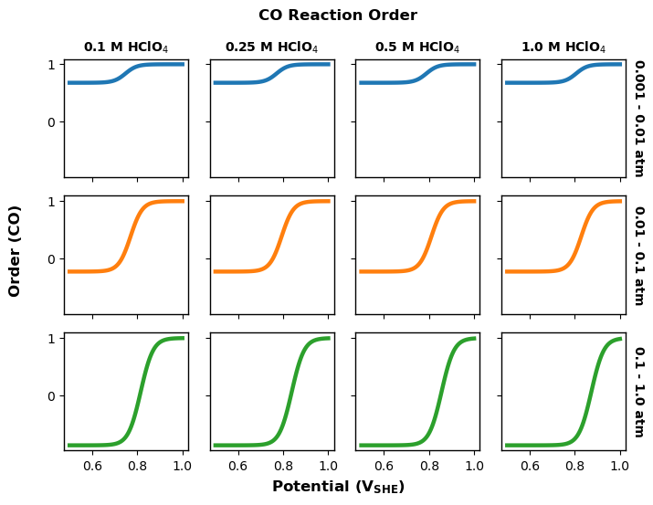
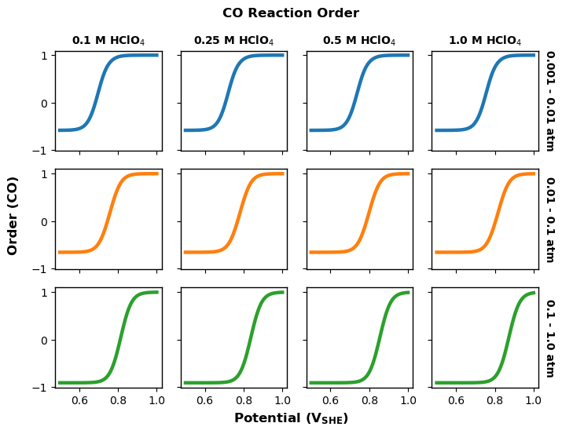
Single site
3 site

