Slide 1
Databases,
Ontologies and Text mining
Session Introduction
Part 2
Carole Goble, University of Manchester, UK
Dietrich Rebholz-Schuhmann, EBI, UK
Philip Bourne, SDSC/UCSD, USA
pbourne@ucsd.edu

Slide 2
Resources in Bioinformatics
Ontologies
The Gene Ontology
Applications
and
Mining
Databases
Bioinformatics
Text mining
UniProt
Knowledge mining
LocusLink
Notes:
Building the Semantic Grid means building it for the three` different knowledge stakeholders.

Slide 3
Resources in Bioinformatics
Databases
Bioinformatics
UniProt
LocusLink
Notes:
Building the Semantic Grid means building it for the three` different knowledge stakeholders.

Slide 4
What perspective do I bring?

Slide 5
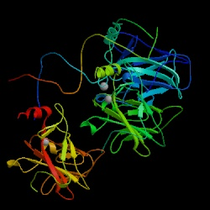

Preface
A review of the state and needs of the field from the perspective of a user of biological databases….
Oops!
ß sandwich? Where?
Large loop? Which one??
Loop-sheet-helix???
?
1TSR
… the p53 core domain structure consists of a ß sandwich that serves as
a scaffold for two large
loops and a loop-sheet-
helix motif ...
----Science Vol.265, p346
Corresponding structure from the PDB

Slide 6
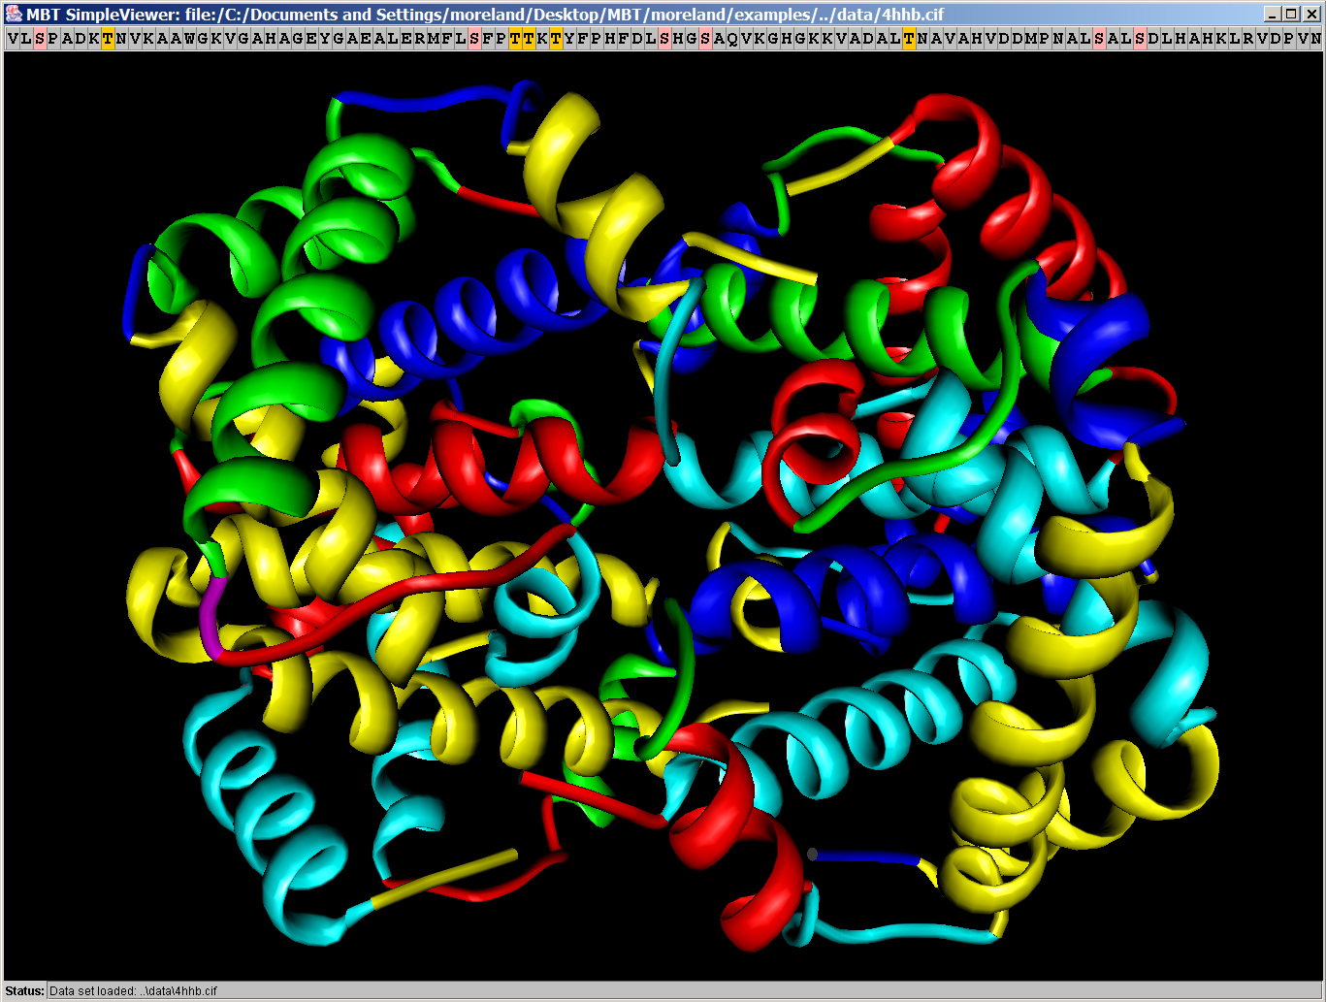

Preface
A review of the state and needs of the field from the perspective of a developer of biological databases….

Slide 7
What are the current biological databases and what does this tell us?

Slide 8
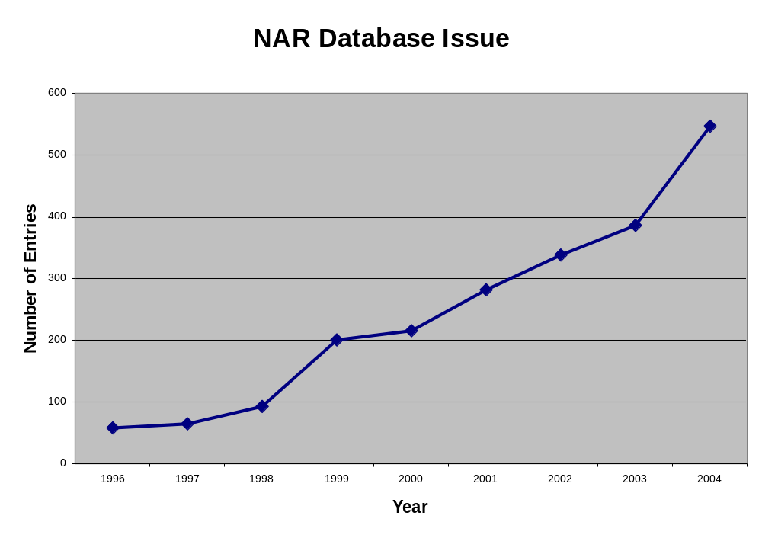
Large Growth in the Number of Biological Databases

Slide 9
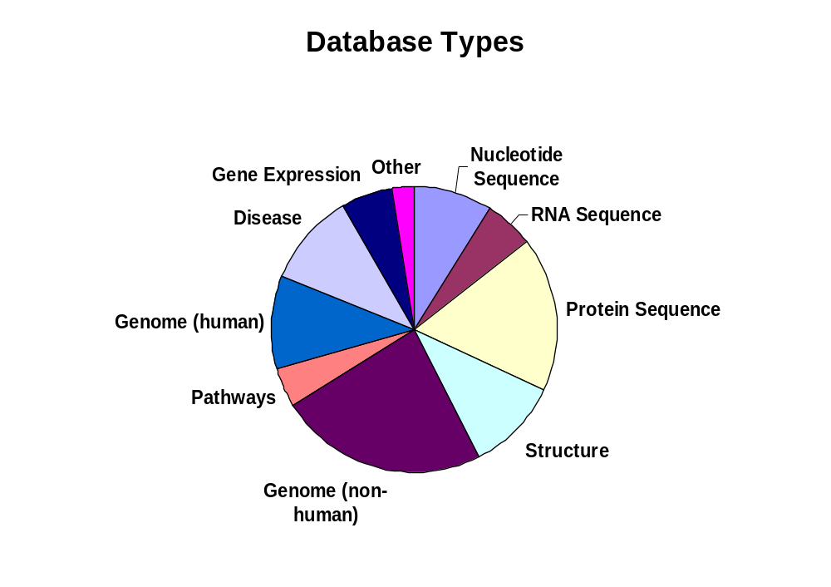
Resources are Becoming More Diverse
NAR 2004 – Division by Resource Type

Slide 10
NAR 2004 – A Closer Look
Genome scale databases have proliferated
Traditional sequence databases are now a small part
Databases around new specific data types are emerging
Pathway and disease orientated databases are emerging

Slide 11
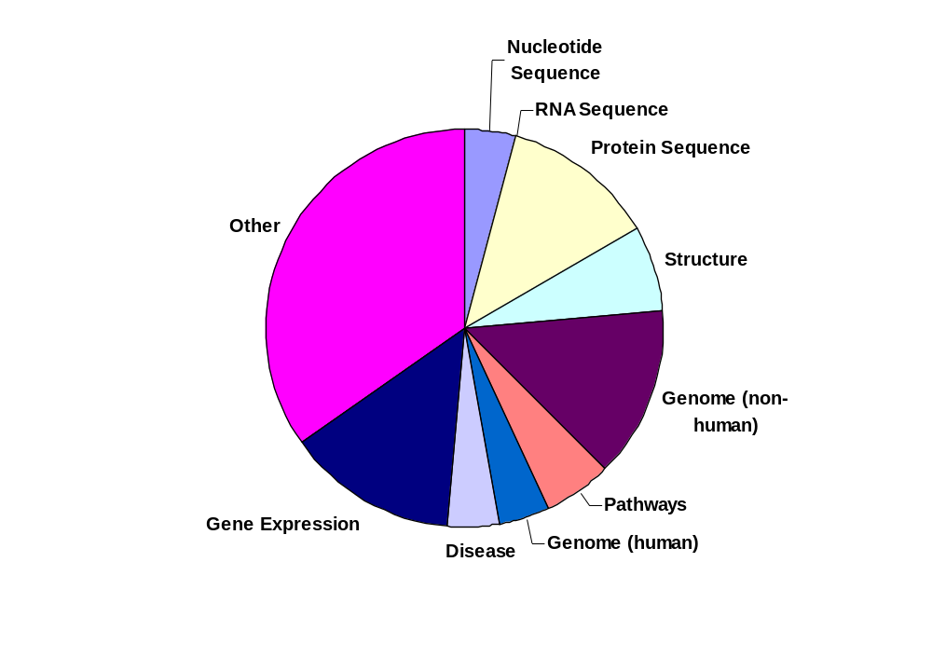
The Future - ISMB04 Poster Distribution
ISMB04

Slide 12
What Does ISMB04 Tell Us About New Biological Databases?
Microarray data resources are hot
Genotypic – phenotypic resources are emerging
Surprisingly pathway resources are not growing fast
Disease and species based resources are increasing – notably plants
Human genome related resources are increasing

Slide 13
What About Data in These Databases?

Slide 14
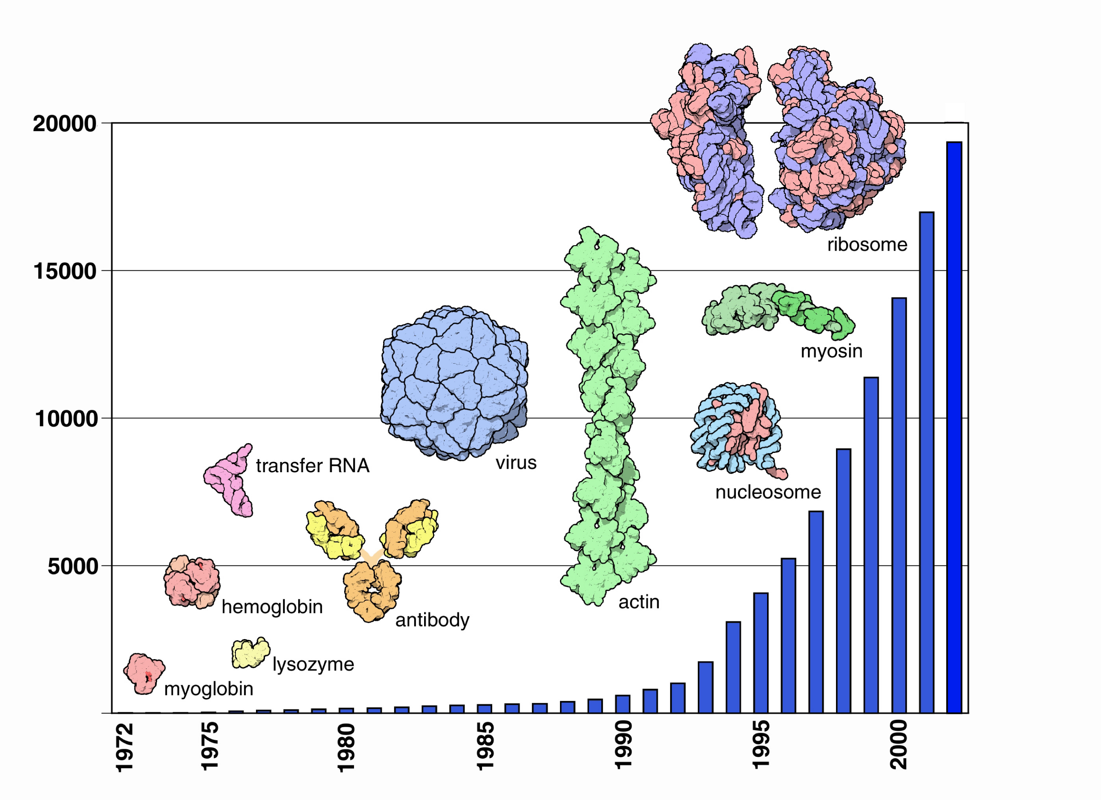
Data are Becoming More Plentiful and More Complex

Slide 15
Data are Becoming More Redundant
Note: Redundancy at 30% Sequence Identity

Slide 16
So the amount and complexity of data are increasing across biological scales – what are the challenges?

Slide 17
A Major Challenge
We suffer from the “high noon syndrome”
Those who can gain and contribute
most to biological databases
are frequently NOT the users
We need to lower the cost:benefit ratio
12:00

Slide 18
How Do We Lower this Barrier?
Better support of complex data types e.g., networks, images, graphs
Associated optimized query languages
Associated ontologies
Better handling of uncertainty and inconsistency
More and automated data curation
Large scale data integration

Slide 19
How Do We Lower this Barrier?
Better support of complex data types e.g., networks, images, graphs
Associated optimized query languages
Associated ontologies
Better handling of uncertainty and inconsistency
More and automated data curation
Large scale data integration

Slide 20
How Do We Lower this Barrier?
Support of data provenance
Support for rapid data and associated schema evolution
Support for temporal data
Better integration of data and methods
Usability engineering

Slide 21
How Do We Lower this Barrier?
Support of data provenance
Support for rapid data and associated schema evolution
Support for temporal data
Better integration of data and methods
Usability engineering
We need more work in these other areas

Slide 22
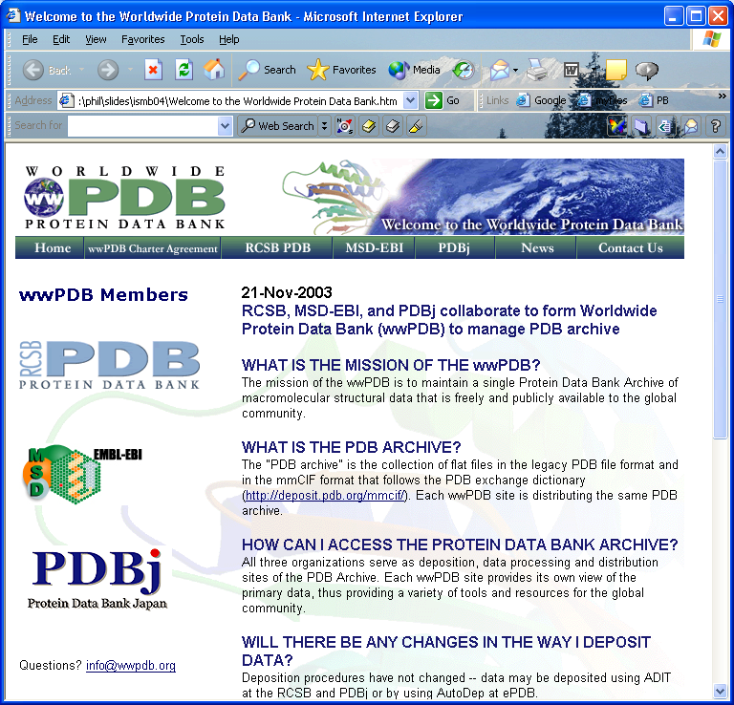
A Note on Data Provenance

Slide 23
Further Reading
Jagadish and Olken (2003) Omics 7(1) 131-137. Data Management for Life Sciences Research http://www.lbl.gov/~olken/wmdbio
Maojo and Kulikowski (2003) J. of AMIA 515-522. Bioinformatics and Medical Informatics – Collaborations on the Road to Genomic Medicine?

Slide 24
GeneXPress: A Visualization and Statistical Analysis Tool for Gene Expression and Sequence Data
Segal, Kaushal, Yelensky, Pham, Regev, Koller, Friedman
Assign biological meaning to gene expression data through post-processing and visualization
Data
Query &
Analysis
Curation
Biological
Results
Usability
Integration

Slide 25
Filtering Erroneous Protein Annotation
Wieser, Kretschmann and Apweiler
Automated detection of annotation errors using a decision tree approach based upon the C4.5 data mining algorithm
Data
Query &
Analysis
Curation
Biological
Results
Usability
Integration

Slide 26
Selecting Biomedical Data Sources According to User Preferences
Cohen-Boulakia, Lair, Stransky, Graziani, Radvanyi, Barillot and Froidevaux
Understand the characteristics of biological data
Present a selection of resources relevant to a user query
Framework for the multiple parametric analysis of cancer
Data
Query &
Analysis
Curation
Biological
Results
Usability
Integration

Slide 27
Integration of Biological Data from Web Resources: Management of Multiple Answers through Metadata Retrieval
Devignes, Smail
Same question – different answers from different resources – How can this be understood?
Semantic integration based on domain ontologies
Data
Query &
Analysis
Curation
Biological
Results
Usability
Integration

Slide 28
Critically-based Task Composition in Distributed Bioinformatics Systems
Karasavvas, Baldock, Burger
Task composition in workflow systems requires decision support
Provision of data providing providence information provides that support
Data
Query &
Analysis
Curation
Biological
Results
Usability
Integration

Slide 29
ENJOY !!

