Slide 1


Slide 2

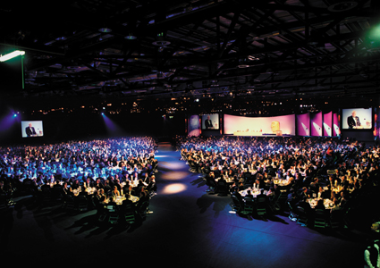
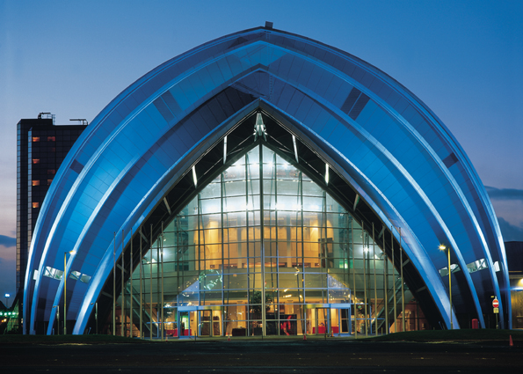
ISMB/ECCB 2004
31 July – 5 August 2004
SIGs 29 & 30 July 2004
Glasgow, Scotland,UK
Scottish Exhibition and Conference Centre

Slide 3

Conference hosts
European Bioinformatics Institute (EBI)
UK’s Collaborative Computational Project 11 (CCP11)
Scottish Bioinformatics Forum
University of Glasgow

Slide 4
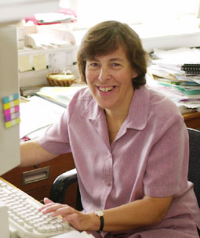
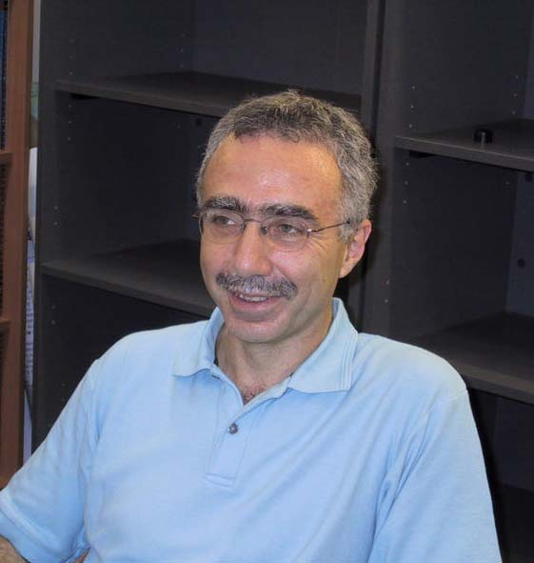
Conference chairs
Janet Thornton, EBI
Photo
David Gilbert, Uni Glasgow
Photo

Slide 5
What is special about ‘04?
Broad scope
Emphasis on biological and biomedical applications of bioinformatics
Programme structured to cater for biologists and computer scientists
Joint with the main European and UK bioinformatics conferences

Slide 6
ECCB
The European Conference on Computational Biology
Multi-disciplinary – bridges computer science, mathematics, physics, chemistry and biology
Annual revolving scheme: European countries host the European conference, jointly with the national conference on computational biology

Slide 7
Why hold ISMB jointly with ECCB?
First year in ECCB's short history that ISMB held in Europe
Best for the bioinformatics community
Best for both societies
Nobody misses out on either of two major bioinformatics conferences
Optimize number & quality of submissions
Maximize quality of the conference

Slide 8
GPC
The UK’s biennial bioinformatics conference – Genes, Proteins and Computers
Has been running since 1988
Engages the more biological end of the bioinformatics spectrum
Organized and funded by CCP11

Slide 9
From molecules to systems
Broad scope
  Accessible to all disciplines: from wet biology to pure computer science
Education day
  To ensure accessibility for all
Keynote talks & submitted papers
Poster sessions

Slide 10
Topics 1
Must have real relevance to biology…
Sequence to structure to function
Applications: from molecules to medicine
Computing for experimental biology…the LIMS challenge
Systems biology: from cells to organisms
Tell us what’s missing!

Slide 11
Topics 2
Comparative genomics, evolution & phylogeny
Transcriptomics, Proteomics, metabolomics…
Genome annotation
Integrating resources
Pathways and networks
Modelling and simulation
Literature extraction, information systems and ontologies
…and more!

Slide 12
Education Day
First day of conference
Combination of hands-on workshops and lectures
Putting computing in biological context for computer scientists
Breaking down computing principles for the biologists
Proposals encouraged!

Slide 13
Bioinformatics in the UK
One of the largest and strongest bioinformatics communities in the world
Home of EBI – Europe's premier provider of bioinformatics resources
Strong UK tradition in bioinformatics teaching
Large pharmaceutical and biotechnology industry

Slide 14
Scottish Bioinformatics
Special strengths in biomedical research
Strong global player in biotechnology and bioinformatics
A key area of strategic interest
Scottish Enterprise promoting development of biotechnology & bioinformatics

Slide 15
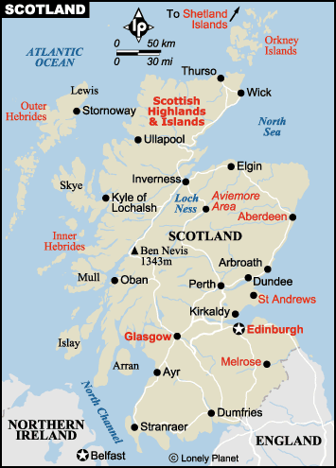

Slide 16
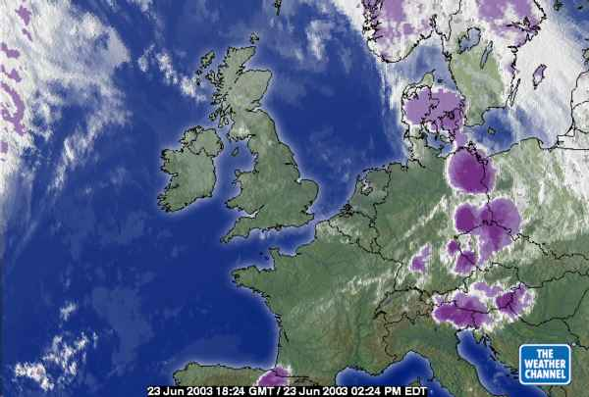

Slide 17

Getting to Glasgow
Excellent international and national transport links: Direct access by air from
  11 European cities
  6 transatlantic destinations
  ~ 47 return flights per day from London

Slide 18
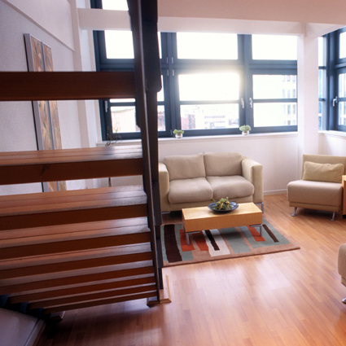
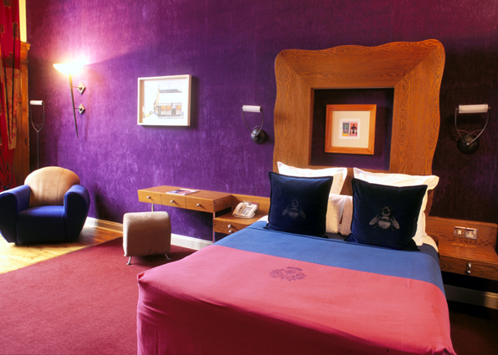
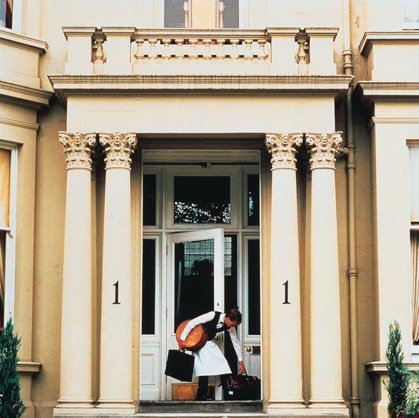
Staying in Glasgow
Conference & accommodation facilities close to each other
Good supporting public transport network
Major centre for conferences & international events
Excellent range of hotels

Slide 19
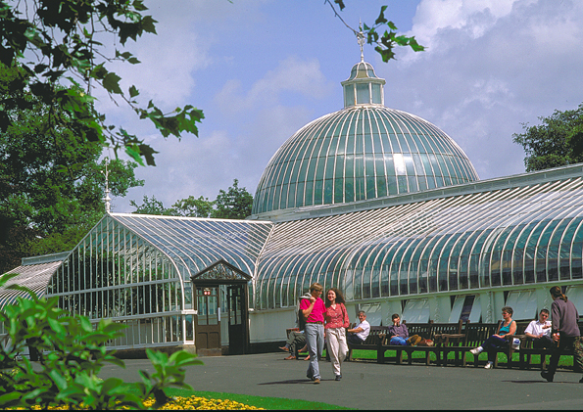
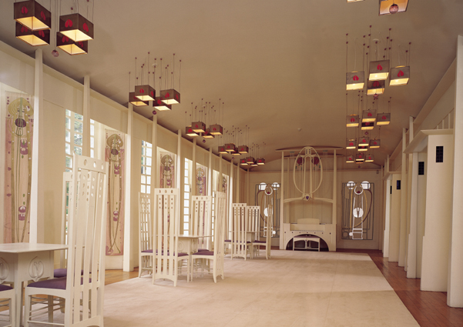
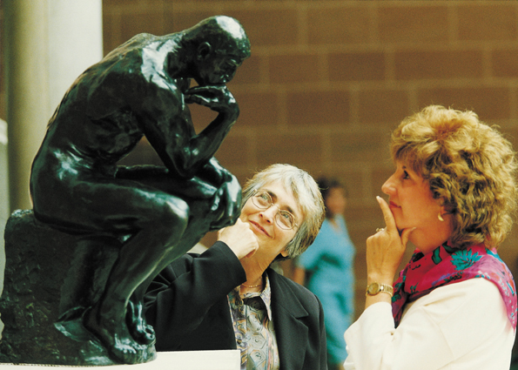
Cultural Glasgow
Unrivalled choice of museums, theatres, parks and specialist shops
Some of the finest Victorian architecture of Europe

Slide 20

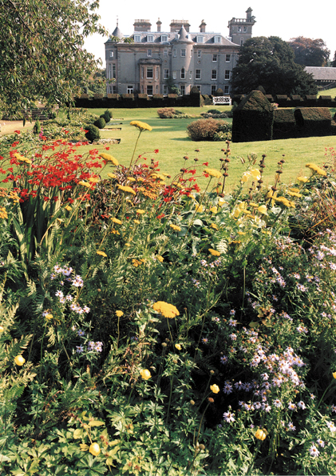

Gateway to Scotland
Romantic lochs, castles and mountains
Historic Edinburgh, the capital of Scotland, less than 1 hour away
Some of the world’s best golf courses

Slide 21
How to find out more
Visit booth 29 in the exhibition
Visit our website: www.iscb.org/ismbeccb2004/
Sign up for email alerts:
http://www.iscb.org/ismbeccb2004/signup.php

Slide 22

See you in 2004!

