Slide 1

Bioinformatics and medicine:
Are we meeting the challenge?

Slide 2
Breadth of Submissions
Submissions 24
Major Categories of areas submitted
  Cancer / genomics
  Statistics/linkage analysis
  Immunolgy/modelling
  Image analysis
  Transcriptomics
  Classifiers
  Implementation of high throughput pipelines

Slide 3
Potential for applications
Molecular Pathology
  Diagnosis and detection
Molecular Medicine
Complex inherited disorders
Epigenetics and human disease
Genomic Medicine
Pathogens and vaccine development
Cancer

Slide 4
Challenges
The molecular biologist
The high throughput biologist
The systems biologist
The clinician
Biomedical informatics? Is that what we mean?
Who is ensuring the application of bioinformatic knowledge to medicine?

Slide 5
When will Bioinformatics activities substantially affect the practice of medicine?
Victor Maojo and Casimir A. Kulikowski
- Medical informatics
- clinical and bibliographic databases
- computerised medical records
- medical information systems
Perception that medline is simply a “data source”
“Bioinformatics and Medical Informatics: Collaborations on the Road to Genomic Medicine? “J Am Med Inform Assoc. 2003 November; 10 (6): 515–522

Slide 6
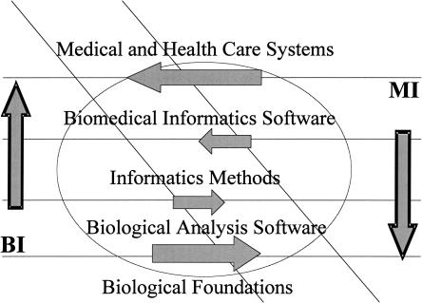
potential synergies and competition between medical informatics (MI) and bioinformatics (BI) J Am Med Inform Assoc. 2003 November; 10 (6): 515–522

Slide 7
The two major knowledge domains
Medical and scientific literature
Encoded human, model and pathogen reagents
Anatomy
Pathology
Epidemiology
Immunology
Biochemistry
Metabolism
Gene function, expression
Regulatory and interaction networks
Genetics

Slide 8
Growth and field convergence
Analysis of gene and protein technologies
Molecular Biology and biochemistry
Data quality and analysis, noise and uncertainty
Integration via curation
Ontologies, network models
Signal and image processing
Widely available tools
Education and training
1960s rapid launch on back of computer technologies in health care
Medical standardisation
Clinical data subjectivity create mining problem
Documentation, standards, vocabularies UML/SNOMED mostly non-public
Information systems
Clinical/radiologic image processing
Widely available information and tools
Consolidated training programmes

Slide 9
Combining Bioinformatics and Clinical data
- To be successful, applications needs to address integration of
the layers of datatypes available.
- Integration should reflect the system under examination

Slide 10
H-INV Disease edition
comprehensive functional link between the genome sequence scaffold and human diseases
Prostrate cancer
  Text mining
  Clinical records and information systems
  Array and MPSS sampling
  Combined domain experts PhD and Physician

Slide 11
Convergence of BI and MI for HIV in South Africa
Ontologies
Information systems
Genomics technologies
Phylogenetics
Immunology
Clinical and bioinformatics data mining techniques
Vaccine development

Slide 12
HIV CAPRISA-SAAVI network
Admin
LAB
Biostatistics
CRF
Molecular Integration
Analysis
Clinical

Slide 13
Actual implementation
Controlled vocabularies for CRF
Networked laboratory information systems and sample tracking
High throughput sequencing
HIV genome diversity analysis
High throughput epitope mapping
Clinicial pathology association with molecular pathology
Clinical trials

Slide 14
The presentations
Reconstructing Tumor Amplisomes
  Raphael and Pevzner
The Cell-Graphs of Cancer
  Gunduz et al
Prediction of Class I T-cell epitopes
  Srinivasan et al
Exploring Williams-Beuren Syndrome using ^{my}GRID
  Stevens et al

