Slide 1
Databases,
Ontologies and Text mining
Session Introduction
Part 1
Carole Goble, University of Manchester, UK
Dietrich Rebholz-Schuhmann, EBI, UK
Phillip Bourne, SDSC, USA

Slide 2
Resources in Bioinformatics
Ontologies
The Gene Ontology
Applications
and
Mining
Databases
Bioinformatics
Text mining
UniProt
Knowledge mining
LocusLink
Notes:
Building the Semantic Grid means building it for the three` different knowledge stakeholders.

Slide 3
Resources in Bioinformatics
Ontologies
The Gene Ontology
Applications
and
Mining
Bioinformatics
Text mining
Knowledge mining
Notes:
Building the Semantic Grid means building it for the three` different knowledge stakeholders.

Slide 4


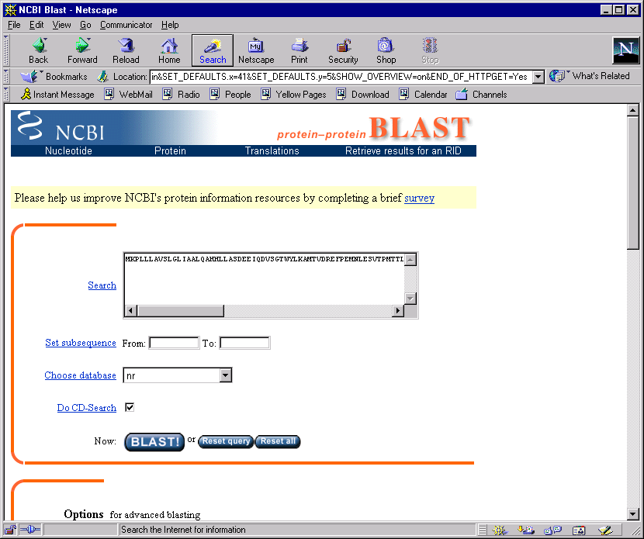


A Tower of Babel
Interoperating resources, intelligent mining and sharing of knowledge, be it by people or computer systems, requires a consistent shared understanding of what the information contained means
Service
provider
Service
provider
Service
provider
Service
provider
Service
provider
Shared common controlled vocabularies
Shared common understanding of domain
Formal, explicit specification of the meaning of the terms
APPLICATION
COMMUNITY
CONSENSUS
EXECUTABLE,
MACHINE READABLE
Notes:
An explicit specification of a shared understanding of some domain of interest.
a formal specification
EXECUTABLE
of a conceptualization of a domain
COMMUNITY
of some part of world that is of interest
APPLICATION

Slide 5
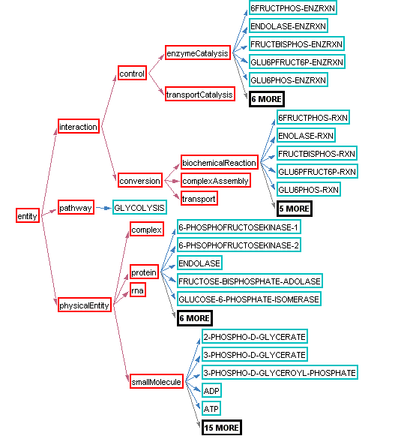
Ontology components
Concepts gene
Properties of concepts and relationships between them function of gene
Constraints or axioms on properties and concepts oligonucleiotides < 20 base pairs
Instances (sometimes) sulphur, trpA Gene
Organised into directed acyclic graph
Classifications isa, part of…
BioPAX Pathway Ontology

Slide 6
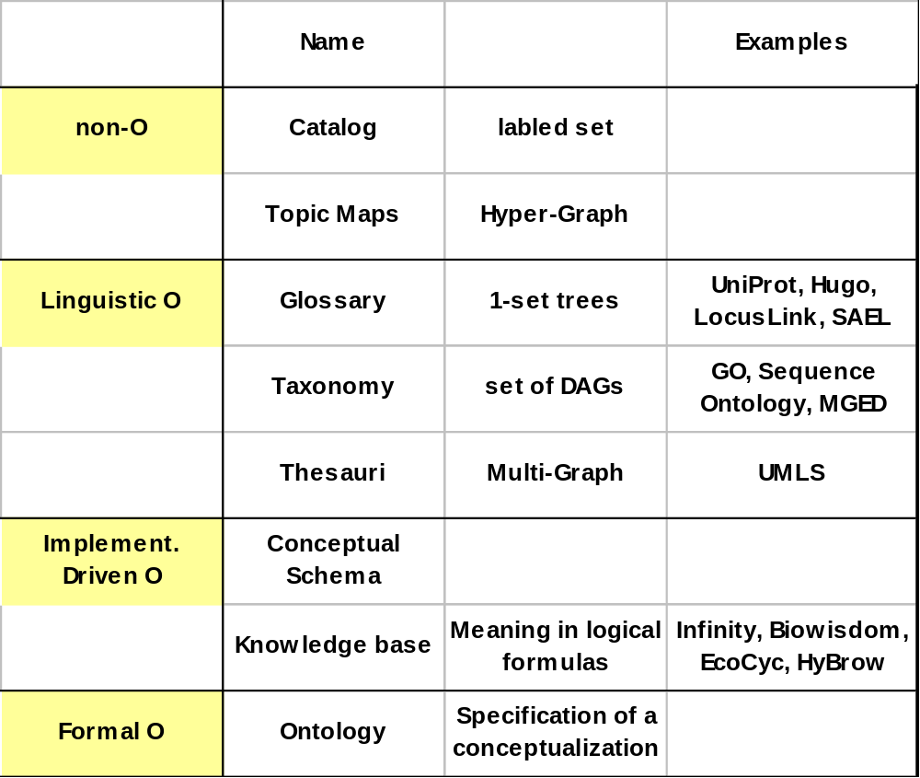
Ontology classification by Borgo/Pisanelli
CNR-ISTC, Rome, Italy
Notes:
Different levels where different resources come in.
GO is important and universal

Slide 7
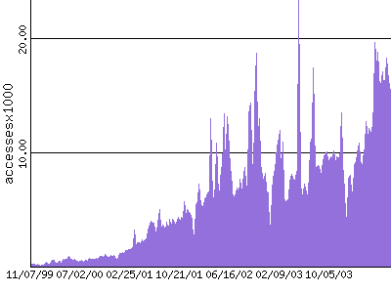


Gene Ontology http://www.geneontology.org
Poster child of bio ontologies and proof of principle
Wide adoption
  168,000 Google hits
International consortium
  Pioneered curation strategy
Changes many times a day
Developed for annotation, but used by other applications for mining (GoMiner)
Large, legacy, inexpressive
  >17,000 concepts

Slide 8
Six major areas of activity increasing maturity
Coverage
Modelling
Community
curation
Deployment &
Use
Technical infrastructure and tools
Examples

Slide 9



Six major areas of activity
Coverage
Modelling
Community collaboration,
social frameworks,
methodologies
Infrastructure
strategy
Community
curation
Deployment &
Use
Technical infrastructure and tools
Examples

Slide 10
Six major areas of activity
Granularity, scales, part-whole relationships, instances, best practice
rigour and formality
Coverage
Modelling
Community
curation
Deployment &
Use
Technical infrastructure and tools
Examples

Slide 11
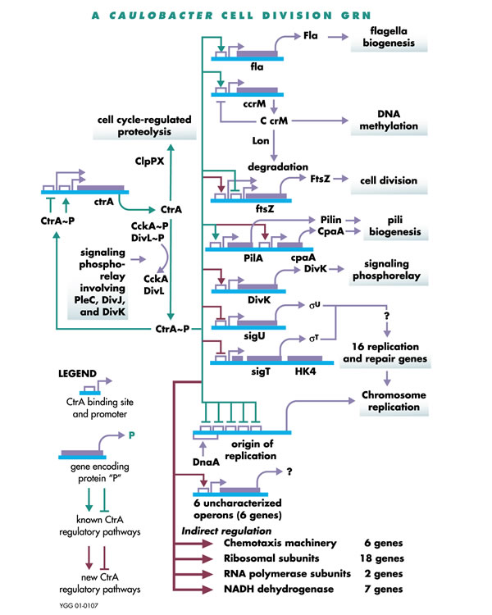




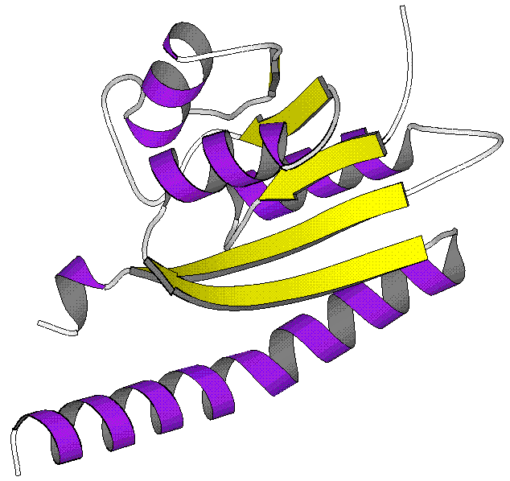
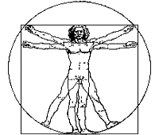
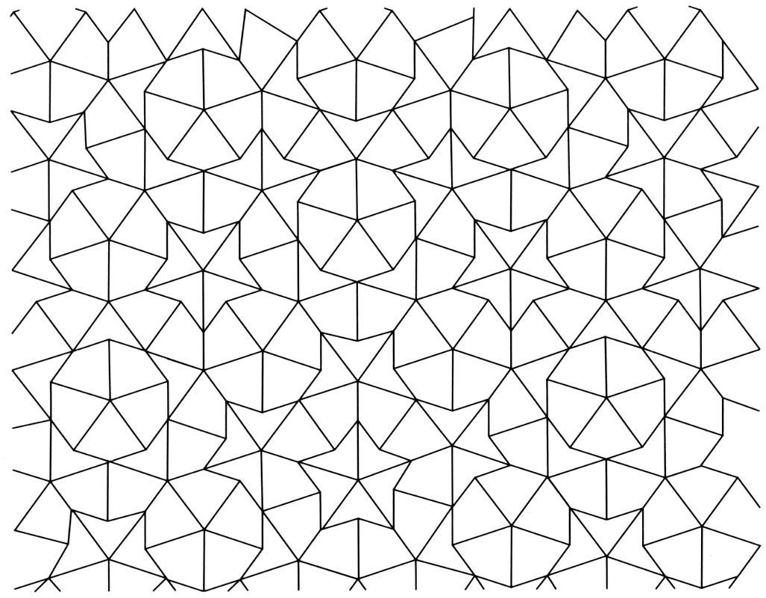

Six major areas of activity
Extended coverage
New ontologies e.g.anatomy
Mapping and integration between ontologies
Coverage
Modelling
Community
curation
Deployment &
Use
Technical infrastructure and tools
Examples

Slide 12
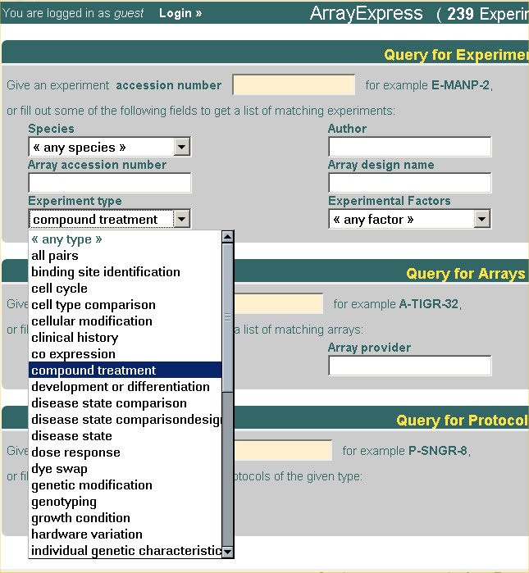
Six major areas of activity
Coverage
Modelling
Community
curation
Deployment &
Use
Database annotation,
Decision support
Advanced querying
Database mediation and integration
Knowledge exchange
Text mining
Technical infrastructure and tools
Examples

Slide 13
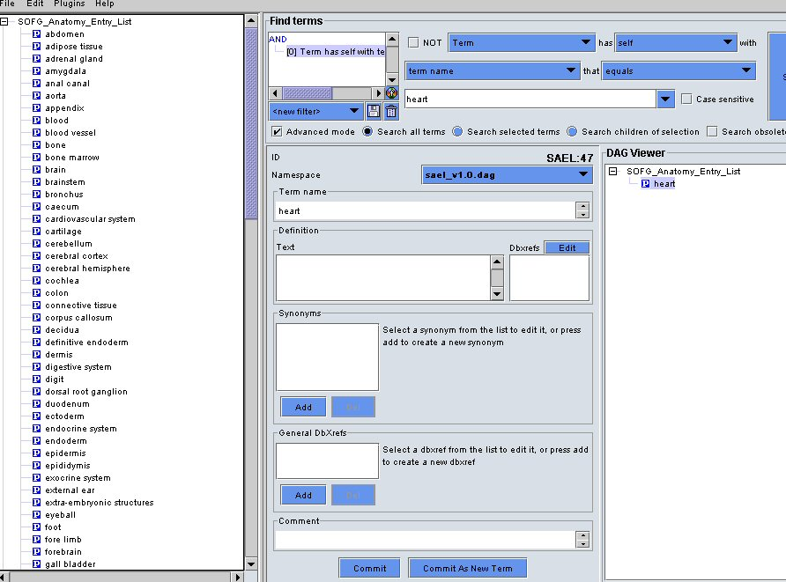


Six major areas of activity
Coverage
Modelling
Community
curation
Deployment &
Use
Technical infrastructure and tools
Examples
Semantic Web, W3C OWL, RDF
Editing,viewing, building
Reasoning, formalising
Notes:
BOF and workshop!

Slide 14

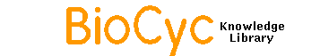
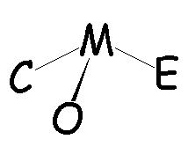
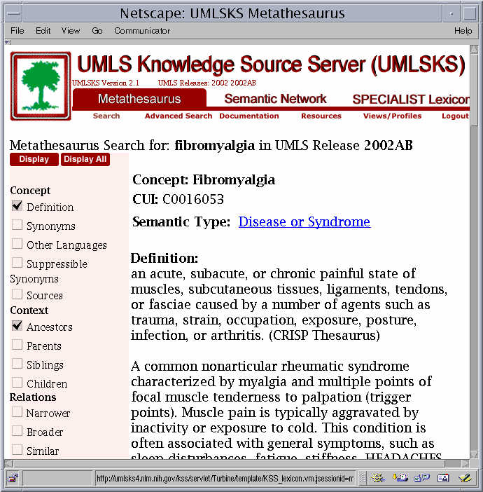


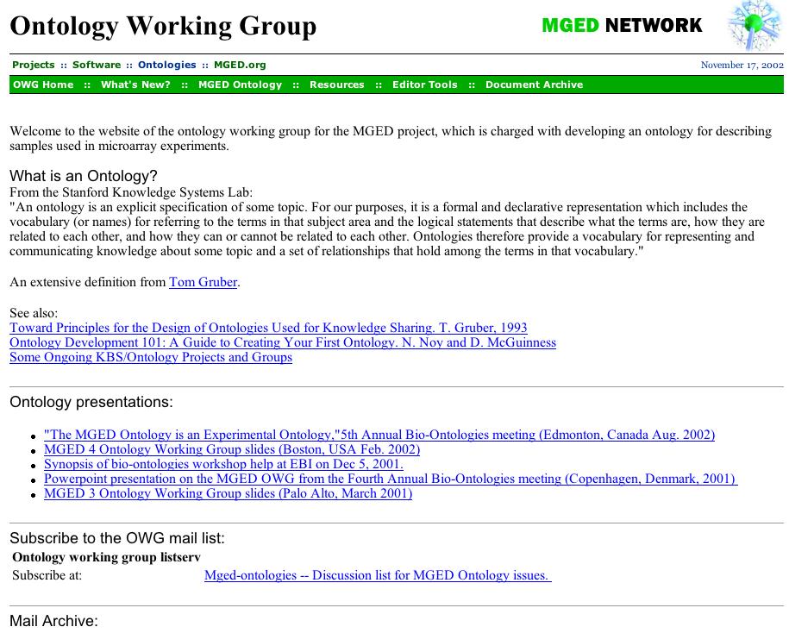

Six major areas of activity
39 on OBO web site
Coverage
Modelling
Community
curation
Deployment &
Use
Technical infrastructure and tools
Examples

Slide 15
The Gene Ontology Categorizer
Joslyn, Mniszewski, Fulmer, Heaton
Los Alamos National Lab, Procter & Gamble
What are the best GO terms for categorising a list of genes?
Interprets GO as partially ordered sets
Generate distance measures between terms
Cluster annotated genes based on their GO terms
Coverage
Modelling
Community
curation
Deployment &
Use
Technical infrastructure and tools
Examples

Slide 16
HyBrow: a prototype system for computer-aided hypothesis evaluation
Racunas, Shah, Albert, Fedoroff
Penn State University
Knowledge driven tool for designing and evaluating hypothesis
Uses an event-based ontology for biological processes
Modelling levels of detail of events
Tools for querying, evaluating and generating hypothesis
A prototype yet to be fielded
Coverage
Modelling
Community
curation
Deployment &
Use
Technical infrastructure and tools
Examples

Slide 17
False Annotations of Proteins: Automatic Detection via Keyword-Based Clustering
Kaplan, Linial
Hebrew University, Jerusalem, Israel
How to separate the TP protein function annotations from the FP?
Clustering of protein functional groups
Tested on ProSite
Coverage
Modelling
Community
curation
Deployment &
Use
Technical infrastructure and tools
Examples

Slide 18
Protein names precisely peeled off free text
Mika, Rost
Columbia University, NY
How to find mentions of protein/gene names in NL text ?
Terminology from Swiss-Prot and TrEMBL
4 SVMs modelled to the task
Assessment against e.g. BioCreAtive
Coverage
Modelling
Community
curation
Deployment &
Use
Technical infrastructure and tools
Examples

Slide 19
BioCreAtive
Task 1a: Named entity tagging
  Identify each mention of a PGN within the NL text
  Input: Tagged samples of PGNs
  Output: correctly tagged samples of PGNs
  Obstacles: correct boundary detection
  Solutions: SVMs / cond. random fields / RegExp / HMM, POS + BIO tags, 1-,2-,3-grams, dictionaries, morphology
(BioCreAtIve:Blaschke/Valencia/Hirschman/Yeh, Granada, March 2004)
Poster A-12

Slide 20
Mining Medline for Implicit Links between Dietary Substances and Diseases
Srinivasan, Libbus
NLM, Bethesda
How to find a (complete) set of documents related to a given topic from Medline ?
Open Discovery Algorithm
(Swanson, Smalheiser)
Extraction of features from the text
Iterate document retrieval based on features
Assessment: Retinal Diseases, Crohn’s Disease, Spinal Chord Diseases
PubMed
MatchMiner (Bussey)
MedMiner (Tanabe)
MeshMap (Srinivasan)
PubMatrix (Becker)
Coverage
Modelling
Community
curation
Deployment &
Use
Technical infrastructure and tools
Examples

Slide 21
Online Tools @ ISMB
GoPubMed, Schroeder, Biotec, TU Dresden, (A-23)
iHop, Hoffmann, CNB, (A-61) http://www.pdg.cnb.uam.es/hoffmann/iHOP/index.html
NLProt, Mika
http://cubic.bioc.columbia.edu/services/nlprot/submit.html
ProtExt, Peng, National Taiwan University, (A-2)
Termino, Gaizauskas, University of Sheffield, (A-73)
http://www.dcs.shef.ac.uk/
Whatizit, Rebholz-Schuhmann, EBI, (A-72)
http://www.ebi.ac.uk/Rebholz-srv/whatizit/form.jsp

Slide 22
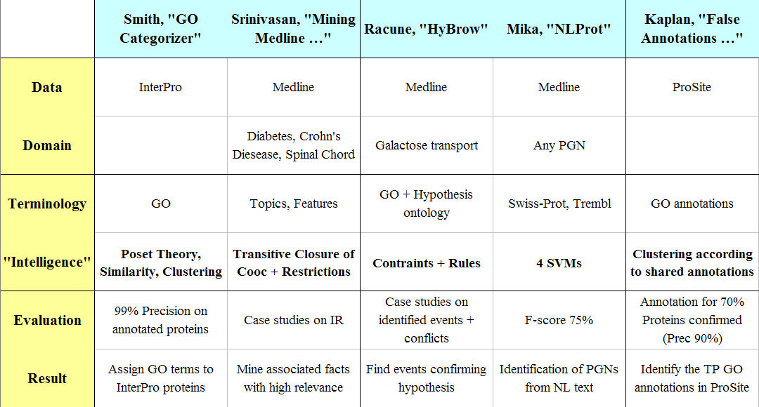

Slide 23
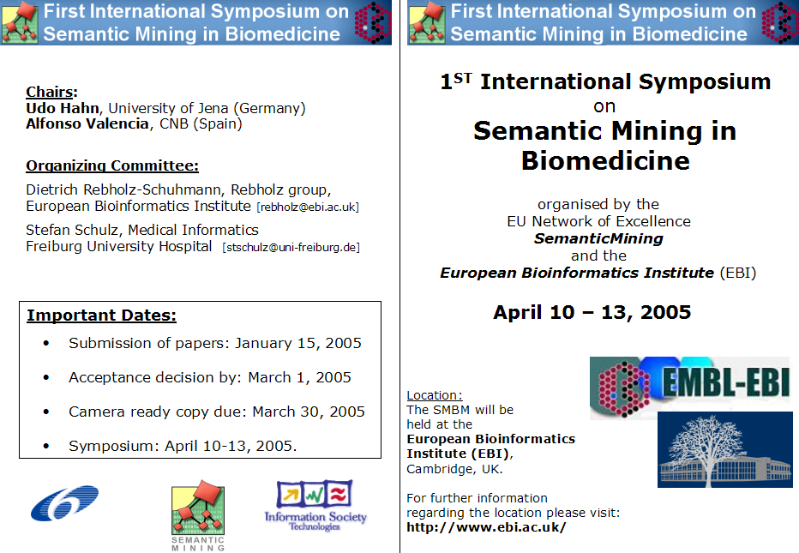

Slide 24
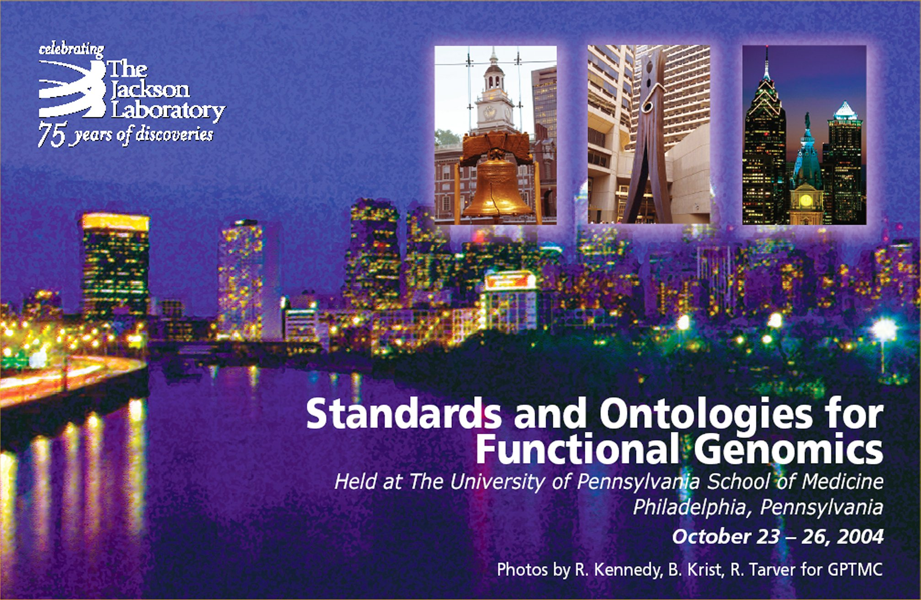
Gratuitous Advertising – SOFG2

Slide 25
ENJOY !!

