Slide 1
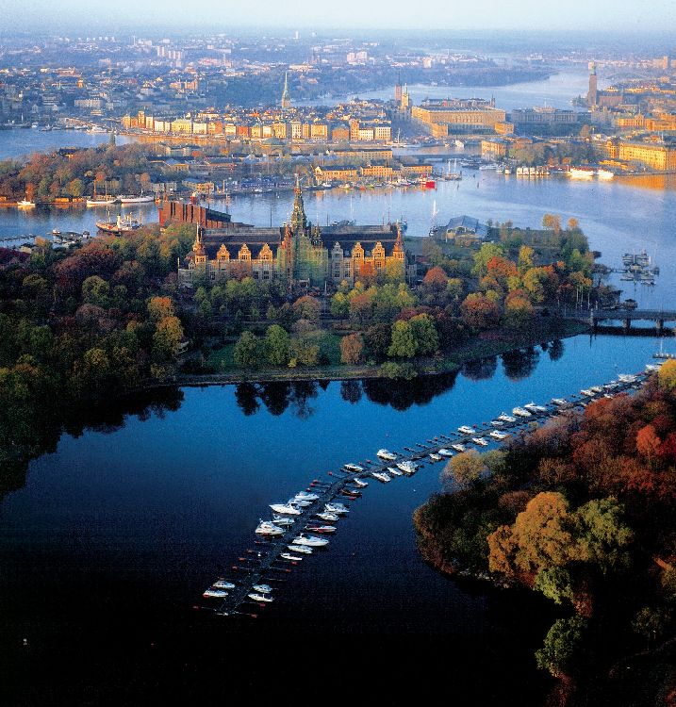
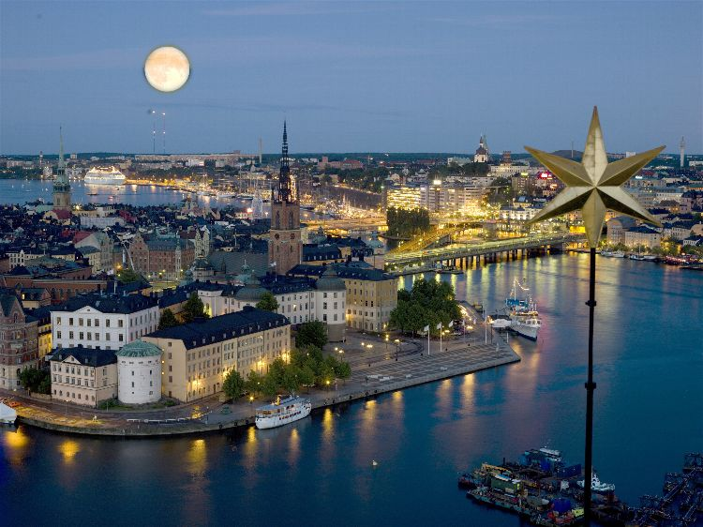

ISMB ECCB 2009
June 27 – July 2, 2009
Chairs
Marie-France Sagot
Gene Myers
Gunnar von Heijne

Slide 2

Keynotes
Pierre-Henri Gouyon
Evolution
Trey Ideker *
Synthetic Biology
Daphne Koller
Machine Learning
Thomas Lengauer
Medical Bioinformatics
Webb Miller *
Comparative Genomics
Eugenia del Pino
Development
Tomaso Poggio
Comp. Neuroscience
Mathias Uhlen
Proteomics
*ISCB award winners
Special Sessions
Epigenomics, Bioinformatic challenges,
Orthology inference, Membrane proteins,
eQTL analysis, Regulatory architecture, …
SIGs
BioLINK, 3D-Structure, BioPathways,
Open source (BOSC), Alt. splicing,
BioOntology, Data analysis & mngmt,
Short read assembly.
Tutorials
Text mining, Pathways, Immunology,
Metabolics, Comparative modeling,
Perturbation analysis, …
Proceedings
Chairs: Dan Gusfield & Anna Tramontano
Selection in progress
Visit url “www.iscb.org/ismbeccb2009/” for more

