Slide 1

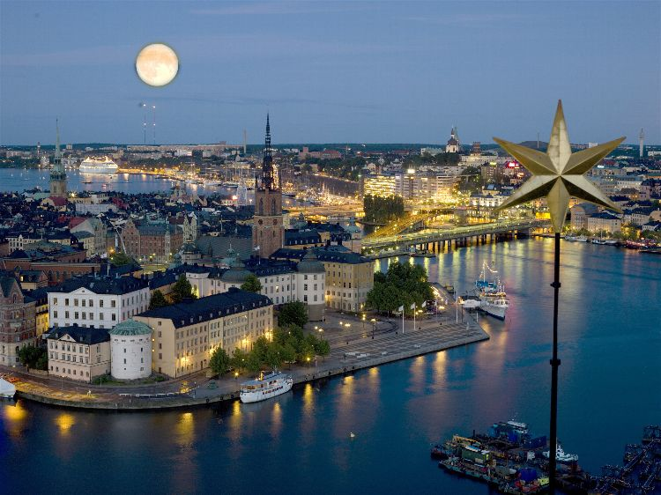


Chairs
Marie-France Sagot
Gene Myers
Gunnar von Heijne
Keynotes
Pierre-Henri Gouyon
Trey Ideker
Daphne Koller
Thomas Lengauer
Webb Miller
Eugenia del Pino
Tomaso Poggio
Mathias Uhlen
SIGs
Tutorials
Special Sessions
Proceedings
Highlights
Tech Tracks
Posters
ISMB ECCB 2009
June 27 – July 2, 2009
www.iscb.org/ismbeccb2009/

