Slide 1
Open Source CFML
From Basic to Badass

Slide 2
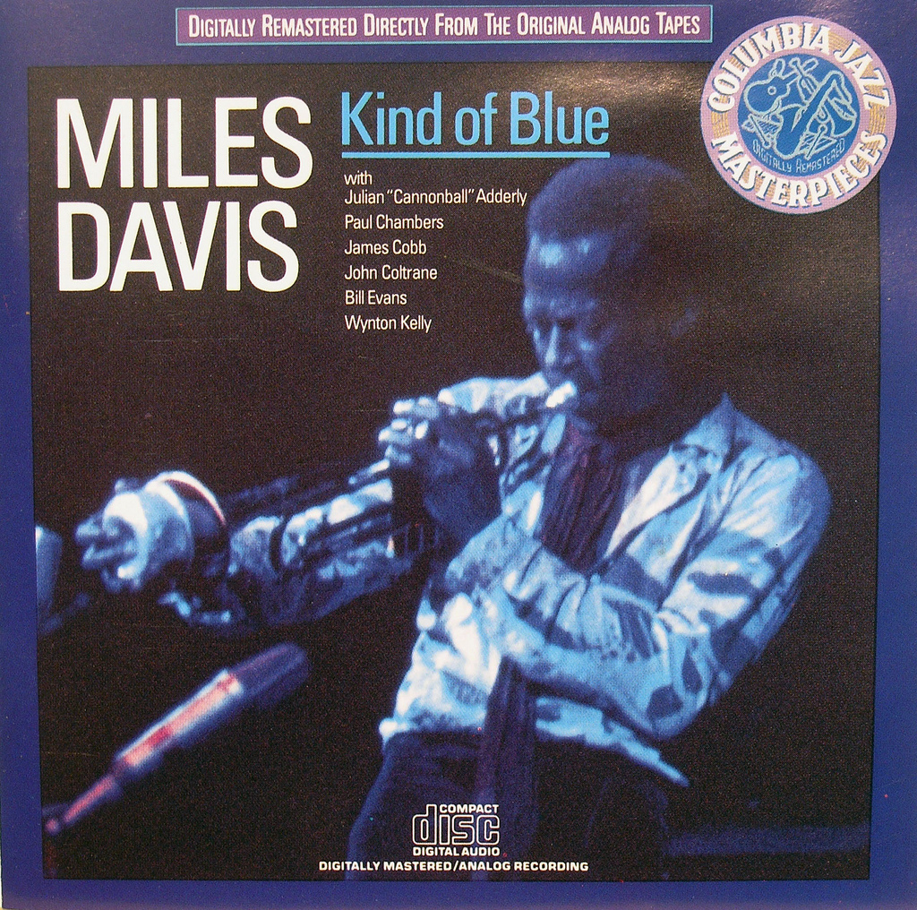
Hi. I’m Miles.
Notes:
http://www.flickr.com/photos/exquisitur/2551730203/sizes/l/in/photostream/

Slide 3
Hi. I’m Miles.
@awayken, +Miles Rausch
Of Miles Rausch: http://milesrausch.com
Awayken.com; http://awayken.com/
This presentation: https://github.com/awayken/2011sdcodecamp

Slide 4

School
Notes:
http://www.flickr.com/photos/awayken/94715288/
Got a double major in CS and Math, but don’t ask me math.
I met and fell in love with my now wife.

Slide 5
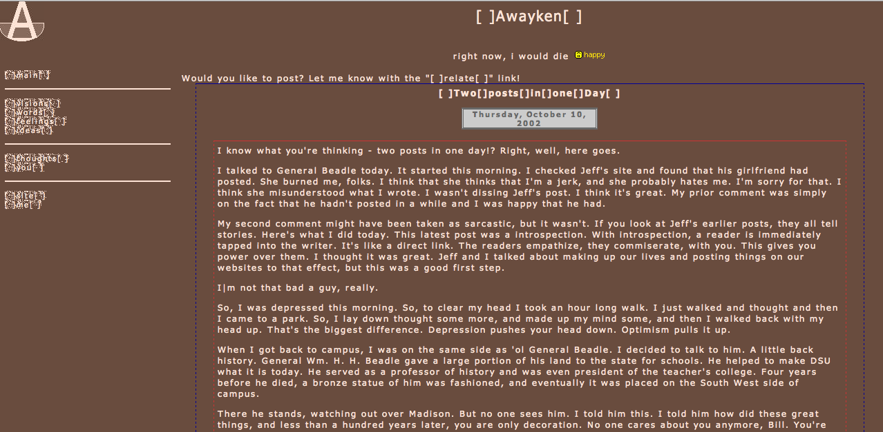
Notes:
http://awayken.com/about/sepia/index2.html
I also met and fell in love with the web.

Slide 6
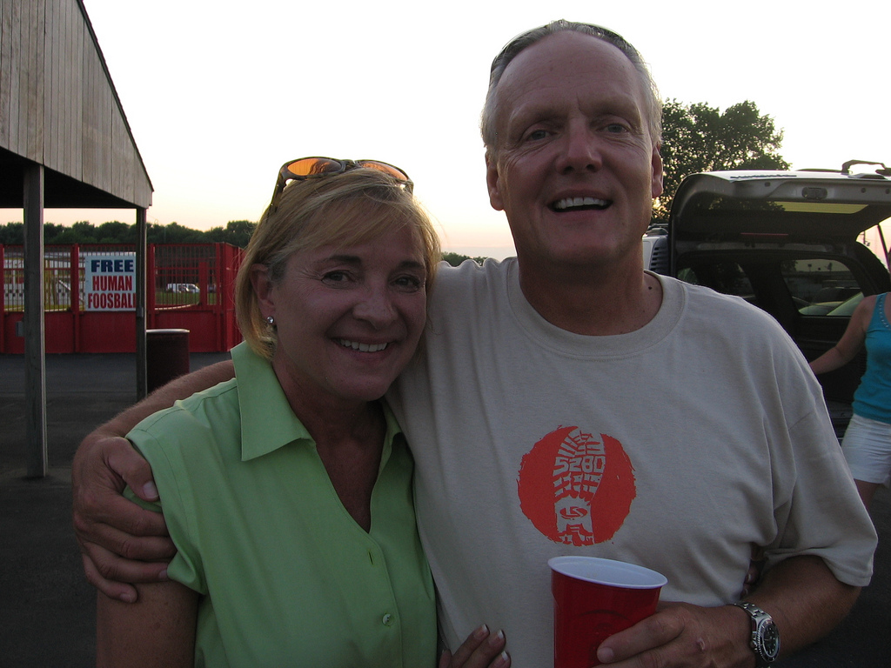
Work
Notes:
http://www.flickr.com/photos/awayken/3839025892/sizes/l/in/photostream/
That enabled me to get a job at L&S, where I do web programming.

Slide 7

Adobe ColdFusion
Notes:
http://www.flickr.com/photos/stevenerat/1462403613/sizes/o/in/photostream/
A rapid application development platform invented in 1995
Bought by Adobe in 2005
App server and markup language, CFML
Proprietary and closed source

Slide 8

Not Cold Fusion
Notes:
http://www.flickr.com/photos/johnmcnab/4248698746/sizes/o/in/photostream/

Slide 9
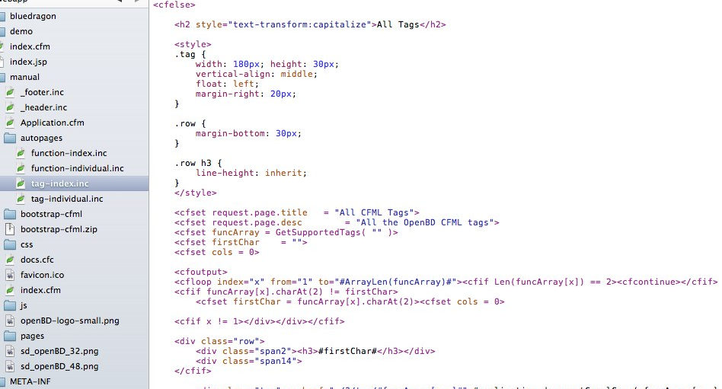
(Open Source) CFML
Notes:
https://skitch.com/awayken/gf9yy/tag-index.inc
ColdFusion Markup Language
Tag-based or ECMA-like syntax within <cfscript>
Extensible with CustomTags and CFCs
CFML Advisory Committee (defunct)
Open BlueDragon: http://openbd.org/
Railo: http://www.getrailo.org/

Slide 10
Install OpenBD Desktop
Go to openbd.org/download
Click OpenBD Desktop
Click Download
Unzip

Slide 11
Run OpenBD Desktop
Execute the .exe or .sh
.sh might need to get chmod +x
Execute .sh as `sudo sh OpenBlueDragonDesktop.sh`
Web App tab
Choose Web App Folder (will add necessary files)
Web Port: 80
Extensions to execute through OpenBD
Options: enable Manual and Admin Console
Standard Engine
Click Start OpenBD
Browse to http://localhost/

Slide 12
Install Railo Express
Go to getrailo.org/download
Choose Railo Express for your OS and architecture
Unzip

Slide 13
Run Railo Express
Execute `start`
Browse to http://localhost:8888/
Modify files in webroot/ instead of pointing to your own folder

Slide 14
Administrator
Differs by engine
Usually, lets you manage (at least):
General Settings (security, caching, default values…)
Datasources
Mappings
Debugging, Logs
Scheduled Tasks
Custom tags, CFX tags
E-mail, Fonts
Web services
Notes:
http://localhost/bluedragon/administrator/

Slide 15
Demo 01
Notes:
Create the Mr. Octopus website.
Show http://localhost/bluedragon/administrator

Slide 16
Basic CFML - syntax
Code lives in CFM or CFC files
Designed to live amongst HTML
Tag-based, starting with “cf” (for example, <cfset>)
Some tags are self-closing, many have attributes, some perform processing within the tag
Can create custom tags
Comments: <!--- comment --->
Notes:
http://openbd.org/manual/?/basic_cfml

Slide 17
Basic CFML - variables
Variables are type-less
String, number, date, boolean, structures, arrays
Variables have scope
Server, cgi, cookie, request, form, url, variables, local, arguments, attributes, application, client, session, cfthread, cffile, this, super, cfcatch
Reference variables [scope].[variable’s name] or [scope][‘variable’s name’]
<cfset message = “Hello, World!”>
Notes:
http://openbd.org/manual/?/basic_cfml
http://openbd.org/manual/?/language_scopes

Slide 18
Basic CFML - output
CFML lives amongst HTML, so you tell it when to output
Use #s to process CFML, with <cfoutput>
Can put variables or function calls within #s
#uCase(message)# outputs the upper case of message
Cannot put tags within #s
Escape # with another #: ##
Need #s in attributes for tags
<cfdump var=“#message#”>
Notes:
http://openbd.org/manual/?/basic_cfml

Slide 19
Using Variables
String: <cfset name=“Miles”>
Number: <cfset age = 28>
Boolean: <cfset isPresenting = true>
Date: <cfset datePresenting = Now()>
<cfparam name=“name” default=“No Name”>
<cfoutput>#simpleVariable#</cfoutput>
Notes:
http://openbd.org/manual/?/language_creation
http://openbd.org/manual/?/tag/CFPARAM

Slide 20
Using Variables - Arrays
1-based, not 0-based
Not typed
<cfset links = ArrayNew(1)> <cfset links[1] = “http://milesrausch.com”> <cfset links[2] = “http://awayken.com”>
<cfset links = [ “http://milesrausch.com”, “http://awaken.com” ]>
<cfoutput>#links[1]#</cfoutput>
Notes:
http://openbd.org/manual/?/language_creation

Slide 21
Using Variables - Structures
Key / value data (map, collection, etc.)
Can reference with dot or bracket notation
<cfset meta = StructNew()> <cfset meta.engine = “OpenBD”> <cfset meta[“version”] = “1.5”>
<cfset meta = { engine = “OpenBD”, version = “1.5” }>
<cfoutput>#meta.engine#</cfoutput> <cfoutput>#meta[“version”]#</cfoutput>
Check for existence before using: <cfif isDefined(“meta.engine”)> <cfif StructKeyExists(meta, “engine”)>
Notes:
http://openbd.org/manual/?/language_creation

Slide 22
Operators
Assignment
=, +=, -=, &=, /=, *=, %=
Unary
++, --, +, -, /, *
Binary
% or MOD
Logical
! or NOT, OR, AND, XOR
Comparators
EQ, NEQ, LT, LTE, GT, GTE, IS, IS NOT, CONTAINS
This is not a complete list.
Notes:
http://openbd.org/manual/?/language_operators

Slide 23
Demo 02

Slide 24
Control
<cfif CONDITION>, <cfelseif CONDITION>, <cfelse>
<cfswitch expression=“VALUE”>, <cfcase value=“VALUE”>, <cfcase value=“VALUE1,VALUE2”>, <cfdefaultcase>
<cftry>, <cfcatch type=“TYPE”>, <cffinally>
<cfcatch> exposes a special cfcatch scope
<cflocation url=“URL” addtoken=“BOOLEAN”>
addtoken = “true” adds session tokens to URL
Notes:
http://openbd.org/manual/?/tag/category/control
http://openbd.org/manual/?/tag/category/network

Slide 25
Iterations
<cfloop>
Types of loops
Numeric: from, to, step, index
Condition: condition
Array: array, index
List: list, index, delimiters
Collection: collection, item
Query: query, startrow, endrow
File: file, index, characters
<cfbreak>
<cfcontinue>
Notes:
http://openbd.org/manual/?/tag/category/control

Slide 26
Content
<cfdirectory action=“ACTION” directory=“REAL PATH” name=“NAME”>
Actions: list, create, rename, delete
<cfhttp url=“URL”>, <cfhttpparam type=“TYPE” value=“VALUE” name=“NAME”>
Exposes a special cfhttp scope
<cfhttpparam> types are: url, formfield, cgi, body, xml, header, cookie, file
<cffile action=“ACTION” file=“REAL PATH” variable=“NAME”>
Actions: read, readbinary, write, append, delete, rename, upload, copy, move
Exposes a special cffile scope (sometimes)
<cfhtmlhead text=“TEXT”>
Text is any HTML you want inserted right before </head>
Notes:
http://openbd.org/manual/?/tag/category/file
http://openbd.org/manual/?/tag/category/remote

Slide 27
Database Content
Datasources are setup in administrator (no connection strings)
<cfquery datasource=“DSN” name=“NAME” cachedwithin=“TIME SPAN”>
Create a timespan using CreateTimespan()
Returns special query object called NAME
Query has records, but also properties: RecordCount, CurrentRow, ColumnList
<cfqueryparam cfsqltype=“SQL Type” value=“VAL”>
SQL Types are cf_sql_[Type] (e.g. cf_sql_varchar)
Provide a number of security and performance benefits
#1 way to protect against SQL injections
<cftransaction action=“ACTION”>
Action can be: begin, commit, and rollback
Allows SQL transactions
Notes:
http://openbd.org/manual/?/tag/category/database

Slide 28
Demo 03

Slide 29
<cfscript>
An entire ECMA-style scripting language
Removes dependency on tag-based markup
Feels “more at home” or “cleaner” for some developers
Can be used amongst tag-based CFML
Learn more.

Slide 30
Functions
2 basic types: core (built-in) and user-defined (UDF)
Can define custom using <cffunction …> or CFCs
Might return a value, output something, or both
Syntax
FunctionName(“Miles”, 28)
FunctionName(name = “Miles”, age = 28)
FunctionName(argumentcollection = argsStruct)
Notes:
http://openbd.org/manual/?/basic_cfml

Slide 31
Core Functions
There are a ton
Some replicate tag functionality
WriteOutput(), WriteDump()
Some stand alone
URLEncodedFormat(), Hash(), CreateTimespan()
Usually return value and doesn’t output

Slide 32
UDFs
<cffunction name=“NAME” access=“ACCESS” returntype=“VARIABLE TYPE”>
Access: public, private, package, remote
<cfargument name=“NAME” required=“BOOLEAN” type=“VARIABLE TYPE” default=“VALUE”>
Exposes a special arguments scope
<cfreturn VAL>
VAL should match “returntype” above

Slide 33
Demo 04

Slide 34
Modularity
<cfinclude template=“REAL PATH”>
Executes the template into your page
Custom Tags
<cf_mycustomtag ...>
Must drop custom tag into custom tags folder
UDFs
ColdFusion Components (CFCs)
Can be collection of UDFs or an object
Notes:
http://openbd.org/manual/?/cfc_introduction

Slide 35
CFC Syntax
<cfcomponent output=“BOOLEAN” displayname=“NAME” hint=“STRING” extends=“COMPONENT”>
Wraps your CFC
Tags are optional, most for documentation
Define functions with <cffunction>
Code between <cfcomponent> and first <cffunction> acts as “init()”
Getters / Setters not automatically created
Instantiated using CreateObject()
Notes:
http://openbd.org/manual/?/cfc_structure
http://openbd.org/manual/?/cfc_encapsulation

Slide 36
CFC Variable Scope
this
CFC’s global scope
Public when added as this.VARIABLE
variables
CFC’s private scope
var’d variables
Function’s local scope
Notes:
http://openbd.org/manual/?/cfc_variables

Slide 37
Demo 05

Slide 38
Applications
Application.cfc or Application.cfm creates an application
Has special properties
this.name, this.scriptprotect, this.applicationtimeout, this.sessionmanagement, this.sessiontimeout
Has normal properties: application.NAME
Has special methods
onApplicationStart() / onApplicationEnd()
onSessionStart() / onSessionEnd()
onRequest() / onRequestStart() / onRequestEnd()
onError()
onMissingTemplate() / onMissingMethod()
Notes:
http://openbd.org/manual/?/app_application
http://openbd.org/manual/?/app_application_cfc

Slide 39
Demo 06

Slide 40
Problems with Open Source CFML
Adobe is big and closed (like Mono and Microsoft)
Community isn’t vibrant
Few high-profile projects that reach beyond CFML
Hosting costs high and capabilities limited
Perception against CFML
Depends on Java / JVM

Slide 41
Benefits of Open Source CFML
Easy to learn
Adobe is a big player
(Slowly) Growing community
Respectable number of “also” projects
Builds on Java
Can (theoretically) be hosted on JVM-supported hosting

Slide 42
Want More Info?
Open BlueDragon: http://openbd.org/
Railo: http://www.getrailo.org/
RIAForge: http://www.riaforge.org/
L&S’s Open Source: http://www.l-s.com/aboutus/OpenSource/

Slide 43
Questions?

