Slide 1
Open Source ColdFusion
From Basic to Badass

Slide 2
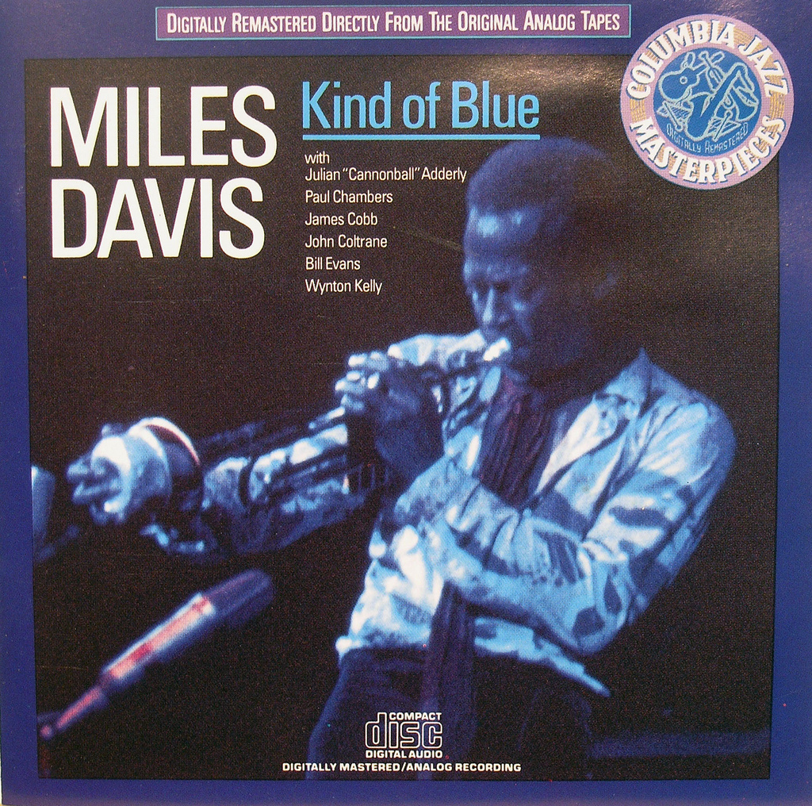
Hi. I’m Miles.
Notes:
http://www.flickr.com/photos/exquisitur/2551730203/sizes/l/in/photostream/

Slide 3
Hi. I’m Miles.
@awayken, +Miles Rausch
https://github.com/awayken
This presentation: http://milesrausch.com/presentations/2011sdcodecamp

Slide 4

School
Notes:
http://www.flickr.com/photos/awayken/94715288/
Got a double major in CS and Math, but don’t ask me math.
I met and fell in love with my now wife.

Slide 5
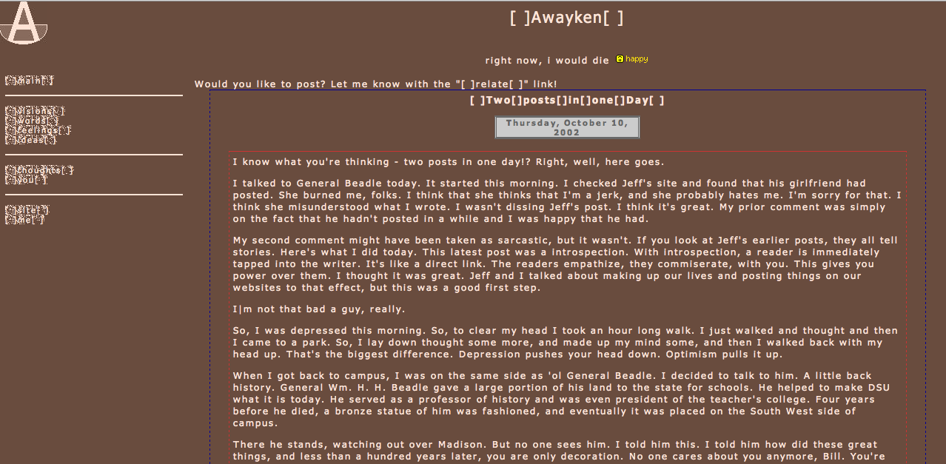
Notes:
http://awayken.com/about/sepia/index2.html
I also met and fell in love with the web.

Slide 6
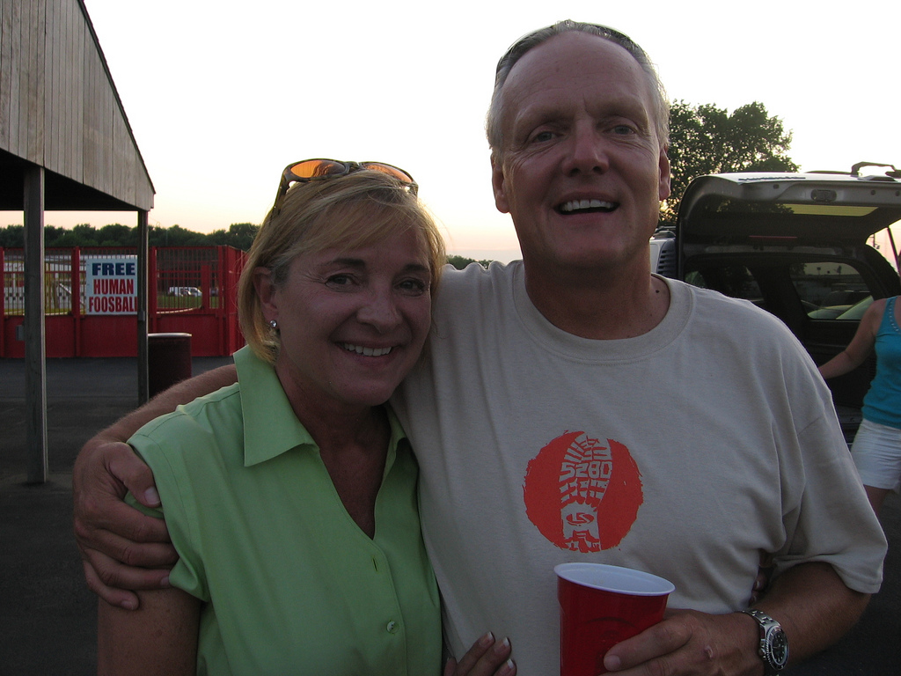
Work
Notes:
http://www.flickr.com/photos/awayken/3839025892/sizes/l/in/photostream/
That enabled me to get a job at L&S, where I do web programming.

Slide 7

Adobe ColdFusion
Notes:
http://www.flickr.com/photos/stevenerat/1462403613/sizes/o/in/photostream/
A rapid application development platform invented in 1995
Bought by Adobe in 2005
App server and markup language, CFML
Proprietary and closed source

Slide 8
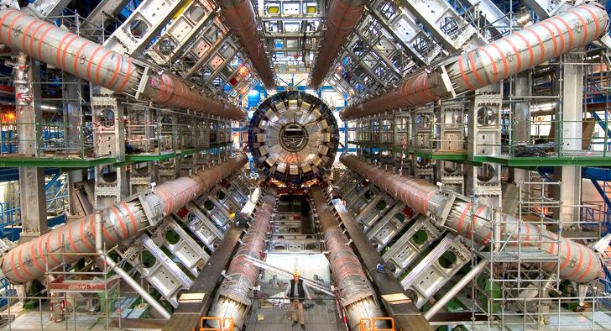
Not Cold Fusion
Notes:
http://www.flickr.com/photos/johnmcnab/4248698746/sizes/o/in/photostream/

Slide 9
(Open Source) CFML
Notes:
ColdFusion Markup Language
Tag-based or ECMA-like syntax within <cfscript>
Extensible with CustomTags and CFCs
CFML Advisory Committee (defunct)
Open BlueDragon: http://openbd.org/
Railo: http://www.getrailo.org/

Slide 10
Install OpenBD Desktop
Go to openbd.org
Click on Download
Click OpenBD Desktop
Click Download
Unzip
Execute the .exe or .sh
.sh might need to get chmod +x
Execute .sh as `sudo sh OpenBlueDragonDesktop.sh`

Slide 11
Run OpenBD Desktop
Web App
Choose Web App Folder (will add necessary files)
Web Port
Extensions to execute through OpenBD
Options: check Manual and Admin Console
Standard Engine
Click Start OpenBD

Slide 12
Demo 01
Notes:
Create a new guestbook website

Slide 13
Basic CFML - syntax
Code lives in CFM or CFC files
Designed to live amongst HTML
Tag-based, starting with “cf” (for example, <cfset>)
Some tags are self-closing, many have attributes, some perform processing within the tag
Can create custom tags
Comments: <!--- comment --->
Notes:
http://openbd.org/manual/?/basic_cfml

Slide 14
Basic CFML - variables
Variables are type-less
String, number, date, boolean, structures, arrays
Variables have scope
Server, cgi, cookie, request, form, url, variables, local, arguments, attributes, application, client, session, cfthread, cffile, this, super, cfcatch
Reference variables [scope].[variable’s name] or [scope][‘variable’s name’]
<cfset message = “Hello, World!”>
Notes:
http://openbd.org/manual/?/basic_cfml
http://openbd.org/manual/?/language_scopes

Slide 15
Basic CFML - output
CFML lives amongst HTML, so you tell it when to output
Use #s to process CFML, with <cfoutput>
Can put variables or function calls within #s
#uCase(message)# outputs the upper case of message
Cannot put tags within #s
Escape # with another #: ##
Need #s in attributes for tags
<cfdump var=“#message#”>
Notes:
http://openbd.org/manual/?/basic_cfml

Slide 16
Basic CFML - functions
2 basic types: core (built-in) and user-defined (UDF)
Can define using <cffunction …> or CFCs
Might return a value, output something, or both
Syntax
FunctionName(“Miles”, 28)
FunctionName(name = “Miles”, age = 28)
FunctionName(argumentcollection = argsStruct)
Notes:
http://openbd.org/manual/?/basic_cfml

Slide 17
Using Variables
String: <cfset name=“Miles”>
Number: <cfset age = 28>
Boolean: <cfset isPresenting = true>
Date: <cfset datePresenting = Now()>
<cfparam name=“name” default=“No Name”>
<cfoutput>#simpleVariable#</cfoutput>
Notes:
http://openbd.org/manual/?/language_creation
http://openbd.org/manual/?/tag/CFPARAM

Slide 18
Using Variables - Arrays
1-based, not 0-based
Not typed
<cfset links = ArrayNew(1)> <cfset links[1] = “http://milesrausch.com”> <cfset links[2] = “http://awayken.com”>
<cfset links = [ “http://milesrausch.com”, “http://awaken.com” ]>
<cfoutput>#links[1]#</cfoutput>
Notes:
http://openbd.org/manual/?/language_creation

Slide 19
Using Variables - Structures
Key / value data (map, collection, etc.)
Can reference with dot or bracket notation
<cfset meta = StructNew()> <cfset meta.engine = “OpenBD”> <cfset meta[“version”] = “1.5”>
<cfset meta = { engine = “OpenBD”, version = “1.5” }>
<cfoutput>#meta.engine#</cfoutput> <cfoutput>#meta[“version”]#</cfoutput>
Check for existence before using: <cfif isDefined(“meta.engine”)> <cfif StructKeyExists(meta, “engine”)>
Notes:
http://openbd.org/manual/?/language_creation

Slide 20
Operators
Assignment
=, +=, -=, &=, /=, *=, %=
Unary
++, --, +, -, /, *
Binary
% or MOD
Logical
! or NOT, OR, AND, XOR
Comparators
EQ, NEQ, LT, LTE, GT, GTE, IS, IS NOT, CONTAINS
This is not a complete list.
Notes:
http://openbd.org/manual/?/language_operators

Slide 21
Demo 02

Slide 22
Control
<cfif>
<cfelseif>
<cfelse>
<cfswitch>
<cfcase>
<cfdefaultcase>
<cftry>
<cfcatch>
<cffinally>
<cflocation>
Notes:
http://openbd.org/manual/?/tag/category/control
http://openbd.org/manual/?/tag/category/network

Slide 23
Iterations
<cfloop>
Types of loops
Numeric: from, to, index, step
Condition: condition
Query: query, startrow, endrow
Array: array, index
List: list, index, delimiters
File: file, index, characters
Collection: collection, item
<cfbreak>
<cfcontinue>
Notes:
http://openbd.org/manual/?/tag/category/control

Slide 24
Content
<cfquery>
<cfqueryparam>
<cftransaction>
<cffile>
<cfdirectory>
<cfhttp>
<cfhttpparam>
<cffeed>
Notes:
http://openbd.org/manual/?/tag/category/database
http://openbd.org/manual/?/tag/category/file
http://openbd.org/manual/?/tag/category/remote

Slide 25
Manipulation
<cfimage>
<cfmail>
<cfmailparam>
<cfmailpart>
<cfdocument>
<cfdocumentsection>
<cfdocumentitem>
<cfform>
<cfinput>
<cftextarea>
Notes:
http://openbd.org/manual/?/tag/category/remote
http://openbd.org/manual/?/tag/category/unknown

Slide 26
Demo 03

Slide 27
CFCs
Notes:
http://openbd.org/manual/?/cfc_introduction

