Slide 1
Open Source CFML
From Basic to Badass

Slide 2
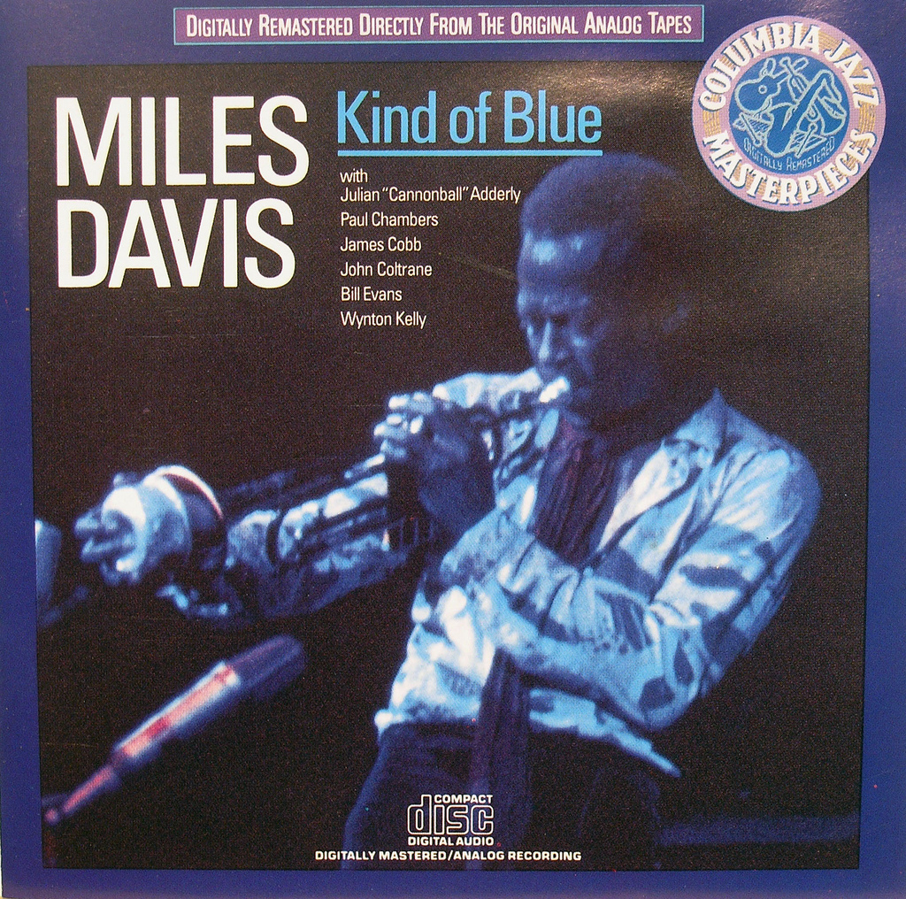
Hi. I’m Miles.
Notes:
http://www.flickr.com/photos/exquisitur/2551730203/sizes/l/in/photostream/

Slide 3
Hi. I’m Miles.
@awayken, +Miles Rausch
Of Miles Rausch: http://milesrausch.com
Awayken.com; http://awayken.com/
This presentation: https://github.com/awayken/2011sdcodecamp

Slide 4

School
Notes:
http://www.flickr.com/photos/awayken/94715288/
Got a double major in CS and Math, but don’t ask me math.
I met and fell in love with my now wife.

Slide 5
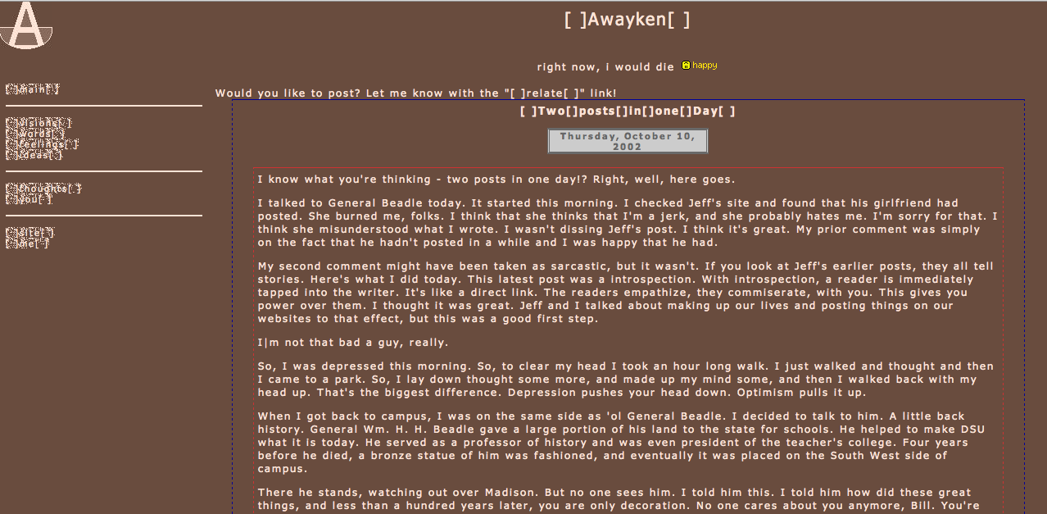
Notes:
http://awayken.com/about/sepia/index2.html
I also met and fell in love with the web.

Slide 6
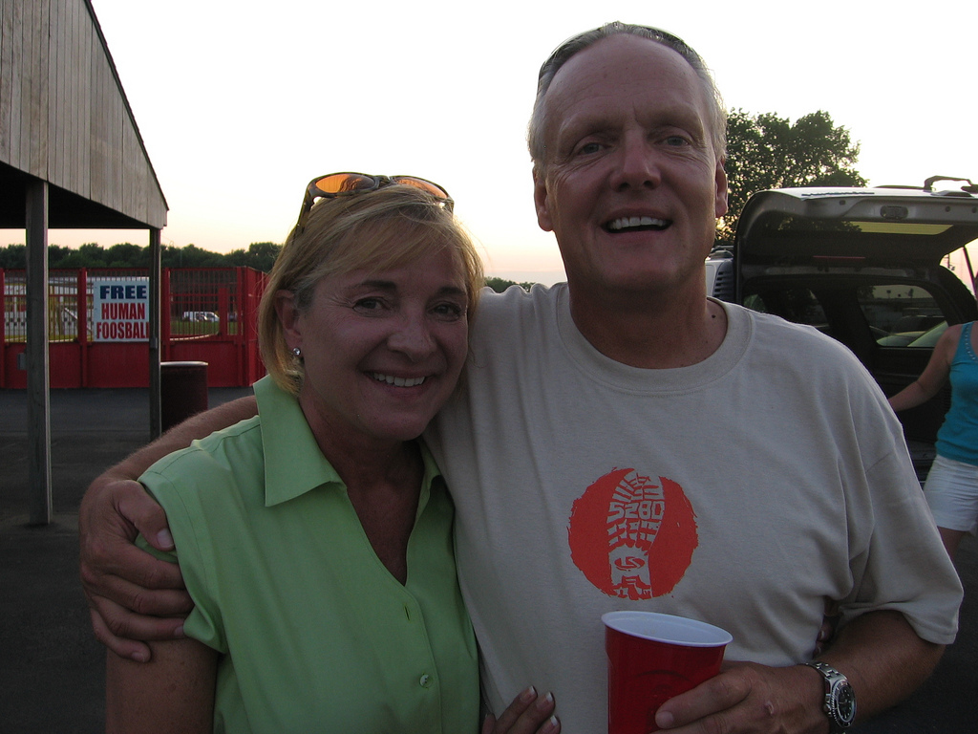
Work
Notes:
http://www.flickr.com/photos/awayken/3839025892/sizes/l/in/photostream/
That enabled me to get a job at L&S, where I do web programming.

Slide 7

Adobe ColdFusion
Notes:
http://www.flickr.com/photos/stevenerat/1462403613/sizes/o/in/photostream/
A rapid application development platform invented in 1995
Bought by Adobe in 2005
App server and markup language, CFML
Proprietary and closed source

Slide 8
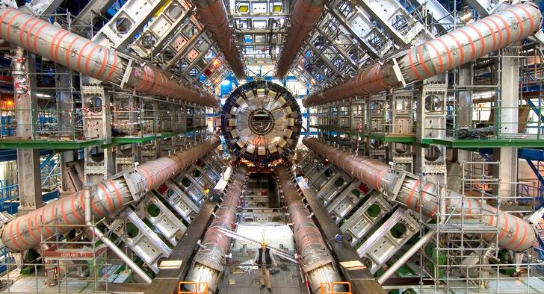
Not Cold Fusion
Notes:
http://www.flickr.com/photos/johnmcnab/4248698746/sizes/o/in/photostream/

Slide 9
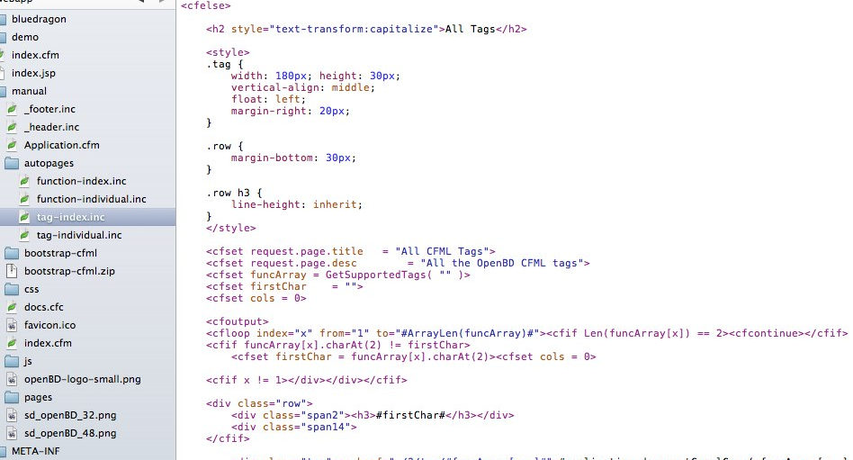
(Open Source) CFML
Notes:
https://skitch.com/awayken/gf9yy/tag-index.inc
ColdFusion Markup Language
Tag-based or ECMA-like syntax within <cfscript>
Extensible with CustomTags and CFCs
CFML Advisory Committee (defunct)
Open BlueDragon: http://openbd.org/
Railo: http://www.getrailo.org/

Slide 10
OpenBD Desktop
Go to openbd.org/download, and download “OpenBD Desktop”
Execute the .exe or .sh
.sh might need to get chmod +x
Execute .sh as `sudo sh OpenBlueDragonDesktop.sh`
Web App tab
Choose Web App Folder (will add necessary files)
Web Port: 80
Extensions to execute through OpenBD
Options: enable Manual and Admin Console
Standard Engine
Click Start OpenBD
Browse to http://localhost/

Slide 11
Railo Express
Go to getrailo.org/download, and download “Railo Express” for your OS / architecture
Execute `start`
Browse to http://localhost:8888/
Modify files in webroot/ instead of pointing to your own folder

Slide 12
Administration
Differs by engine
Usually, lets you manage (at least):
General Settings (security, caching, default values…)
Datasources
Mappings
Debugging, Logs
Scheduled Tasks
Custom tags, CFX tags
E-mail, Fonts
Web services
Notes:
http://localhost/bluedragon/administrator/

Slide 13
Demo 01
Notes:
Create the Mr. Octopus website.
Show http://localhost/bluedragon/administrator

Slide 14
Basic CFML - syntax
Code lives in CFM or CFC files
Designed to live amongst HTML
Tag-based, starting with “cf” (for example, <cfset>)
Some tags are self-closing, many have attributes, some perform processing within the tag
Can create custom tags
Comments: <!--- comment --->
Notes:
http://openbd.org/manual/?/basic_cfml

Slide 15
Basic CFML - variables
Variables are type-less
String, number, date, boolean, structures, arrays
Variables have scope
Server, cgi, cookie, request, form, url, variables, local, arguments, attributes, application, client, session, cfthread, cffile, this, super, cfcatch
Reference variables scope.variable_name or scope[‘variable_name’]
<cfset message = “Hello, World!”>
Notes:
http://openbd.org/manual/?/basic_cfml
http://openbd.org/manual/?/language_scopes

Slide 16
Basic CFML - output
CFML lives amongst HTML, so you tell it when to output
Use #s to process CFML, with <cfoutput>
Can put variables or function calls within #s
#uCase(message)# outputs the upper case of message
Cannot put tags within #s
Escape # with another #: ##
Need #s in attributes for tags
<cfdump var=“#message#”>
Notes:
http://openbd.org/manual/?/basic_cfml

Slide 17
Using Variables
String: <cfset name=“Miles”>
Number: <cfset age = 28>
Boolean: <cfset isPresenting = true>
Date: <cfset datePresenting = Now()>
<cfparam name=“variable_name” default=“default_value”>
<cfoutput>#simpleVariable#</cfoutput>
Notes:
http://openbd.org/manual/?/language_creation
http://openbd.org/manual/?/tag/CFPARAM

Slide 18
Using Variables - Arrays
1-based, not 0-based
Not typed
<cfset links = ArrayNew(1)> <cfset links[1] = “http://milesrausch.com”> <cfset links[2] = “http://awayken.com”>
<cfset links = [ “http://milesrausch.com”, “http://awaken.com” ]>
<cfoutput>#links[1]#</cfoutput>
Notes:
http://openbd.org/manual/?/language_creation

Slide 19
Using Variables - Structures
Key / value data (map, collection, etc.)
Can reference with dot or bracket notation
<cfset meta = StructNew()> <cfset meta.engine = “OpenBD”> <cfset meta[“version”] = “1.5”>
<cfset meta = { engine = “OpenBD”, version = “1.5” }>
<cfoutput>#meta.engine#</cfoutput> <cfoutput>#meta[“version”]#</cfoutput>
Check for existence before using: <cfif isDefined(“meta.homepage”)> <cfif StructKeyExists(meta, “homepage”)>
Notes:
http://openbd.org/manual/?/language_creation

Slide 20
Operators
Assignment
=, +=, -=, &=, /=, *=, %=
Unary
++, --, +, -, /, *
Binary
% or MOD
Logical
! or NOT, OR, AND, XOR
Comparators
EQ, NEQ, LT, LTE, GT, GTE, IS, IS NOT, CONTAINS
This is not a complete list.
Notes:
http://openbd.org/manual/?/language_operators

Slide 21
Demo 02

Slide 22
Control
<cfif CONDITION>, <cfelseif CONDITION>, <cfelse>
<cfswitch expression=“VALUE”>, <cfcase value=“VALUE”>, <cfcase value=“VALUE1,VALUE2”>, <cfdefaultcase>
<cftry>, <cfcatch type=“TYPE”>, <cffinally>
<cfcatch> exposes a special cfcatch scope
<cflocation url=“URL” addtoken=“BOOLEAN”>
addtoken = “true” adds session tokens to URL
Notes:
http://openbd.org/manual/?/tag/category/control
http://openbd.org/manual/?/tag/category/network

Slide 23
Iterations
<cfloop>
Types of loops
Numeric: from, to, step, index
Condition: condition
Array: array, index
List: list, index, delimiters
Collection: collection, item
Query: query, startrow, endrow
File: file, index, characters
<cfbreak>
<cfcontinue>
Notes:
http://openbd.org/manual/?/tag/category/control

Slide 24
Content
<cfdirectory action=“ACTION” directory=“REAL PATH” name=“NAME”>
Actions: list, create, rename, delete
<cfhttp url=“URL”>, <cfhttpparam type=“TYPE” value=“VALUE” name=“NAME”>
Exposes a special cfhttp scope
<cfhttpparam> types are: url, formfield, cgi, body, xml, header, cookie, file
<cffile action=“ACTION” file=“REAL PATH” variable=“NAME”>
Actions: read, readbinary, write, append, delete, rename, upload, copy, move
Exposes a special cffile scope (sometimes)
<cfhtmlhead text=“TEXT”>
Text is any HTML you want inserted right before </head>
Notes:
http://openbd.org/manual/?/tag/category/file
http://openbd.org/manual/?/tag/category/remote

Slide 25
Database Content
Datasources are setup in administrator (no connection strings)
<cfquery datasource=“DSN” name=“NAME” cachedwithin=“TIME SPAN”>
Create a timespan using CreateTimespan()
Returns special query object called NAME
Query has records, but also properties: RecordCount, CurrentRow, ColumnList
<cfqueryparam cfsqltype=“SQL Type” value=“VAL”>
SQL Types are cf_sql_[Type] (e.g. cf_sql_varchar)
Provide a number of security and performance benefits
#1 way to protect against SQL injections
<cftransaction action=“ACTION”>
Action can be: begin, commit, and rollback
Allows SQL transactions
Notes:
http://openbd.org/manual/?/tag/category/database

Slide 26
Demo 03

Slide 27
<cfscript>
An entire ECMA-style scripting language
Removes dependency on tag-based markup
Feels “more at home” or “cleaner” for some developers
Can be used amongst tag-based CFML
Learn more.

Slide 28
Functions
2 basic types: core (built-in) and user-defined (UDF)
Can define custom using <cffunction …> or CFCs
Might return a value, output something, or both
Syntax
FunctionName(“Miles”, 28)
FunctionName(name = “Miles”, age = 28)
FunctionName(argumentcollection = argsStruct)
Notes:
http://openbd.org/manual/?/basic_cfml

Slide 29
Core Functions
There are a ton
Some replicate tag functionality
WriteOutput(), WriteDump()
Some stand alone
URLEncodedFormat(), Hash(), CreateTimespan()
Usually return value and doesn’t output

Slide 30
UDFs
<cffunction name=“NAME” access=“ACCESS” returntype=“VARIABLE TYPE”>
Access: public, private, package, remote
<cfargument name=“NAME” required=“BOOLEAN” type=“VARIABLE TYPE” default=“VALUE”>
Exposes a special arguments scope
<cfreturn VAL>
VAL should match “returntype” above

Slide 31
Demo 04

Slide 32
Modularity
<cfinclude template=“REAL PATH”>
Executes the template into your page
Custom Tags
<cf_mycustomtag ...>
Must drop custom tag into custom tags folder
UDFs
ColdFusion Components (CFCs)
Can be collection of UDFs or an object
Notes:
http://openbd.org/manual/?/cfc_introduction

Slide 33
CFC Syntax
<cfcomponent output=“BOOLEAN” displayname=“NAME” hint=“STRING” extends=“COMPONENT”>
Wraps your CFC
Tags are optional, most for documentation
Define functions with <cffunction>
Code between <cfcomponent> and first <cffunction> acts as “init()”
Getters / Setters not automatically created
Instantiated using CreateObject()
Notes:
http://openbd.org/manual/?/cfc_structure
http://openbd.org/manual/?/cfc_encapsulation

Slide 34
CFC Variable Scope
this
CFC’s global scope
Public when added as this.VARIABLE
variables
CFC’s private scope
var’d variables
Function’s local scope
Notes:
http://openbd.org/manual/?/cfc_variables

Slide 35
Demo 05

Slide 36
Applications
Application.cfc or Application.cfm creates an application
Has special properties
this.name, this.scriptprotect, this.applicationtimeout, this.sessionmanagement, this.sessiontimeout
Has normal properties: application.NAME
Has special methods
onApplicationStart() / onApplicationEnd()
onSessionStart() / onSessionEnd()
onRequest() / onRequestStart() / onRequestEnd()
onError()
onMissingTemplate() / onMissingMethod()
Notes:
http://openbd.org/manual/?/app_application
http://openbd.org/manual/?/app_application_cfc

Slide 37
Demo 06

Slide 38
Problems with Open Source CFML
Adobe is big and closed (like Mono and Microsoft)
Community isn’t vibrant
Few high-profile projects that reach beyond CFML
Hosting costs high and capabilities limited
Perception against CFML
Depends on Java / JVM

Slide 39
Benefits of Open Source CFML
Easy to learn
Adobe is a big player
(Slowly) Growing community
Respectable number of “also” projects
Builds on Java
Can (theoretically) be hosted on JVM-supported hosting

Slide 40
Want More Info?
Open BlueDragon: http://openbd.org/
Railo: http://www.getrailo.org/
RIAForge: http://www.riaforge.org/
L&S’s Open Source: http://www.l-s.com/aboutus/OpenSource/

Slide 41
Questions?

