Slide 1
Open Source ColdFusion
From Basic to Badass

Slide 2
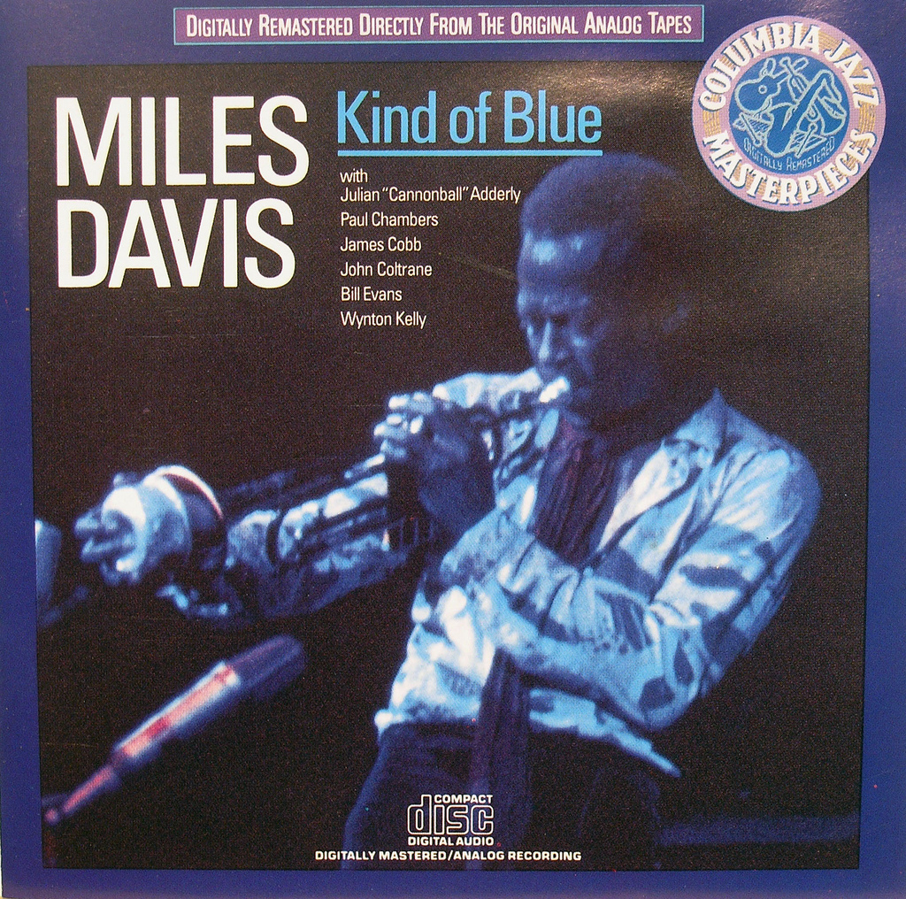
Hi. I’m Miles.
Notes:
http://www.flickr.com/photos/exquisitur/2551730203/sizes/l/in/photostream/

Slide 3
Hi. I’m Miles.
@awayken, +Miles Rausch
https://github.com/awayken
This presentation: http://milesrausch.com/presentations/2011sdcodecamp

Slide 4
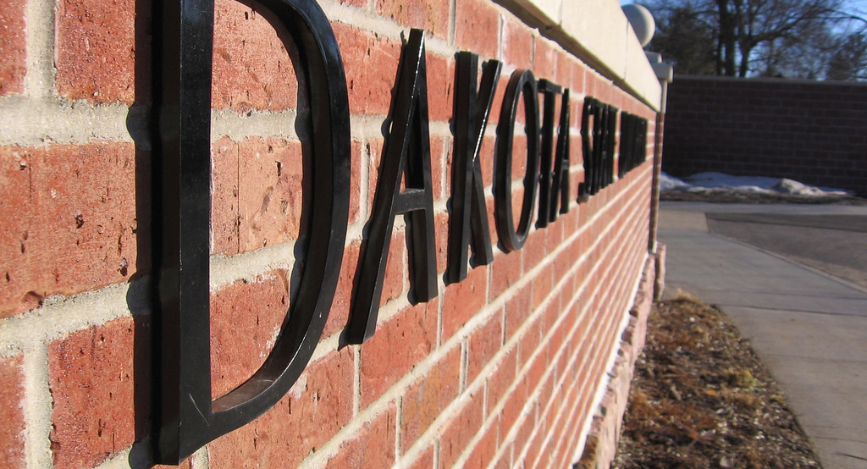
School
Notes:
http://www.flickr.com/photos/awayken/94715288/
Got a double major in CS and Math, but don’t ask me math.
I met and fell in love with my now wife.

Slide 5
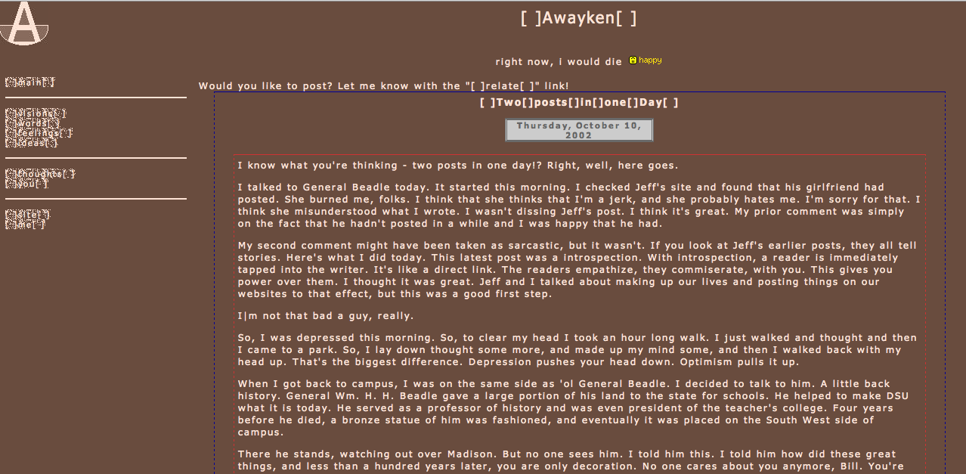
Notes:
http://awayken.com/about/sepia/index2.html
I also met and fell in love with the web.

Slide 6
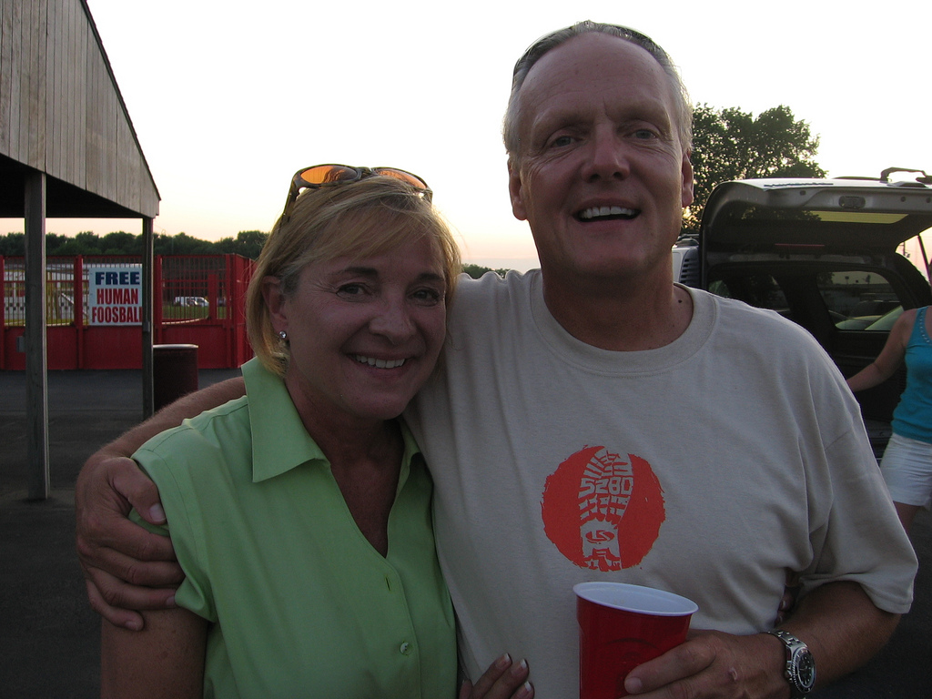
Work
Notes:
http://www.flickr.com/photos/awayken/3839025892/sizes/l/in/photostream/
That enabled me to get a job at L&S, where I do web programming.

Slide 7

Adobe ColdFusion
Notes:
http://www.flickr.com/photos/stevenerat/1462403613/sizes/o/in/photostream/
A rapid application development platform invented in 1995
Bought by Adobe in 2005
App server and markup language, CFML
Proprietary and closed source

Slide 8
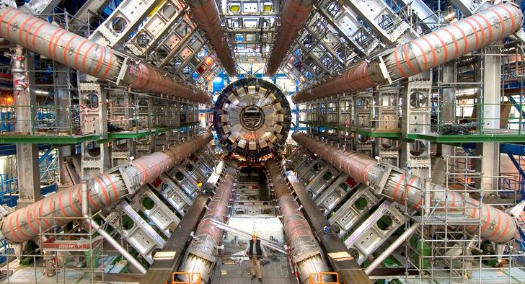
Not Cold Fusion
Notes:
http://www.flickr.com/photos/johnmcnab/4248698746/sizes/o/in/photostream/

Slide 9
(Open Source) CFML
Notes:
ColdFusion Markup Language
Tag-based or ECMA-like syntax within <cfscript>
Extensible with CustomTags and CFCs
CFML Advisory Committee (defunct)
Open BlueDragon: http://openbd.org/
Railo: http://www.getrailo.org/

