Slide 1
Class Nine
Designing With Color

Slide 2
Overview
What's new?
Attendance
Quiz
Autopsy
Guest Speaker
The Chapter
Notes:
5 minutes

Slide 3
What’s New?
Kamie was the only vote, so she has decided the fate of the class slides
Slides will be a hybrid
Class will have more "lab" time

Slide 4
Quiz Time
Notes:
10 minutes

Slide 5
Website Autopsy
http://www.ohmycupcakes.com/
http://spacecollective.org/projects/The-great-enhancement-debate
http://google.com
"do a barrel roll"
"askew"
http://www.google.com/language_tools
http://en.wikipedia.org/wiki/Google%27s_hoaxes#Easter_eggs
Notes:
20 - 30 minutes

Slide 6
Break
Notes:
Break – 8 minutes

Slide 7
Guest Speaker

Slide 8
Break
Notes:
Break – 8 minutes

Slide 9
The Chapter

Slide 10
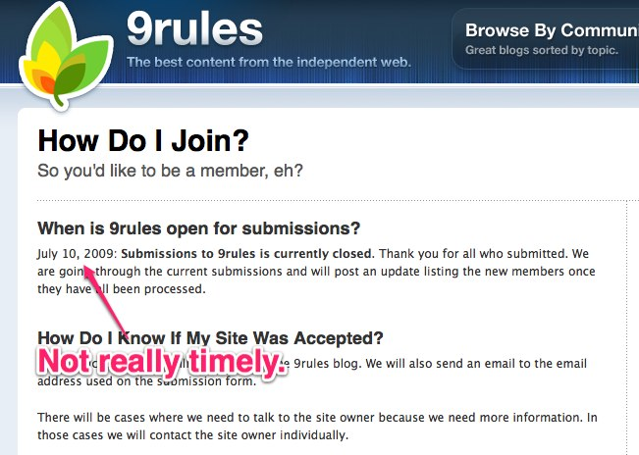
9Fools?

Slide 11

Color
Creates emotion
Red = excitement
Blue = comfort
Purple = dignity
No different than other artistic media
Notes:
http://www.flickr.com/photos/uaeincredible/231011361/

Slide 12

Color Wheel
Helpful for visually showing color relationships
Complementary colors live across
Notes:
http://www.flickr.com/photos/uckhet/368594481/

Slide 13
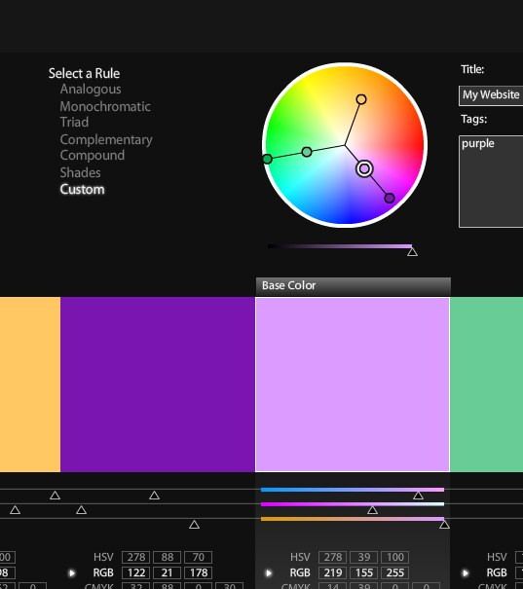
Digital Color Wheel
http://colorschemedesigner.com/
http://kuler.adobe.com/

Slide 14

Color schemes
A grouping of colors that go well together
Start with a base color
Pick other colors using a certain scheme or pattern
Notes:
http://www.flickr.com/photos/jkownacki/4067668954/

Slide 15
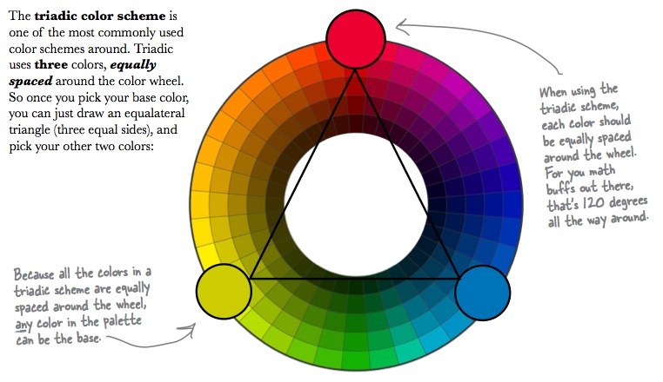
Triadic
Three colors
Additional colors equally spaced from base color

Slide 16
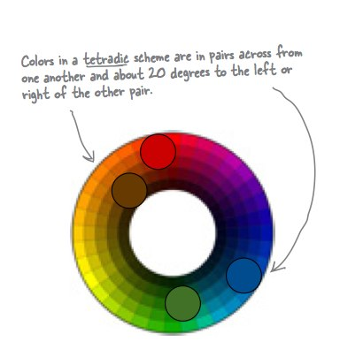
Tetradic
Four colors
AKA double complementary scheme
2 pairs of colors about 20° apart

Slide 17
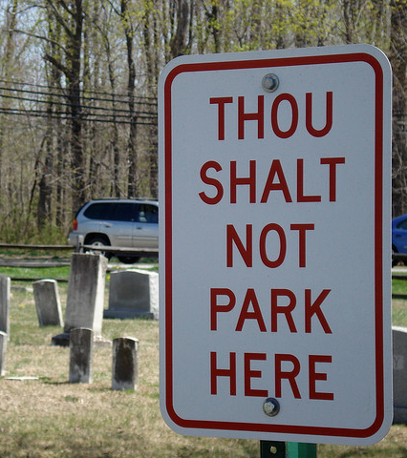
The Rules
There are no rules
Create contrast
Use dominant colors to emphasize
Notes:
http://www.flickr.com/photos/nhall/477025209/

Slide 18
Class Ten
Smart Navigation

