Slide 1
Class Eight
Layout and Design (Part II)

Slide 2
Overview
What's new?
Attendance
Quiz
Autopsy
The Chapter
Notes:
5 minutes

Slide 3
What’s New?
A Vote!
Informative slides?
Entertaining slides?
Guest speaker!
Tara Adamson, graphic / web designer
What do you want to know?

Slide 4
Quiz Time
Notes:
10 minutes

Slide 5
Website Autopsy
http://www.thelocalbest.com/
http://www.time.com/time/
http://www.packers.com/
http://www.ikea.com/us/en/
http://goldenratiocalculator.com/
Notes:
20 - 30 minutes

Slide 6
Break
Notes:
Break – 8 minutes

Slide 7
The Chapter
Informative
Interesting

Slide 8
Grids
Human beings like grids
Golden Ratio: 1.618… http://en.wikipedia.org/wiki/Golden_ratio
Rule of thirds
Important content should get weight
Symmetrical balance vs. Asymmetrical balance
Frameworks help (sound familiar)

Slide 9
Content vs. Style
How to style album listing?
Which is more important?
You need content for a website
You need style for users to enjoy a website
Must complement each other

Slide 10
Vertical Golden Ratios
Can require images
Can require CSS positioning
Use a background image to create "faux" stripes of content

Slide 11
Finally.

Slide 12

Grids
Notes:
Human beings like grids

Slide 13

Golden Ratio
Notes:
Golden Ratio: 1.618… http://en.wikipedia.org/wiki/Golden_ratio

Slide 14

Notes:
Important content should get weight

Slide 15
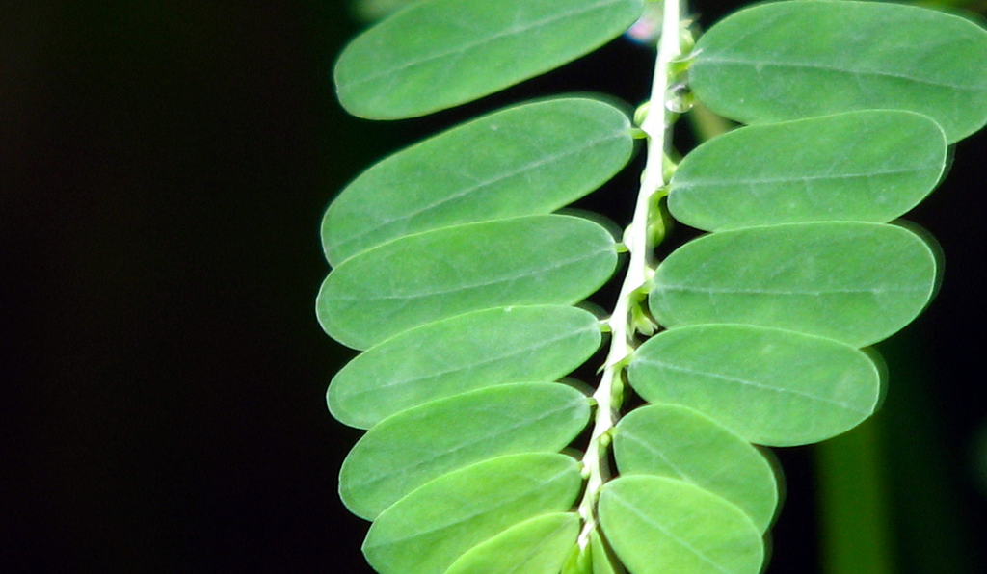
Symmetrical balance
Notes:
Symmetrical balance occurs when elements on either side of a line (either horizontal or vertical) have the same weight.

Slide 16

Asymmetrical balance
Notes:
Asymmetrical balance occurs when the weight of a site’s elements is not evenly distributed around a central line.

Slide 17
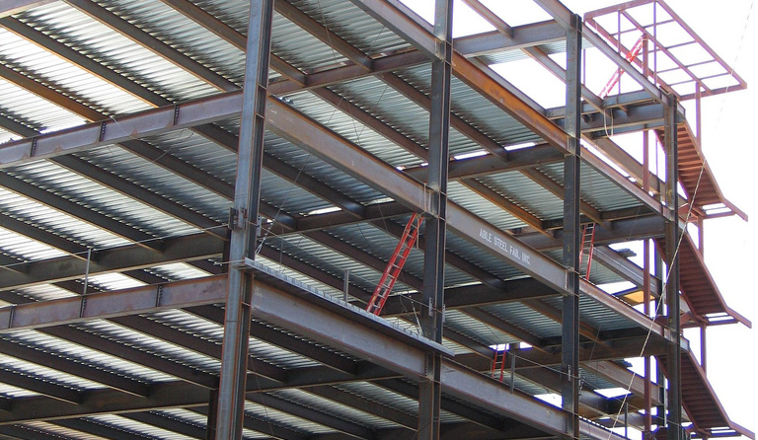
Frameworks
Notes:
Frameworks help (sound familiar)

Slide 18

Content vs. Style
Notes:
How to style album listing?
Which is more important?
You need content for a website
You need style for users to enjoy a website
Must complement each other

Slide 19

Vertical Golden Ratios
Notes:
Can require images
Can require CSS positioning
Use a background image to create "faux" stripes of content

Slide 20
Class Nine
Designing With Color

