Slide 1
Class Fourteen
Portfolio Presentations

Slide 2
Overview
Autopsy
The Chapter
Portfolio Presentations
Attendance
Notes:
5 minutes

Slide 3
Website Autopsy
http://www.middlebury.edu/#story276576
http://soulwire.co.uk/hello
http://abc.go.com/
Notes:
20 - 30 minutes

Slide 4
Break
Notes:
Break – 8 minutes

Slide 5
The Chapter

Slide 6

1. Cross-cultural & International design
Icons have different meanings
Language differences
Cultural differences
Notes:
http://www.flickr.com/photos/jasonbachman/4177519542/sizes/z/in/photostream/

Slide 7

2. The future of web markup
HTML 5 vs. XHTML 2
XHTML 2 is dead
Pretty good support for HTML 5 already
HTML 5 written for web apps
Notes:
http://www.w3.org/html/logo/

Slide 8

3. The future of CSS
CSS 3
WOFF
Rounded corners
Shadows
Opacity
Columns
Notes:
http://www.w3.org/html/logo/

Slide 9
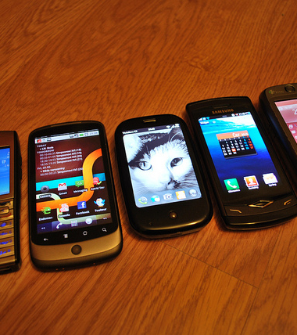
4. Designing for mobile
Mobile much more prevalent
Smaller screen size
Data plans
"Wild West" for browsers
Notes:
http://www.flickr.com/photos/carnero/4728435040/sizes/m/in/photostream/

Slide 10
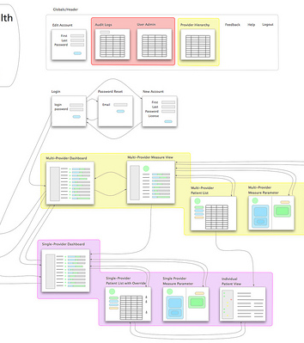
5. Developing web applications
Websites that do something
Server-side language:
PHP
ASP.Net
Python
ColdFusion
Ruby on Rails
Notes:
http://www.flickr.com/photos/mccready/6473842721/sizes/m/in/photostream/

Slide 11

6. Rhythm in your layout
Repetition of design elements
Repeat common element or theme
Notes:
http://www.flickr.com/photos/thomashawk/2681744739/sizes/m/in/photostream/

Slide 12
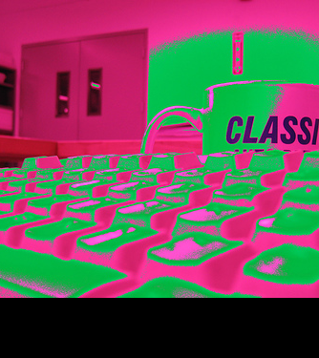
7. Text contrast
Scannable text isn't necessarily legible
Notes:
http://www.flickr.com/photos/majorlefty/820516039/sizes/m/in/photostream/

Slide 13

8. Match link names with destination page
Maintains consistency
Also helps with SEO
Notes:
http://www.flickr.com/photos/dystopos/5176673982/sizes/m/in/photostream/

Slide 14
9. Contrast in layout
Use contrast in layout
Creates emphasis
Notes:
http://www.flickr.com/photos/majorlefty/820516039/sizes/m/in/photostream/

Slide 15
10. Tools for design
Pencil project: http://pencil.evolus.vn/en-US/Home.aspx
WriteMaps: http://writemaps.com/
Web Developer: http://chrispederick.com/work/web-developer/
CSSTidy: http://csstidy.sourceforge.net/
Firebug: http://getfirebug.com/

Slide 16
Break
Notes:
Break – 8 minutes

Slide 17
Portfolio Presentations

Slide 18
Happy Holidays!

