Slide 1
From
https://campus.datacamp.com/courses/data-visualization-in-tableau/start-to-visualize?ex=8

Slide 2
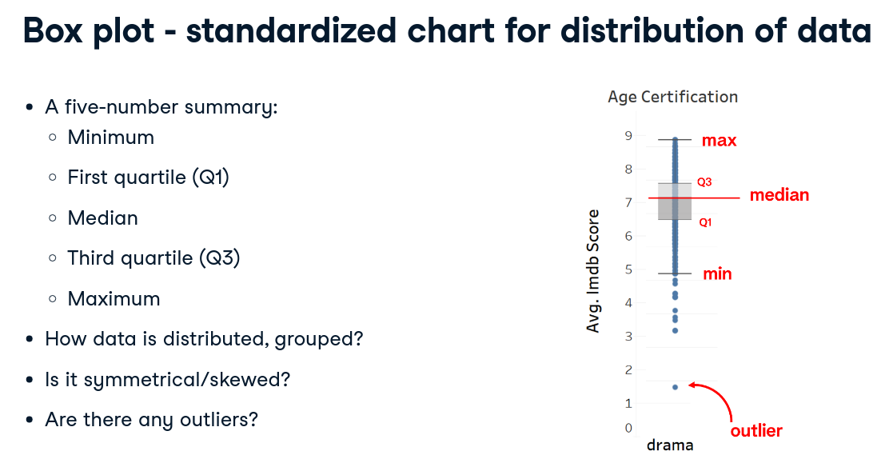

Slide 3
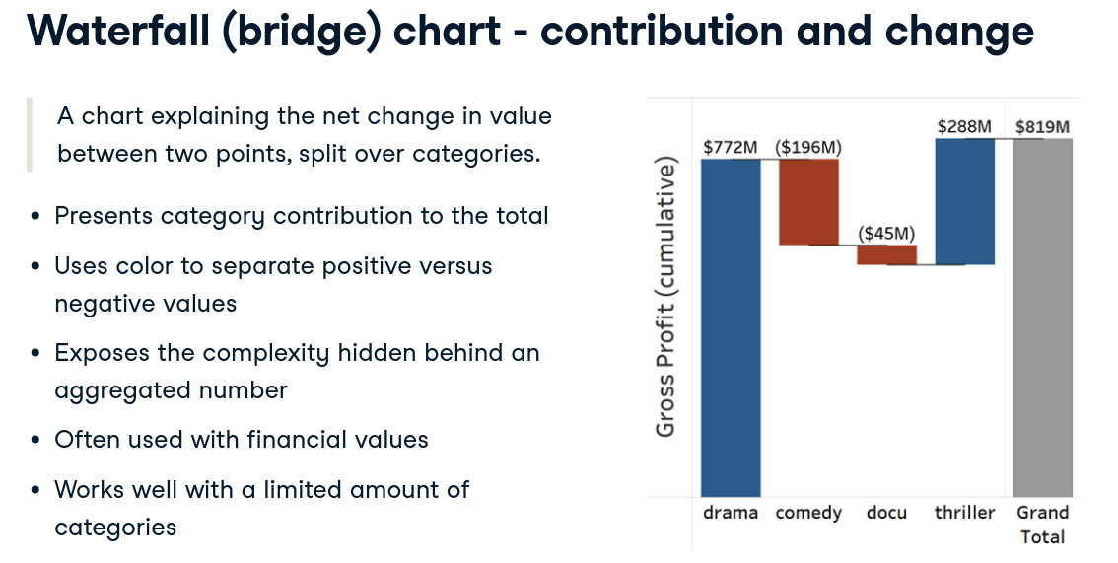

Slide 4
