Slide 1
OBJECTIVES
The main objective of this project is to building a web based application which will help Retailers
& wholesaler to manage their inventory for different types of product efficiently and to get an idea about
EOQ (Economic Order Quantity) and inform about reorder level. This system also helps to overcome out
of stock problems and helps to improve Profit margins which will result in simplifies the process and
facilitate the growth. System will also provide forecasting report of different stock which will help retailer
to manage their inventory accordingly.

Slide 2
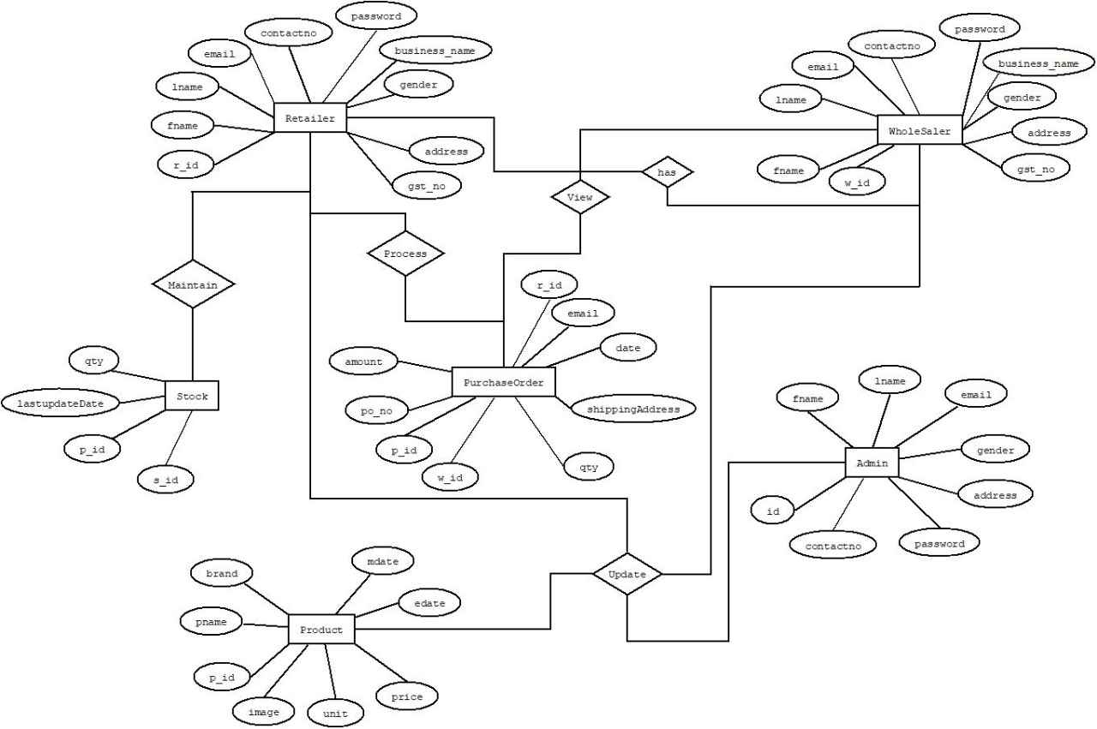
ER-DIAGRAM

