Slide 1
子查詢 補充

Slide 2
子查詢
一個敘述中的查詢敘述
WHERE、HAVING子句與子查詢
SELECT子句與子查詢
FROM子句與子查詢
資料維護與子查詢
關聯子查詢
子查詢與結合查詢

Slide 3
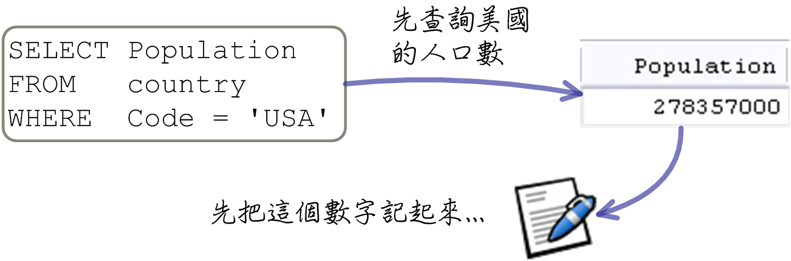
一個敘述中的查詢敘述

Slide 4
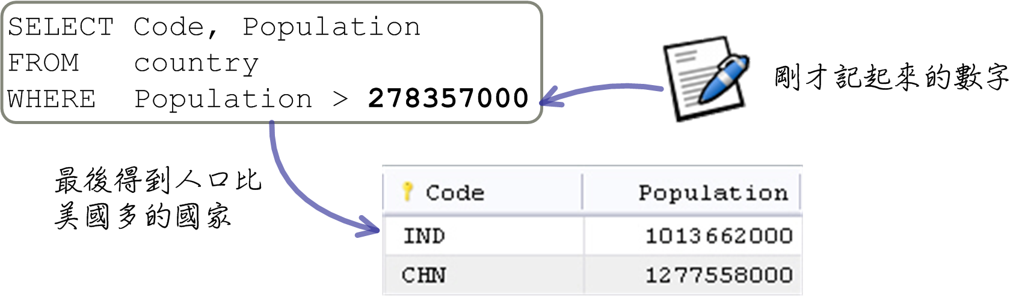
一個敘述中的查詢敘述

Slide 5
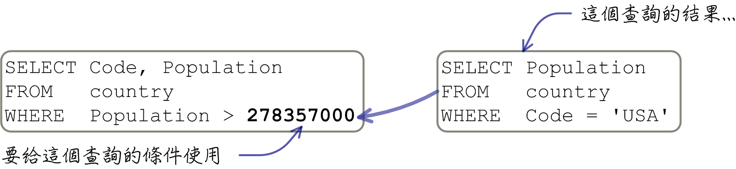
一個敘述中的查詢敘述

Slide 6
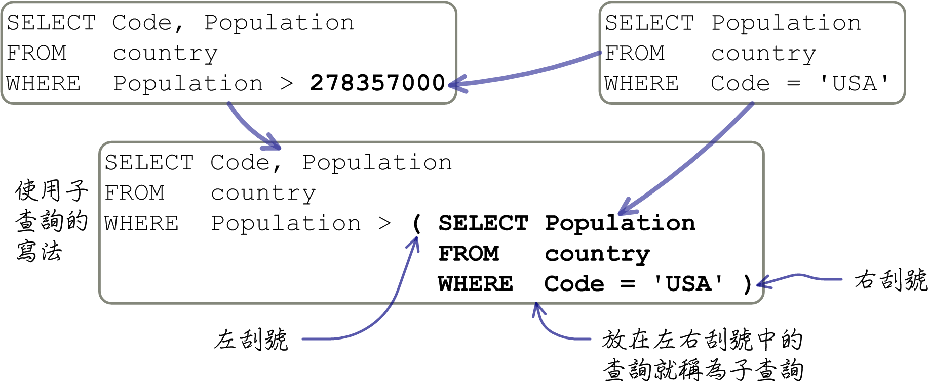
一個敘述中的查詢敘述

Slide 7
SELECT Code, Population
FROM country
WHERE Population > ( SELECT Population
FROM country
WHERE Code = 'USA' )

Slide 8
WHERE、HAVING子句與子查詢
比較運算子
「IN」運算子
其它運算子
多欄位子查詢

Slide 9
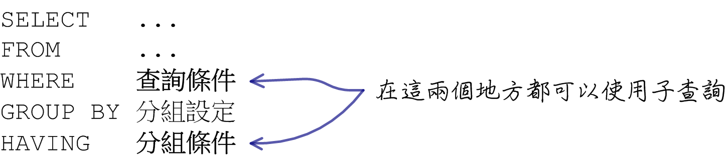
WHERE、HAVING子句與子查詢

Slide 10
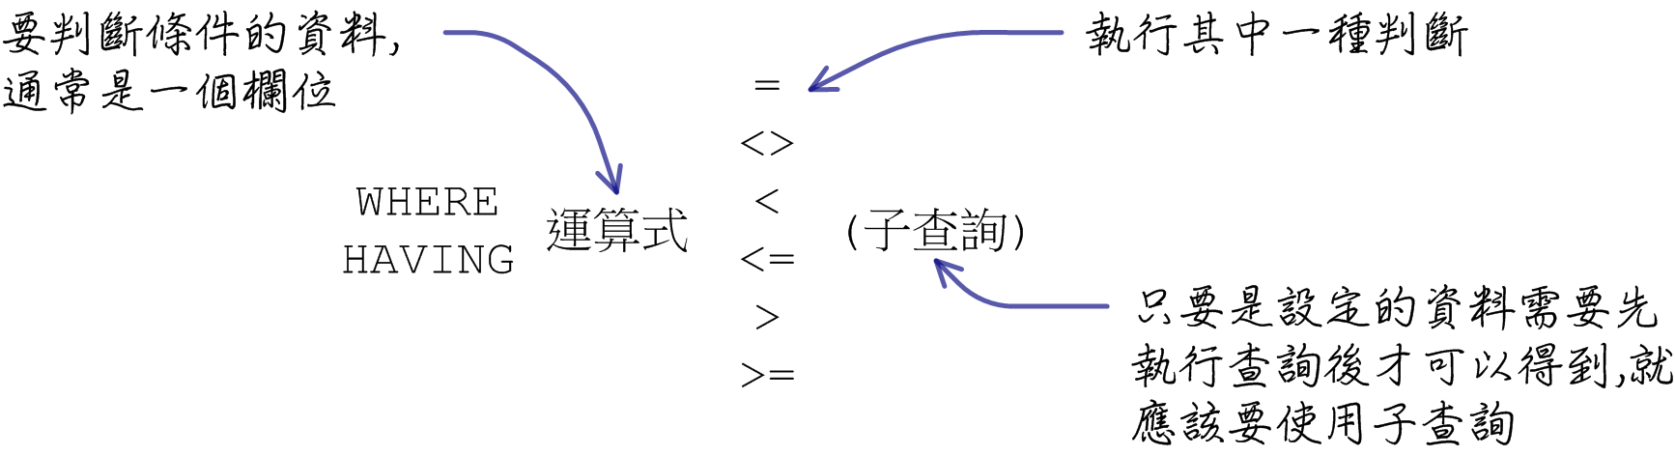
比較運算子

Slide 11
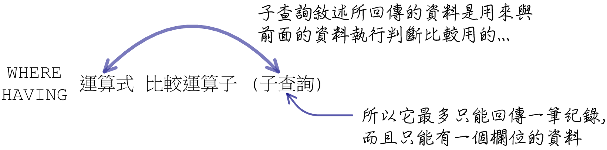
比較運算子

Slide 12
SELECT Name, GNP
FROM country
WHERE GNP = ( SELECT MAX(GNP)
FROM country )
SELECT Name, GNP
FROM country
WHERE GNP = ( SELECT Code, MAX(GNP)
FROM country )
SELECT Name, GNP
FROM country
WHERE GNP = ( SELECT MAX(GNP)
FROM country
GROUP BY Continent )

Slide 13
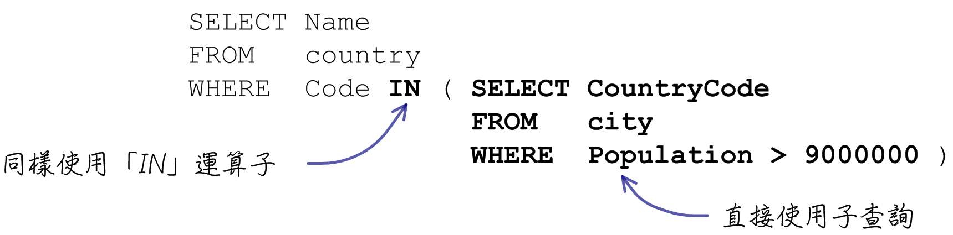
「IN」運算子

Slide 14
SELECT Name
FROM country
WHERE Code IN ( SELECT CountryCode
FROM city
WHERE Population > 9000000 )
SELECT Name
FROM country
WHERE Code = ( SELECT CountryCode
FROM city
WHERE Population > 9000000 )
SELECT Name
FROM country
WHERE Code NOT IN ( SELECT CountryCode
FROM city
WHERE Population > 9000000 )

Slide 15
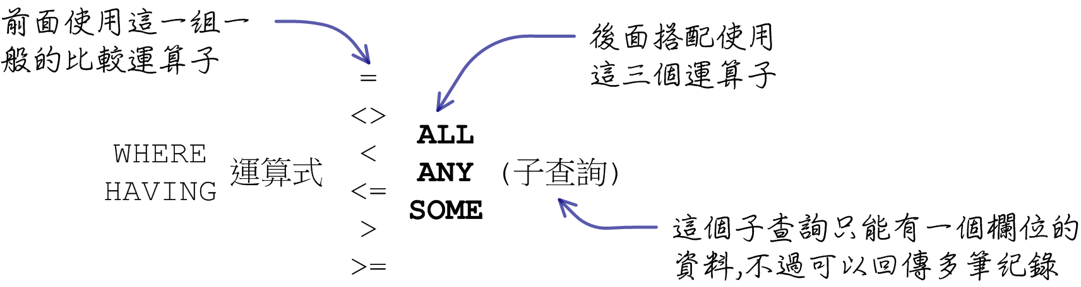
其它運算子

Slide 16
SELECT * FROM outertable
SELECT * FROM innertable
SELECT *
FROM outertable
WHERE n > ALL ( SELECT n
FROM innertable )
SELECT *
FROM outertable
WHERE n <> ALL ( SELECT n
FROM innertable )
SELECT *
FROM outertable
WHERE n NOT IN ( SELECT n
FROM innertable )
SELECT *
FROM outertable
WHERE n = ANY ( SELECT n
FROM innertable )
SELECT *
FROM outertable
WHERE n IN ( SELECT n
FROM innertable )

Slide 17
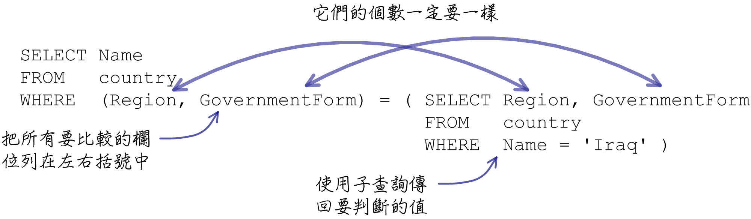
多欄位子查詢

Slide 18
SELECT Name, GNP
FROM country
WHERE Continent = 'Asia' AND GovernmentForm = 'Republic'
SELECT Name, GNP
FROM country
WHERE ( Continent, GovernmentForm ) = ( 'Asia', 'Republic' )
SELECT Name
FROM country
WHERE Region = ( SELECT Region
FROM country
WHERE Name = 'Iraq' )
AND
GovernmentForm = ( SELECT GovernmentForm
FROM country
WHERE Name = 'Iraq' )
SELECT Name
FROM country
WHERE (Region, GovernmentForm) = ( SELECT Region, GovernmentForm
FROM country
WHERE Name = 'Iraq' )

Slide 19
SELECT Continent, MAX(GNP)
FROM country
GROUP BY Continent
SELECT Continent, Name, GNP
FROM country
WHERE (Continent, GNP) IN ( SELECT Continent, MAX(GNP)
FROM country
GROUP BY Continent )

Slide 20
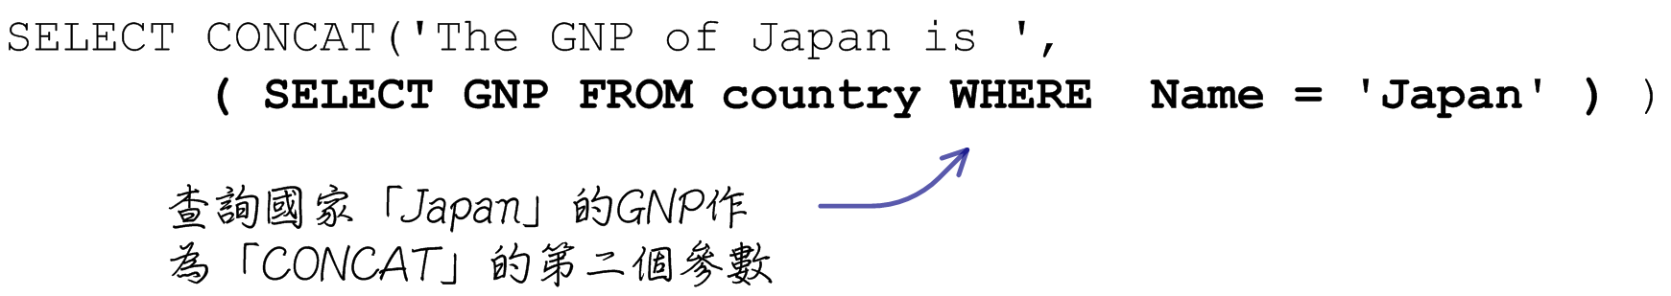
SELECT子句與子查詢

Slide 21
SELECT CONCAT('The GNP of Japan is ', GNP)
FROM country
WHERE Name = 'Japan'
SELECT CONCAT('The GNP of Japan is ',
( SELECT GNP FROM country WHERE Name = 'Japan' ) )
SELECT ( SELECT Population FROM country WHERE Name = 'India' ) /
( SELECT SUM(Population) FROM country )

Slide 22
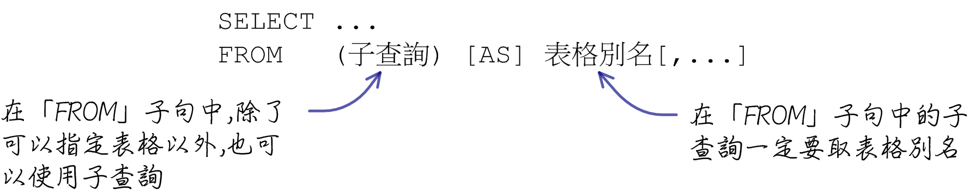
FROM子句與子查詢

Slide 23
SELECT Name, GNP
FROM ( SELECT *
FROM country
WHERE Continent = 'Asia' ) asiacountry
ORDER BY GNP DESC
LIMIT 10
SELECT Name, Language, Population * Percentage
FROM country, ( SELECT CountryCode, Language, Percentage
FROM countrylanguage
WHERE IsOfficial = 'T' ) officiallanguage
WHERE Code = CountryCode

Slide 24
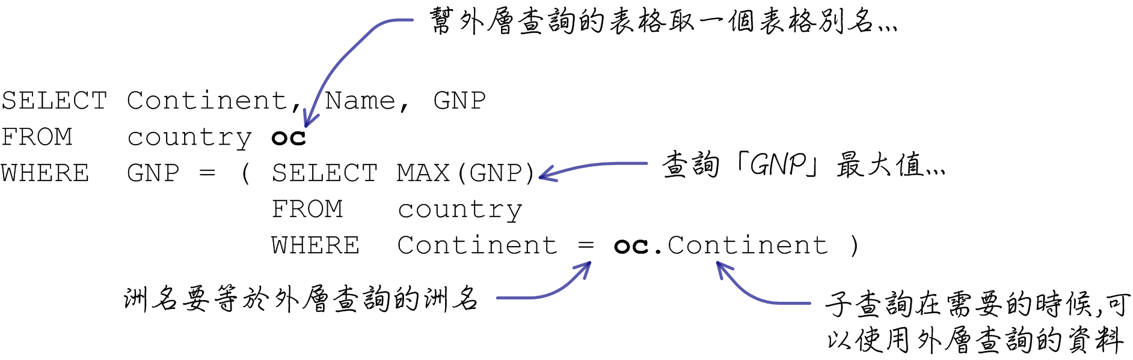
關聯子查詢

Slide 25
SELECT Continent, Name, GNP
FROM country
WHERE (Continent, GNP) IN ( SELECT Continent, MAX(GNP)
FROM country
GROUP BY Continent )
SELECT Continent, Name, GNP
FROM country oc
WHERE GNP = ( SELECT MAX(GNP)
FROM country
WHERE Continent = oc.Continent )
SELECT Name
FROM country c
WHERE EXISTS ( SELECT *
FROM city
WHERE CountryCode = c.Code AND
Population > 8000000 )
SELECT Name
FROM country c
WHERE NOT EXISTS ( SELECT *
FROM city
WHERE CountryCode = c.Code AND
Population > 8000000 )

Slide 26
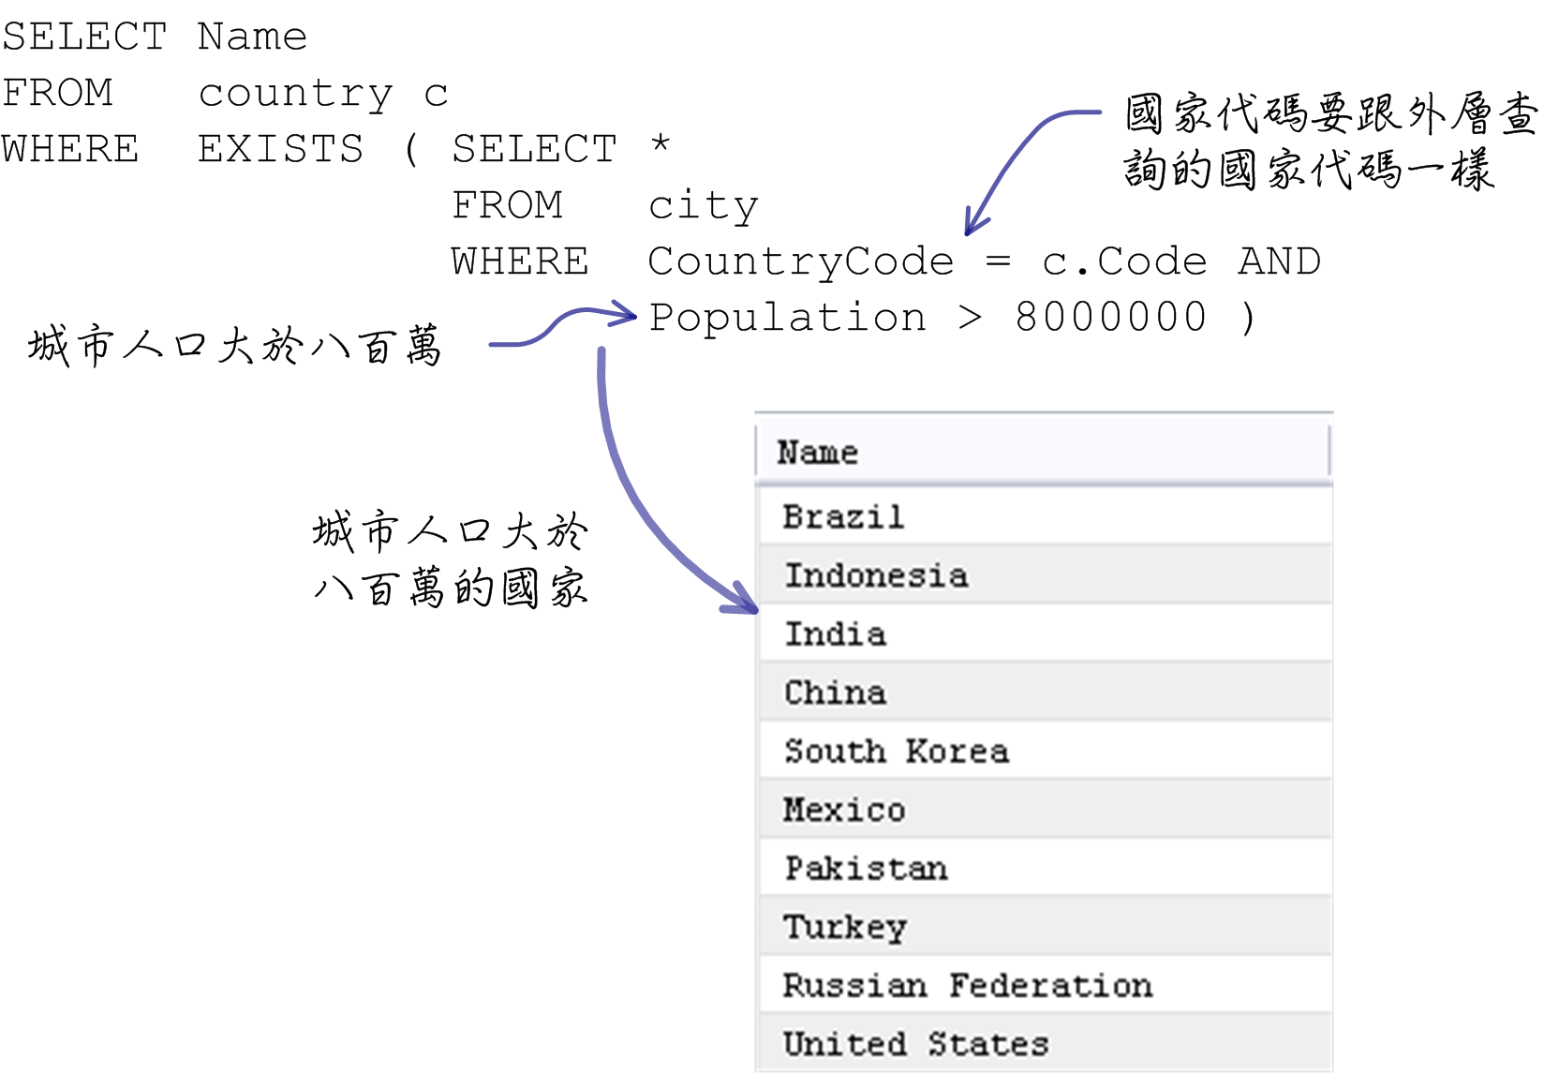
子查詢與結合查詢

Slide 27
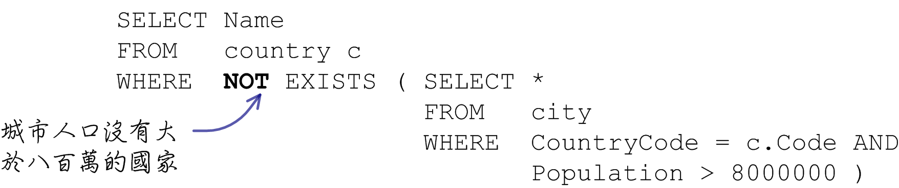
子查詢與結合查詢

Slide 28
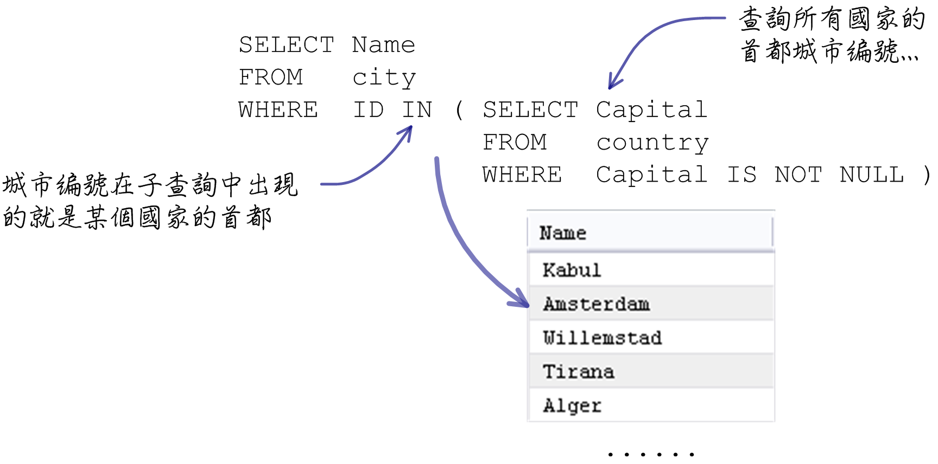
子查詢與結合查詢

Slide 29
SELECT Name
FROM city
WHERE ID IN ( SELECT Capital
FROM country
WHERE Capital IS NOT NULL )
SELECT city.Name
FROM city, country
WHERE ID = Capital
SELECT Name
FROM city
WHERE ID NOT IN ( SELECT Capital
FROM country
WHERE Capital IS NOT NULL )
SELECT city.Name, country.Capital
FROM city LEFT JOIN country ON city.ID = country.Capital
SELECT city.Name
FROM city LEFT JOIN country ON city.ID = country.Capital
WHERE country.Capital IS NULL

