Slide 1
Lab3 Speaker Recognition

Slide 2
Pytorch tutorial
https://youtu.be/MrnQ5LgcNBI
https://youtu.be/QAY6sfca6wI
Pytorch version is 0.4 in this tutorial
Official tutorial
https://pytorch.org/tutorials/
莫凡
https://www.youtube.com/watch?v=lAaCeiqE6CE&list=PLXO45tsB95cJxT0mL0P3-G0rBcLSvVkKH
You can only use pytorch in this Lab!!

Slide 3
Lab3 Commands
Decompress the files with command
tar xvf ~dl2023f_ta1/Lab03.tar
Download dataset from
https://drive.google.com/file/d/1vw-s048wsyddG8kxjCiDt7hm7DZsOhV8/view?usp=drive_link
Environment (every time before opening jupyter notebook)
source /home/NFS/opt/scripts/load_ml2023f.sh

Slide 4
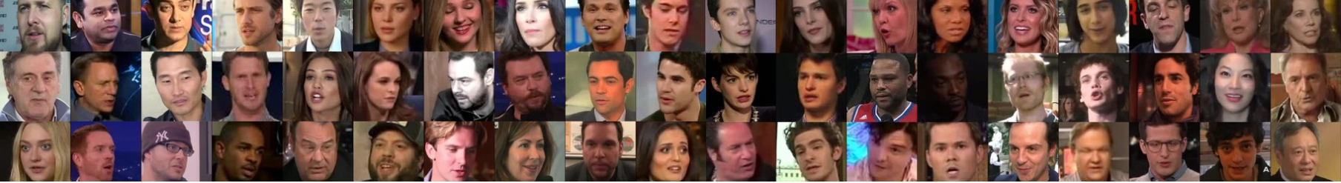
Dataset – Speaker Recognition
Identify 600 speakers

Slide 5
Tasks in this lab
1. In “DL_Lab03.ipynb”
Build vanilla transformer encoder block (from Attention is All You Need) by yourself
https://arxiv.org/abs/1706.03762
(You can’t call the model directly with the command)
The number of transformer encoder layers should be less than 4 !
(put the screenshot in your report)
The parameter size of transformer encoder block should be less than 500k !
(put the screenshot in your report)
Achieve at least 65% validation accuracy
(put the screenshot in your report)

Slide 6
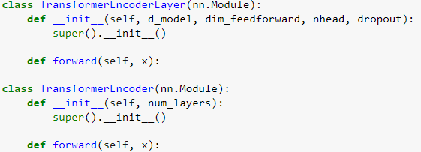
Code
The number of transformer encoder layers should be less than 4

Slide 7
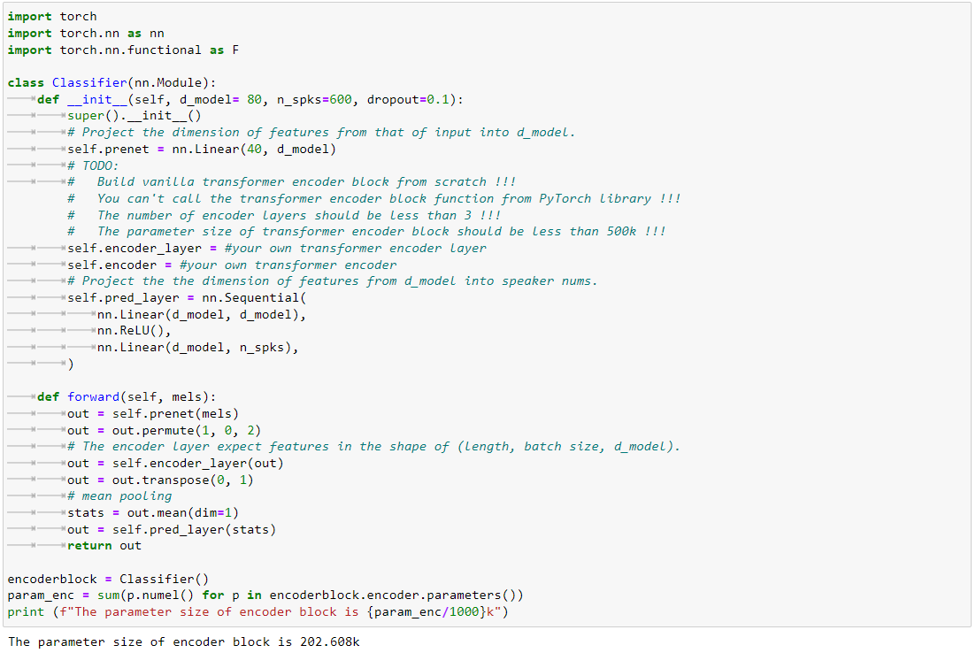
Code
You can set whatever you want Hint：The larger isn’t always the better.
The parameter size of transformer encoder block should be less than 500k !

Slide 8
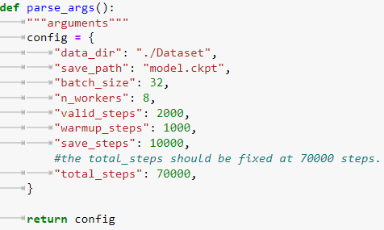
Code
Achieve at least 65% validation accuracy

Slide 9
Tasks in this lab
2. Task-2
Choose one transformer-like model to implement.
example：conformer(highly-recommended), branchformer, sumformer,…..
requirements：
The number of transformer encoder layers should be less than 4 !
(put the screenshot in your report)
The parameter size of transformer encoder block should be less than 500k !
(put the screenshot in your report)
Achieve at least 68% validation accuracy
(put the screenshot in your report)

Slide 10
Tasks in this lab
3. Write a report
Required
Screenshot of task-1
Number of layers
Parameter size
Accuracy
Screenshot of task-2
Number of layers
Parameter size
Accuracy
In task-2
Which kind of transformer-like model do you choose？
The reason why you choose this model.
The advantage of chosen model.
Anything you do to improve the performance.
Screenshot of your transformer code for both encoder layer and encoder
Plagiarism is forbidden !!!
There should be comment in your code
For both Task-1 and Task-2

Slide 11
Score
Three requirements in Task-1 are fulfilled (30%)
Number of layers < 4
Parameter size < 500k
Validation accuracy > 0.65
Three requirements in Task-2 are fulfilled (30%)
Number of layers < 4
Parameter size < 500k
Validation accuracy > 0.68
Report (30%)
Performance (10%)
Performance rank for Task-1

Slide 12
Reminder
Submit Deadline : 2 week (2023/11/28 11:59 PM)
Upload 4 files to new e3
Lab3.ipynb
model.ckpt
output.csv
StudentID_report.pdf (example: 311555555_report.pdf)

Slide 13
Supplementary：Transformer-like Model
A Survey of Transformers
https://arxiv.org/pdf/2106.04554.pdf
Attention is All You Need (Vanilla transformer model)
https://arxiv.org/pdf/1706.03762.pdf
Conformer: Convolution-augmented Transformer for Speech Recognition
https://arxiv.org/pdf/2005.08100.pdf
Linformer: Self-Attention with Linear Complexity
https://arxiv.org/pdf/2006.04768.pdf
Efficient conformer-based speech recognition with linear attention
https://arxiv.org/pdf/2104.06865.pdf
Branchformer: Parallel MLP-Attention Architectures to Capture Local and Global Context for Speech Recognition and Understanding
https://arxiv.org/pdf/2207.02971.pdf
Sumformer: A Linear-Complexity Alternative to Self-Attention for Speech Recognition
https://arxiv.org/pdf/2307.07421.pdf

Slide 14
HAVE FUN !!!

