Slide 1
Lab1 Backpropagation

Slide 2
Download
tar -xvf ~dl2023f_ta1/Lab01.tar

Slide 3
Outline
Backpropagation
Dataset
Code

Slide 4
Outline
Backpropagation
Dataset
Code

Slide 5
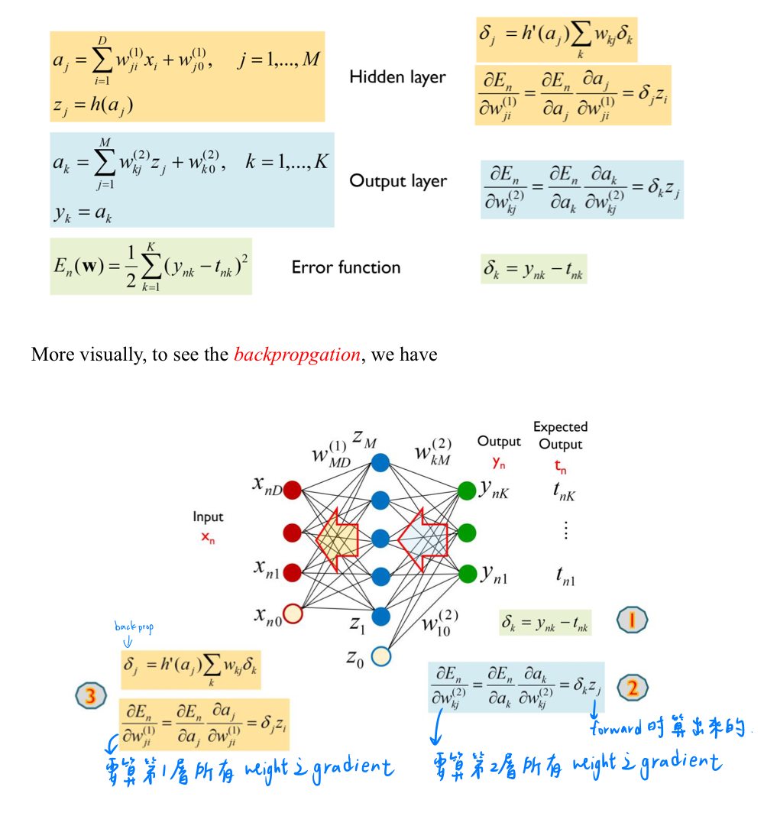

Backpropagation
$$θ=θ−η\frac{∂L}{∂θ}$$
沿著 gradient 的反方向走
Learning rate

Slide 6
Outline
Backpropagation
Dataset
Code

Slide 7
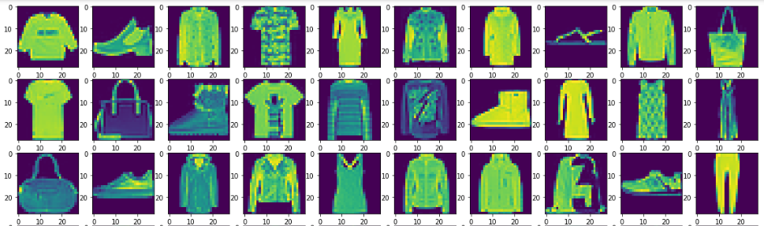
Dataset
Classification
Classes: 10, image size =28*28
Training: 60,000, Testing: 10,000

Slide 8
Outline
Backpropagation
Dataset
Code

Slide 9
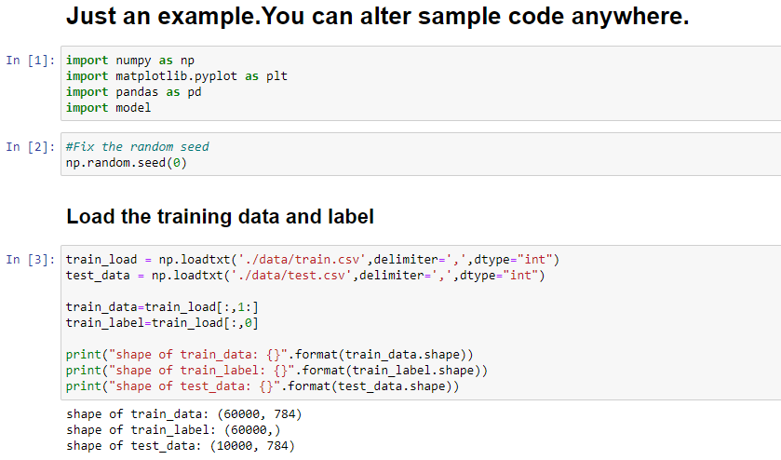
Code

Slide 10
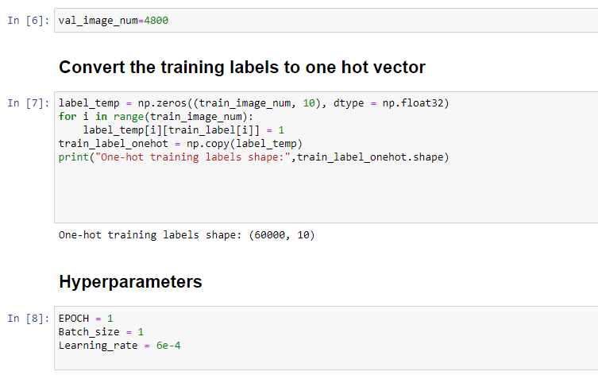
Code

Slide 11
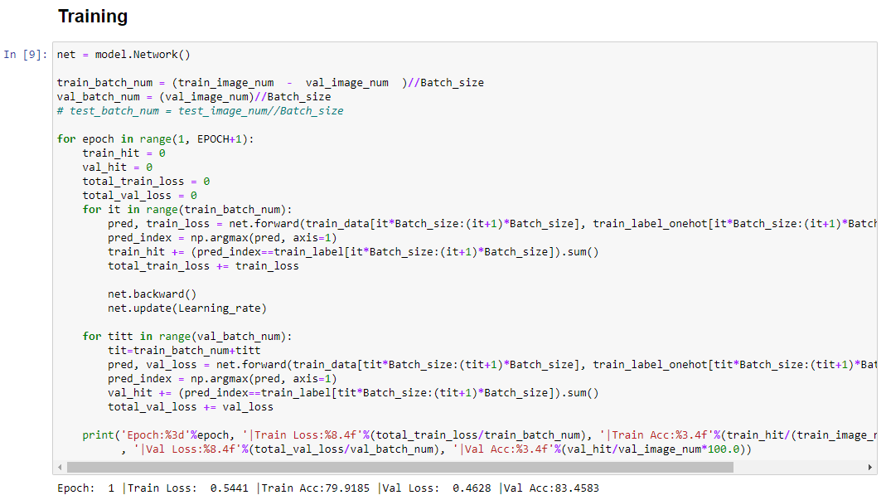
Code

Slide 12
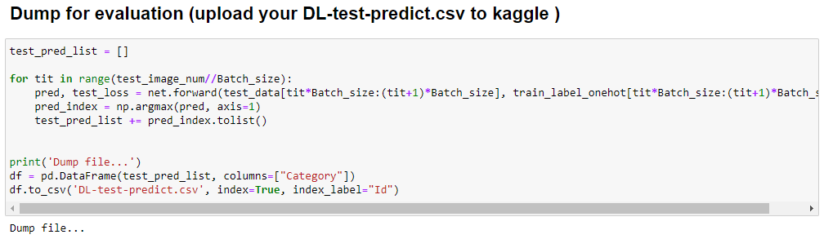
Code
Make sure your prediction type is int not float

Slide 13
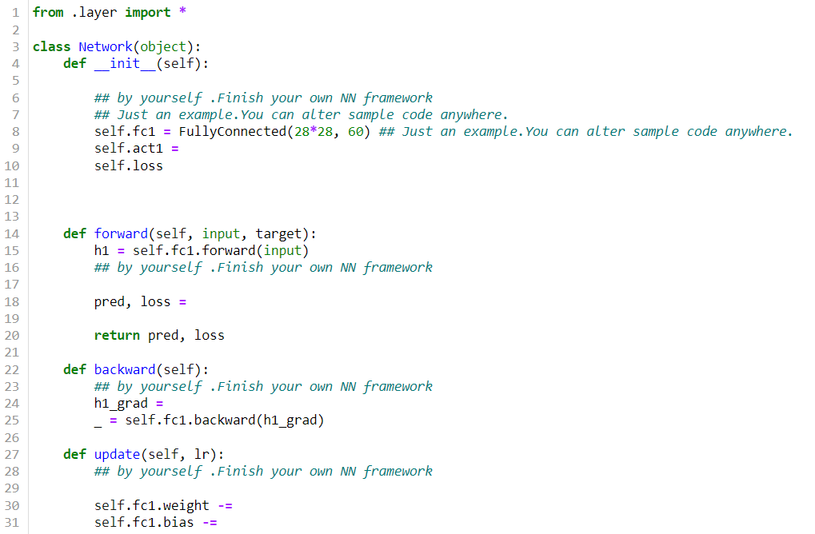
Code model/network.py

Slide 14
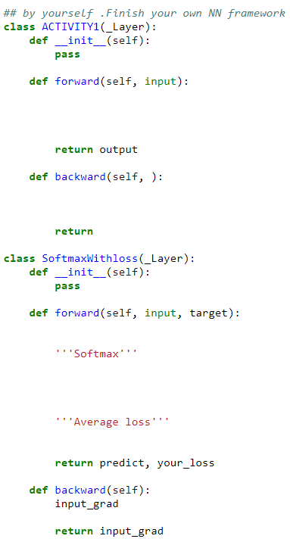
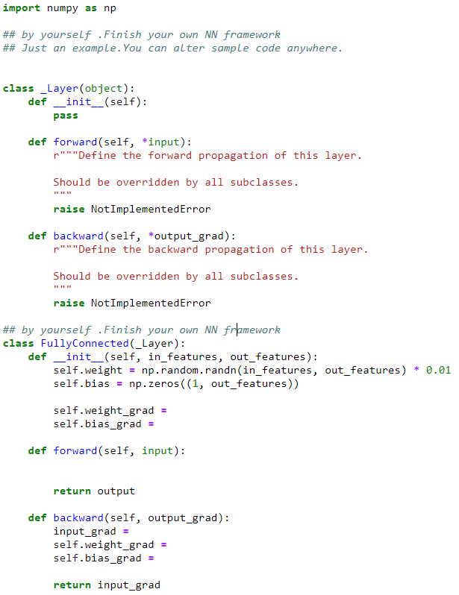
Code model/layer.py

Slide 15
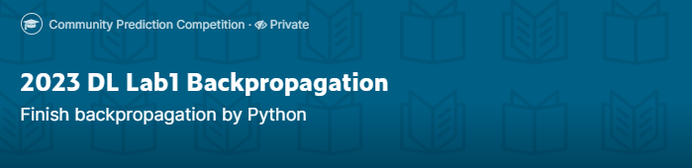
Join Kaggle competition
Competition URL:
https://www.kaggle.com/t/c882cf540921e139bebf91e63c7bb6cb
Upload your test prediction
Change your team name to your ID

Slide 16
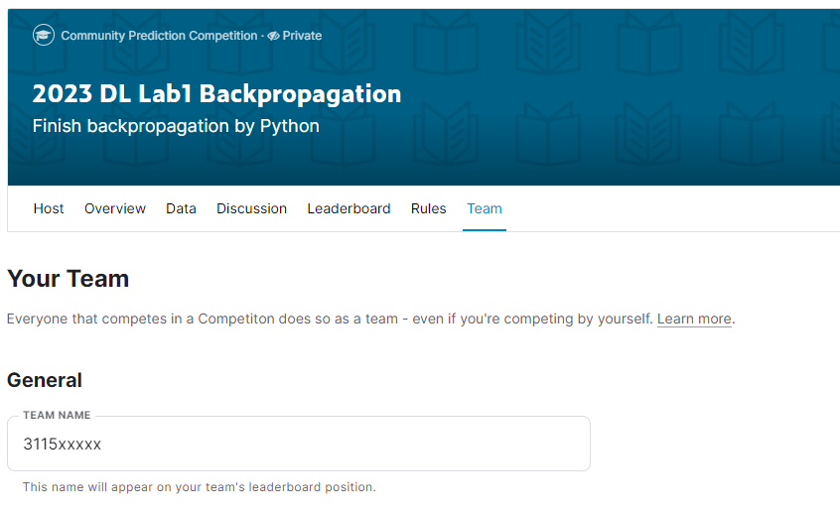
Change your team name to your ID
If TA can not find your ID, you will loss 40% of score in this lab directly

Slide 17
Assignment Regulation
Please use jupyter notebook to finish this lab (.ipynb)
You don’t need to use GPU in this lab
Package available
numpy
pandas
Scikit-learn
Pytorch ,tensorflow , keras

Slide 18
Reminder
Submit Deadline : 2 weeks (2023/10/6 11:59 PM)
You need to submit your code and result to New E3
Hand in your code and in the following format (4 files)
Lab1_studentid.ipynb
network.py
layer.py
Lab1_report_studentid.pdf

Slide 19
Lab1 Grading policy
Lab1
Submit your homework to E3 and kaggle (40%), test accuracy must >80%
Performance (40%)
Report (20%)
Please do not plagiarize (0 points will be calculated if caught)

Slide 20
Lab1 report
How to improve the accuracy (list your method )
Loss function ?
Your network?
Activation function?
Etc…

Slide 21
Shut down your kernel !!!!!
Remember to SHUTDOWN the kernel
To release resources for others.

Slide 22

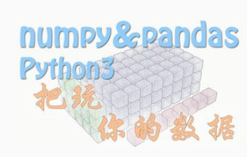
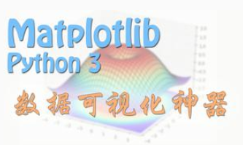
Lab0 Overview
You need to be familiar with jupyter python and useful library
numpy, pandas, matplot, etc
If you are not familiar with python, I strongly recommend you to see 莫凡’s python tutorial. (or other online materials)
https://morvanzhou.github.io/

