Slide 1
Lab 4 Structure and Class

Slide 2
Outline
Structure in C
Class
Exercise
Appendix

Slide 3
Structure in C
A user-defined data type
(vs. built-in data types: int, double, …)
An aggregate (grouping) data type
Array - collection of elements of the same type
Structure - collection of elements of different types
Usage
First define your own structure
Then declare objects using new structure type just like declaring objects of built-in types

Slide 4
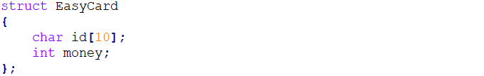
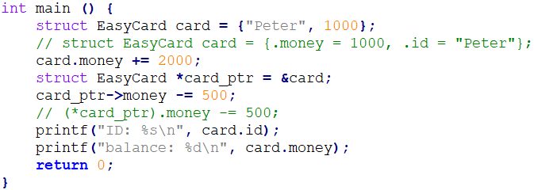
Structure Example (1/2)
Definition
Usage

Slide 5
Structure Example (2/2)
Output

Slide 6
Limitations of Structure
Prohibit functions inside structures
No static members
No constructors and destructor
All above are the features of class in C++

Slide 7
Class
The foundation for OOP in C++
Class in C++ is an enhanced version of structure in C
Access modifiers
Functions inside classes
Static data members
Constructors and destructor
Operator overloading ➔ Can be used as built-in data types
Usage
Same as structures

Slide 8
Class Member Function
Must define(i.e., implement) class member functions
If defined outside class definition, MUST specify the class it belongs to
<ret_type> <cls_name>::<func_name> (…) {…}
“::” is called scope resolution operator
Different classes can have member functions with the same name
Items before “::” are called type qualifier
Class name serves as type qualifier here

Slide 9
Private vs. Public
Both data members and member functions can be either private or public
Data members are usually private
You don’t know exact representation ➔ encapsulation
Manipulated through member functions
Member functions are usually public
You can use public interface for manipulations
you needn’t know how these functions get implemented ➔ abstraction

Slide 10
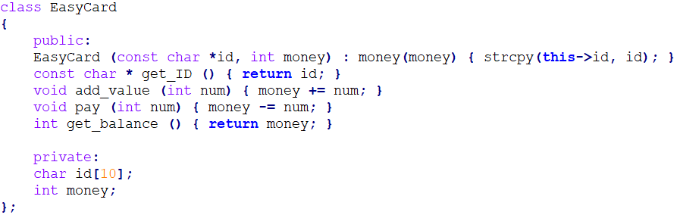
Class Example (1/2)
Definition

Slide 11
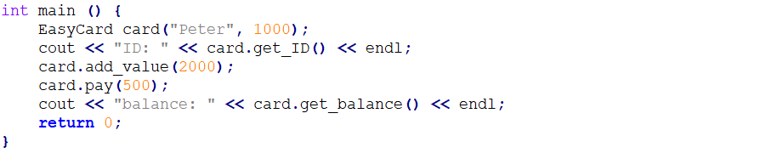
Class Example (2/2)
Usage
Output

Slide 12
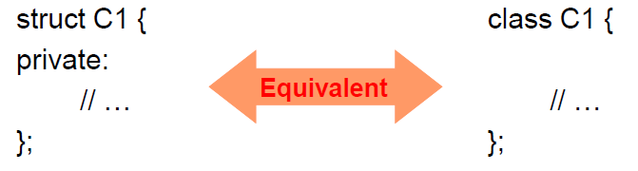
Structure in C++
In fact, structure in C++ is a class basically
Difference
a structure assumes all members public by default
a class assumes all members private by default

Slide 13
Exercise Objective
Practice to write a class
Learn how to solve a problem with the class

Slide 14
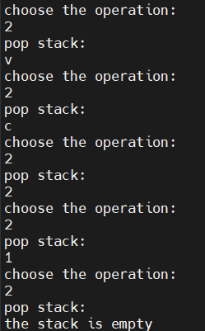
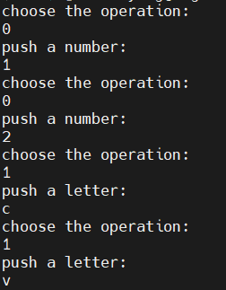
Lab Exercise (1/2)
You are asked to store input data in a stack
Example

Slide 15
Lab Exercise (2/2)
You CANNOT use STL container (e.g., list, stack, …)
You are asked to
Use class to construct a stack
Create a structure as data type in the stack
No checking of syntax error needed

Slide 16
Appendix

Slide 17
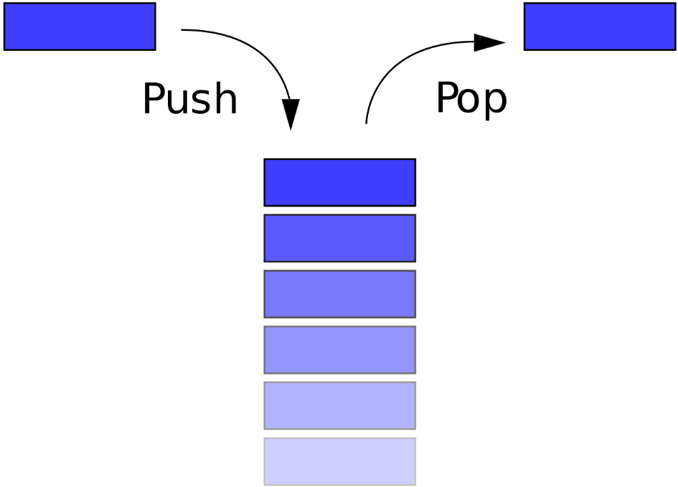
Introduction to Stack
A container with last-in-first-out (LIFO) property
Two operation
push – put a data on the top of the stack
pop – fetch a data from the top of the stack

Slide 18
Prescribed Functions for Stack
Stack ();
Constructor for initializing data members
void push (Data);
Perform push operation
Data pop ();
Perform pop operation
bool empty ();
Return true if the stack is empty, otherwise return false

Slide 19
Data Representation of Stack
array
array
array
array
array
7
A
B
A
C
B
A
B
A
6
5
4
3
2
1
0
index = 0
index = 1
index = 2
index = 3
index = 2

