Slide 1
Lab 0 Vscode IDE & GDB
UEE 1303
Department of Electrical and Computer Engineering, Institute of Electronics
National Chiao Tung University

Slide 2
C++ for Visual Studio Code
https://code.visualstudio.com/download
https://code.visualstudio.com/docs/languages/cpp
https://www.msys2.org/

Slide 3
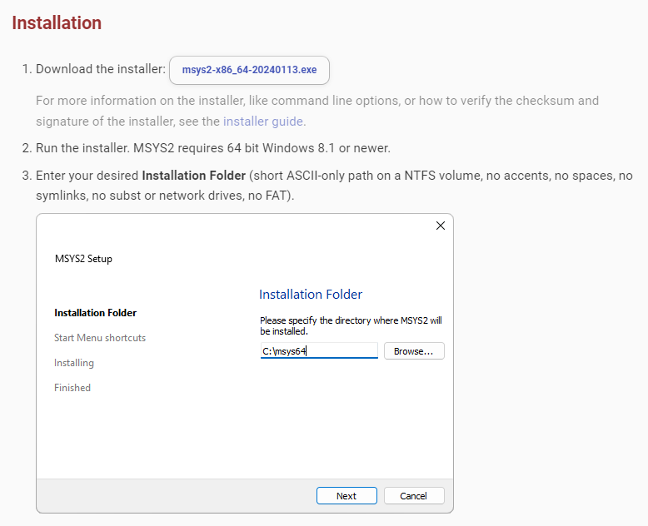

Slide 4
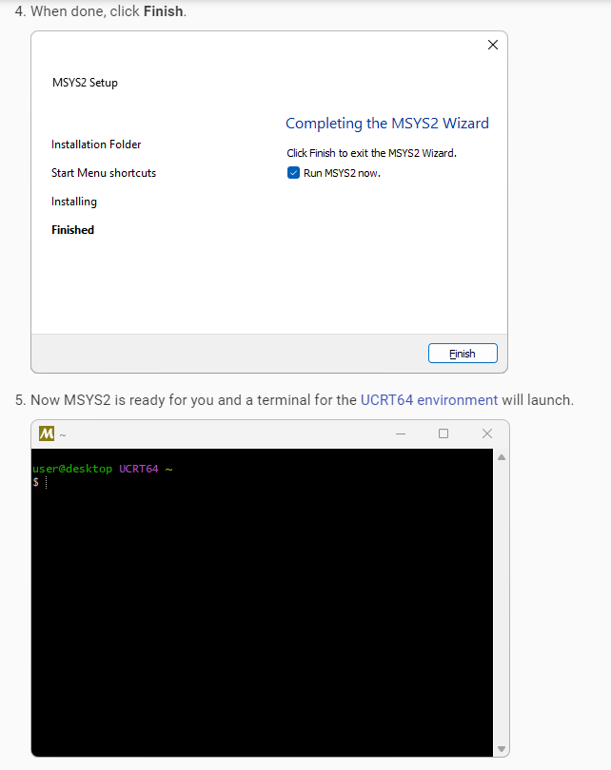

Slide 5
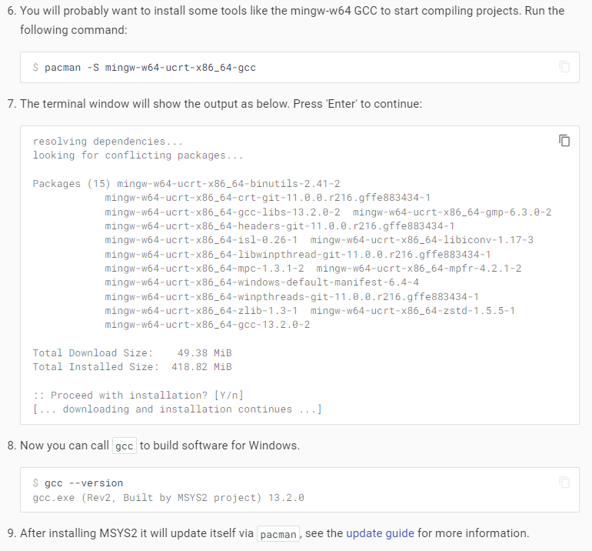

Slide 6
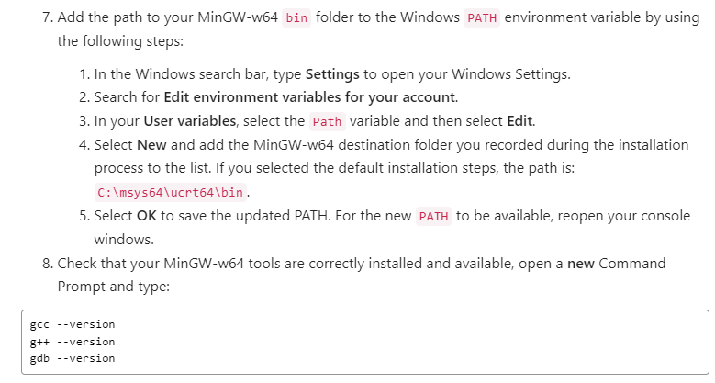
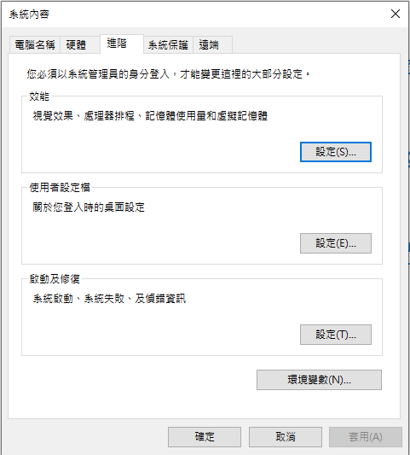
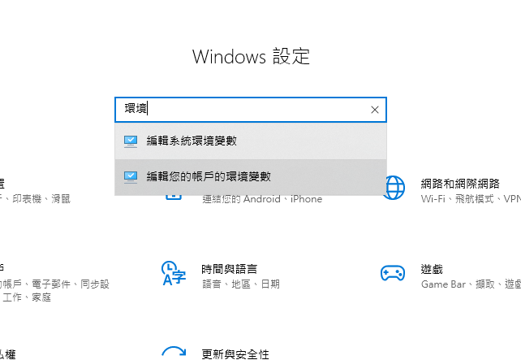

Slide 7
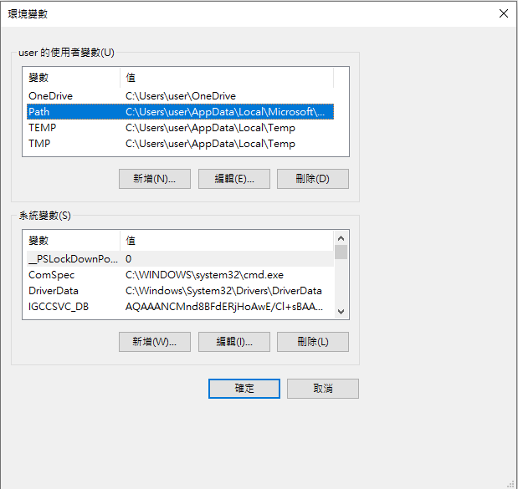
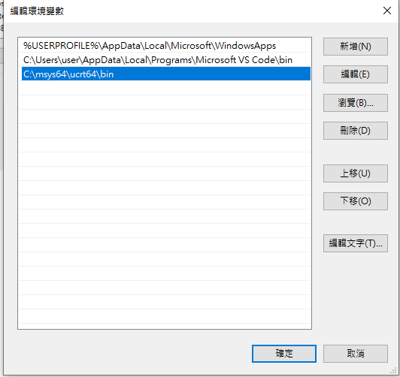

Slide 8
GDB
http://www.study-area.org/cyril/opentools/opentools/x1253.html

