Slide 1
LAB 3
ARRAY
Department of Electronics Engineering
National Yang Ming Chiao Tung University

Slide 2
Outline
Array introduction
Lab4 exercise

Slide 3
Array Declaration
type array_name[size]
  int score[5]
  5 variables of int named score, score[0]~score[4]
  size must be an expression evaluating to integral CONSTANT
int a_arr[10+20];// ok
const int K = 100;
int b_arr[K];// ok, b_arr[100];
int n = 100;
int c_arr[n];// error, n is not a constant

Slide 4
Array Initialization (1/3)
An array can be initialized
int score[3] = {2, 12, 1};
–which is equivalent to following:
int score[3];
score[0] = 2;
score[1] = 12;
score[2] = 1;

Slide 5
Array Initialization (2/3)
If fewer values than size
–fills from the beginning
–fills the remaining elements with 0 of array base type
–e.g., int a[6] = {10, 11, 12, 13}; // a[4] = 0, a[5] = 0
If more values than size
–compilation error
–e.g., double b[3] = { 6.0, 6.5, 7.0, 8.0}; // error

Slide 6
Array Initialization (3/3)
If size is unspecified
–size is automatically determined based on number
of initialization values
–example:
int b[]= {5, 12, 11}; // equivalent =>int b[3] = {5, 12, 11};
int c[];// error, unknown size

Slide 7
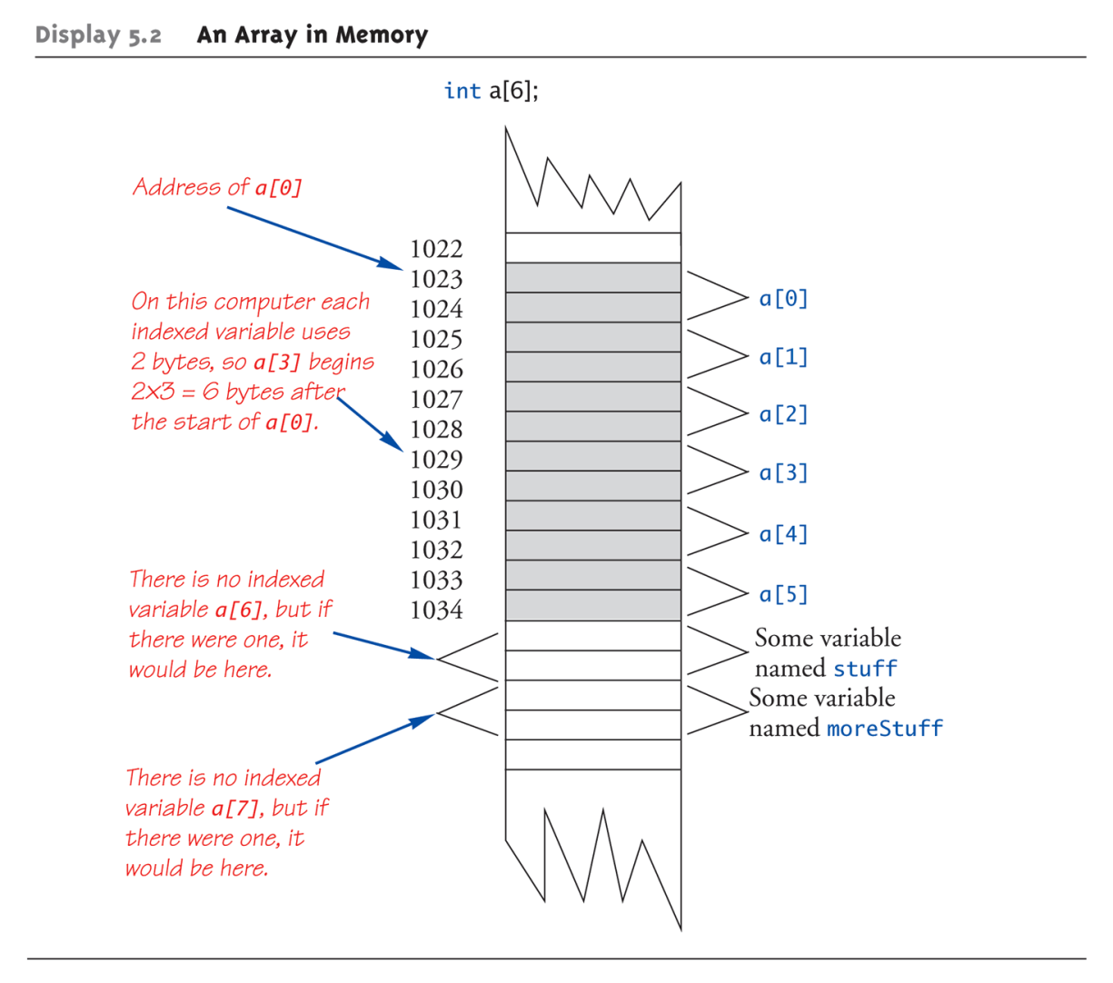
Array in Memory
// example
// a short int takes 2bytes
short a[6]; // start @ 1023
short stuff; // start @ 1035
moreStuff; // start @ 1037
address of a[4]
= 1023+ 4* 2=1031

Slide 8
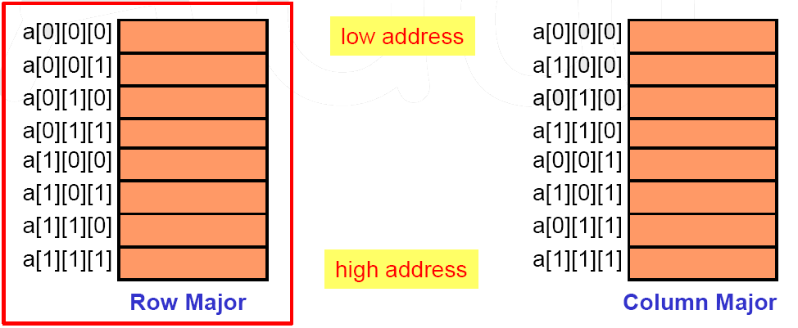
Multidimensional Array(1/2)
How to put a multidimensional array into linearly addressed memory?
–row major (used in C/C++, …)
–column major (used in age-old FORTRAN, …)
An array, a[2][2][2], has 8 elements
–a[0][0][0], a[0][0][1], a[0][1][0], a[0][1][1],a[1][0][0], a[1][0][1], a[1][1][0], a[1][1][1]

Slide 9
Multidimensional Array(2/2)
For an array a[u1][u2]…[un] starting at the address A,what is the address of a[i1][i2]…[in] ?
int a[6][7][8]; // assume starting from address 1000, sizeof(int) = 4
a[1][2][3] = 10; // what is the address of a[1][2][3]?
address = 1000+ ( (1* 7* 8) + (2* 8) + 3) * 4= 1300
address= A+ i1u2u3…un
+ i2u3u4…un
...
+ i(n-1)un
+ in

Slide 10
Array in Function (1/2)
In function declaration and definition
void f1(char arr[ ]); // just use empty brackets
void f2(char arr[10]); // still ok, compiler simply ignores what’s inside [ ]
In function call
–use array name as actual argument
void f() {
char table[10];
f1(table);// ok
f2(table);// still ok
}
Need another parameter for array sizeif required
void f3(char arr[ ], int size);

Slide 11
Array in Function (2/2)
In function declaration and definition
–MUST specify sizes for ALL dimensions except for the first one
void f1(char arr[ ][6][7][8]); // a 4-dimentional array
void f2(char arr[9][6][7][8]); // still ok, compiler ignores what’s inside [ ]
In function call
–use array name as actual argument; sameway as for 1D array
void f() {
char table1[5][6][7][8];
char table2[5][5][7][8];
f1(table1);// ok
f2(table1);// still ok
f1(table2);// compilation error, array size not matched!
}

Slide 12
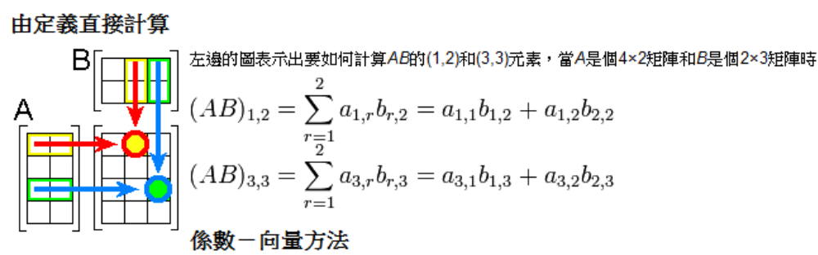
Exercise (1/2)
Exercise 1
  input 3x3 Matrix A
  operation =1 ➔ output A^T & continue
  operation =2 ➔ input 3x2 Matrix B & multiply two Matrix

Slide 13
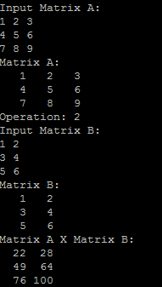
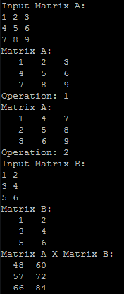
Exercise (2/2)

