Slide 1
MLCHIP 2025-Spring Final Project AXI Introduction
Advisor: Kun-Chih, Chen
Date : 2025/05/16

Slide 2
Outline
Bus Architecture
Handshake Process
AXI Introduction
Read Transaction
Write Transaction
Reference

Slide 3
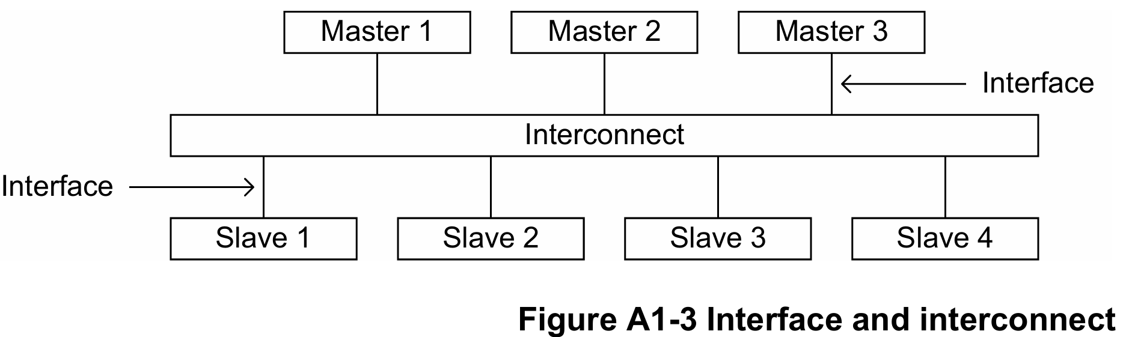
Bus Architecture

Slide 4

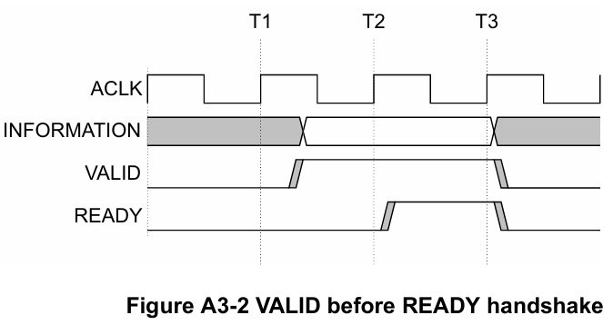
Handshake Process Scenario 1
Slave: Valid Master: Ready

Slide 5
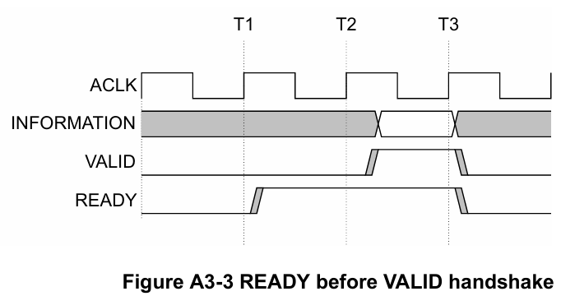
Handshake Process Scenario 2
Slave: Valid Master: Ready

Slide 6
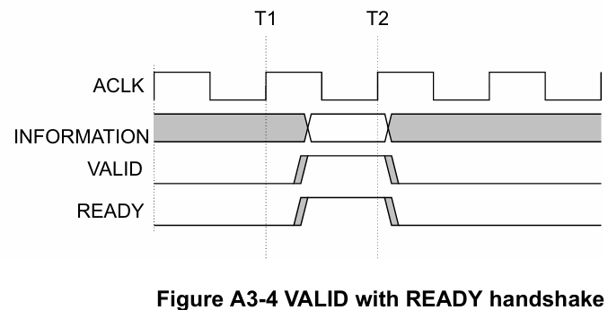
Handshake Process Scenario 3
Slave: Valid Master: Ready

Slide 7
Handshake Dependencies
The VALID signal of one AXI component must be independent on the READY signal of the other component in the transaction. (prevent deadlock)
The READY signal can wait for assertion of the VALID signal.

Slide 8
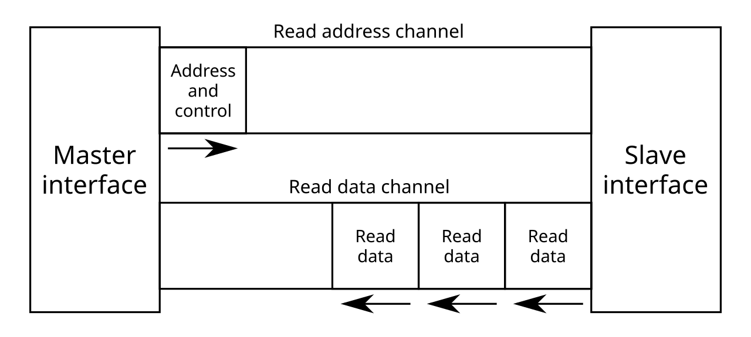
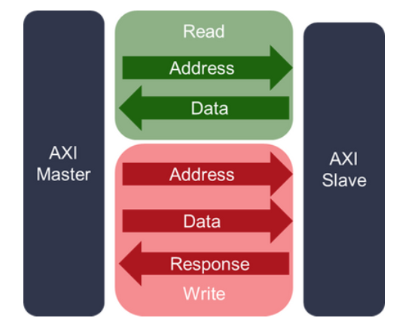
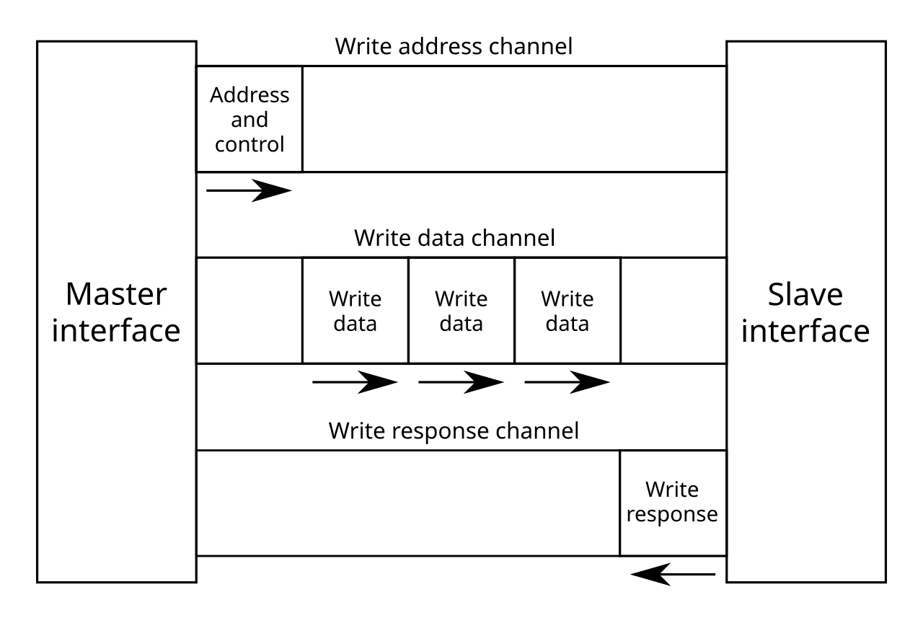
AXI Read/Write Channel

Slide 9
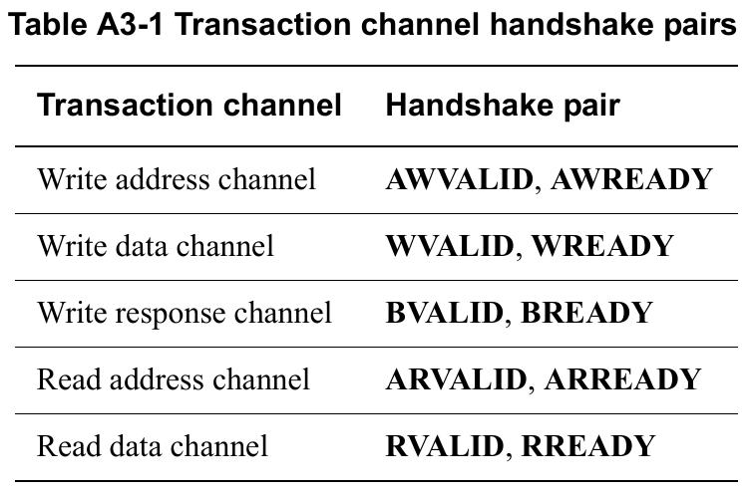
AXI Read/Write Channel

Slide 10
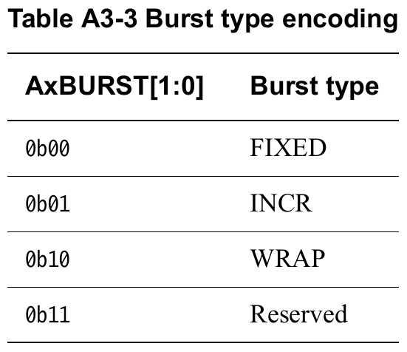
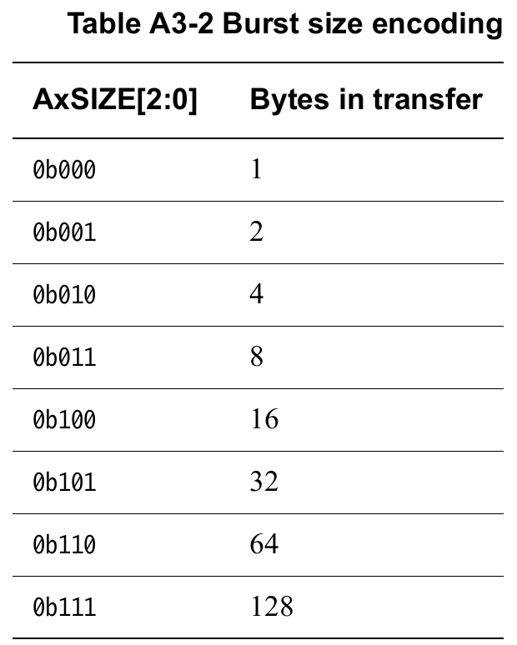
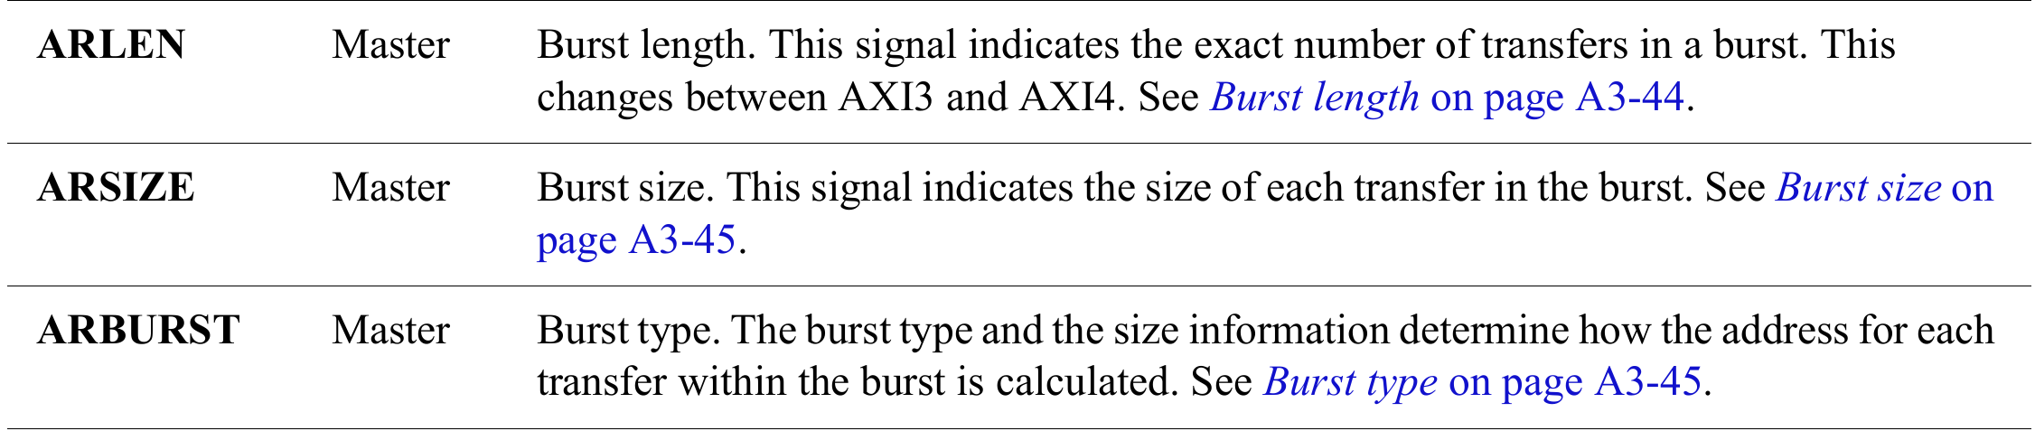
AXI Signal Description
AXI Transaction：the complete set of required operations on the AXI bus form the AXI Transaction
AXI Burst：any required payload data is transferred as an AXI Burst
AXI Beats：a burst can comprise multiple data transfers, or AXI Beats

Slide 11
AXI 4 Basic Transaction
Read Transaction
Read Address Channel
Read Data Channel
Each channel have valid-ready pair for handshaking process

Slide 12
AXI 4 Basic Transaction
Write Transaction
Write Address Channel
Write Data Channel
Write Response Channel
Each channel have valid-ready pair for handshaking process

Slide 13
Global Signals
Signal | Source | Description
clk | Clock source | Global clock signal. All signals are sampled on the rising edge of the global clock.
rst_n | Reset source | Global reset signal. This signal is active LOW.

Slide 14
Read Address Channel
Signal | Source | Description
ARID[3:0] | Master | Read address ID. This signal is the identification tag for the read address group of signals.
ARADDR[31:0] | Master | Read address. The read address gives the address of the first transfer in a read burst transaction.
ARLEN[7:0] | Master | Burst length. The burst length gives the exact number of transfers in a burst. This information determines the number of data transfers associated with the address.
ARSIZE[2:0] | Master | Burst size. This signal indicates the size of each transfer in the burst.
ARBURST[1:0] | Master | Burst type. The burst type, coupled with the size information, details how the address for each transfer within the burst is calculated.
ARVALID | Master | Read address valid. This signal indicates, when HIGH, that the read address and control information is valid and will remain stable until the address acknowledge signal, ARREADY, is high. 1 = address and control information valid 0 = address and control information not valid.
ARREADY | Slave | Read address ready. This signal indicates that the slave is ready to accept an address and associated control signals: 1 = slave ready 0 = slave not ready.

Slide 15
Read Data Channel
Signal | Source | Description
RID[3:0] | Slave | Read ID tag. This signal is the ID tag of the read data group of signals. The RID value is generated by the slave and must match the ARID value of the read transaction to which it is responding.
RDATA | Slave | Read data.
RRESP[1:0] | Slave | Read response. This signal indicates the status of the read transfer. The allowable responses are OKAY, EXOKAY, SLVERR, and DECERR.
RLAST | Slave | Read last. This signal indicates the last transfer in a read burst.
RVALID | Slave | Read valid. This signal indicates that the required read data is available and the read transfer can complete: 1 = read data available 0 = read data not available.
RREADY | Master | Read ready. This signal indicates that the master can accept the read data and response information: 1= master ready 0 = master not ready.

Slide 16
Read Transaction

Slide 17
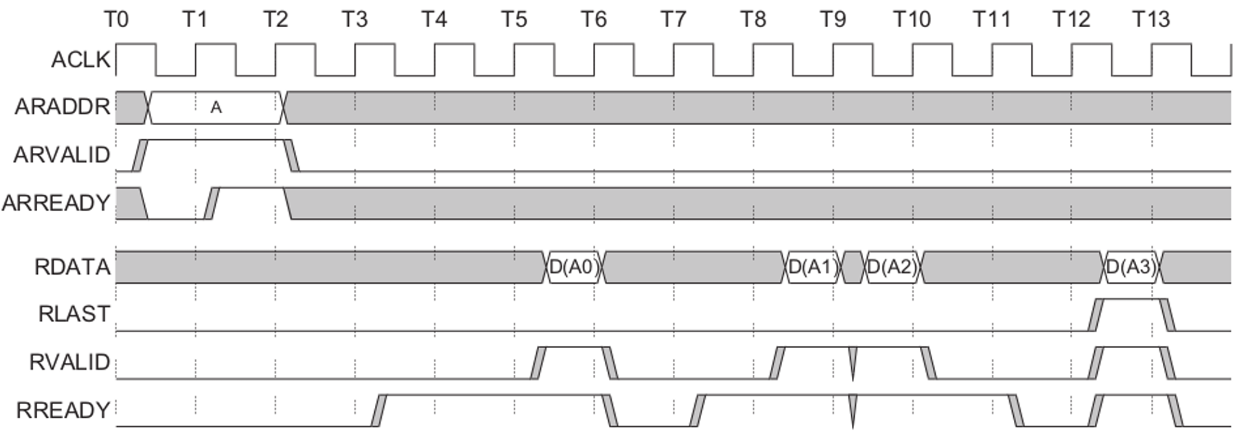
Waveform of Read Transaction

Slide 18
Write Address Channel
Signal | Source | Description
AWID[3:0] | Master | Write address ID. This signal is the identification tag for the write address group of signals.
AWADDR[31:0] | Master | Write address. The write address bus gives the address of the first transfer in a write burst transaction. The associated control signals are used to determine the addresses of the remaining transfers in the burst transaction.
AWLEN[7:0] | Master | Burst length. The burst length gives the exact number of transfers in a burst. This information determines the number of data transfers associated with the address.
AWSIZE[2:0] | Master | Burst size. This signal indicates the size of each transfer in the burst.
AWBURST[1:0] | Master | Burst type. The burst type, coupled with the size information, details how the address for each transfer within the burst is calculated.
AWVALID | Master | Write address valid. This signal indicates that valid write address and control information are available: 1 = address and control information available 0 = address and control information not available. The address and control information remain stable until the address acknowledge signal, AWREADY, goes HIGH.
AWREADY | Slave | Write address ready. This signal indicates that the slave is ready to accept an address and associated control signals: 1 = slave ready 0 = slave not ready.

Slide 19
Write Data Channel
Signal | Source | Description
WDATA | Master | Write data. The write data bus can be 8, 16, 32, 64, 128, 256, 512, or 1024 bits wide.
WLAST | Master | Write last. This signal indicates the last transfer in a write burst.
WVALID | Master | Write valid. This signal indicates that valid write data and strobes are available: 1 = write data and strobes available 0 = write data and strobes not available.
WREADY | Slave | Write ready. This signal indicates that the slave can accept the write data: 1 = slave ready 0 = slave not ready.

Slide 20
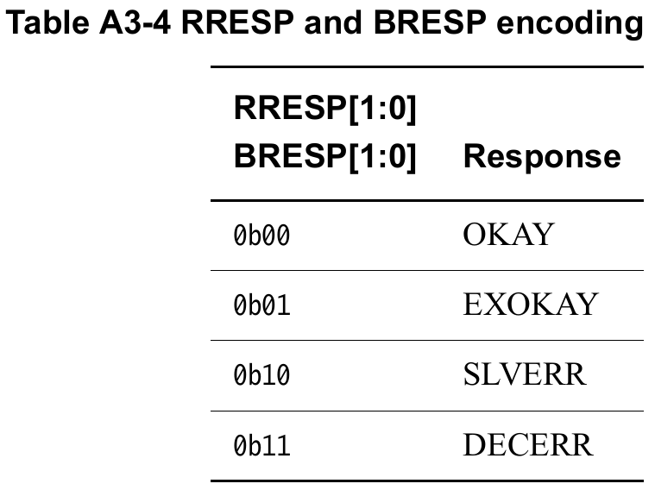
Write Response Channel
Signal | Source | Description
BID[3:0] | Slave | Response ID. The identification tag of the write response. The BID value must match the AWID value of the write transaction to which the slave is responding.
BRESP[1:0] | Slave | Write response. This signal indicates the status of the write transaction. The allowable responses are OKAY, EXOKAY, SLVERR, and DECERR.
BVALID | Slave | Write response valid. This signal indicates that a valid write response is available: 1 = write response available. 0 = write response not available.
BREADY | Master | Response ready. This signal indicates that the master can accept the response information. 1 = master ready. 0 = master not ready.

Slide 21
Write Transaction

Slide 22
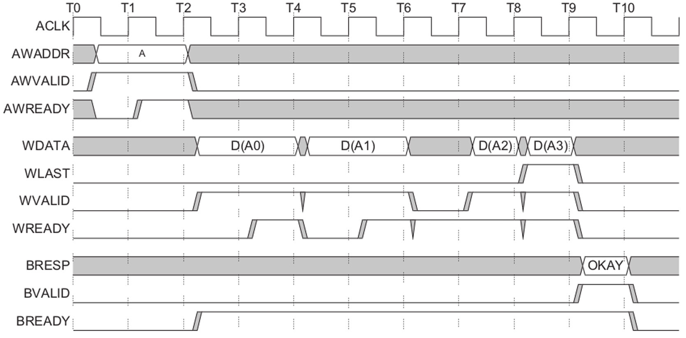
Waveform of Write Transaction

Slide 23
Reference
AMBA AXI and ACE Protocol Specification AXI3, AXI4, and AXI4-Lite ACE and ACE-Lite
Design of Multi Master Single Slave AXI4

