Slide 1
MLchip Lab2 AXI
TA : Billy
Institute of Electronics,
National Yang Ming Chiao Tung University 2025/05/14

Slide 2
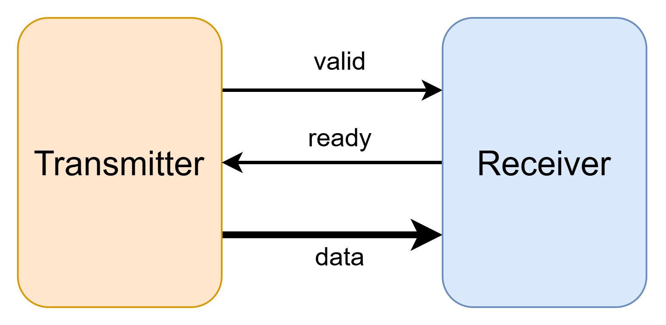
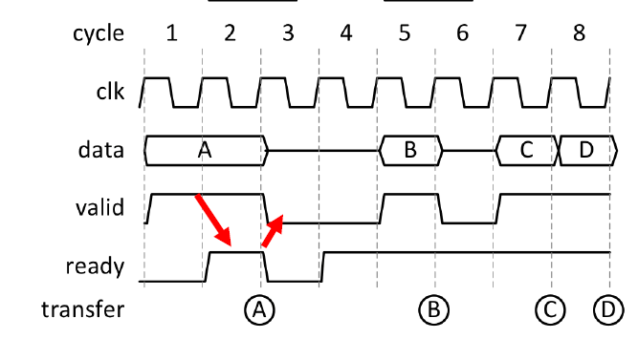
Handshake Process
data transmission successfully if (valid & ready)

Slide 3
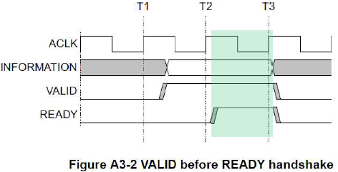
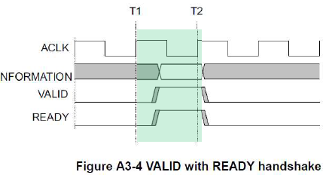
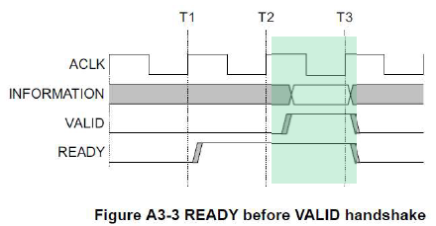
Handshake Dependencies
The VALID signal of the transmitter must be independent of the READY signal of the receiver in a transaction. (avoid deadlock)
The READY signal of the receiver can wait for the assertion of the VALID signal of the transmitter.

Slide 4
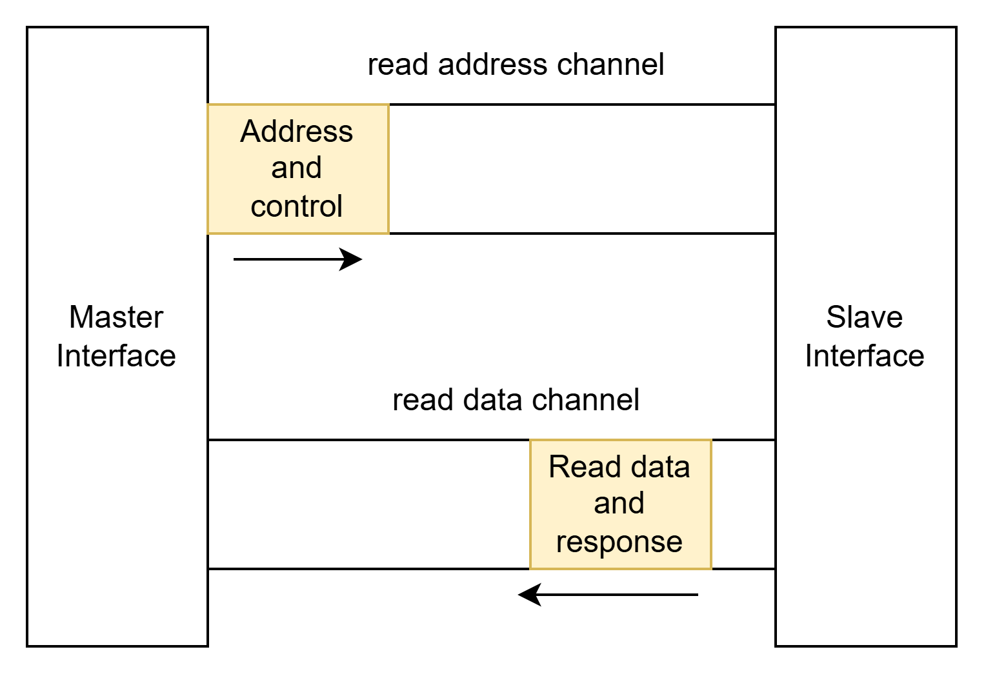
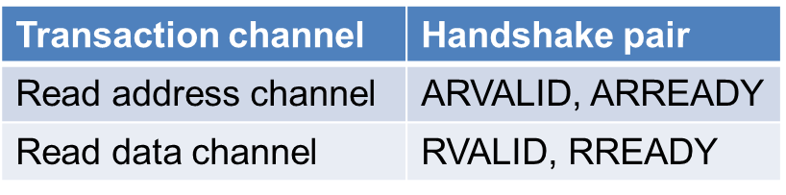
Simplified AXI protocol
Read Channel
Read address channel
Read data channel

Slide 5
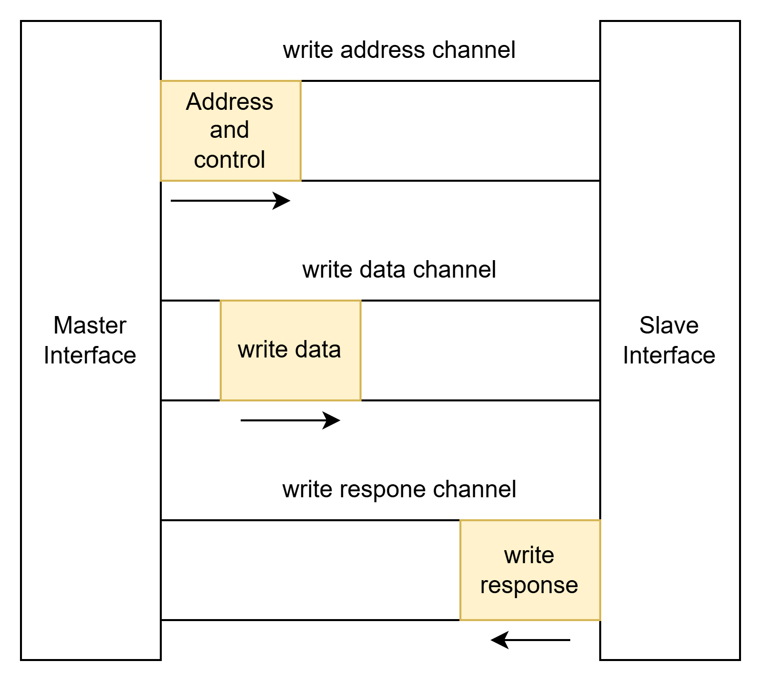
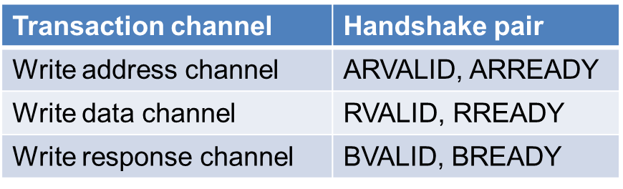
Simplified AXI protocol
Write channel
Write address channel
Write data channel
Write response channel
You must wait for the write response handshake to complete before issuing a new transaction (either read or write)

Slide 6
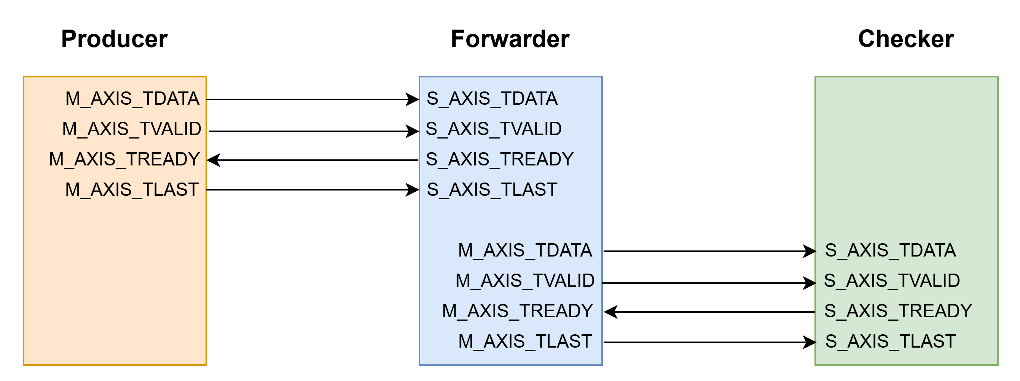
Lab2 Description
In Lab2, you are required to implement the Forwarder shown in the diagram below, in order to realize the function of transmitting data from the producer to the checker.

Slide 7
AXI Signal Description (for Lab2)
In Lab2, we will focus solely on practicing the handshake process based on AXI-Stream, so there will be no address signal involved.
Note: In this lab, S_AXIS_TREADY must not be asserted only after S_AXIS_TVALID is asserted.
Global Signals
Signal | Source | Description
ACLK | Clock source | Global clock signal. All signals are sampled on the rising edge of the global clock
ARESETn | Reset source | Global active-low reset signal.

Slide 8
AXI Signal Description (for Lab2)
Write data channel
Signal | Source | Description
M_AXIS_TDATA | Master | Write data. A single piece of data will be one character (char).
M_AXIS_TVALID | Master | Write valid indicates that valid write data is available : 1 = write data available 0 = write data not available
M_AXIS_TREADY | Slave | Write ready indicates that the slave can accept the write data : 1 = slave ready 0 = slave not ready
M_AXIS_TLAST | Master | The last piece of data in a sequence of consecutive characters: 1 = Last data 0 = Not last data

Slide 9
AXI Signal Description (for Lab2)
Read data channel
Signal | Source | Description
S_AXIS_TDATA | Slave | Read data. A single piece of data will be one character (char).
S_AXIS_TVALID | Slave | Read_valid indicates that valid read data is available : 1 = read data available 0 = read data not available
S_AXIS_TREADY | Master | Read_ready indicates that the master can accept the read data : 1 = master ready 0 = master not ready
S_AXIS_TLAST | Slave | The last piece of data in a sequence of consecutive characters: 1 = Last data 0 = Not last data

Slide 10
Command & Submission
Data download:
tar xvf ~mlchipTA01/lab2.tar
You must use make to complete the compilation and execution.
Submission:
cd 09_SUBMIT/
./00_tar
./01_submit
./02_checl

Slide 11
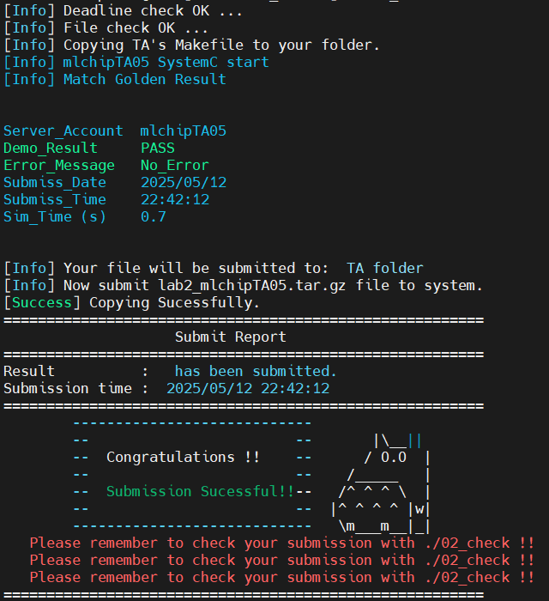
Grading policy
As long as you see the following output after running ./01_submit, you will receive a score of 100.

Slide 12
Grading policy
The following are rules that must be absolutely adhered to. Any violation will result in 0 points.
Plagiarism is forbidden.
The only file you are allowed to modify is forwarder.h.
You cannot use any Chinese characters in the assignment, including within comments.

