Slide 1
MLchip Lab3 DMA
TA : Billy
Institute of Electronics,
National Yang Ming Chiao Tung University 2025/05/28

Slide 2
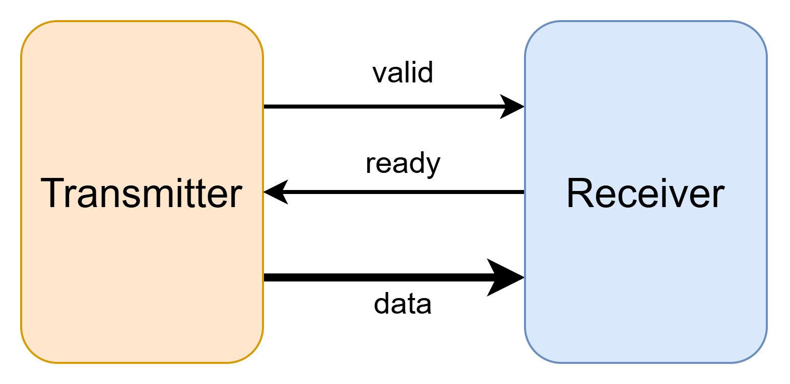
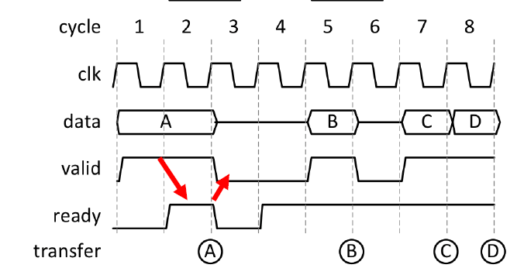
Handshake Process
data transmission successfully if (valid & ready)

Slide 3
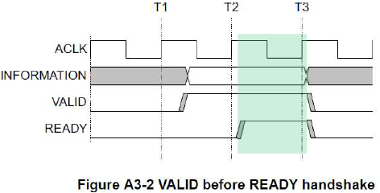
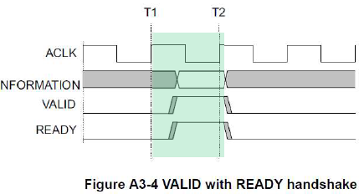
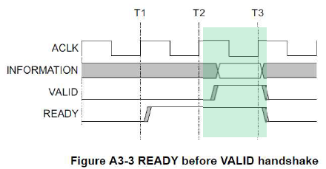
Handshake Dependencies
The VALID signal of the transmitter must be independent of the READY signal of the receiver in a transaction. (avoid deadlock)
The READY signal of the receiver can wait for the assertion of the VALID signal of the transmitter.

Slide 4
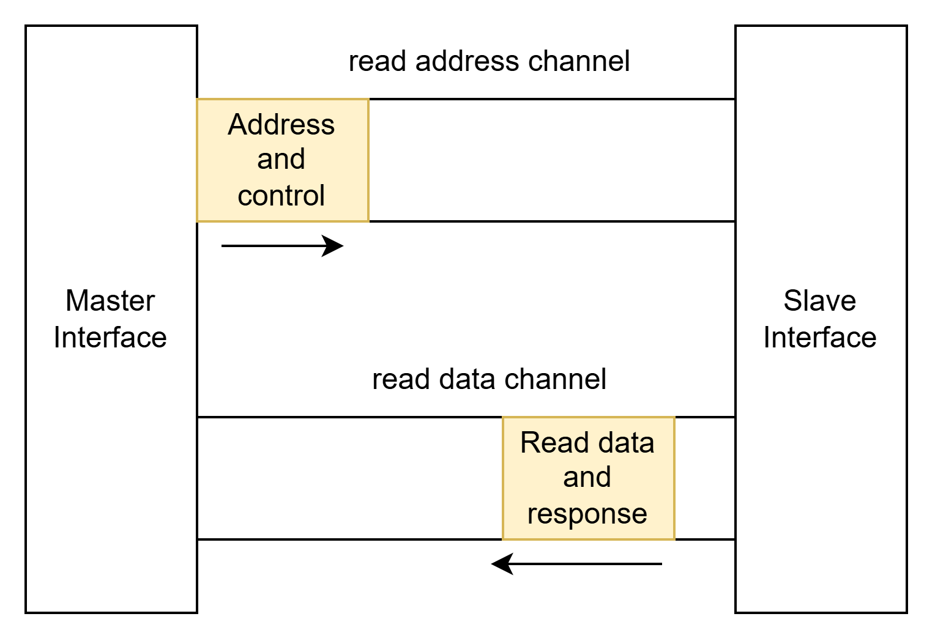
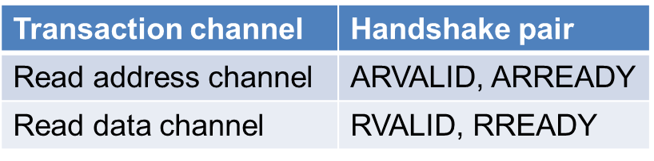
Simplified AXI protocol
Read Channel
Read address channel
Read data channel

Slide 5
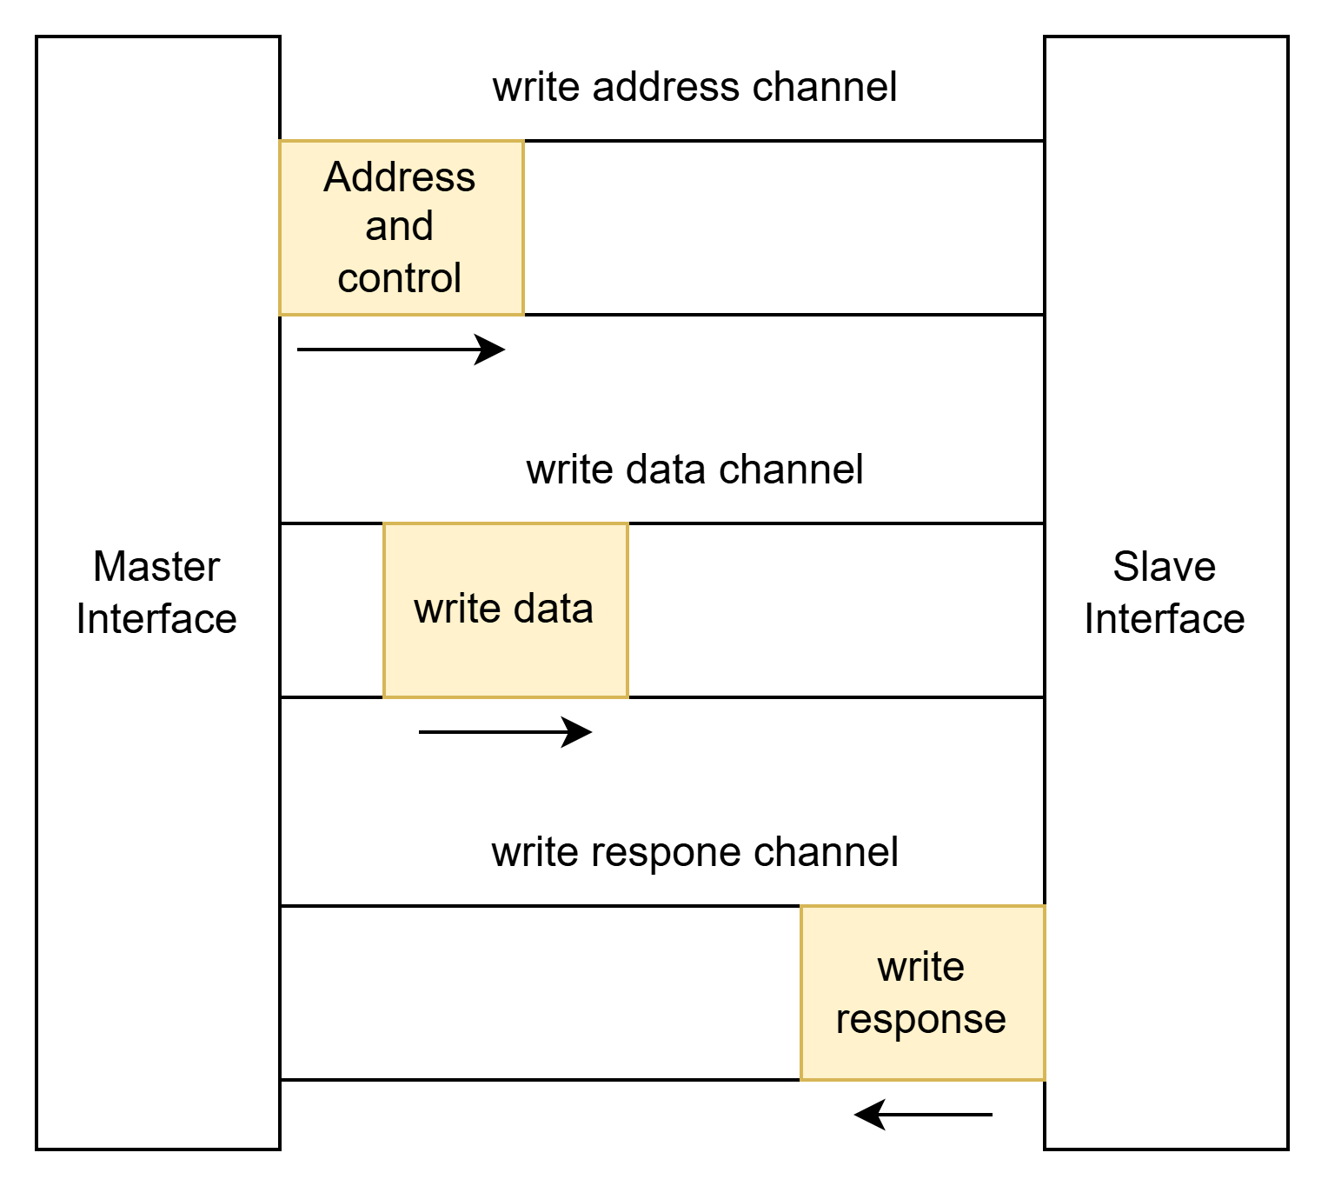
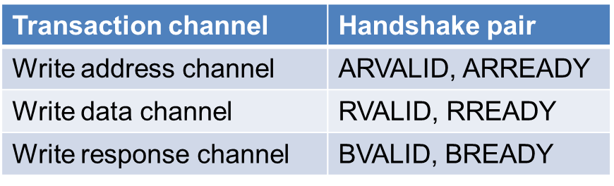
Simplified AXI protocol
Write channel
Write address channel
Write data channel
Write response channel
You must wait for the write response handshake to complete before issuing a new transaction (either read or write)

Slide 6
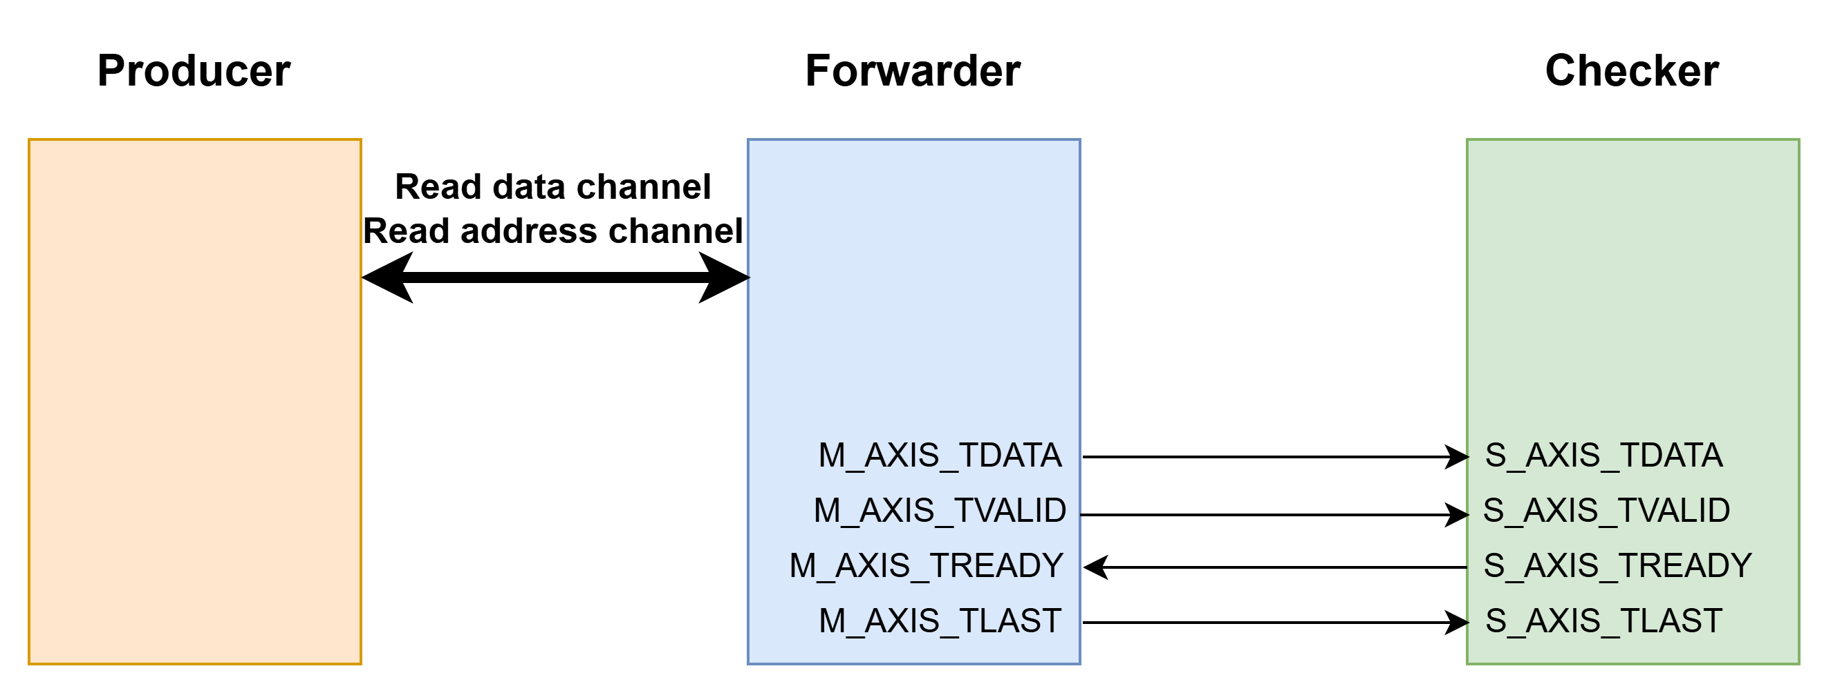
Lab3 Description
In Lab 3, you will practice a simple DMA read process. You are required to complete the following Forwarder module and successfully transfer data from the Producer to the Checker.
Unlike Lab 2, you will need to actively request data from the Producer yourself. Therefore, you are required to implement the Read Address channel.

Slide 7
AXI Signal Description (for Lab3)
In Lab 3, you will need to request a string composed of multiple characters from the Producer by sending an address, and then forward that string to the Checker for verification.
Note: You can directly pull S_AXIS_TREADY to 1
Note: The address, which is represented in the code as REQ_ID_TO_PROD, can simply be set to 0.
Global Signals
Signal | Source | Description
ACLK | Clock source | Global clock signal. All signals are sampled on the rising edge of the global clock
ARESETn | Reset source | Global active-low reset signal.

Slide 8
AXI Signal Description (for Lab3)
Write data channel
Signal | Source | Description
M_AXIS_TDATA | Master | Write data. A single piece of data will be one character (char).
M_AXIS_TVALID | Master | Write valid indicates that valid write data is available : 1 = write data available 0 = write data not available
M_AXIS_TREADY | Slave | Write ready indicates that the slave can accept the write data : 1 = slave ready 0 = slave not ready
M_AXIS_TLAST | Master | The last piece of data in a sequence of consecutive characters: 1 = Last data 0 = Not last data

Slide 9
AXI Signal Description (for Lab3)
Read address channel
Signal | Source | Description
REQ_ID_TO_PROD | Master | Read address indicates the location to be read.
REQ_VALID_TO_PROD | Master | Read address valid indicates that valid read address is available: 1 = address available 0 = address not available
REQ_READY_FROM_PROD | Slave | Read address ready indicates that the slave can accept the read address : 1 = slave ready 0 = slave not ready

Slide 10
AXI Signal Description (for Lab3)
Read data channel
Signal | Source | Description
S_AXIS_TDATA | Slave | Read data. A single piece of data will be one character (char).
S_AXIS_TVALID | Slave | Read_valid indicates that valid read data is available : 1 = read data available 0 = read data not available
S_AXIS_TREADY | Master | Read_ready indicates that the master can accept the read data : 1 = master ready 0 = master not ready
S_AXIS_TLAST | Slave | The last piece of data in a sequence of consecutive characters: 1 = Last data 0 = Not last data

Slide 11
Command & Submission
Data download:
tar xvf ~mlchipTA01/lab3.tar
You must use make to complete the compilation and execution.
Submission:
cd 09_SUBMIT/
./00_tar
./01_submit
./02_checl

Slide 12
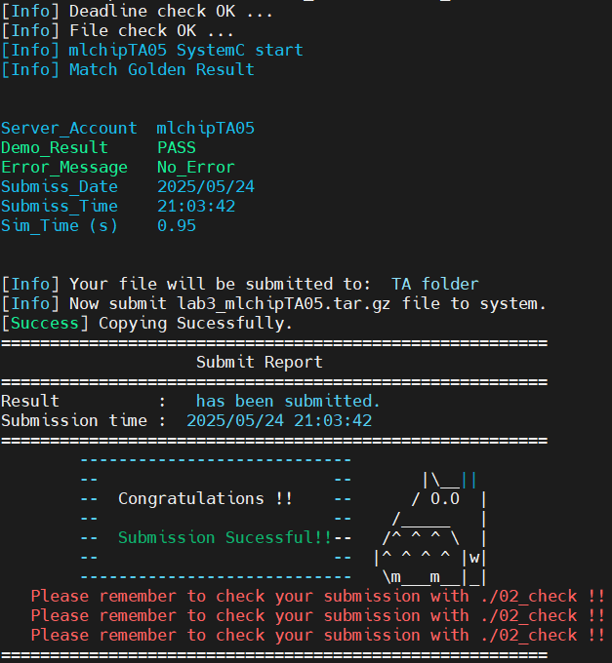
Grading policy
As long as you see the following output after running ./01_submit, you will receive a score of 100.

Slide 13
Grading policy
The following are rules that must be absolutely adhered to. Any violation will result in 0 points.
Plagiarism is forbidden.
The only file you are allowed to modify is forwarder.h.
You cannot use any Chinese characters in the assignment, including within comments.

