Slide 1
Optimizing the Technology Value Stream: Insights from DevOps and Lead Time Reduction
Enhancing efficiency through DevOps and faster deployments
By Amanda Wedergren

Slide 2
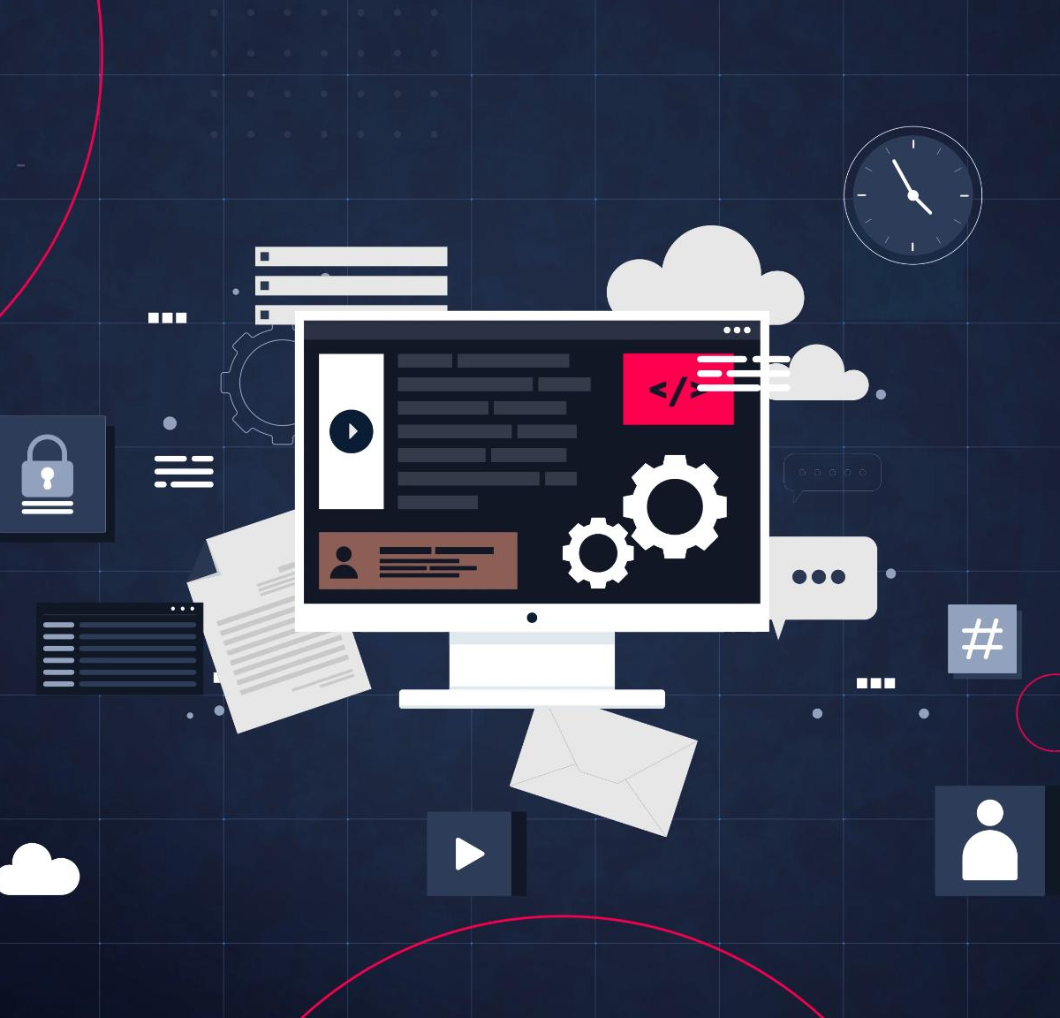
Introduction to the Technology Value Stream
Software Development Activities
The technology value stream covers coding, testing, deployment, and release activities in software development.
Value Stream Optimization
Optimizing the technology value stream accelerates feature delivery and improves software quality for organizations.

Slide 3
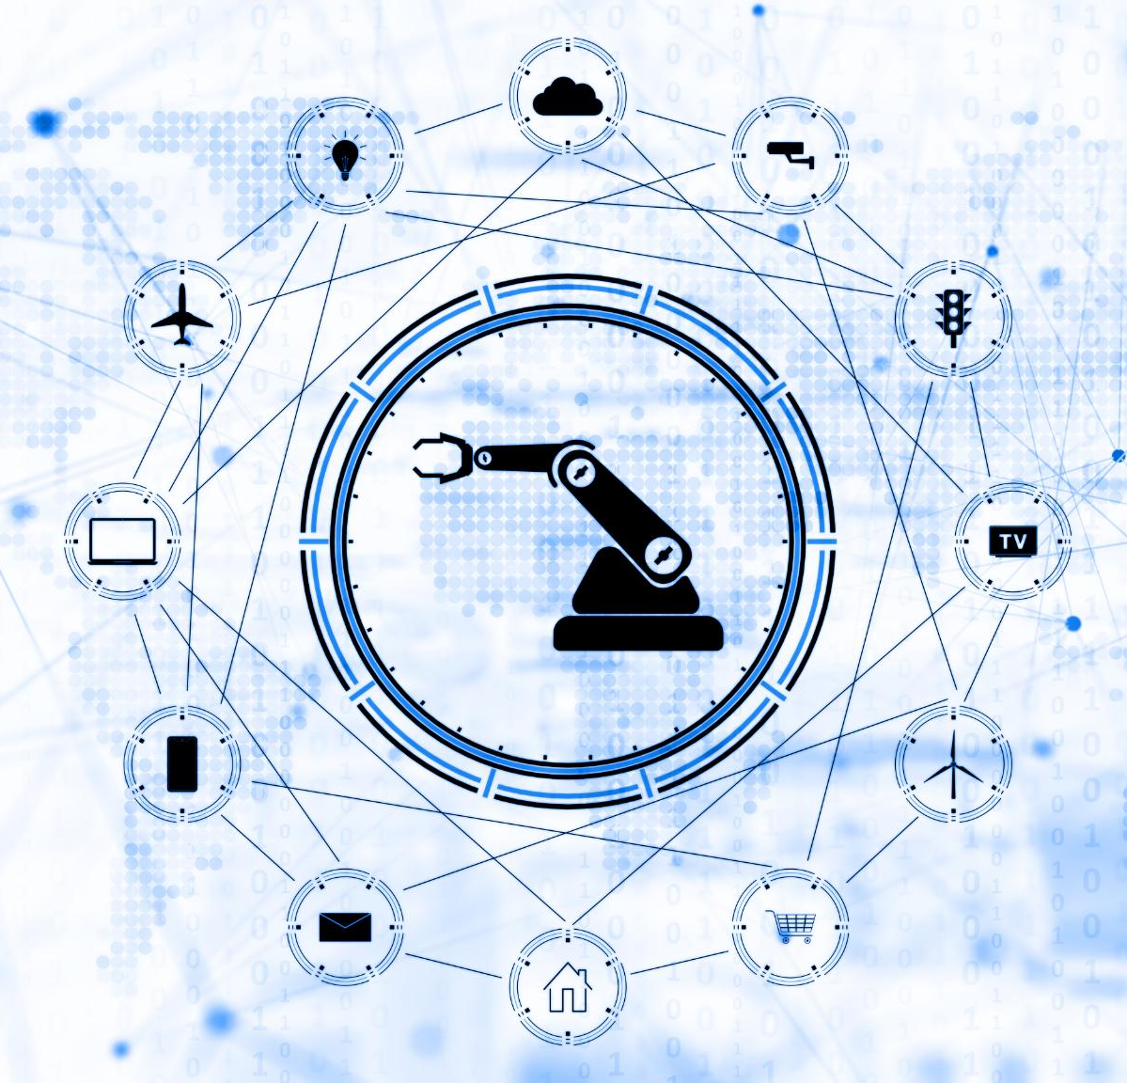
Key Concepts From The DevOps Handbook
Continuous Integration
Continuous integration ensures frequent merging of code to detect issues early and maintain software quality.
Continuous Delivery
Continuous delivery automates software release to production enabling faster and reliable deployments.
Culture and Automation
A collaborative culture combined with automation improves workflow and reduces waste in delivery pipelines.

Slide 4

Defining Lead Time Vs. Processing Time
Lead Time Definition
Lead time includes total duration from work start to delivery, encompassing wait and processing periods.
Processing Time Explained
Processing time is the actual time spent actively working on the task, excluding delays and waiting.
Importance of Reducing Lead Time
Reducing lead time improves delivery speed more effectively than just shortening processing time.

Slide 5

Challenges: Long Deployment Lead Times
Impact of Long Deployment Times
Extended deployment lead times delay project delivery and reduce the speed of feedback cycles.
Causes of Long Lead Times
Manual processes and environment inconsistencies contribute significantly to long deployment lead times.
Role of DevOps
DevOps practices address deployment delays by breaking down silos and automating processes.

Slide 6

DevOps Ideal: Achieving Short Deployment Lead Times
Rapid Deployment Lead Times
DevOps aims to reduce deployment lead times to minutes or hours for faster delivery and feedback.
Automation Importance
Automation is essential to streamline deployment processes and minimize manual errors.
Collaboration and Processes
Collaboration between teams and streamlined processes enable continuous improvement in DevOps.

Slide 7
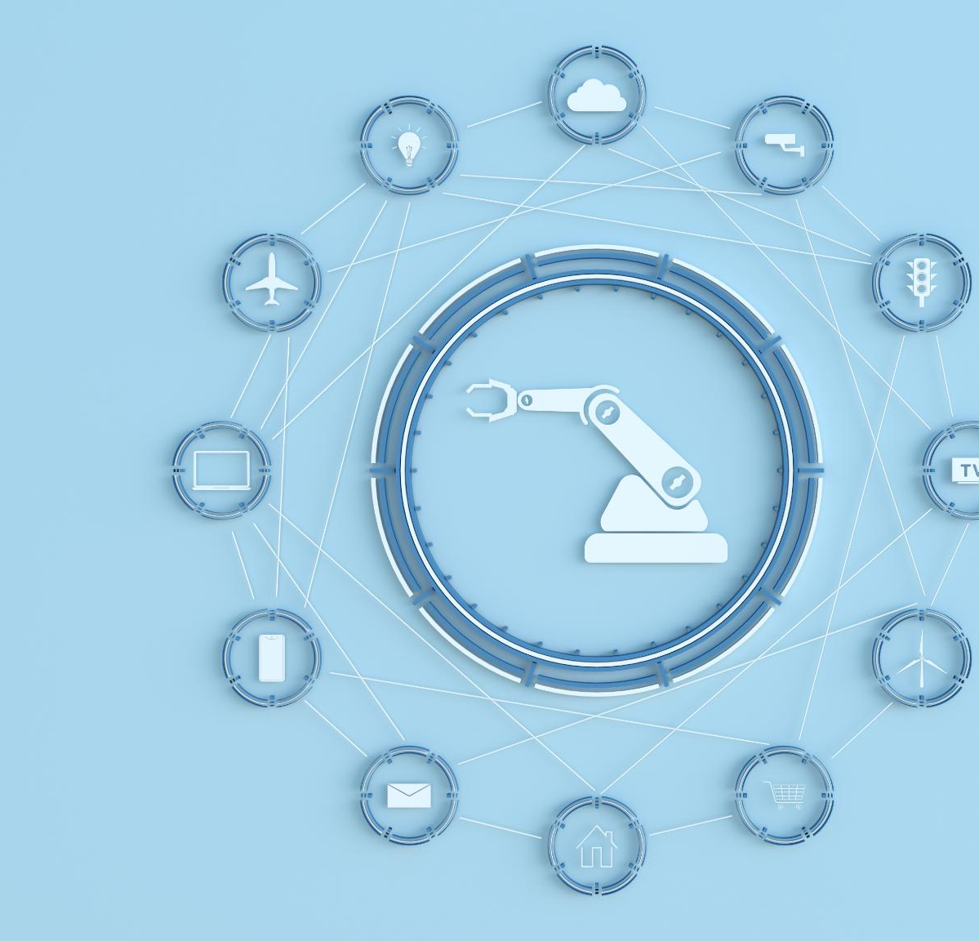
Strategies for Streamlining the Technology Value Stream
Continuous Integration and Delivery
Implementing CI/CD pipelines accelerates software development and ensures faster, reliable releases.
Automated Testing and Deployment
Automation of testing and deployment reduces errors and speeds up delivery cycles.
Cross-Functional Team Collaboration
Improving collaboration among teams enhances communication and productivity across development stages.
Monitoring and Bottleneck Identification
Tracking performance metrics helps identify and resolve bottlenecks in the technology value stream.

Slide 8

Visualizing the Value Stream: Graphic Representation
Value Stream Mapping
Value stream maps visually display the entire process to identify bottlenecks and inefficiencies effectively.
Identifying Delays
Graphic tools help teams spot process delays and focus efforts on areas needing improvement.
Facilitating Team Alignment
Clear graphic representation improves communication and ensures team alignment on process goals.

Slide 9
Conclusion
Optimizing Value Stream
Applying DevOps principles optimizes the technology value stream and enhances software delivery efficiency.
Reducing Lead Times
Shortening lead times accelerates software delivery and improves product quality across releases.
Visualizing Workflow
Understanding and visualizing workflows highlights improvement areas for agile and reliable deployments.
Notes:
Optimizing the technology value stream through DevOps principles and reducing lead times significantly improves software delivery speed and quality. By understanding and visualizing the flow, organizations can target improvements and achieve agile, reliable deployments.

Slide 10
References
DevOps Foundations and Practices (4th ed.) [Course Textbook]. (2025). TechPress.
Kim, G., Humble, J., Debois, P., Willis, J., & Forsgren, N. (2021). The DevOps Handbook: How to Create World- Class Agility, Reliability, & Security in Technology Organizations (2nd ed.). IT Revolution Press.
Notes:
Optimizing the technology value stream through DevOps principles and reducing lead times significantly improves software delivery speed and quality. By understanding and visualizing the flow, organizations can target improvements and achieve agile, reliable deployments.

