Slide 1
Overcoming Barriers to Implementing a Just, Learning Culture
Addressing challenges to promote fairness and growth
Amanda Wedergren

Slide 2

Introduction to Just, Learning Culture
Accountability Over Blame
  Emphasizes accountability and learning instead of focusing on assigning blame for mistakes.
Open Communication
  Encourages transparent and honest communication among team members to foster trust.
Continuous Improvement
  Focuses on ongoing learning and improvement to boost safety and performance.

Slide 3
Defining 'Just Culture' And Its Importance
Just Culture Framework
Just Culture balances accountability with a non-punitive approach to handling errors and mistakes in organizations.
Safe Reporting Environment
It creates a safe environment for employees to report mistakes without fear of punishment or blame.
Improved Learning and Safety
Encouraging open reporting leads to better organizational learning and safer operational practices.

Slide 4

Common Barriers to Implementation
Entrenched Organizational Norms
  Deeply rooted customs and norms within organizations hinder change and the adoption of new practices.
Fear of Punishment
  Employees may avoid taking risks due to fear of negative consequences, limiting innovation and openness.
Lack of Trust
  Insufficient trust between team members obstructs collaboration and open communication.
Communication Silos and Hierarchies
  Rigid hierarchies and isolated communication block transparent dialogue and organizational learning.

Slide 5

Organizational Resistance to Change
Causes of Resistance
  Resistance stems from comfort with current processes and fear of unknown changes.
Fear and Authority Threats
  Fear of the unknown and perceived threats to authority fuel organizational resistance.
Overcoming Resistance
  Leadership commitment and clear communication of benefits help overcome resistance.

Slide 6

Fear of Retribution and Lack of Psychological Safety
Fear Inhibits Reporting
  Fear of punishment prevents employees from reporting mistakes, risking repeated errors and safety issues.
Importance of Psychological Safety
  Psychological safety encourages open communication and transparency, fostering a supportive learning environment.

Slide 7
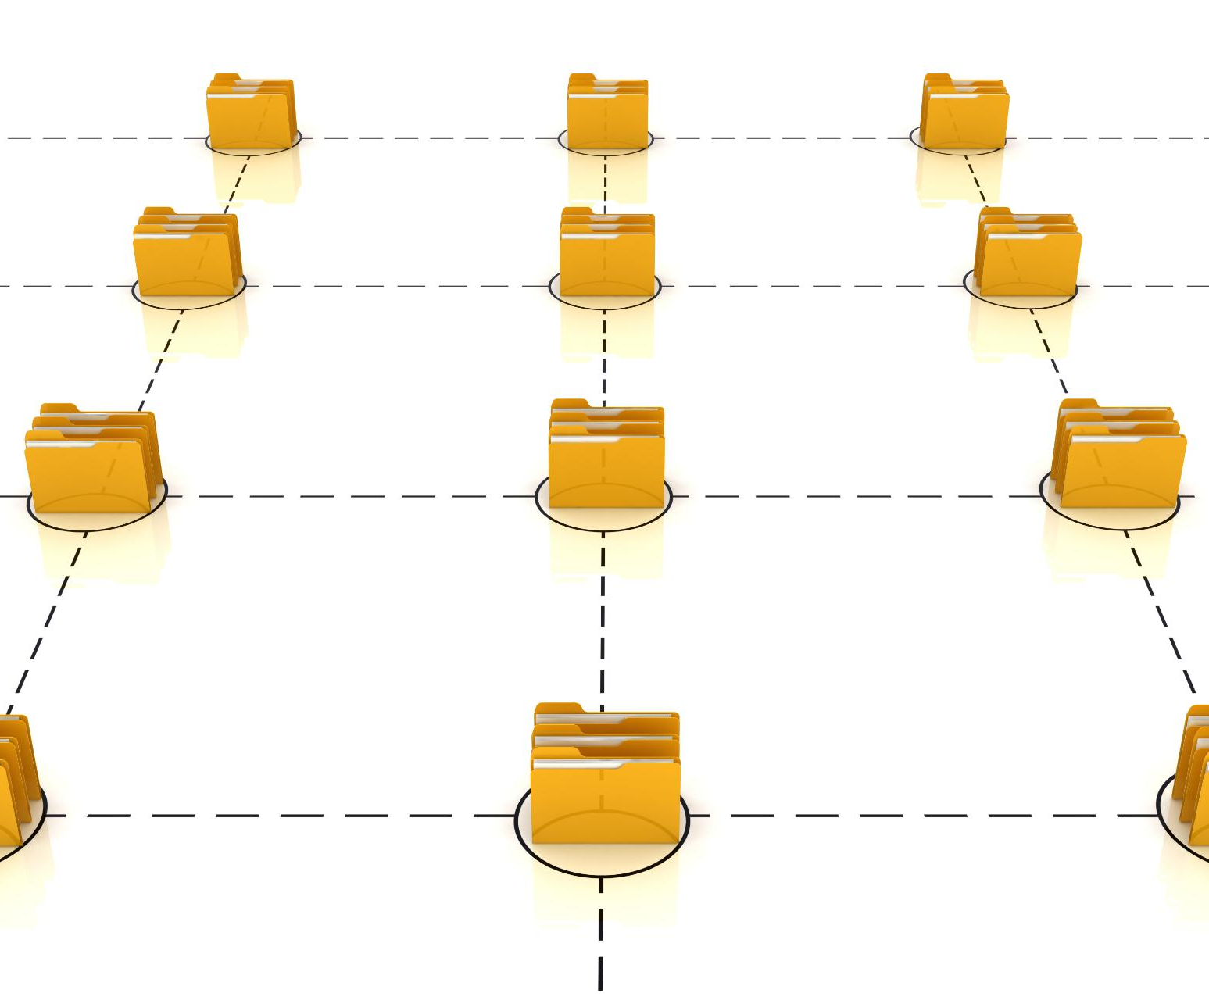
Communication Gaps and Hierarchical Structures
Impact of Rigid Hierarchies
  Rigid hierarchies can block information flow and limit open discussions about errors in organizations.
Importance of Communication
  Effective communication channels encourage transparency and foster problem-solving in teams.
Flattening Structures
  Flattening organizational structures helps improve information flow and supports collaborative environments.

Slide 8

Strategies to Overcome Barriers
Leadership Modeling
  Leaders demonstrate Just Culture behaviors to set a positive example within the organization.
Training and Education
  Providing staff with training improves understanding and application of Just Culture principles.
Clear Policies
  Establishing clear policies guides consistent behavior and expectations across the organization.
Encouraging Communication
  Open communication channels foster trust and psychological safety among team members.

Slide 9
Conclusion
Understanding Barriers
Recognizing and addressing barriers is essential to successfully implement a Just, Learning Culture in organizations.
Committed Leadership
Strong leadership commitment is crucial to foster a culture focused on safety, transparency, and continuous learning.
Targeted Strategies
Implementing specific strategies helps organizations create an environment that supports learning and accountability.

Slide 10
References
ASHP. (n.d.). Just Culture Toolkit. https://www.ashp.org/-/media/assets/pharmacy-practice/resource-centers/patient-safety/Just-Culture-Toolkit_-Final.pdf
Health Quality Alberta. (n.d.). Overcoming barriers to a just culture. https://justculture.hqa.ca/overcoming-barriers-to-a-just-culture/
Humanistic Systems. (2023, October 18). Why is it just so difficult? Barriers to ‘Just Culture’ in the real world. https://humanisticsystems.com/2023/10/18/why-is-it-just-so-difficult-barriers-to-just-culture-in-the-real-world/
Just Culture in Health Care. (n.d.). Defining just culture. https://www.justculture.healthcare/defining-just-culture/
Medical Professional Liability Association. (2025). Medical malpractice versus just culture. https://www.mplassociation.org/Web/Publications/Inside_Medical_Liability/Issues/2025/Spring/Medical_Malpractice_Versus_Just_Culture.aspx
Murray, J. S., Clifford, J., Larson, S., Lee, J., & Sculli, G. L. (2022). Implementing just culture to improve patient safety. Military Medicine, 188(7–8), 1596–1599. https://doi.org/10.1093/milmed/usac115
NurseLeader. (2022). To Err Is Human, Just Culture, Practice, and Liability. https://www.nurseleader.com/article/S1541-4612(22)00149-5/fulltext
Page, A. H. (2007). Making just culture a reality: One organization’s approach. AHRQ PSNet. https://psnet.ahrq.gov/perspective/making-just-culture-reality-one-organizations-approach
Tasker, A., Jones, J., & Brake, S. (2023). How effectively has a Just Culture been adopted? BMJ Open Quality, 12, e002049. https://bmjopenquality.bmj.com/content/12/1/e002049
(no attribution required for Microsoft 365 stock image gallery images)

