Slide 1

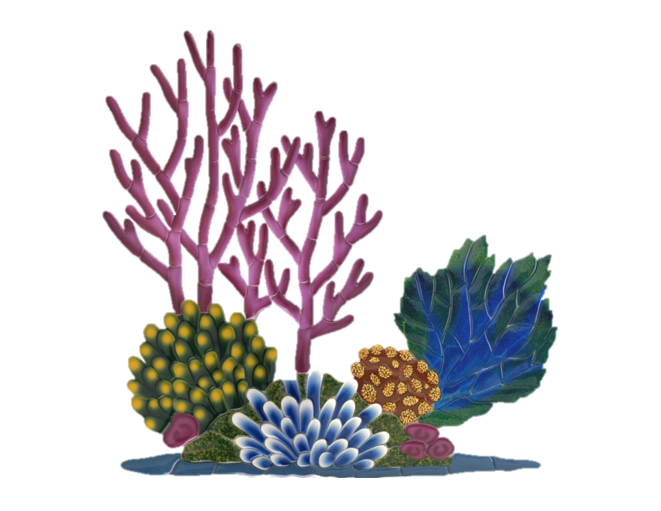
Documenting nature: recreating published data
Background
Workflow
Documentation
Results
Summary
Notes:
In-Class Presentation:
Each group will have ~20 minutes to present their work on either December 11th or 13th. Each presentation should include:
Background on the biological question being investigated.
A description of the workflow carried out by the group.
An overview of the group's documentation.
Presentation of results including comparison to results from the published paper.
Please feel free to message the instructors on Slack if you are unclear about the requirements of the assignment or regarding the suitability of a particular manuscript for the assignment.

Slide 2
Background
Workflow
Documentation
Results
Summary
Notes:
Who we are: introductions
Names & research / use of data skills

Slide 3
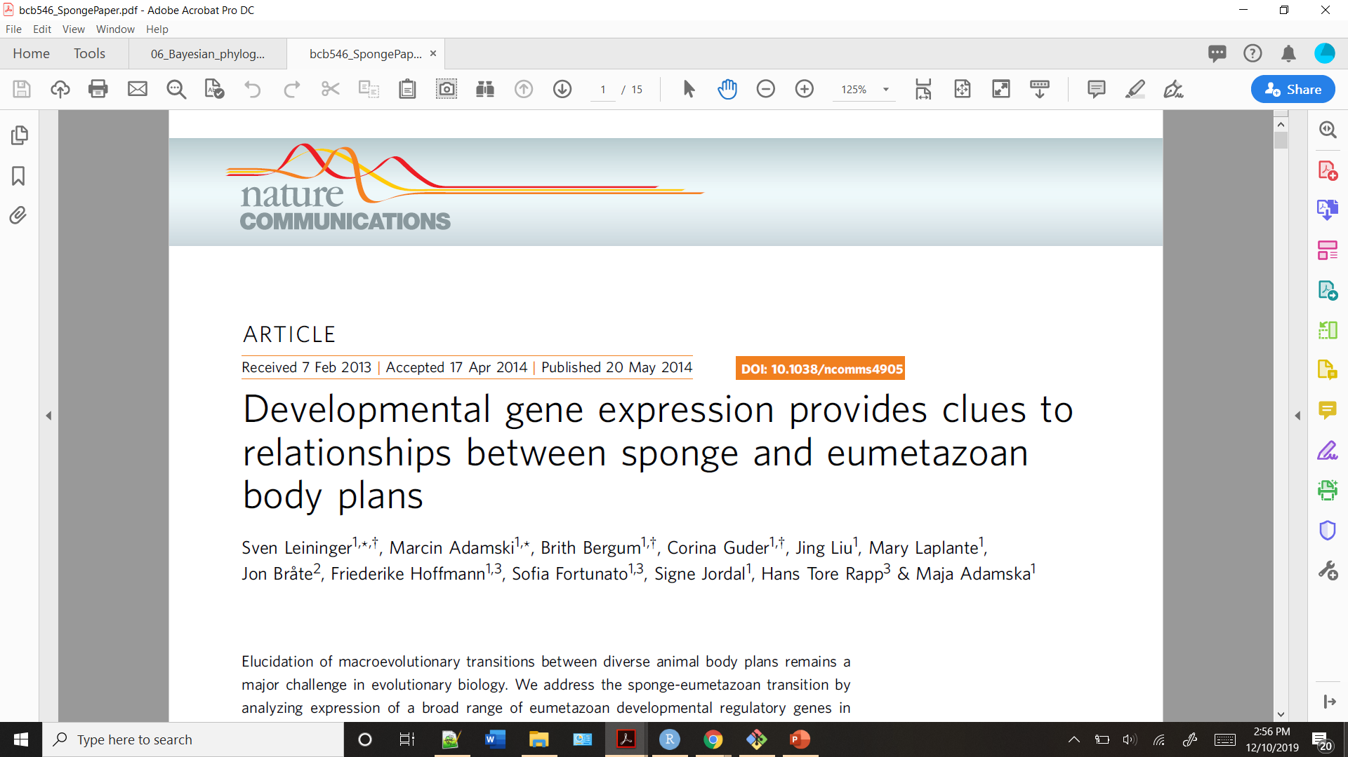
Background
Workflow
Documentation
Results
Summary
Notes:
What paper did we choose?
“We choose …. as this not only fulfilled the requirements outlined, but it also provided an opportunity for some group members to begin to work with datasets and construct pipelines that they will more than likely be doing for future work.”

Slide 4
Background
Workflow
Documentation
Results
Summary
Why this paper?
Notes:
Why this paper? (Benefits for group members)

Slide 5
Background
Workflow
Documentation
Results
Summary
But first, what do you mean sponge or eumetazoan?
Notes:
Main Q of this paper:

Slide 6
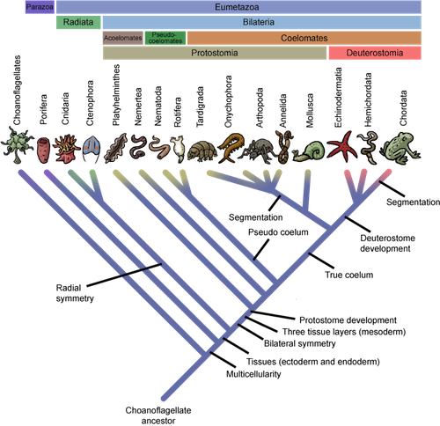
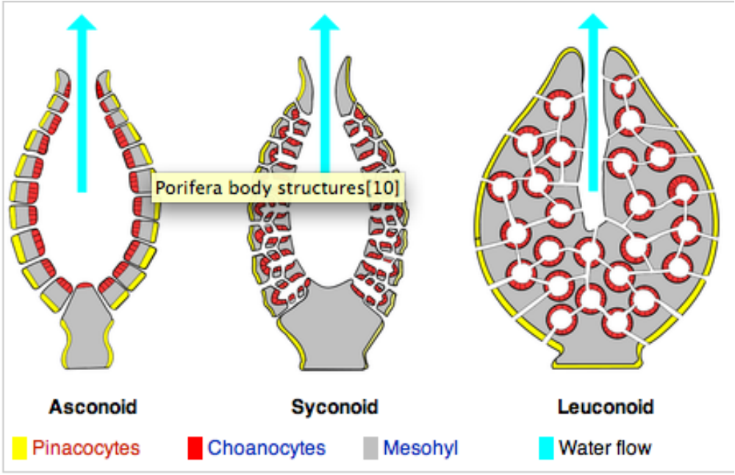
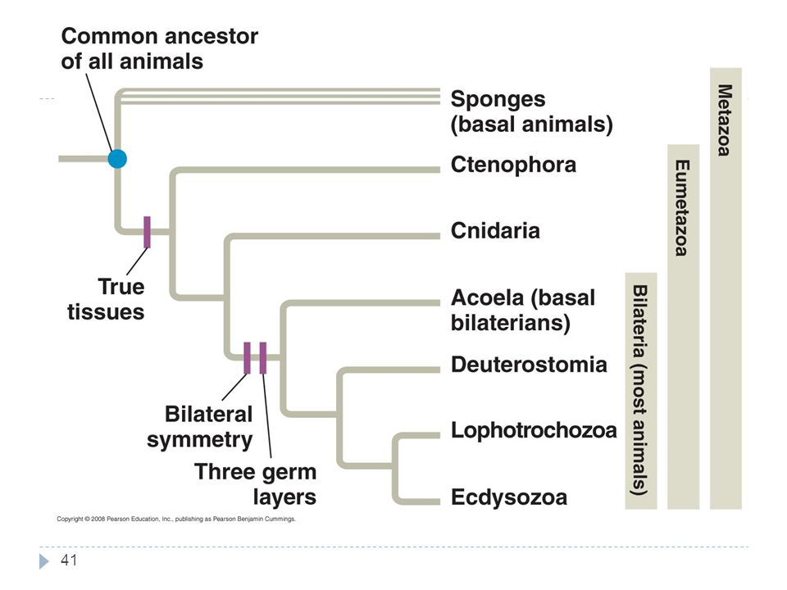
Background
Workflow
Documentation
Results
Summary
What is a sponge?
multicellular organisms that have bodies full of pores and channels allowing water to circulate through them, consisting of jelly-like mesohyl sandwiched between two thin layers of cells.
https://en.wikipedia.org/wiki/Eumetazoa
https://en.wikipedia.org/wiki/Sponge

Slide 7
Background
Workflow
Documentation
Results
Summary
What is a eumetazoan?

Slide 8
Background
Workflow
Documentation
Results
Summary
History between sponges and eumetazoans:

Slide 9
Background
Workflow
Documentation
Results
Summary
Main objective of their study:
To investigate what causes different body plans on a macroevolutionary scale using sponges and eumetazoans.
Notes:
Main Q of this paper:

Slide 10
Background
Workflow
Documentation
Results
Summary
Aims of their study:
- Create an inferred phylogeny of developmental genes in Sycon ciliatum
- Determine the developmental genes responsible during each stage of development using differential express

Slide 11
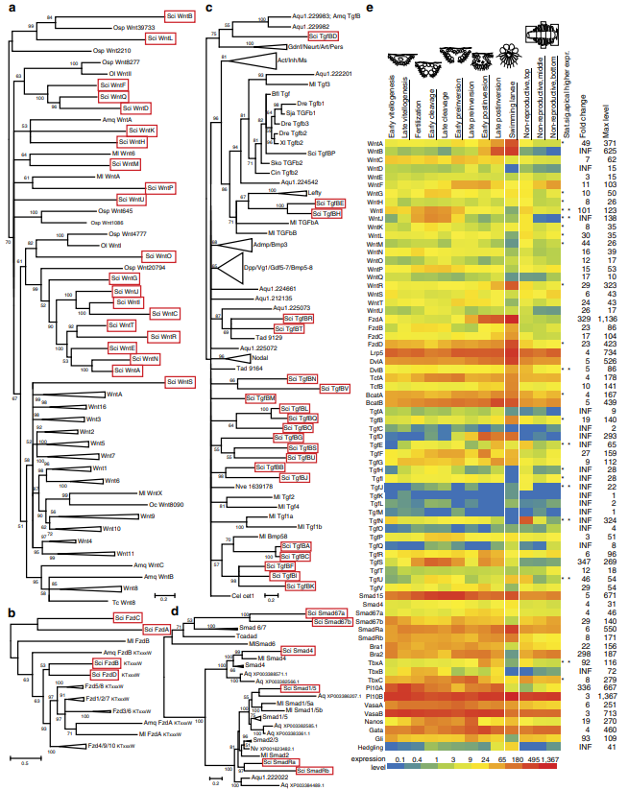
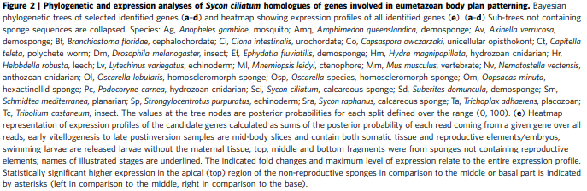
Background
Workflow
Documentation
Results
Summary
Aims of their study:
- Create an inferred phylogeny of developmental genes in Sycon ciliatum

Slide 12
Background
Workflow
Documentation
Results
Summary
Aims of their study:
- Determine the developmental genes responsible during each stage of development using differential express

Slide 13
Background
Workflow
Documentation
Results
Summary
Methods: Sampling
Notes:
What did they do in the study for these aims:

Slide 14
Background
Workflow
Documentation
Results
Summary
Methods: Sequencing
Notes:
What did they do in the study for these aims:

Slide 15
Background
Workflow
Documentation
Results
Summary
Original workflow:
Notes:
What did they do in the study for these aims:

Slide 16
Background
Workflow
Documentation
Results
Summary
Planned workflow: Data collection

Slide 17
Background
Workflow
Documentation
Results
Summary
Planned workflow: Data Verification

Slide 18
Background
Workflow
Documentation
Results
Summary
Planned workflow: Sequence alignment

Slide 19
Background
Workflow
Documentation
Results
Summary
Planned workflow: Phylogenetic tree

Slide 20
Background
Workflow
Documentation
Results
Summary
Planned workflow: Heat map??

Slide 21
Background
Workflow
Documentation
Results
Summary
Documentation “rules”:
Ensure that all commands written down
Write notes on mx logistics from original paper and assumptions made/justifications for
Have group member check if understand process
Compile in Jupyter document

Slide 22
Background
Workflow
Documentation
Results
Summary
Data Collection

Slide 23
Background
Workflow
Documentation
Results
Summary
Alignment

Slide 24
Background
Workflow
Documentation
Results
Summary
Tree

Slide 25
Background
Workflow
Documentation
Results
Summary
Heat Map

Slide 26
Background
Workflow
Documentation
Results
Summary
Data Collection

Slide 27
Background
Workflow
Documentation
Results
Summary
Alignment

Slide 28
Background
Workflow
Documentation
Results
Summary
Tree

Slide 29
Background
Workflow
Documentation
Results
Summary
Heat Map

Slide 30
Background
Workflow
Documentation
Results
Summary

Slide 31
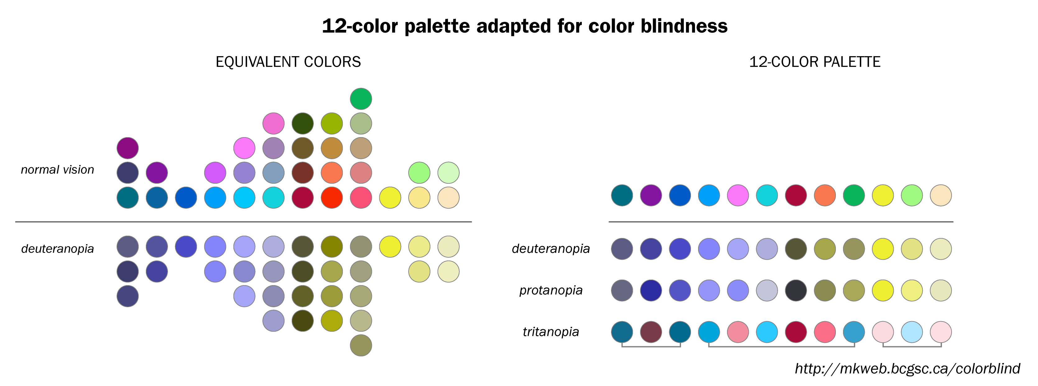
Background
Workflow
Documentation
Results
Summary

Slide 32
Background
Workflow
Documentation
Results
Summary

