Slide 1
Developmental gene expression provides clues to relationships between sponge and eumetazoan body plans

Slide 2
Main Question
What causes different body plans on a macroevolutinoary scale?

Slide 3
Aims of the study
Create an inferred phylogeny of developmental genes in Sycon ciliatum
Determine the developmental genes responsible during each stage of development using differential express

Slide 4
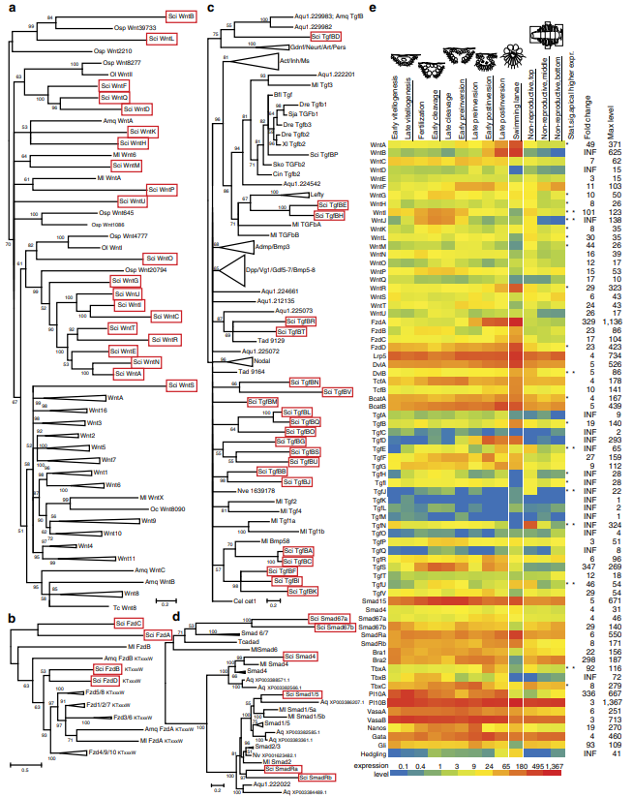
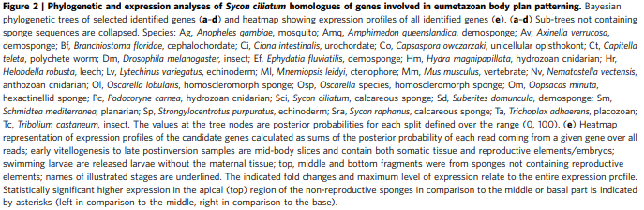

Slide 5
Description of workflow

Slide 6
Documentation

Slide 7
Results

