Slide 1

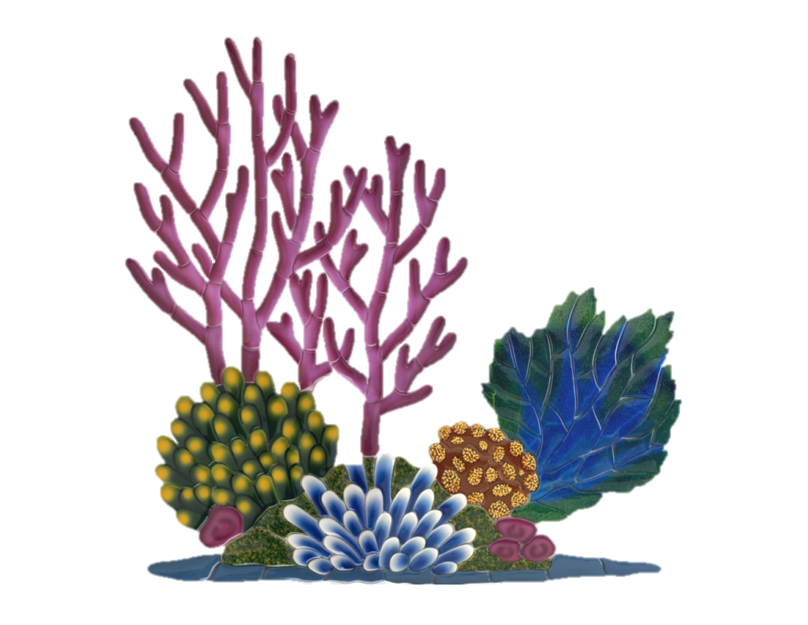
Documenting nature: recreating published data
Background
Workflow
Documentation
Results
Summary
The eclectics:
Elizabeth Glynne
Axelle Weeger
Huyu Liu
Ryan Fortune
Akhil Anilkumar
Notes:
In-Class Presentation:
Each group will have ~20 minutes to present their work on either December 11th or 13th. Each presentation should include:
Background on the biological question being investigated.
A description of the workflow carried out by the group.
An overview of the group's documentation.
Presentation of results including comparison to results from the published paper.
Please feel free to message the instructors on Slack if you are unclear about the requirements of the assignment or regarding the suitability of a particular manuscript for the assignment.

Slide 2
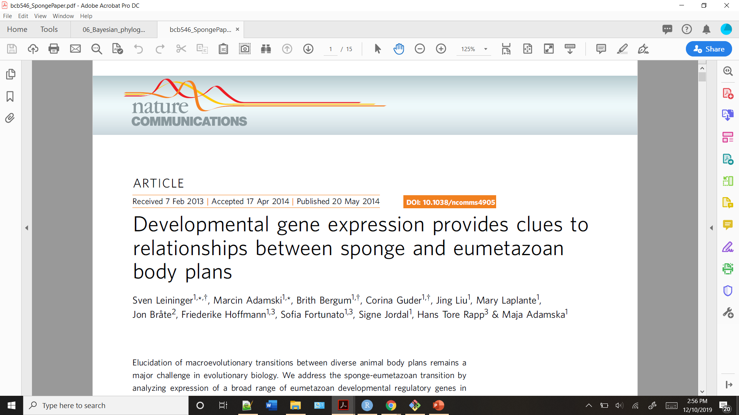
Background
Workflow
Documentation
Results
Summary
Notes:
What paper did we choose?
“We choose …. as this not only fulfilled the requirements outlined, but it also provided an opportunity for some group members to begin to work with datasets and construct pipelines that they will more than likely be doing for future work.”

Slide 3
Background
Workflow
Documentation
Results
Summary
Why this paper?
Paper from Nature communications
i.e. Read by scientists from all backgrounds
Approachable # of figures
Should be well documented
Recent publication
Beneficial for group members to work with this type of data
Notes:
Why this paper? (Benefits for group members)
> nature: read by scientists from all backgrounds
> nature: approachable # of figures
> nature: should be well documented
> Recent publication (2014), further justifying the potential for documentation

Slide 4
Background
Workflow
Documentation
Results
Summary
But first, what do you mean sponge or eumetazoan?
Notes:
Main Q of this paper:

Slide 5
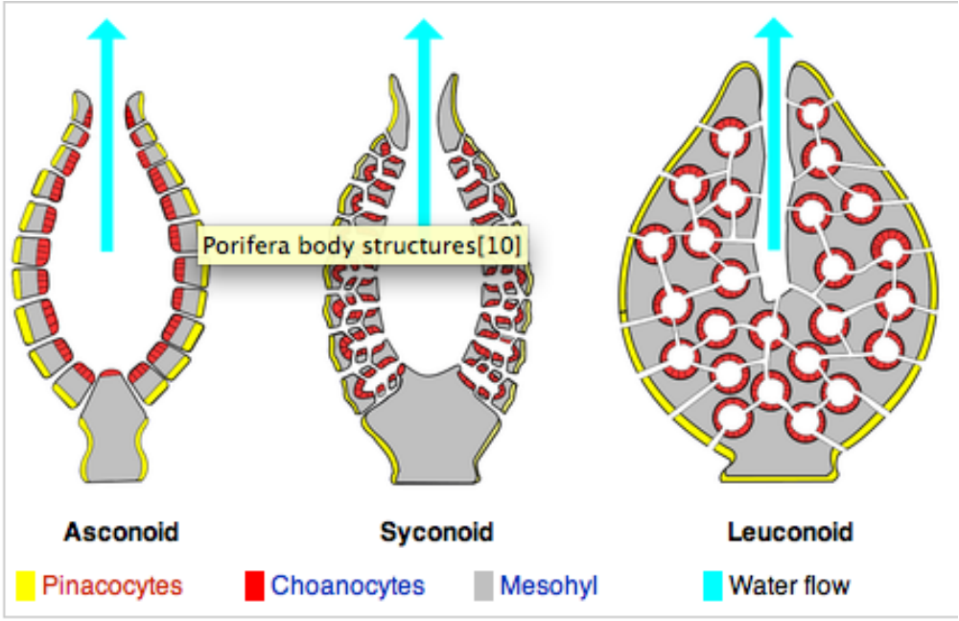
Background
Workflow
Documentation
Results
Summary
What is a sponge?
Multicellular organism, body full of pores and channels for water circulation
https://en.wikipedia.org/wiki/Eumetazoa
https://en.wikipedia.org/wiki/Sponge

Slide 6
Background
Workflow
Documentation
Results
Summary
What is a eumetazoan?
All other animals

Slide 7
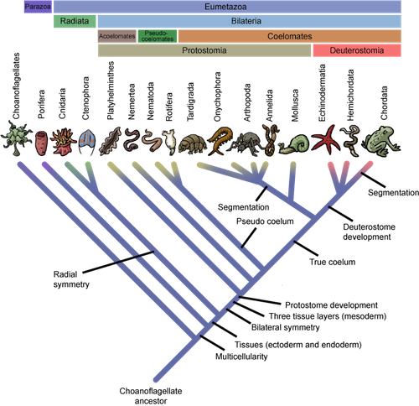
Background
Workflow
Documentation
Results
Summary

Slide 8
Background
Workflow
Documentation
Results
Summary
Main objective of their study:
To investigate what causes different body plans on a macroevolutionary scale using sponges and eumetazoans.
Notes:
Main Q of this paper:

Slide 9
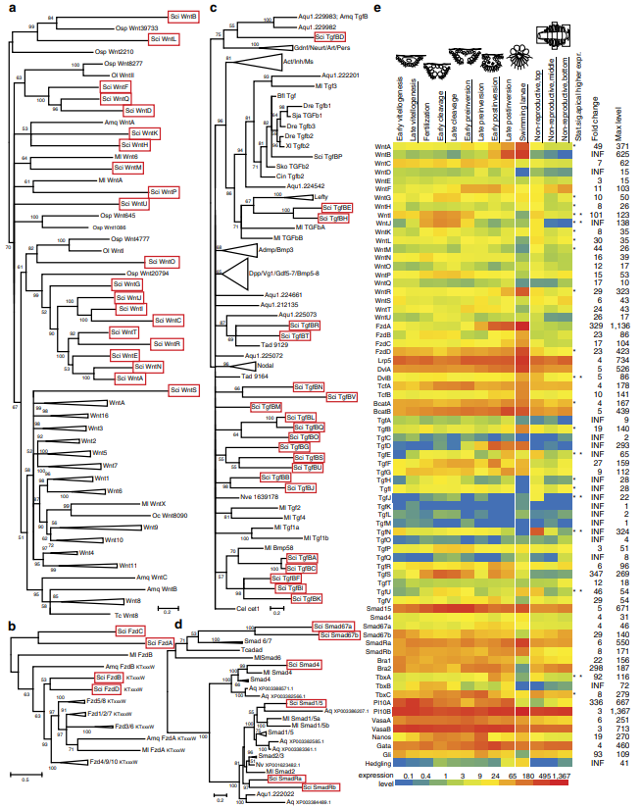
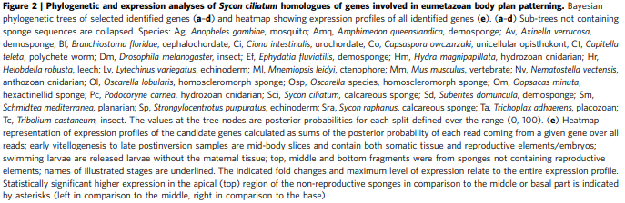
Background
Workflow
Documentation
Results
Summary
Aims of their study:
1. Create an inferred phylogeny of developmental genes in Sycon ciliatum

Slide 10
Background
Workflow
Documentation
Results
Summary
Aims of their study:
1. Create an inferred phylogeny of developmental genes in Sycon ciliatum
2. Determine the developmental genes responsible during each stage of development using differential expression

Slide 11
Background
Workflow
Documentation
Results
Summary
Methods: Sampling
- Adult Sycon ciliatum collected from fjords near Bergen, Norway
Only midbody fragments were used to investigate expression changes during oogenesis and embryonic development
- Determined 9 embryonic stages
- Isolated RNA from released larvae without adult tissue
- Genomic DNA isolated from non-reproductive single specimens and juveniles grown in the lab
- For RNA and DNA, used AllPrep DNA/RNA Mini Kit
Notes:
What did they do in the study for these aims:

Slide 12
Background
Workflow
Documentation
Results
Summary
Methods: Sequencing
- Used Illumina to create complementary DNA and genomic libraries were constructed and sequenced
de-novo assemblies of the genome and transcriptome
S. ciliatum genomic scaffolds and compl. DNA contigs identified by aligning them with juvenile-derived genomic sequences
Notes:
What did they do in the study for these aims:

Slide 13
Background
Workflow
Documentation
Results
Summary
Planned workflow: Data download
Raw data was downloaded from the repositories provided in the paper’s method.

Slide 14
Background
Workflow
Documentation
Results
Summary
Planned workflow: Phylogenetic tree
Fasta file
Aligned using Clustal
Converted to Nexus format
Run MrBayes
Visualization

Slide 15
Background
Workflow
Documentation
Results
Summary
Planned workflow:
Differential expression heat map
Sequence alignment
RSEM
Bowtie2
Count Data for DESeq

Slide 16
Background
Workflow
Documentation
Results
Summary
Planned workflow:
Differential expression heat map
Count data
DESeq normalized
Visualization

Slide 17
Background
Workflow
Documentation
Results
Summary
Guidelines for how we documented:
Tracked all steps taken
Including intersteps, versions, packages, etc.
Tracked what information was missing from original publication
Tracked how we made assumptions and justified choices on what we chose for versions or parameters
Had group members verifying each others work

Slide 18
Background
Workflow
Documentation
Results
Summary
Where we documented:
Files are stored on Github :
https://github.com/EEOB-BioData/BCB546X-Fall2019
Created consolidated workflow with Juptyer notebook
Used HPC /ptmp for large files

Slide 19
Background
Workflow
Documentation
Results
Summary
Two files to recreate:
1. Phylogenetic Tree

Slide 20
Background
Workflow
Documentation
Results
Summary
Two files to recreate:
1. Phylogenetic Tree
2. Heat map

Slide 21
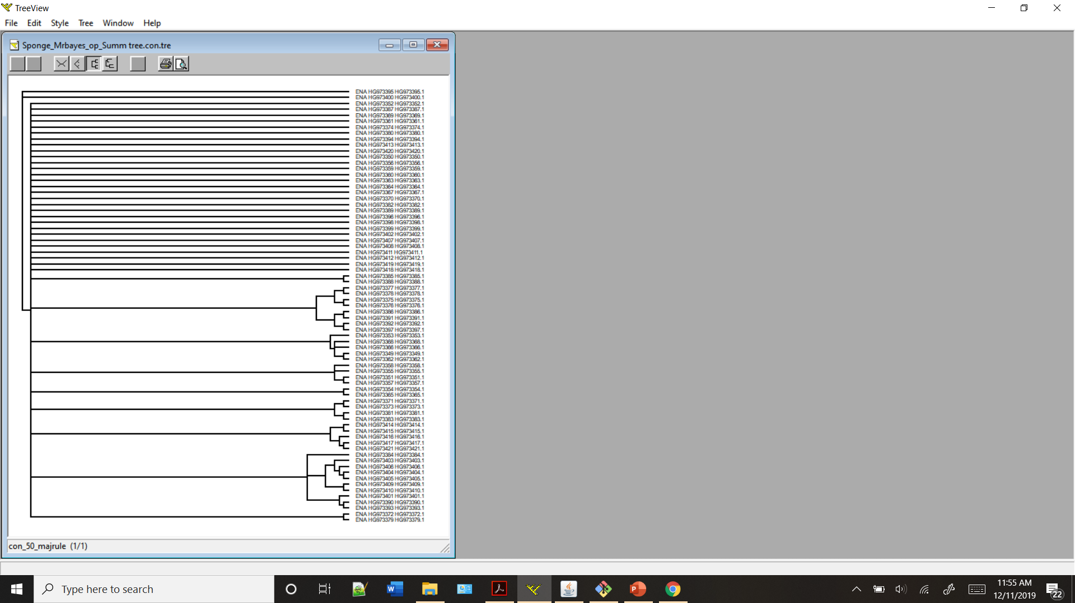
Background
Workflow
Documentation
Results
Summary
1. Phylogenetic Tree:
(Tree created with TreeView)
Notes:
Did not turn out well. Comb results.

Slide 22
Background
Workflow
Documentation
Results
Summary
1. Phylogenetic Tree:
(Tree created with FigTree)
Notes:
File name issues

Slide 23
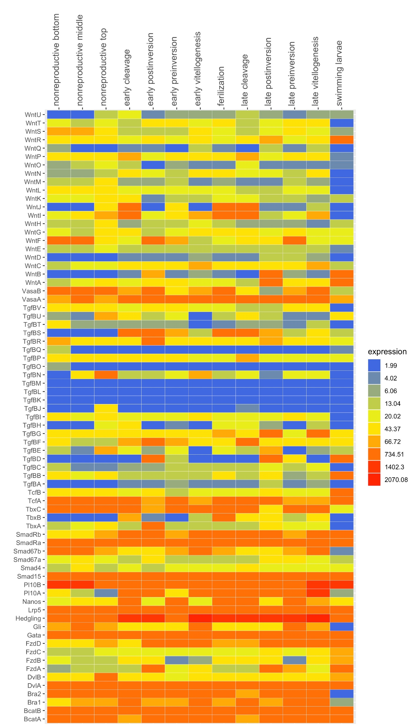
Background
Workflow
Documentation
Results
Summary
Heat Map
Notes:
Our heat map

Slide 24
Background
Workflow
Documentation
Results
Summary
Phylogenetic tree
Our tree is significantly different from the published tree
There were multiple steps where we do not know if we used similar parameters
Heatmap
Our heatmap is visually different, but contains some regions that look very similar.
We could not match parameters exactly, but were able to replicate this figure more faithfully.
This paper did not provide enough information for an intuitive replication of their figures.
Notes:
Summary of comparison of results and replication

Slide 25
Background
Workflow
Documentation
Results
Summary
This was a lot harder than anticipated.
Major roadblocks
No documentation of intermediate file processing steps
No parameter documentation of each program
No documentation of program version
Even in a premiere journal, documentation requirements are not sufficient to ensure easy replication of results.
Based on this experiment, we would not be able to come to the same conclusions that the original authors drew from these figures.
Notes:
Summary of thoughts and final comments about replication of a Nature paper

Slide 26
Background
Workflow
Documentation
Results
Summary
Questions?

Slide 27
Background
Workflow
Documentation
Results
Summary
Thank you!

