Slide 1
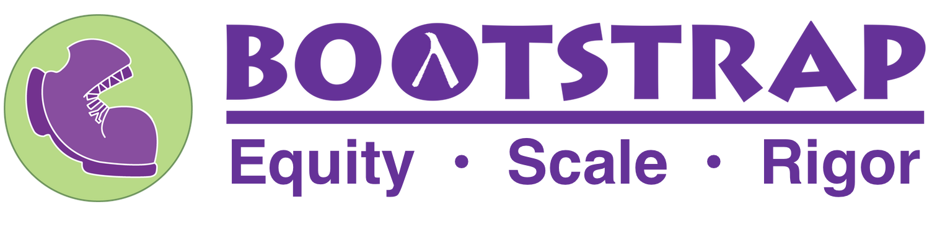
Data Science as a Route to AI for Middle- and High-School Students
For K-12, Data Science provides critical foundations for AI
(that non-CS teachers can also help support)
Brown University and
Emmanuel Schanzer
Kathi Fisler
Shriram Krishnamurthi

Slide 2
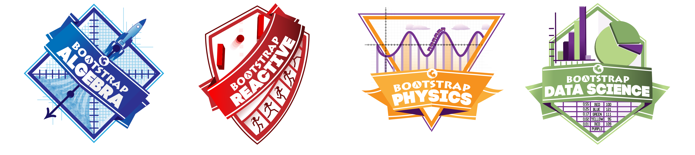
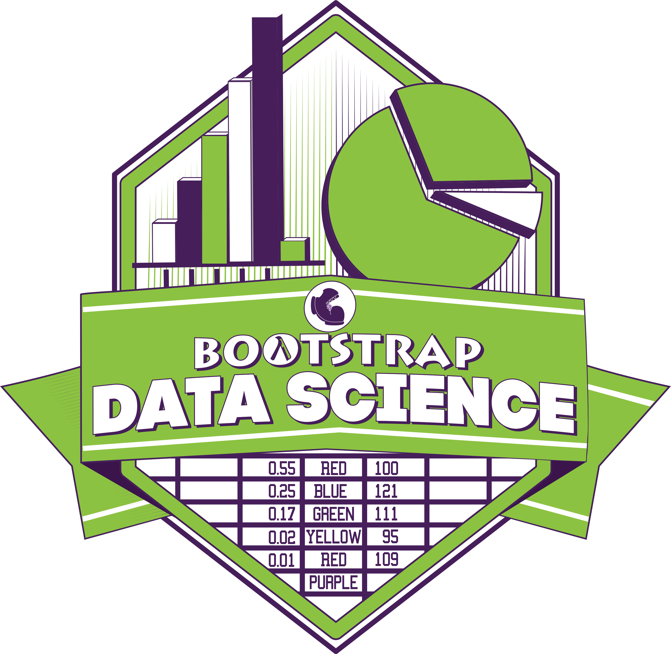
Integrating introductory computing into existing K-12 classes, such as math, physics, and social studies
Equity
(for students)
We work with teachers with no prior computing background
We target learning goals of host discipline (as well as CS)
Scale
(by teachers)
Rigor

Slide 3
Domain Expertise
Presentation/
Visualization
Data Management
(organization, cleaning, validating, ...)
Statistics
Scripting/Programming
Building Models
Data-Centric Computing = Data Science + Data Structures
(ask me about Brown’s new Intro CS course on this)

Slide 4
Make sense of data, then turn questions into programs
Hypothesis: Younger animals are cuter, so they tend to get adopted faster
Name | Species | Gender | Age (years) | Legs
Sasha | cat | female | 1 | 4
Lucky | dog | male | 3 | 3
Buddy | lizard | male | 2 | 4
Snowcone | cat | female | 2 | 4
... | ... | ... | ... | ...
Does hypothesis seem plausible?
Do outcomes differ by species?
How to tell the story?
Only basic statistics (mean, mode, etc), plots/displays based on type of variable, table manipulation, write report to communicate findings
An animal shelter dataset: other columns are
weight (lbs), weeks to adoption, and is-fixed

Slide 5
Categorical vs quantitative variables
Different operations on different data/variable types
Consider different subsets of a dataset
Display data to explore possible relationships within a dataset
What is a model?
Different datasets (same schema) yield different models
Is data appropriate to the question?
Data validity
Perception
Representation and Reasoning
Learning
Natural Interaction
Societal Impact

Slide 6
CSTA standards
Fostering an inclusive computing culture
Collaborating around computing
Recognizing and defining computational problems
Developing and using abstractions
Creating computational artifacts
Testing and refining computational artifacts
Communicating about computing
Common Core math standards
Make sense of problems and persevere in solving them
Reason abstractly and quantitatively
Construct viable arguments and critique the reasoning of others
Model with mathematics
Use appropriate tools strategically
Attend to precision
Look for and make use of structure
Look for and express regularity in repeated reasoning
Notes:
Not saying artifacts are wrong, but we lose something in not bringing in the sensemaking from mathematics.
From own experience teaching, building something doesn’t mean we understand it

Slide 7
But Data & Analysis is already a subconcept in CSTA standards
Collection and Visualization
Collection with different/appropriate tools
Present with different displays/charts
Select/use appropriate tools for collection and analysis
where are we asking students to think about data and how it gets
(can be) manipulated?
Inference and Models
K-2: identify patterns in charts and graphs to make predictions
3-5: propose cause and effect relationships and predict outcomes
6-8 refine computational models
9-10: create computational models
11-12: evaluate suitability of models wrt hypotheses to test
Storage
Working with bit-level representations and tradeoffs in data organization

Slide 8
K-12 CS tends to overthink tools and underthink sensemaking
Tools focus makes it harder for teachers
Data thinking can weave into many subjects
We have an ethical responsibility to teach data thinking – argument is more than just foundational
Equity
We offer teacher professional development and are happy to partner with others
Scale
Rigor
I’ve helped write a lot of CS K-12 standards, and I’m uneasy/skeptical ...
kathi@bootstrapworld.org
kfisler@cs.brown.edu

