Slide 1
A grammar for data transformations in R
Santiago Caño Muñiz, Aaron Weimann, Chris Ruis
https://aweimann.github.io/floto-lab-learning-bioinformatics/docs/

Slide 2
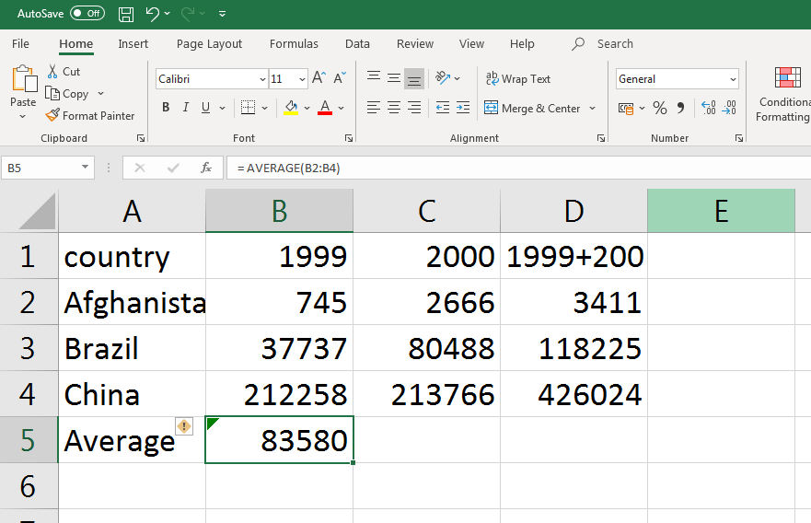
Data transformations in Excel

Slide 3
Working in tables so far in R
Base R
Selecting: mpg$manufacturer
Sorting: memPotDT[order(Measurement1)]
Merging: merge(memPotDT, memPotDT2, by = c("Cell_type", "Replicate"))
data.table
Summarizing: memPotDT[, mean(Measurement1)]
Filtering: memPotDT[Measurement1 > 2.5 & Measurement2 > 2.5]
Grouping and summarizing: memPotDT[, mean(Measurement1), by = .(Cell_type, Day_of_experiment)

Slide 4
Outline
Pick observations by their values (filter()).
Pick variables by their names (select()).
Create new variables with functions of existing variables (mutate()).
Collapse many values down to a single summary (summarise()).
Group data and do the same transformations on groups (group_by())
Re-arranging data in tables (pivot_longer(), pivot_wider())
Merge tables using joins (inner_join(), full_join() left_join(), right_join()

Slide 5
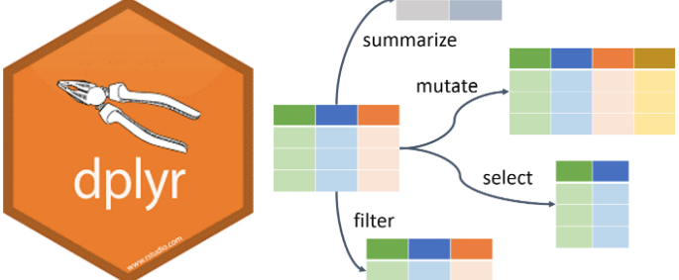
dplyr
Notes:
https://towardsdatascience.com/data-manipulation-in-r-with-dplyr-3095e0867f75

Slide 6
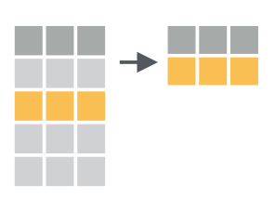
Filtering rows using filter()
filter(.data, ...) Extract rows that meet logical criteria.
For example filter(mpg, cty > 20)
Supports unlimited number of filters: filter(.data, filter1, filter2, filter3)

Slide 7
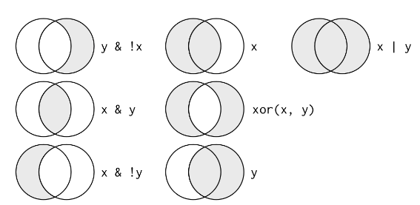
Logical operations
Filter also supports more complicated filter conditions
filter(data, condition1, condition2) is the same as filter(condition1 & condition2)

Slide 8

Modifying and adding columns with mutate()
mutate(.data, ...)
Compute new column(s) e.g. mutate(mpg, cty_cyl = cty/cyl)
Is based on existing fields in the data table
Can also replace columns e.g. mutate(mpg, cty = cty/1.7)

Slide 9
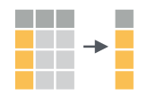
Selecting columns with select()
select(.data, ...)
Extract columns as a table e.g. select(mpg, model, year)
Also supports ranges: select(mpg, manufacturer:year)
And unselecting select(mpg, -manufacturer)

Slide 10
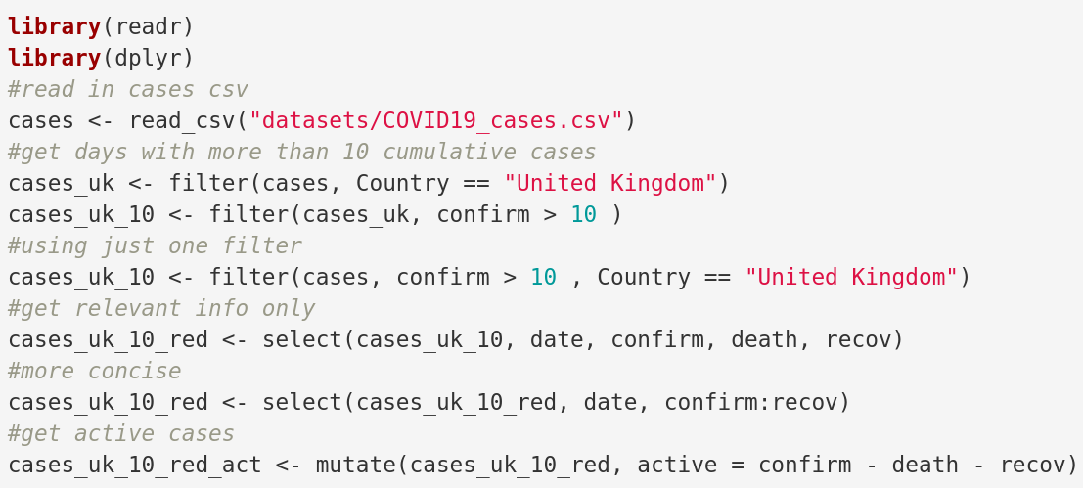
Let’s program
Try with a different country and add another select statement at the end to only show active cases

Slide 11
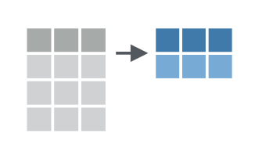
Summarizing data with summarise()
summarise(.data, ...)
Compute table of summaries. e.g. summarise(mpg, mean(cty))
Name the summary variable by using summarise(mpg, mean_cty = mean(cty))

Slide 12
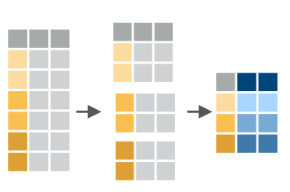
Grouping data and summarizing
Use group_by() to create a "grouped" copy of a table.
dplyr functions will manipulate each "group" separately and then combine the results. group_by(mpg, drv) %>% summarise(avg = mean(cty))
Can also group by more than one column: get all unique combinations group_by(mpg, manufacturer, year)

Slide 13
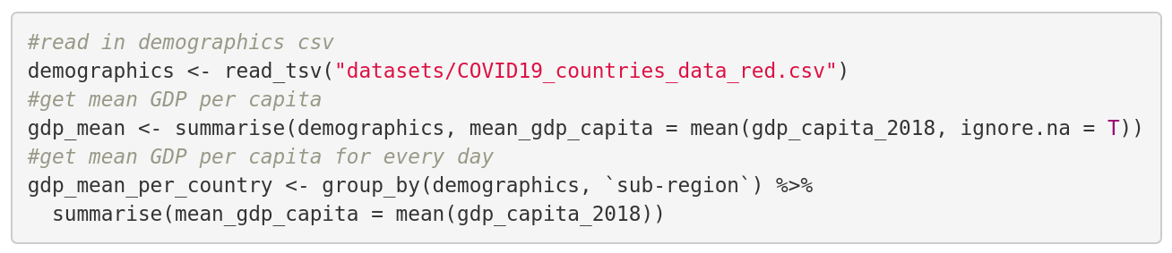
Let’s program
What happens if you don’t use the ignore.na = T in the summarise function
Try with a different demographic

Slide 14

Chaining operations using pipes
Moving A %>% B
Placeholder
The %>% operator
One of the most useful and powerful elements of R. The operator ¨%>% helps structure the code and minimizes the creation of "transitional variables.
Requires package magrittr o tidyverse.
The basic idea:
x %>% f is f(x)
x %>% f %>% g %>% h is h(g(f(x)))
Object %>%
function1(.) %>%
function2(.) ->
result
Notes:
Even if you work alone, it is useful, and it can also be used for text files, e.g. if you use markdown/knitr/Sweave combos (see Reproducible Research). I use Git with Dropbox to track my progress both for code and reports.
Each project has its own working directory. You can achieve that in bare R, but R studio manages this automatically.
The same goes for your workspace, each project has a separate one.
Source files you had open in re-loaded project will open automatically.
La organización de archivos de forma sistemática permite trabajar de forma dinámica con la información
Carpetas y

Slide 15
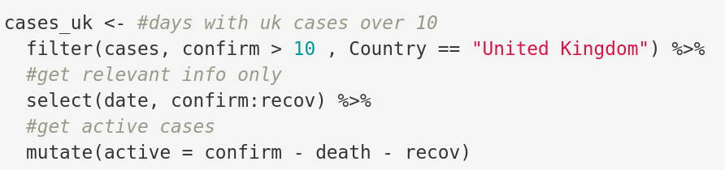
Let’s program
add another select statement at the end to only show active cases and recovered

Slide 16

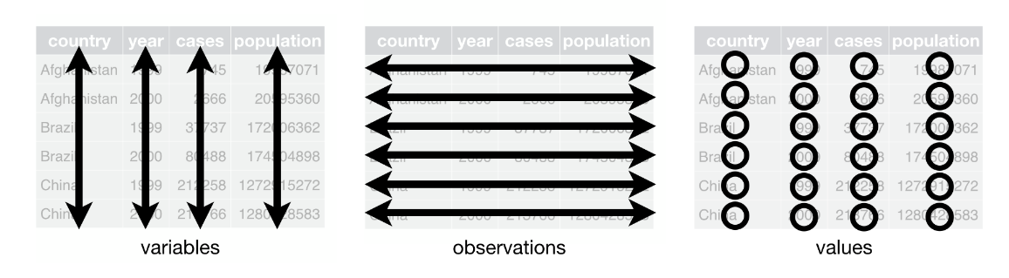
tidyr
Each variable must have its own column.
Each observation must have its own row.
Each value must have its own cell.

Slide 17
Untidy data
country | 1999 | 2000
Afghanistan | 745 | 2666
Brazil | 37737 | 80488
China | 212258 | 213766

Slide 18
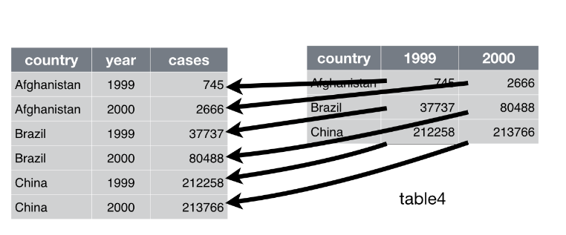
Make tables longer with pivot_longer()
pivot_longer(data, cols, names_to = “name”, values_to = “values”) e.g. pivot_longer(data, `1999`:`2000`, names_to = “year”, values_to = “cases”)

Slide 19
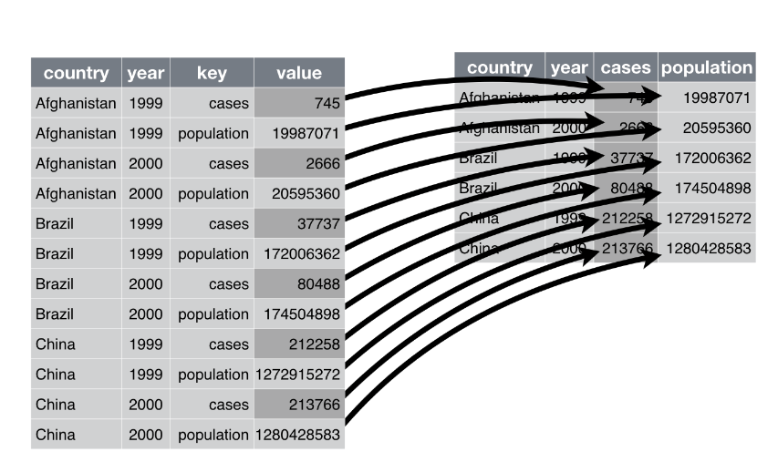
Make tables wider with pivot_wider()
pivot_wider(data, cols, names_from = name, values_from = value) e.g. pivot_wider(data, names_from = key, values_from = count)

Slide 20
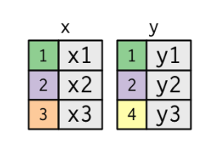
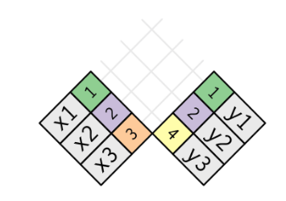
Intersecting tables
Two tables may contain complementary information
Combine information in two tables into to one
Needs a shared column

Slide 21
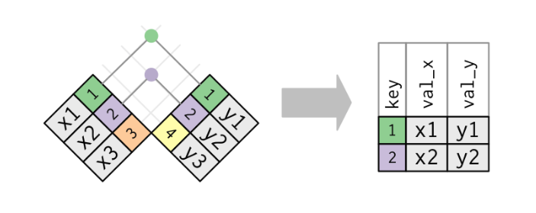
Joining tables
inner_join(x, y, by = NULL)
Retain only rows with matches.
Identifies matching columns automatically “by”
Will suffix duplicate names

Slide 22
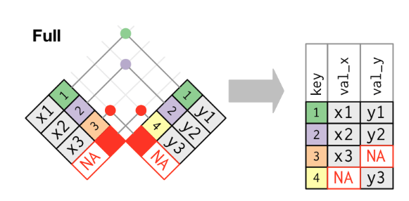
Full joins
full_join(x, y, by = NULL, copy=FALSE, suffix=c(“.x”,“.y”),...)
Join data. Retain all values, all rows.

Slide 23
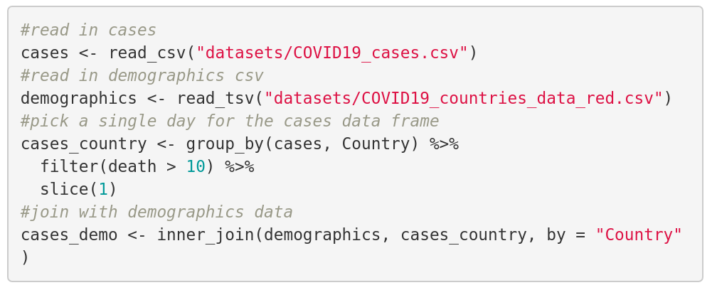
Let’s program
What happens if we replace inner_join with full_join?

Slide 24
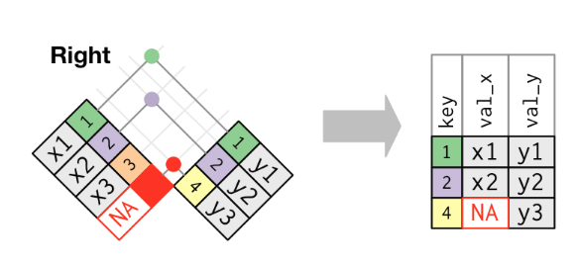
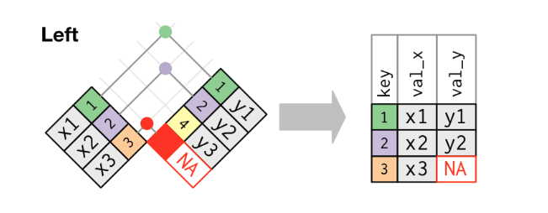
Left and right joins
left_join(x, y, b = NULL)
Join matching values from y to x.
Retain all values in y
left_join(x, y, b = NULL)
Join matching values from x to y.

Slide 25
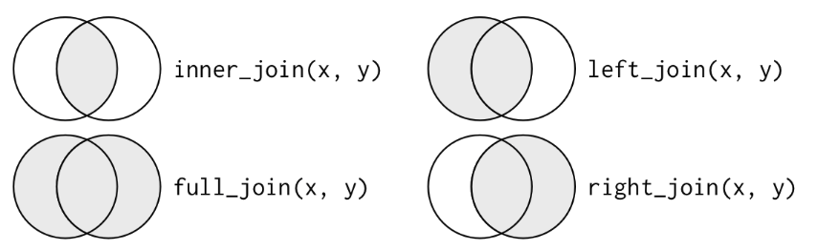
All the joy(ns)

Slide 26
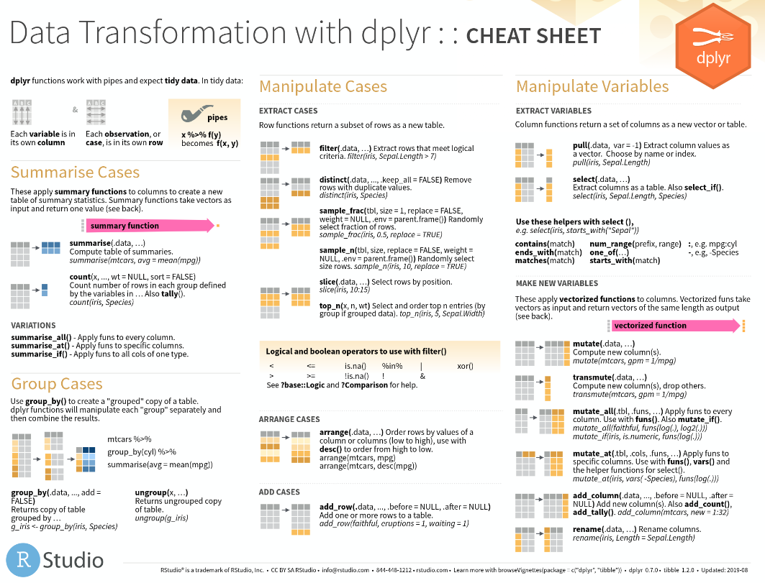
Cheat sheet dplyr

Slide 27
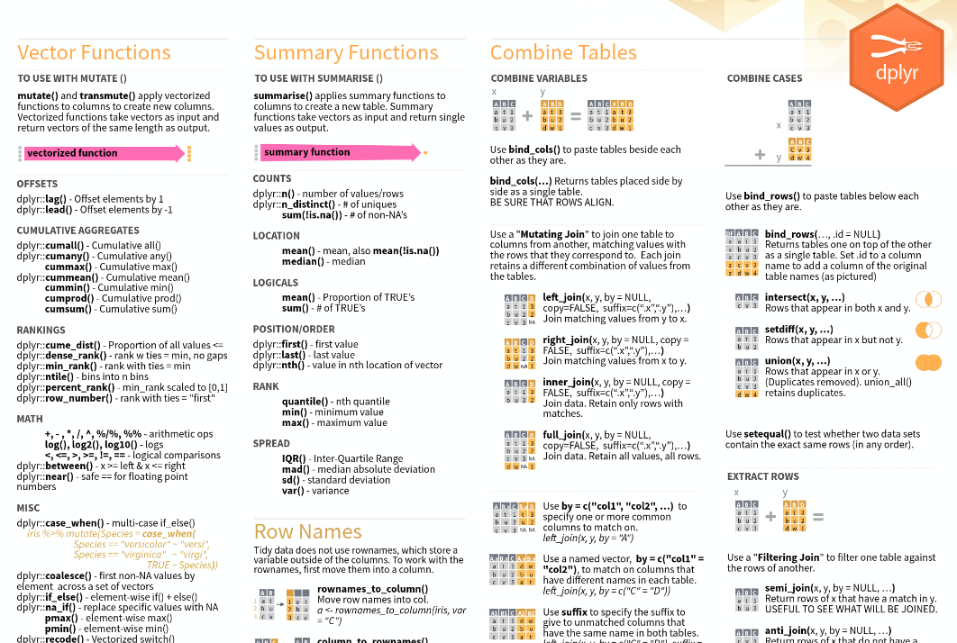
Cheat sheet dplyr

Slide 28
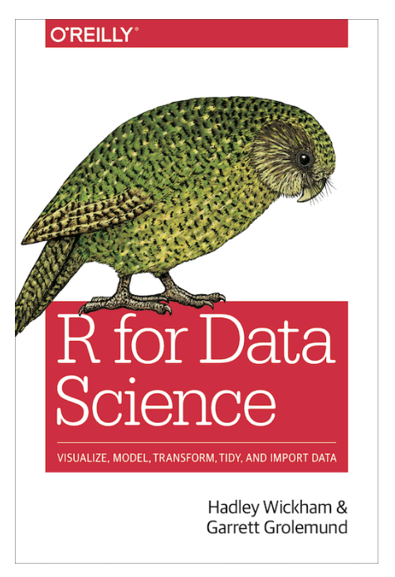
Further reading
Chapter 5 Data Transformations
Chapter 12 Tidy data
Chapter 13 Relational data
Cheat sheets for tidyr, dplyr, ggplot2 and many more

