Slide 1
Statistics and predictive models
Santiago Caño Muñiz
All models are wrong, but some are useful
George Box

Slide 2
The research cycle
2
The first step for an intuition is to observe the data
Information
Explore
Abstract
Validate

Slide 3
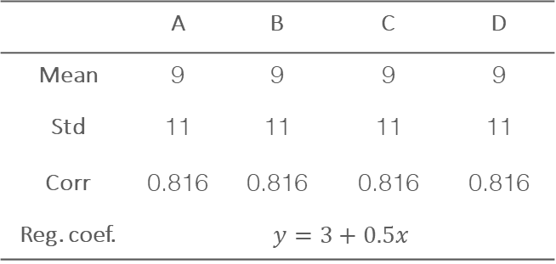
The measure
3
Descriptive statistics
A |  | B |  | C |  | D
x | y | x | y | x | y | x | y
10 | 8.04 | 10 | 9.14 | 10 | 7.46 | 8 | 6.58
8 | 6.95 | 8 | 8.14 | 8 | 6.77 | 8 | 5.76
13 | 7.58 | 13 | 8.74 | 13 | 12.74 | 8 | 7.71
9 | 8.81 | 9 | 8.77 | 9 | 7.11 | 8 | 8.84
11 | 8.33 | 11 | 9.26 | 11 | 7.81 | 8 | 8.47
14 | 9.96 | 14 | 8.1 | 14 | 8.84 | 8 | 7.04
6 | 7.24 | 6 | 6.13 | 6 | 6.08 | 8 | 5.25
4 | 4.26 | 4 | 3.1 | 4 | 5.39 | 19 | 12.5
12 | 10.84 | 12 | 9.13 | 12 | 8.15 | 8 | 5.56
7 | 4.82 | 7 | 7.26 | 7 | 6.42 | 8 | 7.91
5 | 5.68 | 5 | 4.74 | 5 | 5.73 | 8 | 6.89
Summary data
 | A | B | C | D
Mean | 9 | 9 | 9 | 9
Std | 11 | 11 | 11 | 11
Corr | 0.816 | 0.816 | 0.816 | 0.816
Reg. coef. | $$y=3+0.5x$$

Slide 4
The measure
4
The first step for an intuition is to observe the data
cell_type treatment size intake
1: Gram + control 7 10
2: Gram - control 8 8
3: Gram + control 7 10
4: Gram - control 5 9
5: Gram - control 7 8
---
396: Gram + treat 4 10
397: Gram - treat 9 10
398: Gram + treat 6 11
399: Gram - treat 6 10
400: Gram + treat 7 11
Notes:
La forma en la que elegimos representar nuestras ideas será determinante en el impacto de nuestro mensaje. Orientarán al lector u oyente en una u otra dirección

Slide 5
The measure
5
The first step for an intuition is to observe the data
cell_type treatment size intake
1: Gram + control 7 10
2: Gram - control 8 8
3: Gram + control 7 10
4: Gram - control 5 9
5: Gram - control 7 8
---
396: Gram + treat 4 10
397: Gram - treat 9 10
398: Gram + treat 6 11
399: Gram - treat 6 10
400: Gram + treat 7 11

Slide 6
The measure
6
The first step for an intuition is to observe the data
cell_type treatment size intake
1: Gram + control 7 10
2: Gram - control 8 8
3: Gram + control 7 10
4: Gram - control 5 9
5: Gram - control 7 8
---
396: Gram + treat 4 10
397: Gram - treat 9 10
398: Gram + treat 6 11
399: Gram - treat 6 10
400: Gram + treat 7 11

Slide 7

Projecting an idea
7
The grammar of graphs
cell_type treatment size intake
1: Gram + control 7 10
2: Gram - control 8 8
3: Gram + control 7 10
4: Gram - control 5 9
5: Gram - control 7 8
---
396: Gram + treat 4 10
397: Gram - treat 9 10
398: Gram + treat 6 11
399: Gram - treat 6 10
400: Gram + treat 7 11
Aes(
X =
Y =
col =
fill =
size =
label =
Linetype =
Data
Projection
Geometry
Aesthetic
Notes:
La gramática de los gráficos [], será la herramienta que nos ayude a traducir nuestras abstracciones mentales en representaciones visuales.
La estructura básica de ggplot se organiza a través de “capas” que se asiente una encima de otra
Primero entran los datos
Luego, elegiremos como proyectar las variables
Y cual será su forma visual
Por último, tendremos infinidad de opciones para retocar los gráficos

Slide 8
Projecting an idea
8
ggplot, the grammar of graphs
ggplot(data = …,
mapping = aes(…)) +
geom_*() +
stat_*() +
facet_*()
The information we want to represent
The representation coordinates (x, y...)
The shape (points, lines, polygons..)
Statistical transformations
As the data is divided into subgroups
Notes:
La función básica de la librería ggplot2 es ggplot
Como hemos visto lo primero en entrar serán los dats
En el argumento mapping = introduciremos las variables deseadas mediante la función “aes()” de aesthetic
A partir de aquí, empezaremos a añadir capas con el operador +, siendo la más relevante la geometría
Además, las funciones stat_ nos permite representar modelos de regresión sencillos
Finalmente, las funciones de teselado “facet_” facilitan la división de los datos en subgrupos.

Slide 9

Projecting an idea
9
A simple example
Kill bacteria
Notes:
La función básica de la librería ggplot2 es ggplot
Como hemos visto lo primero en entrar serán los dats
En el argumento mapping = introduciremos las variables deseadas mediante la función “aes()” de aesthetic
A partir de aquí, empezaremos a añadir capas con el operador +, siendo la más relevante la geometría
Además, las funciones stat_ nos permite representar modelos de regresión sencillos
Finalmente, las funciones de teselado “facet_” facilitan la división de los datos en subgrupos.

Slide 10
Projecting an idea
10
Univariate representations
ggplot(d, aes(x = drug_intake)) +
geom_histogram(fill = "cornflowerblue",
col = "gray80")
ggplot(d, aes(sample = drug_intake)) +
geom_qq(col = "cornflowerblue") +
geom_qq_line(distribution = qnorm)
ggplot(d, aes(x = drug_intake), bins = 64) +
geom_histogram(fill = "cornflowerblue",
col = "gray80")
Notes:
Histograma
Gráfico de quantiles

Slide 11
Projecting an idea
11
Categorical variables, grups divisions
ggplot(d, aes(x = grupo, y = y)) +
geom_bar(stat = "identity",
fill = "cornflowerblue")
ggplot(d, aes(x = grupo, y = y)) +
geom_boxplot(fill = "cornflowerblue")
Notes:
Diagrama de cajas y bigotes vs barras
Estos gráficos ilustra muy bien el constraste entre grupos. Si el numero excede los 10, probablemente será complicado apreciar la diferencia.

Slide 12
Projecting an idea
12
Bivariant relationships
ggplot(d, aes(x = x, y = y)) +
geom_point()
ggplot(d, aes(x = x, y = y) +
geom_point() +
stat_smooth()
Notes:
Mencionar, especificar los argumentos por separado

Slide 13
Projecting an idea
13
Bivariant relationships, contrast of perception
ggplot(d, aes(x = cell_size,
y = superdrug_killing, shape = treatment)) +
geom_point()
ggplot(d , aes(x = cell_size,
y = superdrug_killing, shape = treatment)) +
geom_point() +
stat_smooth()

Slide 14
Projecting an idea
14
Visual perception
0
1
2
3
4
…
Position
Color
Text/Tags
Form
Size/Area
España
México

Slide 15
Projecting an idea
15
Cartesian graphic
ggplot(d,
# The parameters in aes() represent variables
aes(x = cell_size,
y = superdrug_killing,
col = treatment)) +
# Point geometry
geom_point(
# Parameters outside aes() are fixed
# Size size = 2,
# Form shape = 16,
# Transparency alpha = 0.5,
show.legend = TRUE) +
# Add simple regression
stat_smooth(method = "lm")

Slide 16
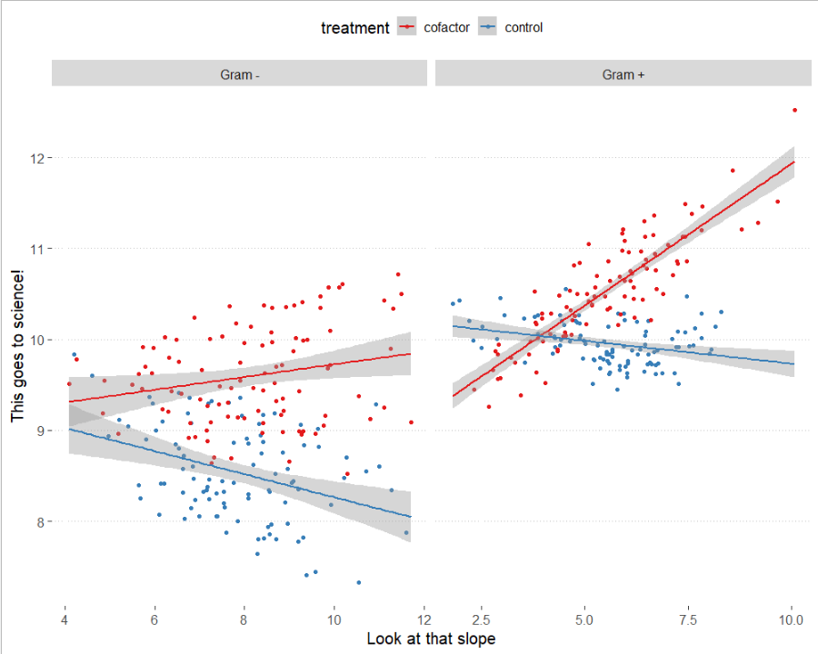

Projecting an idea
16
X-Y plot with Color and Regression Chart
ggplot(d, aes(x = cell_size,
y = superdrug_killing,
col = treatment)) +
# Represent points
geom_point() +
# Simple regression
stat_smooth(method = "lm",
fullrange = TRUE) +
# Divide data by location
facet_grid(. ~ cell_type,
scales = "free_x") +
# Name the axes
labs(x = "Look at that slope",
y = "This goes to science") +
# Choose colors
scale_color_brewer(palette = "Set1")

Slide 17
Time to program
For example
library(data.table)
library(ggplot2)
d <- data.table(iris)
ggplot(d, aes(x = Sepal.Length, y = Petal.Width, col = Species)) +
geom_point() +
labs(x = "Sepal Length", y = "Petal Width") +
theme_bw()

Slide 18
El ciclo investigador
18
Once the data is explored, it's time to abstract, ignore distractions
Information
Exploratin
Abstraction
Validation

Slide 19
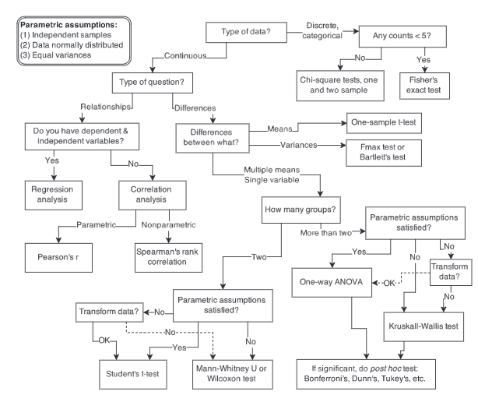
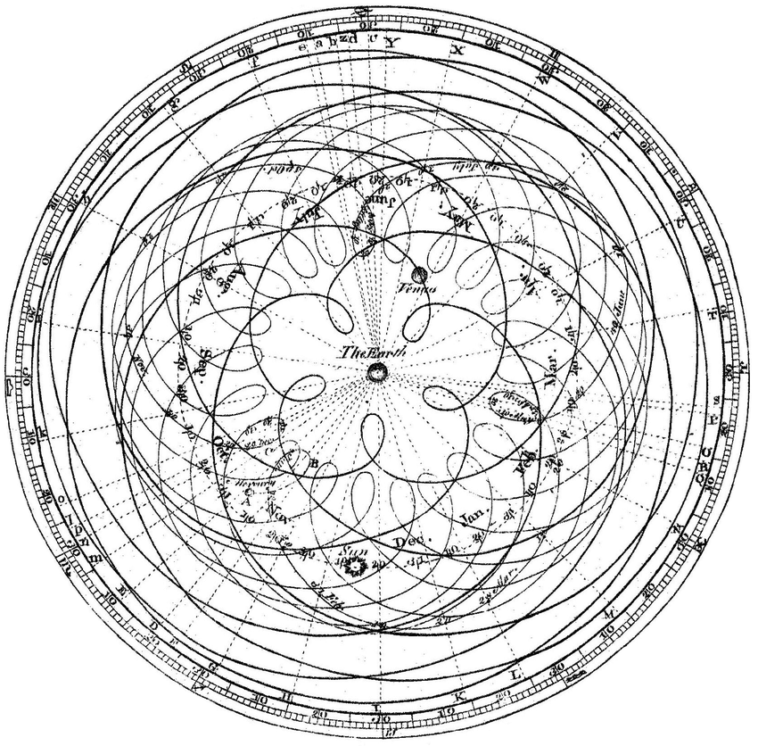
The scientific method
19
Modeling the world
Ptolemaic model of the sky with the earth in the center. Jean Dominique Cassini.
Map of statistical horrors. A. McElreath, Rethinking Statistics.
Notes:
The
person who programmed that computer was necessarily, whether or not they thought of it
that way, designing part of the brain of a robot according to some preconceived notion of
how the robot should behave. But very few of the computer programs now in use satisfy all
our desiderata; indeed, most are intuitive ad hoc procedures that were not chosen with any
well-defined desiderata at all in mind
Statistical modellingis the art of building parsimonious statistical modelsfor a better understanding of the phenomena of interest.
Any model is a simplification of reality therefore no model is correct but some of them are useful
Los modelos como herramientas para extraer información de una realidad compleja y ayudar a decidir

Slide 20
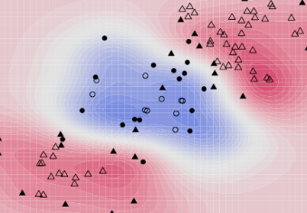
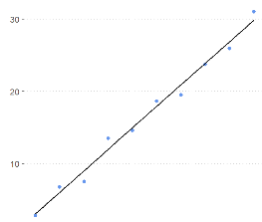

Building models
31
The school of linear models
ML
$$y=bx+a$$
GAM
GLM
LM
Notes:
In the physical world, “models” are generally simplifications of things in the real world that nonetheless convey the essence of the thing being modeled.

Slide 21
The model
31
Linear models
ML
$$y=bx+a$$
GAM
GLM
LM
Notes:
In the physical world, “models” are generally simplifications of things in the real world that nonetheless convey the essence of the thing being modeled.

Slide 22
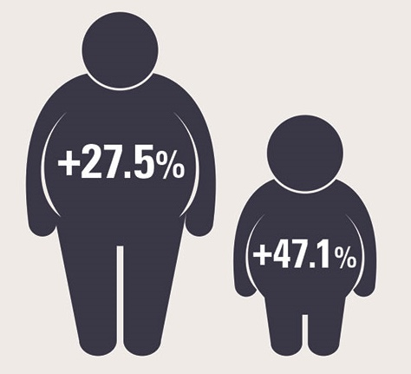
The question
22
Obesity as a problem
The why of our research question
One-quarter of the adult population and nearly half of children are obese Loss of quality of life Chance of heart attack Direct cause of diabetes

Slide 23
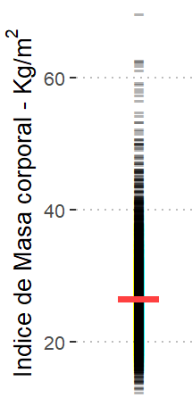
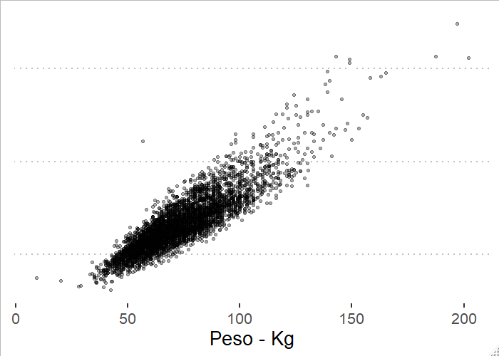






The measure
23
The basis of inference
$$Y=N(μ,σ)$$
$$f(x)$$
$$X_{i}$$
$$Y_{i}$$
$$Y=[y_{i}]$$
$$X_{i}$$

Slide 24
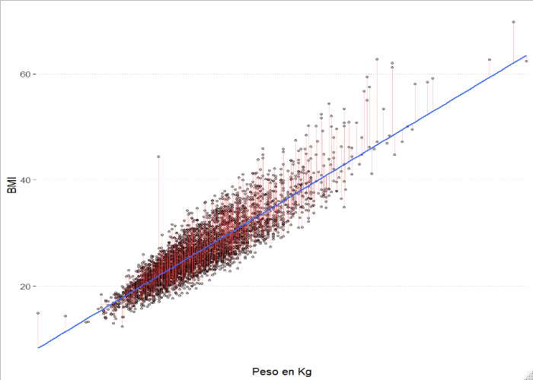
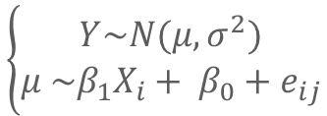
The model
24
Simple explanations for complicated relationships
Hypothesis
$$f(x)$$
$$X_{i}$$
$$Y_{i}$$
Weight is linked to obesity
$$\left\{\begin{aligned}Y\sim N(μ, σ^{2}) \\ μ \sim β_{1}X_{i}+ β_{0}+e_{ij}\end{aligned}\right.$$
library(data.table)
d <- fread(“Datasets/brownfat")
m <- lm(BMI ~ Weight, # Formula Y ~ X
data = d)

Slide 25
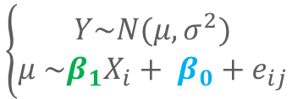
The model
25
Simple explanations for complicated relationships
Hypothesis
Weight is linked to obesity
Family: gaussian
Link function: identity
Formula:
BMI ~ weight
Parametric coefficients:
Estimate Std. Error t value Pr(>|t|)
(Intercept) 5.677964 0.167303 33.94 <2e-16 ***
weight 0.286155 0.002218 129.02 <2e-16 ***
---
Signif. codes: 0 ‘***’ 0.001 ‘**’ 0.01 ‘*’ 0.05 ‘.’ 0.1 ‘ ’ 1
Residual standard error: 2.803 on 4840 df
Multiple R-squared: 0.7747,Ajd. R-squared: 0.7747
F-statist: 1.665e+04 on 1 and 4840 DF,p-val: < 2.2e-16
$$\left\{\begin{aligned}Y\sim N(μ, σ^{2}) \\ μ \sim β_{1}X_{i}+ β_{0}+e_{ij}\end{aligned}\right.$$
library(data.table)
d <- fread(“Datasets/brownfat")
m <- lm(BMI ~ Weight, # Formula Y ~ X
data = d)
summary(m)
plot(m)

Slide 26

P-value
26
Data in an uncertain world, perfect knowledge of the uncertainty
Definition
Sensu stricto:
Probability corresponding to the statistic if possible under the null hypothesis. If it meets the condition of being less than the level of significance arbitrarily imposed, then the null hypothesis will eventually be rejected. (value of the calculated statistic). (Wikipedia, extracted in 2019)
Human definition
Proof by contradition
$$ℙ(x|H_{0})$$
Suppose I'm wrong, and there's no effect
Then, what is the probability that my data will be pure chance?

Slide 27
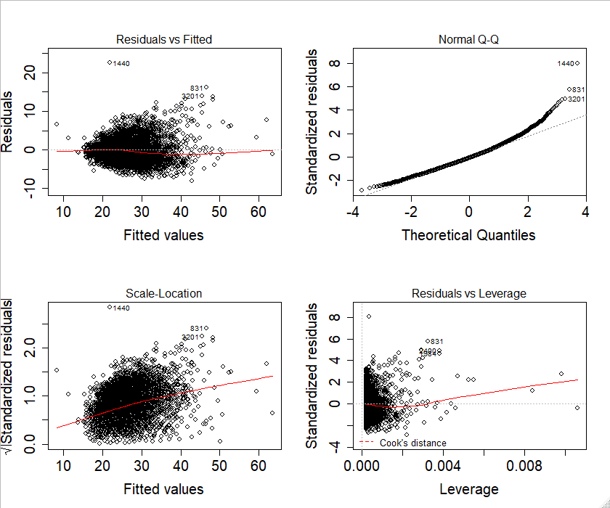

Diagnosis of a model
27
Data in an uncertain world, perfect knowledge of the uncertainty
Residual value
$$ε_{i}=(\hat{y}−y_{i})$$
Adjusted value vs residue: Shows if there is curvature in our model. Quartiles: Shows model waste follows a normal distribution Scale-Location: Shows if variance (sigma) is constant Leverage and residue: Shows the points with the greatest influence on the model
Notes:
Residual vs Fitted – The plot gives an idea of whether there is any curvature in the data. If the line is strongly curved, a quadratic or other model may be better.
Scale -Location– The plot is used to check if the variance is constant (ie, if the standard deviation among the residuals appears to be about constant). Fitted Vs root of(standadise residuals )
Residual vs Leverage This plot is used to check to see if there were any overly influential points .
Normal Q-Q The plot is to check whether the residuals are normally distributed.
I should mention the assumptions of the linear model

Slide 28
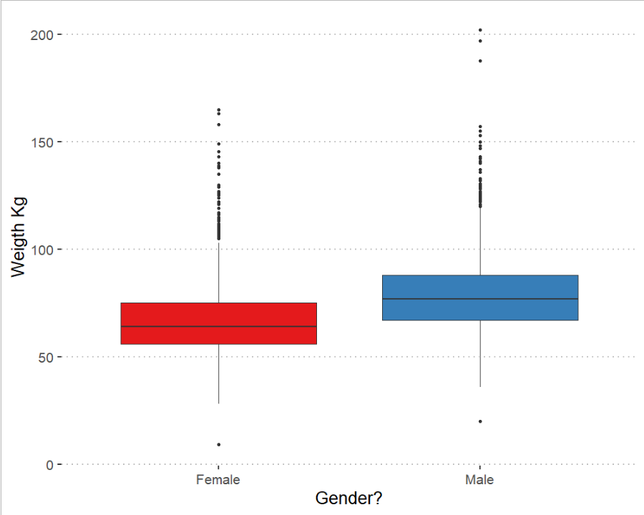
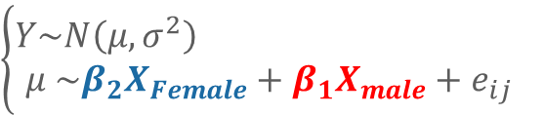
Categorical variables
28
Groups comparison
Hypothesis
Gender is related to weight
$$\left\{\begin{aligned}Y\sim N\left(μ, σ^{2}\right) \\ μ \sim β_{2}X_{Female}+β_{1}X_{male}+e_{ij}\end{aligned}\right.$$
d[,Sex_c := ifelse(Sex == 1, “Female", “Male")]
m1 <- lm(Weight ~ Sex_c, # Formula Y ~ X
data = d)
summary(m1)
plot(m1)
Notes:
Residual vs Fitted – The plot gives an idea of whether there is any curvature in the data. If the line is strongly curved, a quadratic or other model may be better.
Scale -Location– The plot is used to check if the variance is constant (ie, if the standard deviation among the residuals appears to be about constant). Fitted Vs root of(standadise residuals )
Residual vs Leverage This plot is used to check to see if there were any overly influential points .
Normal Q-Q The plot is to check whether the residuals are normally distributed.

Slide 29
Categorical variables
29
Compare groups
Hypothesis
Gender is related to weight
Call:
lm(formula = Weight ~ Sex_c, data = d)
Residuals:
Min 1Q Median 3Q Max
-59.065 -11.226 -2.109 8.866 122.935
Coefficients:
Estimate Std. Error t value Pr(>|t|)
(Intercept) 67.1095 0.3523 190.49 <2e-16 ***
Sex_cMale 11.9558 0.4931 24.25 <2e-16 ***
---
Signif. codes: 0 ‘***’ 0.001 ‘**’ 0.01 ‘*’ 0.05 ‘.’ 0.1 ‘ ’ 1
Residual standard error: 17.15 on 4840 degrees of freedom
Multiple R-squared: 0.1083, Adjusted R-squared: 0.1081
F-statistic: 588 on 1 and 4840 DF, p-value: < 2.2e-16
$$\left\{\begin{aligned}Y\sim N\left(μ, σ^{2}\right) \\ μ \sim β_{2}X_{Female}+β_{1}X_{male}+e_{ij}\end{aligned}\right.$$
d[,Sex_c := ifelse(Sex == 1, “Female", “Male")]
m1 <- lm(Weight ~ Sex_c, # Formula Y ~ X
data = d)
summary(m1)
plot(m1)
Notes:
Residual vs Fitted – The plot gives an idea of whether there is any curvature in the data. If the line is strongly curved, a quadratic or other model may be better.
Scale -Location– The plot is used to check if the variance is constant (ie, if the standard deviation among the residuals appears to be about constant). Fitted Vs root of(standadise residuals )
Residual vs Leverage This plot is used to check to see if there were any overly influential points .
Normal Q-Q The plot is to check whether the residuals are normally distributed.

Slide 30
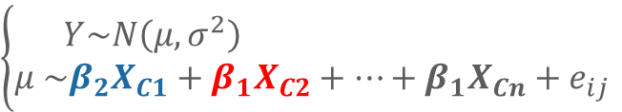
Categorical variables
30
Compare multiple groups
Hypothesis
Cancer is related to weight
$$\left\{\begin{aligned}Y\sim N\left(μ, σ^{2}\right) \\ μ \sim β_{2}X_{C1}+β_{1}X_{C2}+…+β_{1}X_{Cn}+e_{ij}\end{aligned}\right.$$
cancer_t <- c ("No cancer", "lung", "digestive", "ORL", "breast", "gynaecological (female)",
"genital (male)", "urothelial", "kidney", "brain", "skin", "thyroid", "prostate",
"non-Hodgkin lymphoma", "Hodgkin", "kaposi", "Myelona", "leukemia", "other")
d[, Cancer_t_cat := cancer_t[Cancer_Type + 1] %>% as.factor() ]
d[, Cancer_t_cat := relevel(Cancer_t_cat, ref = "No cancer") ]
m1.2 <- lm(Weight ~ Cancer_t_cat, data = d)
summary(m1.2)
Notes:
Residual vs Fitted – The plot gives an idea of whether there is any curvature in the data. If the line is strongly curved, a quadratic or other model may be better.
Scale -Location– The plot is used to check if the variance is constant (ie, if the standard deviation among the residuals appears to be about constant). Fitted Vs root of(standadise residuals )
Residual vs Leverage This plot is used to check to see if there were any overly influential points .
Normal Q-Q The plot is to check whether the residuals are normally distributed.

Slide 31
Categorical variables
31
Compare groups
Call:
lm(formula = Weight ~ Cancer_t_cat, data = d)
Residuals:
Min 1Q Median 3Q Max
-65.464 -12.604 -2.300 9.819 127.396
Coefficients:
Estimate Std. Error t value Pr(>|t|)
(Intercept) 69.1846 5.0183 13.786 <2e-16 ***
Cancer_t_catbreast -0.4923 5.2232 -0.094 0.9249
Cancer_t_catdigestive 3.5625 5.0877 0.700 0.4838
. . . . .
Cancer_t_catprostate 7.3554 6.4461 1.141 0.2539
Cancer_t_catskin 10.1125 5.8768 1.721 0.0854 .
Cancer_t_catthyroid 10.7106 6.3854 1.677 0.0935 .
Cancer_t_caturothelial 6.1154 5.4254 1.127 0.2597
---
Signif. codes: 0 ‘***’ 0.001 ‘**’ 0.01 ‘*’ 0.05 ‘.’ 0.1 ‘ ’ 1
Residual standard error: 18.09 on 4454 degrees of freedom
(369 observations deleted due to missingness)
Multiple R-squared: 0.01568, Adjusted R-squared: 0.0117
F-statistic: 3.942 on 18 and 4454 DF, p-value: 3.687e-08
Notes:
Residual vs Fitted – The plot gives an idea of whether there is any curvature in the data. If the line is strongly curved, a quadratic or other model may be better.
Scale -Location– The plot is used to check if the variance is constant (ie, if the standard deviation among the residuals appears to be about constant). Fitted Vs root of(standadise residuals )
Residual vs Leverage This plot is used to check to see if there were any overly influential points .
Normal Q-Q The plot is to check whether the residuals are normally distributed.

Slide 32
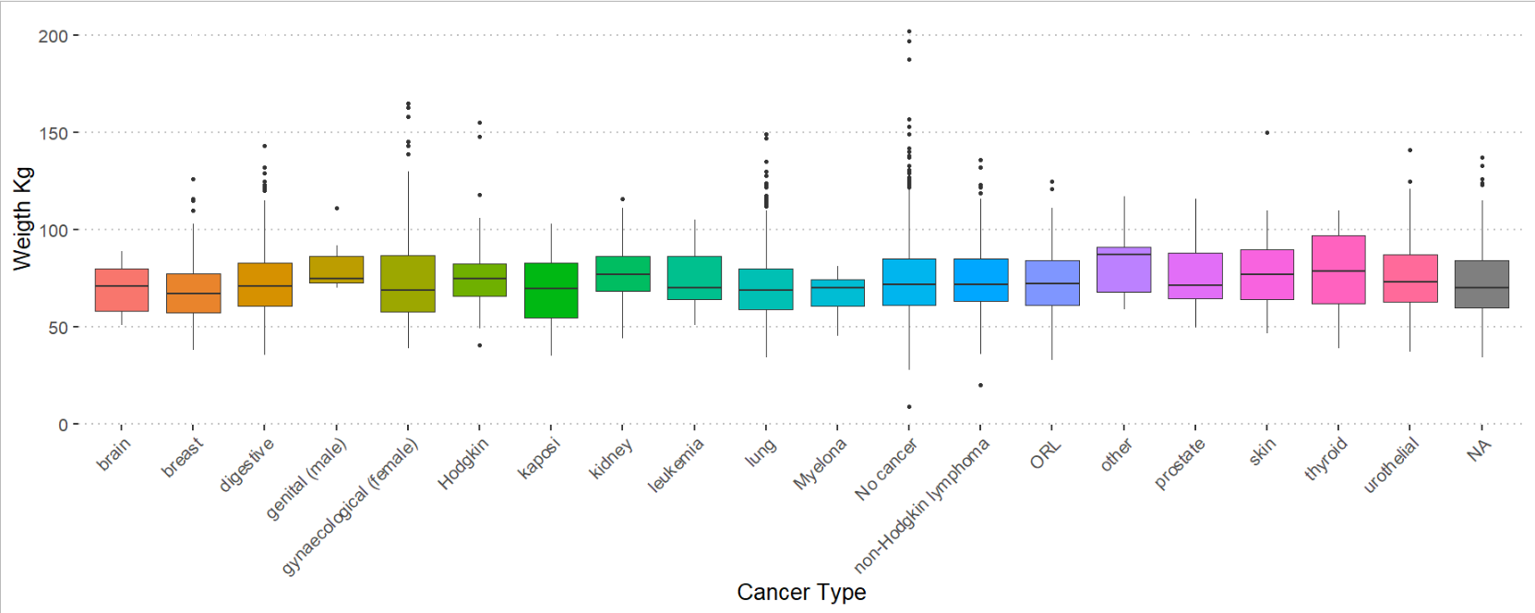
Categorical variables
32
Compare groups
Hypothesis
Notes:
Residual vs Fitted – The plot gives an idea of whether there is any curvature in the data. If the line is strongly curved, a quadratic or other model may be better.
Scale -Location– The plot is used to check if the variance is constant (ie, if the standard deviation among the residuals appears to be about constant). Fitted Vs root of(standadise residuals )
Residual vs Leverage This plot is used to check to see if there were any overly influential points .
Normal Q-Q The plot is to check whether the residuals are normally distributed.

Slide 33
Time to program
For example
d <- fread("Datasets/BrownFat_2011.csv")
m <- lm(BMI ~ Weigth, # Formula Y ~ X
data = d, )
summary(m)
plot(m)

Slide 34




Multiple regression
34
Family grows
Hypothesis
We suspect there's more parameters (Xi, Xj) that might condition the variability of Y
$$X_{i}$$
$$X_{j}$$
$$X_{i}$$
$$X_{j}$$
$${XX}_{ij}$$
$$Y_{i}$$
$$Y_{i}$$
$$Y_{i}$$

Slide 35



Adding variables
35
Family grows
Hypothesis
The Xi and Xj parameters control the variability of the Y variable
$$\left\{\begin{aligned}Y\sim N(μ, σ^{2}) \\ μ \sim β_{2}X_{j}+ β_{1}X_{i}+ β_{0}+e_{ij}\end{aligned}\right.$$
$$\left\{\begin{aligned}Y\sim N(μ, σ^{2}) \\ μ \sim β_{3}X_{i}X_{j}+ β_{2}X_{j}+ β_{1}X_{i}+ β_{0}+e_{ij}\end{aligned}\right.$$
$$\left\{\begin{aligned}Y\sim N(μ, σ^{2}) \\ μ \sim β_{2}X_{i}X_{j}+ β_{0}+e_{ij}\end{aligned}\right.$$
update() # The update function allows us to update an already initialized model!
m2 <- update(m, ~ . + Sex_c) # From the parameters
m3.1 <- update(m, ~ Sex_c*Weight) # Two parameters with interaction
m3.2 <- update(m, ~ Sex_c:Weight) # Two parameters with interaction

Slide 36
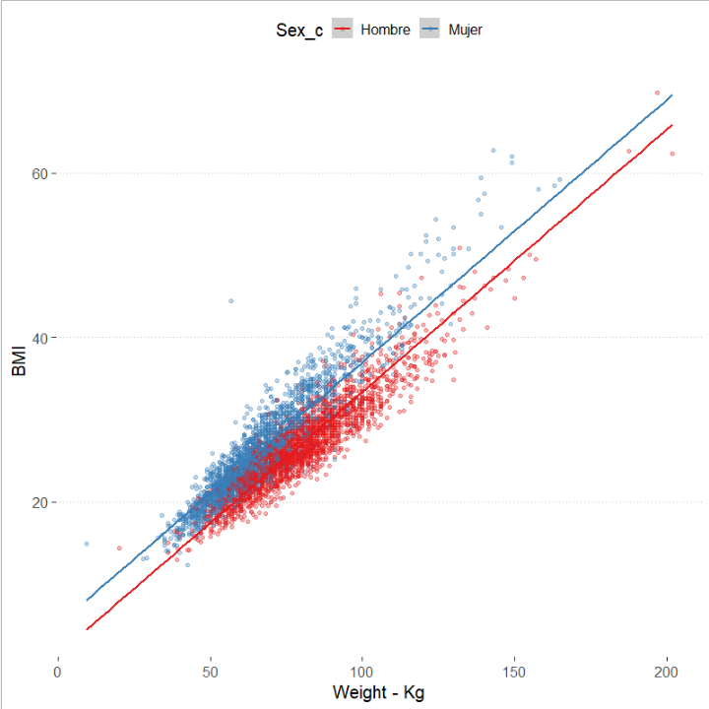
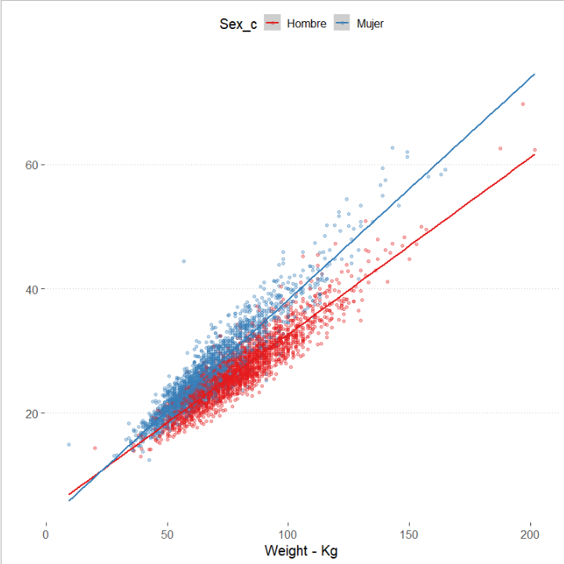
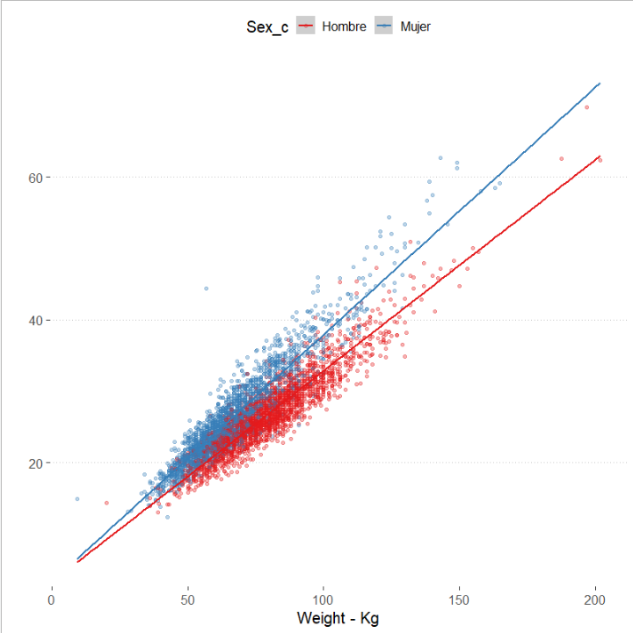



Adding variables
36
Family grows
$$\left\{\begin{aligned}Y\sim N(μ, σ^{2}) \\ μ \sim β_{2}X_{j}+ β_{1}X_{i}+ β_{0}+e_{ij}\end{aligned}\right.$$
$$\left\{\begin{aligned}Y\sim N(μ, σ^{2}) \\ μ \sim β_{3}X_{i}X_{j}+ β_{2}X_{j}+ β_{1}X_{i}+ β_{0}+e_{ij}\end{aligned}\right.$$
$$\left\{\begin{aligned}Y\sim N(μ, σ^{2}) \\ μ \sim β_{2}X_{i}X_{j}+ β_{0}+e_{ij}\end{aligned}\right.$$

Slide 37
Adding variables
37
Understanding interactions
summary(m2)
>
Call:
lm(formula = BMI ~ Weight + Sex_c, data = d)
Residuals:
Min 1Q Median 3Q Max
-8.924 -1.487 -0.087 1.340 21.199
Coefficients:
Estimate Std. Error t value Pr(>|t|)
(Intercept) 1.530807 0.154388 9.915 <2e-16 ***
Weight 0.318749 0.001868 170.592 <2e-16 ***
Sex_cMujer 3.597444 0.067875 53.001 <2e-16 ***
---
Signif. codes: 0 ‘***’ 0.001 ‘**’ 0.01 ‘*’ 0.05 ‘.’ 0.1 ‘ ’ 1
Residual standard error: 2.229 on 4839 degrees of freedom
Multiple R-squared: 0.8575, Adjusted R-squared: 0.8574
F-statistic: 1.456e+04 on 2 and 4839 DF, p-value: < 2.2e-16
summary(m3.1)
Call:
lm(formula = BMI ~ Weight + Sex_c + Weight:Sex_c, data = d)
Residuals:
Min 1Q Median 3Q Max
-9.836 -1.380 -0.090 1.276 21.596
Coefficients:
Estimate Std. Error t value Pr(>|t|)
(Intercept) 4.244629 0.200291 21.192 < 2e-16 ***
Weight 0.284425 0.002474 114.967 < 2e-16 ***
Sex_cMujer -1.675915 0.269593 -6.216 5.51e-10 ***
Weight:Sex_cMujer 0.072464 0.003595 20.159 < 2e-16 ***
---
Signif. codes: 0 ‘***’ 0.001 ‘**’ 0.01 ‘*’ 0.05 ‘.’ 0.1 ‘ ’ 1
Residual standard error: 2.142 on 4838 degrees of freedom
Multiple R-squared: 0.8685, Adjusted R-squared: 0.8684
F-statistic: 1.065e+04 on 3 and 4838 DF, p-value: < 2.2e-16
summary(m3.2)
Call:
lm(formula = BMI ~ Weight:Sex_c, data = d)
Residuals:
Min 1Q Median 3Q Max
-9.6288 -1.3829 -0.1024 1.2826 21.4415
Coefficients:
Estimate Std. Error t value Pr(>|t|)
(Intercept) 3.319602 0.134588 24.66 <2e-16 ***
Weight:Sex_cHombre 0.295583 0.001709 172.95 <2e-16 ***
Weight:Sex_cMujer 0.346364 0.001991 173.93 <2e-16 ***
---
Signif. codes: 0 ‘***’ 0.001 ‘**’ 0.01 ‘*’ 0.05 ‘.’ 0.1 ‘ ’ 1
Residual standard error: 2.15 on 4839 degrees of freedom
Multiple R-squared: 0.8675, Adjusted R-squared: 0.8674
F-statistic: 1.584e+04 on 2 and 4839 DF, p-value: < 2.2e-16

Slide 38
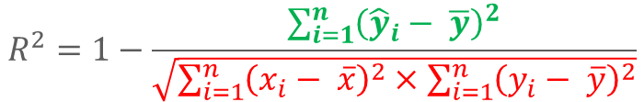
Compare models/divergence
38
Regularization and Information Criteria
Explained variance
Determination coefficient (R²):
Proportion of variance explained
For normo-linear models only
Don't discount the number of parameters
$$R^{2}=1−\frac{\sum_{i=1}^{n}{{\left({\hat{y}}_{i}− \overline{y}\right)}^{2}}}{\sqrt{\sum_{i=1}^{n}{{\left(x_{i}− \overline{x}\right)}^{2}}×\sum_{i=1}^{n}{{\left(y_{i}− \overline{y}\right)}^{2}}}}$$
Sample variance
Notes:
Problem 1: Every time you add a predictor to a model, the R-squared increases, even if due to chance alone. It never decreases. Consequently, a model with more terms may appear to have a better fit simply because it has more terms.
Problem 2: If a model has too many predictors and higher order polynomials, it begins to model the random noise in the data. This condition is known as overfitting the model and it produces misleadingly high R-squared values and a lessened ability to make predictions.

Slide 39
Adding variables
39
Understanding interactions
summary(m2)
>
Call:
lm(formula = BMI ~ Weight + Sex_c, data = d)
Residuals:
Min 1Q Median 3Q Max
-8.924 -1.487 -0.087 1.340 21.199
Coefficients:
Estimate Std. Error t value Pr(>|t|)
(Intercept) 1.530807 0.154388 9.915 <2e-16 ***
Weight 0.318749 0.001868 170.592 <2e-16 ***
Sex_cMujer 3.597444 0.067875 53.001 <2e-16 ***
---
Signif. codes: 0 ‘***’ 0.001 ‘**’ 0.01 ‘*’ 0.05 ‘.’ 0.1 ‘ ’ 1
Residual standard error: 2.229 on 4839 degrees of freedom
Multiple R-squared: 0.8575, Adjusted R-squared: 0.8574
F-statistic: 1.456e+04 on 2 and 4839 DF, p-value: < 2.2e-16
summary(m3.2)
Call:
lm(formula = BMI ~ Weight:Sex_c, data = d)
Residuals:
Min 1Q Median 3Q Max
-9.6288 -1.3829 -0.1024 1.2826 21.4415
Coefficients:
Estimate Std. Error t value Pr(>|t|)
(Intercept) 3.319602 0.134588 24.66 <2e-16 ***
Weight:Sex_cHombre 0.295583 0.001709 172.95 <2e-16 ***
Weight:Sex_cMujer 0.346364 0.001991 173.93 <2e-16 ***
---
Signif. codes: 0 ‘***’ 0.001 ‘**’ 0.01 ‘*’ 0.05 ‘.’ 0.1 ‘ ’ 1
Residual standard error: 2.15 on 4839 degrees of freedom
Multiple R-squared: 0.8675, Adjusted R-squared: 0.8674
F-statistic: 1.584e+04 on 2 and 4839 DF, p-value: < 2.2e-16

Slide 40

The problem of over-adjustment
40
Memorizing data is not understanding it
Hypothesis
What other variables do you think influence the BMI?
Maybe the gender?
Diabetes?
Height?
The season and day of observation?
Remember Ockham's knife
Non sunt multiplicanda entia sine necessitate
An explanation should not be complicated without need
Willem of Ockham, Iglesia de Surrey
Notes:
Entities are not to be multiplied without necessity

Slide 41
The problem of over-fitting
41
Memorizing data is not knowledge
m4 <- lm(BMI ~ Weigth * Age + Height + Sex + Day + Season + Ext_Temp, data = d, )
m5 <- lm(BMI ~ Weigth * Age + Height + Sex, data = d)
summary(m4)
…
…
Multiple R-squared:0.9846,Adj. R-squared: 0.9846
F-st: 2.8e+04 on 255 and 4586 DF, p-value: < 2.2e-16
summary(m5)
…
…
Multiple R-squared: 0.9846, Adj R-squared: 0.9846
F-st: 1.3e+05 on 4 and 4837 DF, p-value: < 2.2e-16
Notes:
Los modelos son ciegos a la realidad, solo ven la información que les damos.

Slide 42

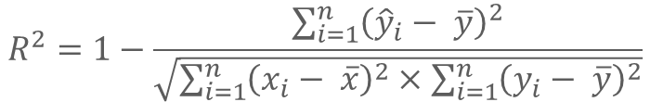
Compare models/divergence
42
Regularization and Information Criteria
Determination coefficient:
For normo-linear models only
Don't discount the number of parameters
Akaike Information Criterion (AIC):
Probability of measured values relative to the theoretical model Penalizes complex models
$$R^{2}=1−\frac{\sum_{i=1}^{n}{{\left({\hat{y}}_{i}− \overline{y}\right)}^{2}}}{\sqrt{\sum_{i=1}^{n}{{\left(x_{i}− \overline{x}\right)}^{2}}×\sum_{i=1}^{n}{{\left(y_{i}− \overline{y}\right)}^{2}}}}$$
$$AIC=−log⁡(ℙ\left(Θ | Y\right)+kτ$$
AIC(m4, m5, k = log(nrow(d))) %$% .[order(AIC), ] # If K ~ log(n), then AIC = BIC
> df AIC
m5 7 10720.20
m4 10 10740.47
Notes:
Problem 1: Every time you add a predictor to a model, the R-squared increases, even if due to chance alone. It never decreases. Consequently, a model with more terms may appear to have a better fit simply because it has more terms.
Problem 2: If a model has too many predictors and higher order polynomials, it begins to model the random noise in the data. This condition is known as overfitting the model and it produces misleadingly high R-squared values and a lessened ability to make predictions.

Slide 43
Present results
43
Tables vs images
Coef. | 2.50% | 97.50% | Estimate
(Intercept) | 52.84821 | 54.08622 | 53.46721
Weight | 0.341727 | 0.35174 | 0.346734
Age | -0.02391 | -0.01199 | -0.01795
Height | -0.31998 | -0.31354 | -0.31676
Sex2 | -0.17377 | -0.05999 | -0.11688
Weight:Age | 0.000225 | 0.000387 | 0.000306
result <- confint(m5) %>%
data.table(., keep.rownames = T)
result[, Estimate := coef(m5)]
library(sjPlot)
plot_model(m5, show.values = TRUE, sort.est = TRUE, value.offset = .3)
Notes:
Entities are not to be multiplied without necessity

Slide 44
Otras funciones importantes
44
Nunca hay timpo para hablar de todo
summary(data) # Summary report of the table
cor(x, y) # Correlation between two variables
GGally::ggpairs(data) # Pair plot for all variables GGally::ggcorr(data) # Correlation plot for all variables
model <- lm(y ~ x, data = d) # Simple model
model <- lm(y ~ ., data = d) # Model with all the variables
summary(model) # Summary report of the model
coef(model) # Extract coefficients
confint(model) # Extract confidence intervals
plot(model) # Represent model
predict(model, newdata = ) # Predict new data not seen by the model
fitted(model) # Strate tight values
resid(model) # Extracting residual error
allEffects(model) # Extract all effects from the model

Slide 45
Time to program
For example
d <- fread("Datasets/BrownFat_2011.csv")
# Find the best possible model
m <- lm(BMI ~ ., # Formula Y ~ X
data = d, )
summary(m)
plot(m)

Slide 46




Support channels
46
Interactive support
StatQuest https://www.youtube.com/channel/UCtYLUTtgS3k1Fg4y5tAhLbw
Seeing Theory
https://seeing-theory.brown.edu/
3Blue1brown
https://www.youtube.com/channel/UCYO_jab_esuFRV4b17AJtAw
Stats of DOOM
https://www.youtube.com/channel/UCMdihazndR0f9XBoSXWqnYg

Slide 47
¡Gracias por
vuestro tiempo!
¿Preguntas?

