Slide 1
Wrap-up: Stats in R
Aaron Weimann

Slide 2
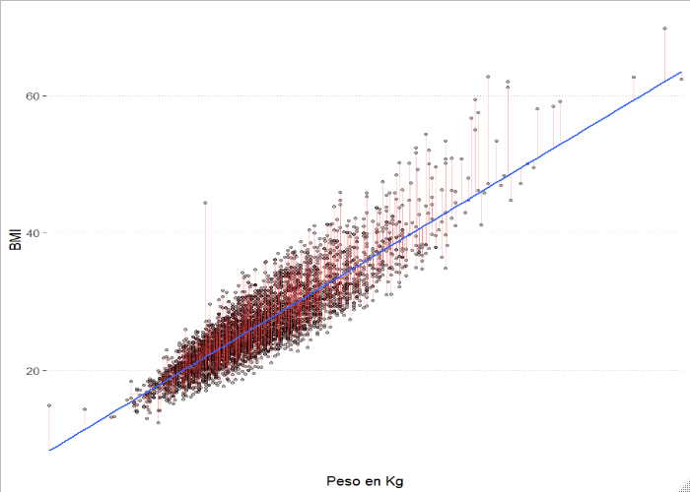

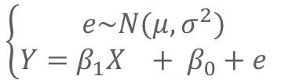


Linear models
2
Simple explanations for complicated relationships
Hypothesis
$$f(x)$$
$$X_{i}$$
$$Y_{i}$$
Weight is linked to obesity in a linear fashion
$$\left\{\begin{aligned}e\sim N(μ, σ^{2}) \\ Y=β_{1}X_{}+ β_{0}+e_{}\end{aligned}\right.$$
library(data.table)
d <- fread(“Datasets/brownfat")
m <- lm(BMI ~ Weight, # Formula Y ~ X
data = d)

Slide 3
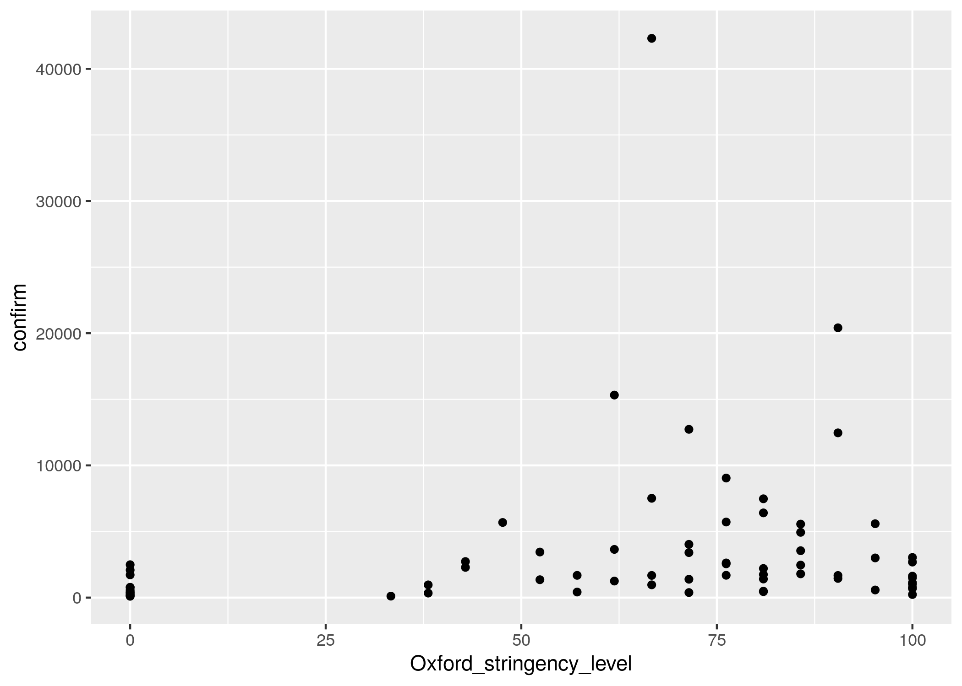
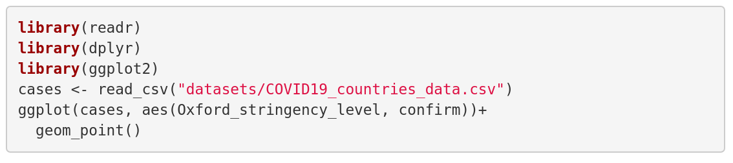
Oxford stringency level vs. number of cases

Slide 4
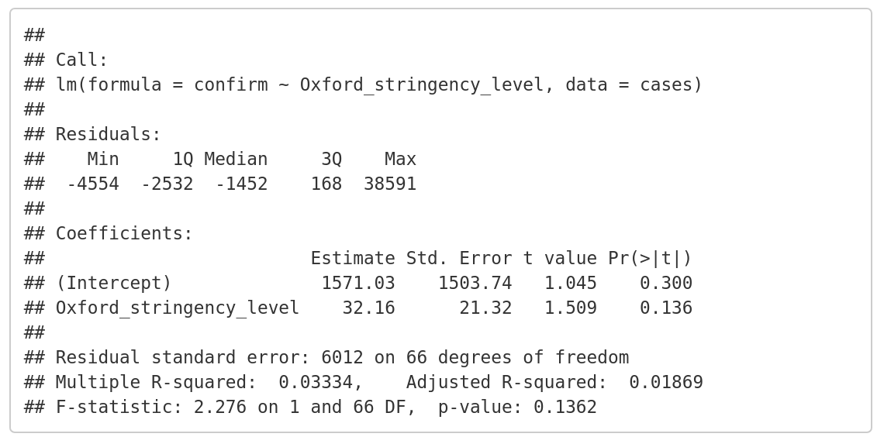
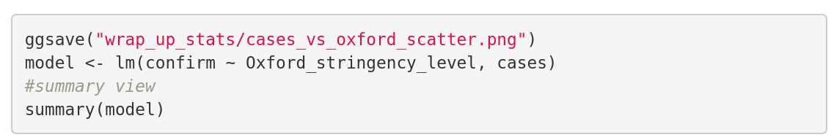
A linear model of case numbers
The R call
Summary of the
residuals
Each independent variable
Coefficient of determination R^2

Slide 5
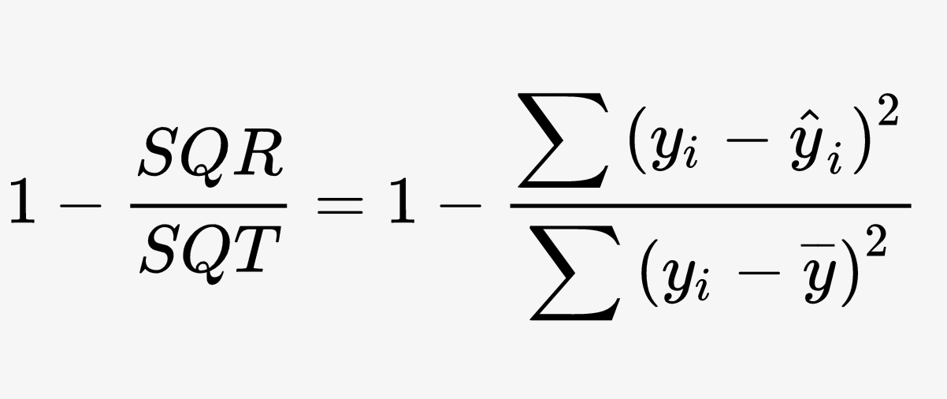
Coefficient of determination
R² =

Slide 6
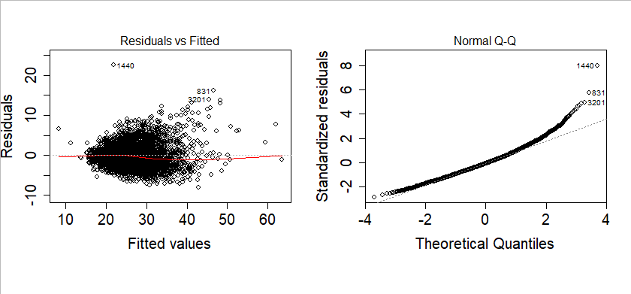
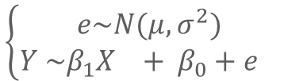

Diagnosis of a model
6
Data in an uncertain world, perfect knowledge of the uncertainty
Residual value
$$ε_{i}=(\hat{yi}−y_{i})$$
$$\left\{\begin{aligned}e\sim N(μ, σ^{2}) \\ Y \sim β_{1}X_{}+ β_{0}+e_{}\end{aligned}\right.$$
Residuals vs Fitted: Shows how residuals are distributed around the fitted values Quartiles: Shows if residuals follow a normal distribution
Notes:
Residual vs Fitted – The plot gives an idea of whether there is any curvature in the data. If the line is strongly curved, a quadratic or other model may be better.
Scale -Location– The plot is used to check if the variance is constant (ie, if the standard deviation among the residuals appears to be about constant). Fitted Vs root of(standadise residuals )
Residual vs Leverage This plot is used to check to see if there were any overly influential points .
Normal Q-Q The plot is to check whether the residuals are normally distributed.
I should mention the assumptions of the linear model

Slide 7
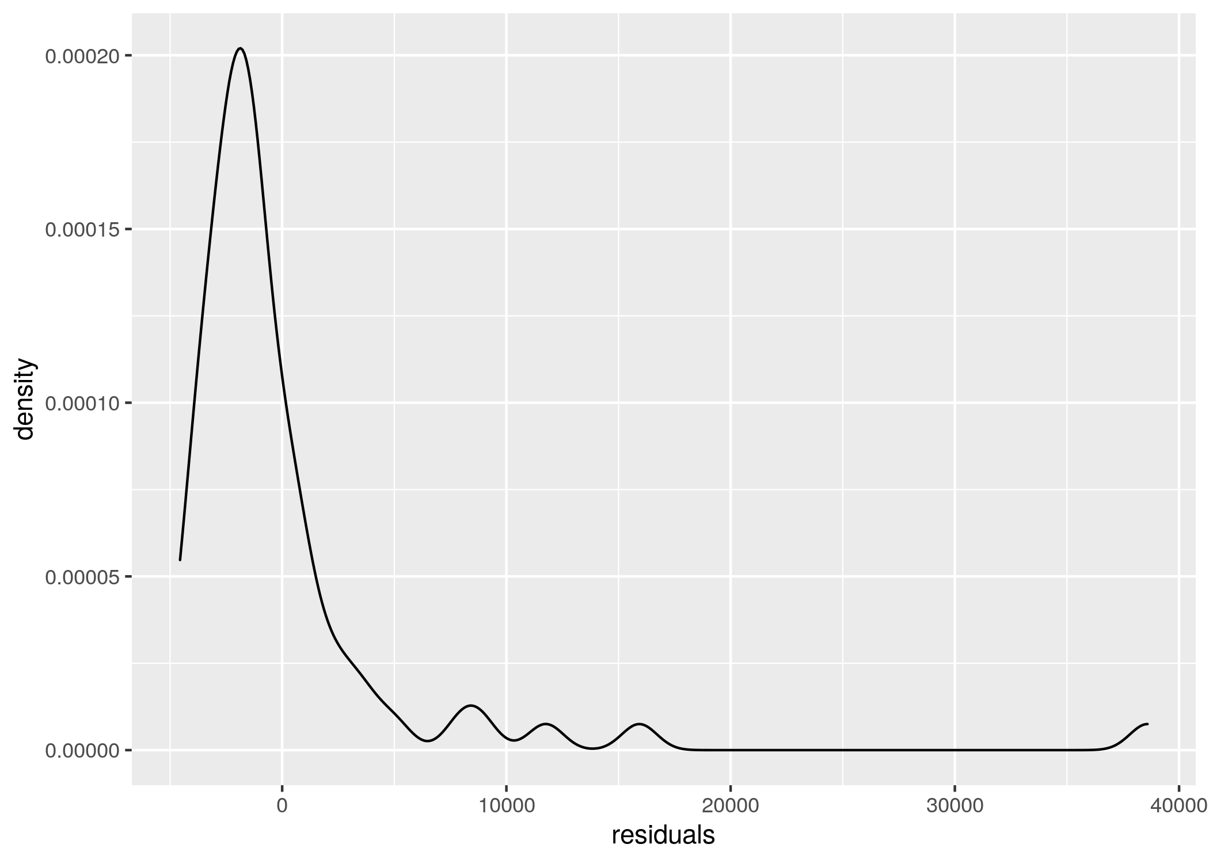
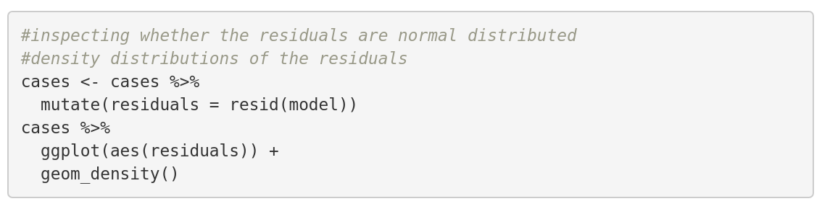
Inspecting the residuals
Does the distribution have a bell shape of a normal distribution?

Slide 8
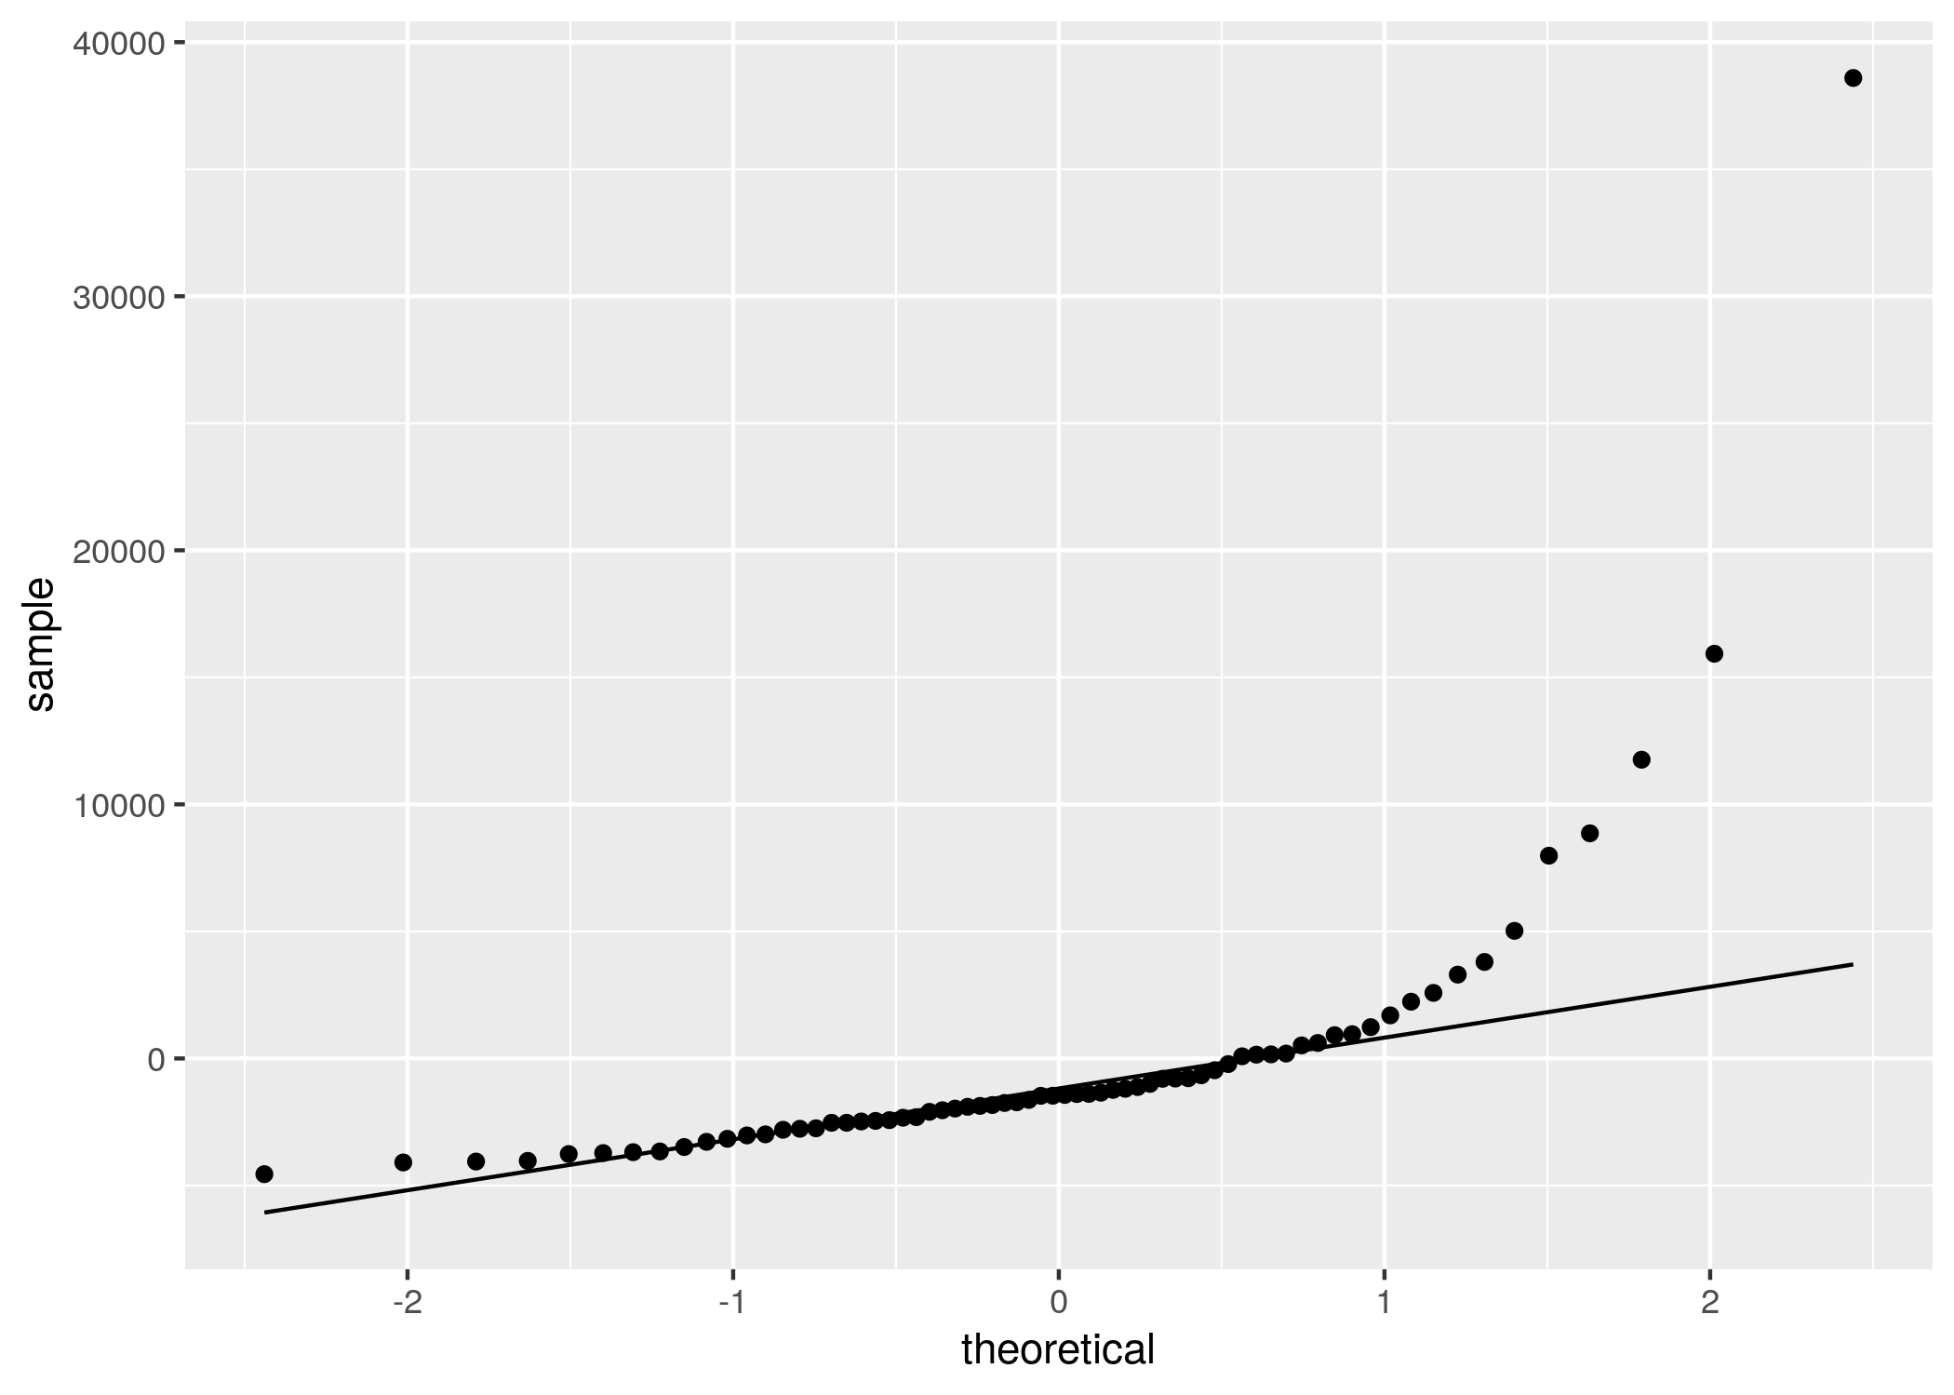
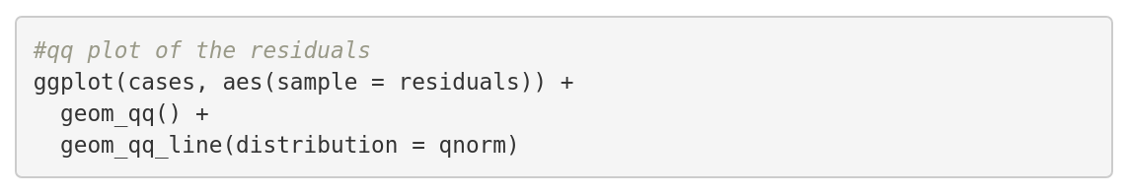
A q-q plot of the residuals
Do the quartiles of the residuals lies on a straight line corresponding to a normal distribution?

Slide 9
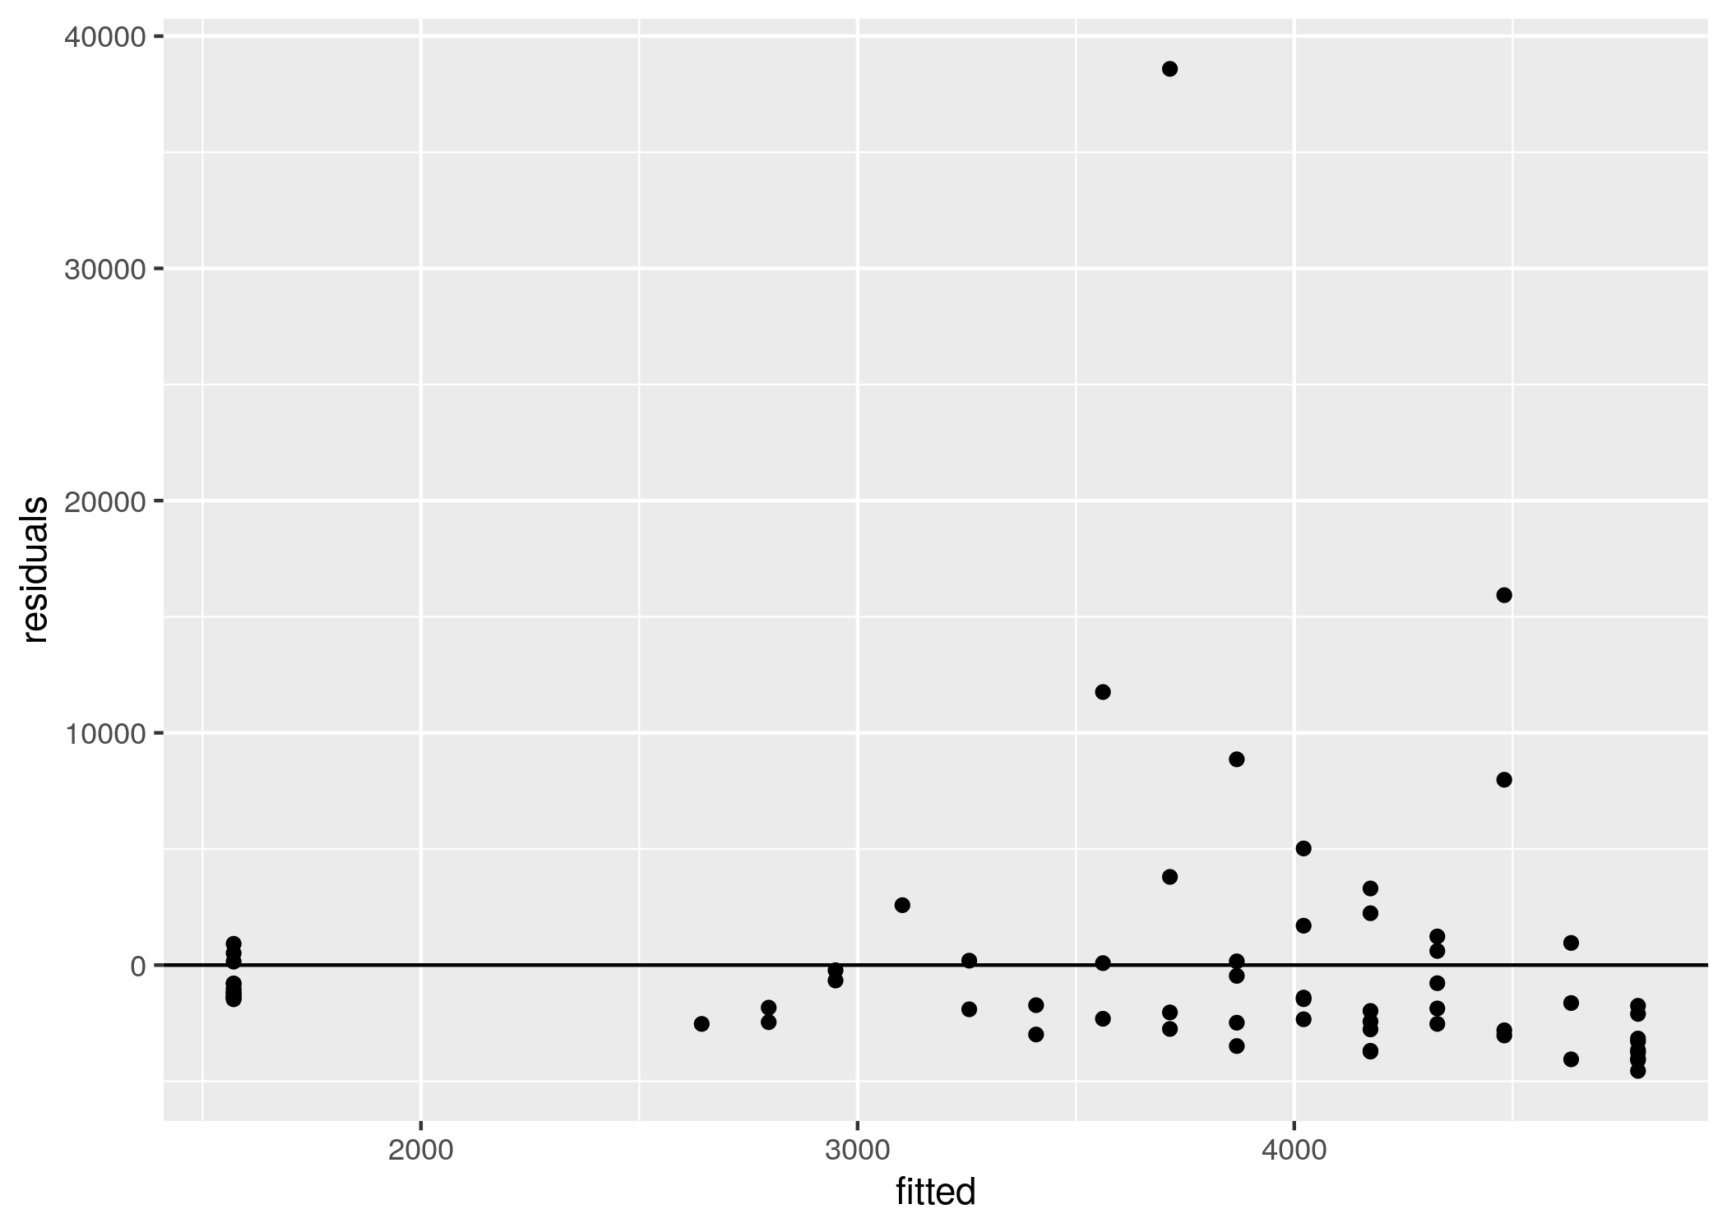
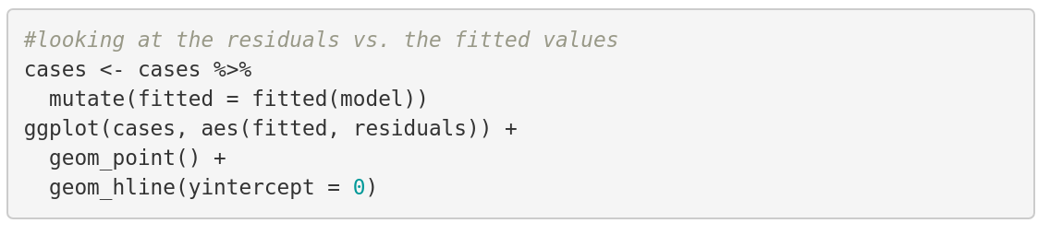
The residuals vs the fitted values
Are the residuals spread evenly on both sides of the horizontal 0-axis?

Slide 10
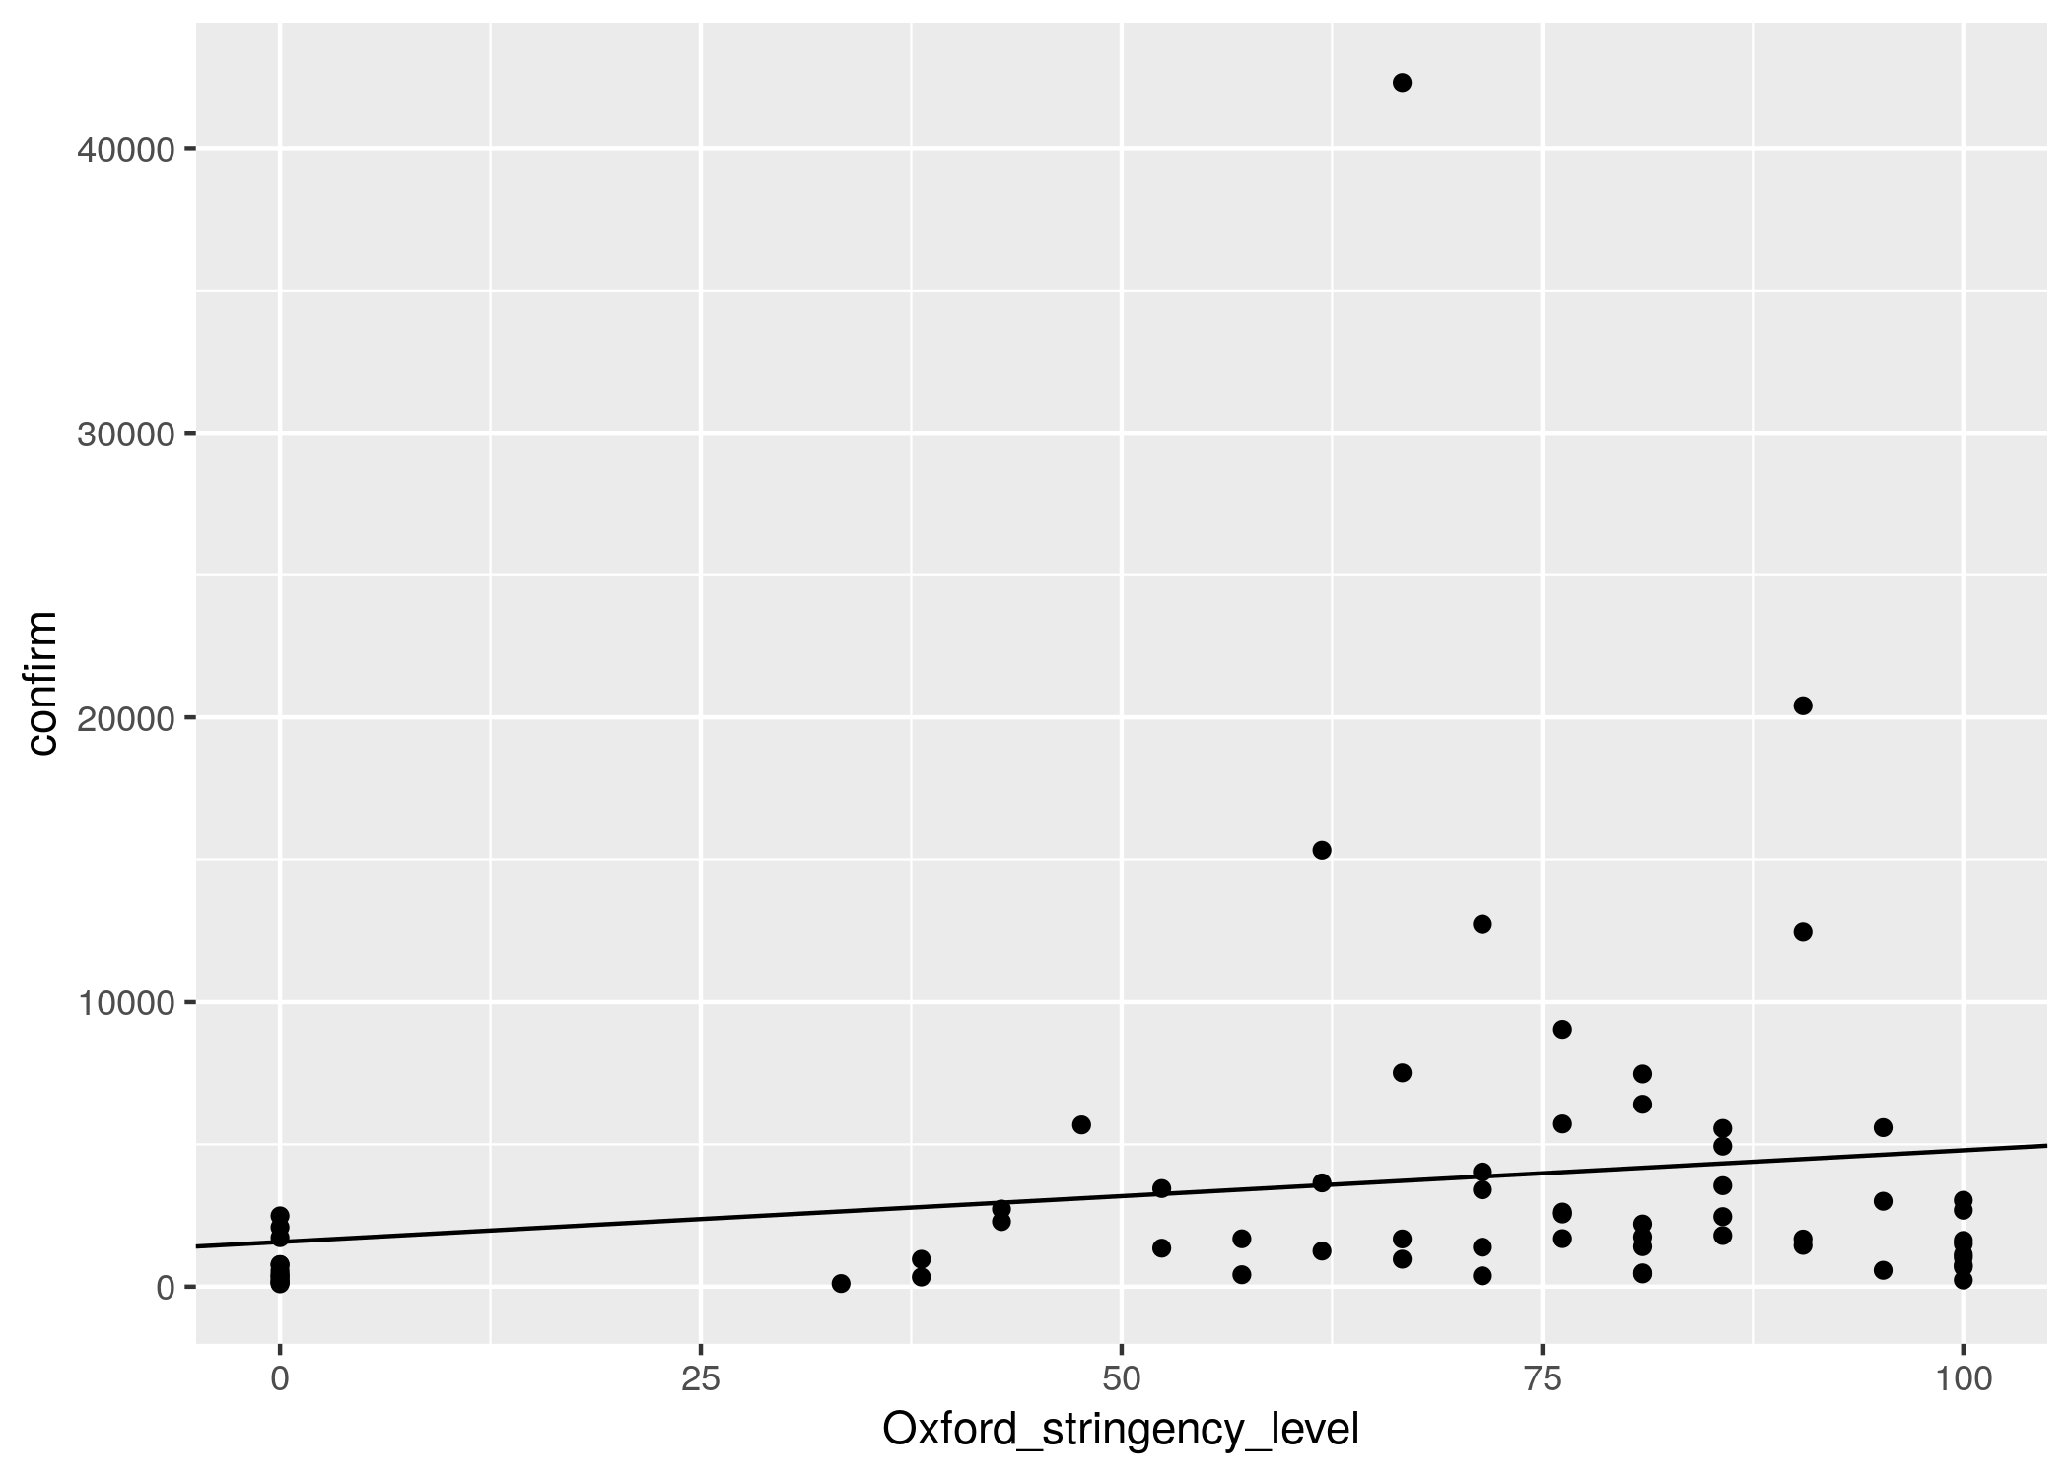
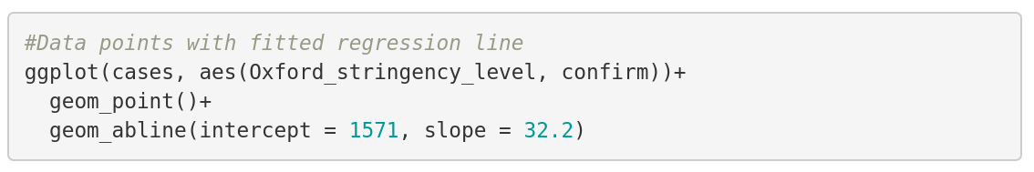
Plotting the regression line

Slide 11
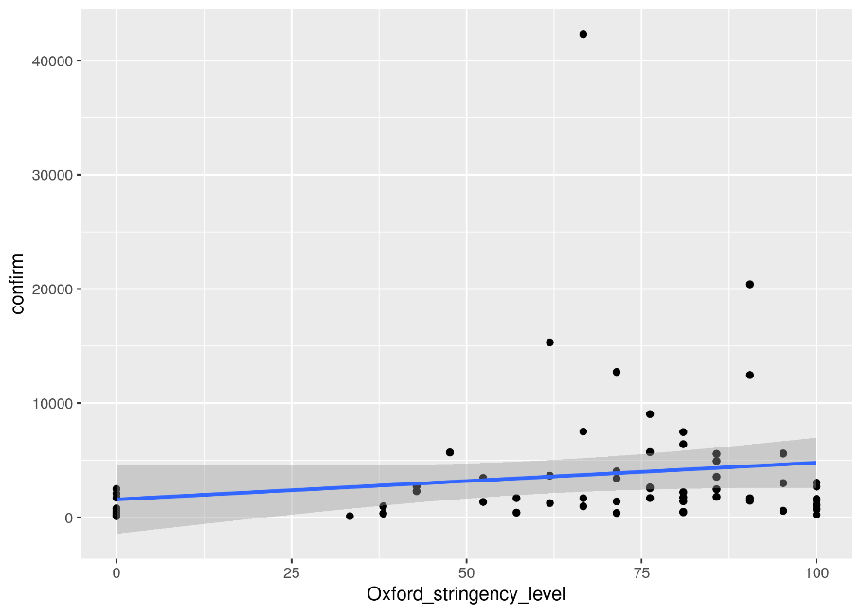
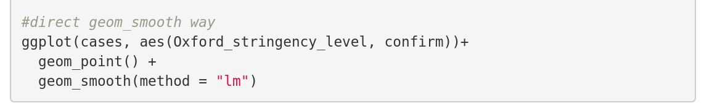
A geometry for linear models

Slide 12




Multiple regression
12
Family grows
Hypothesis
We suspect there's more parameters (Xi, Xj) that might condition the variability of Y
$$X_{i}$$
$$X_{j}$$
$$X_{i}$$
$$X_{j}$$
$${XX}_{ij}$$
$$Y_{i}$$
$$Y_{i}$$
$$Y_{i}$$

Slide 13
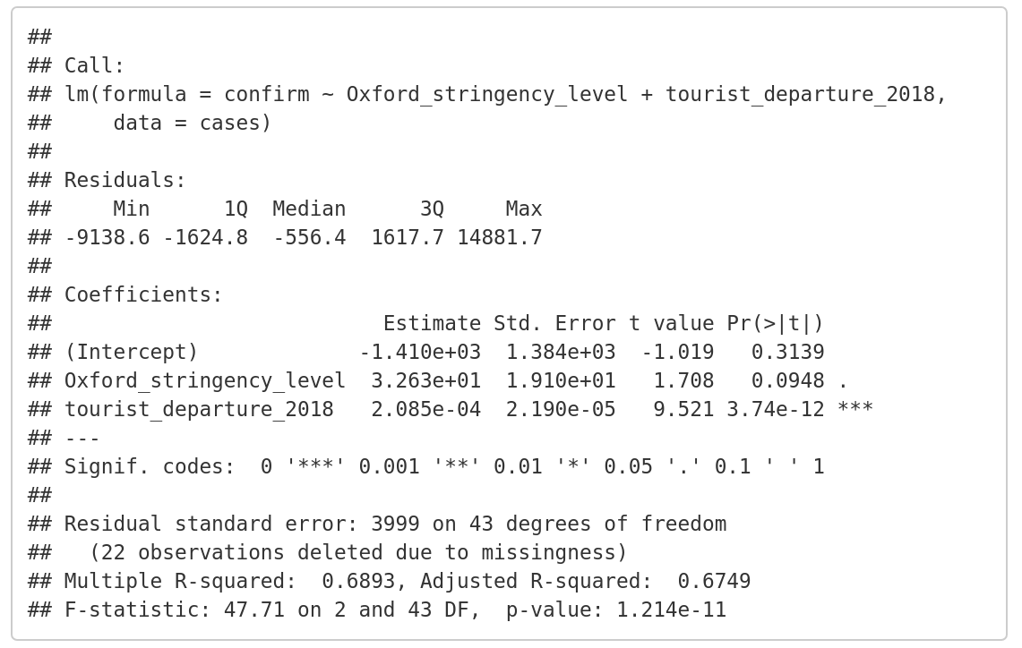
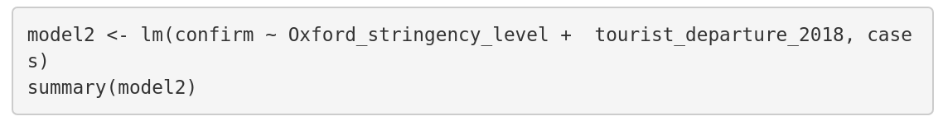
More complicated models

Slide 14
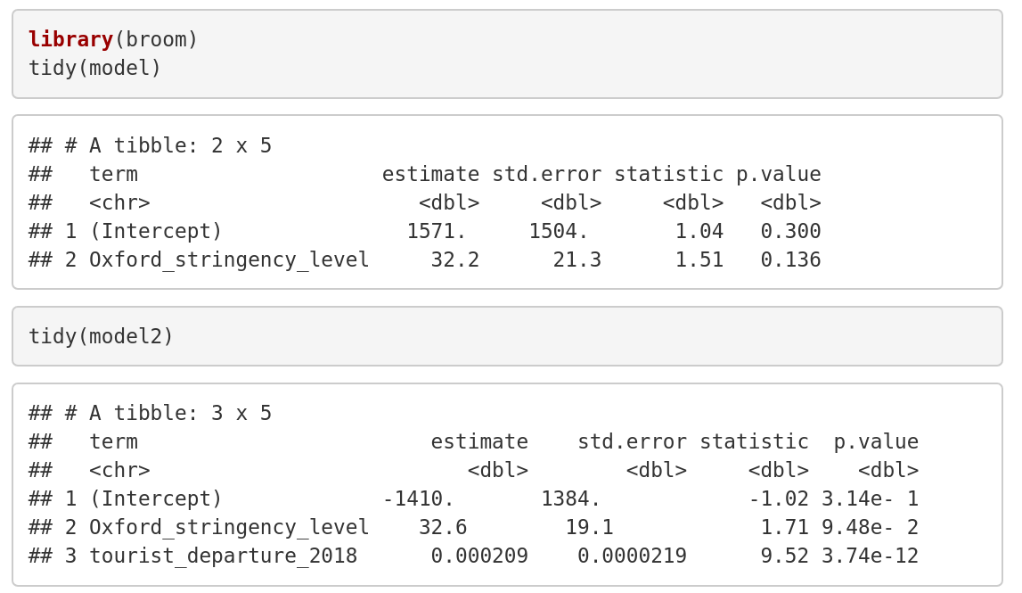

Tidy models with Broom

Slide 15
Present results
15
Tables vs images
Coef. | 2.50% | 97.50% | Estimate
(Intercept) | 52.84821 | 54.08622 | 53.46721
Weight | 0.341727 | 0.35174 | 0.346734
Age | -0.02391 | -0.01199 | -0.01795
Height | -0.31998 | -0.31354 | -0.31676
Sex2 | -0.17377 | -0.05999 | -0.11688
Weight:Age | 0.000225 | 0.000387 | 0.000306
Notes:
Entities are not to be multiplied without necessity

Slide 16
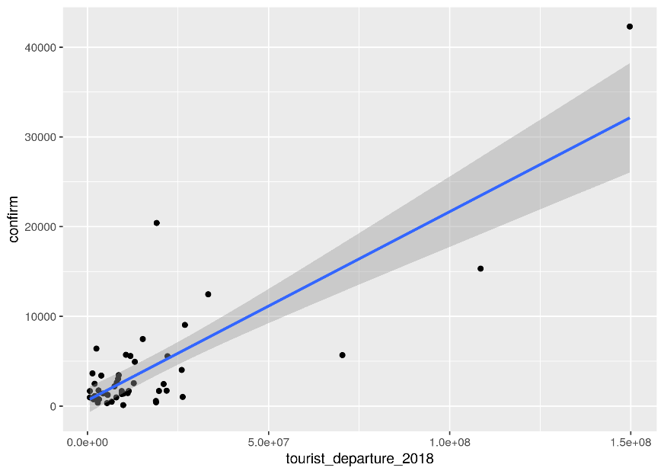
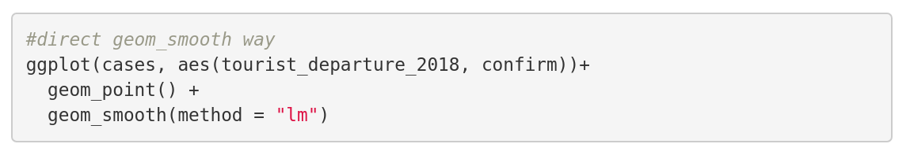
A better model of case numbers

Slide 17

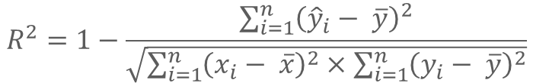
Compare models/divergence
17
Regularization and Information Criteria
Determination coefficient:
For normo-linear models only
Don't discount the number of parameters
Akaike Information Criterion (AIC):
Probability of measured values relative to the theoretical model Penalizes complex models
$$R^{2}=1−\frac{\sum_{i=1}^{n}{{\left({\hat{y}}_{i}− \overline{y}\right)}^{2}}}{\sqrt{\sum_{i=1}^{n}{{\left(x_{i}− \overline{x}\right)}^{2}}×\sum_{i=1}^{n}{{\left(y_{i}− \overline{y}\right)}^{2}}}}$$
$$AIC=−log⁡(ℙ\left(Θ | Y\right)+kτ$$
AIC(m4, m5, k = log(nrow(d))) %$% .[order(AIC), ] # If K ~ log(n), then AIC = BIC
> df AIC
m5 7 10720.20
m4 10 10740.47
Notes:
Problem 1: Every time you add a predictor to a model, the R-squared increases, even if due to chance alone. It never decreases. Consequently, a model with more terms may appear to have a better fit simply because it has more terms.
Problem 2: If a model has too many predictors and higher order polynomials, it begins to model the random noise in the data. This condition is known as overfitting the model and it produces misleadingly high R-squared values and a lessened ability to make predictions.

