Slide 1
Probability distributions
Santiago Caño Muñiz, Aaron Weimann, Chris Ruis
https://aweimann.github.io/floto-lab-learning-bioinformatics/docs/

Slide 2
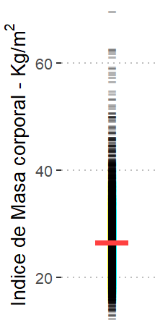
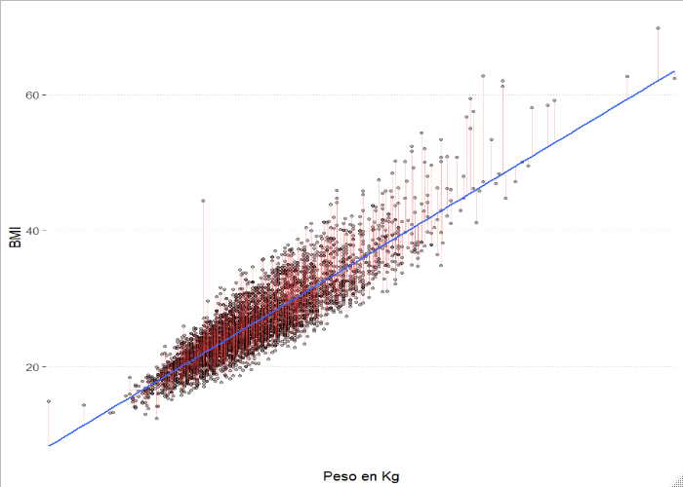
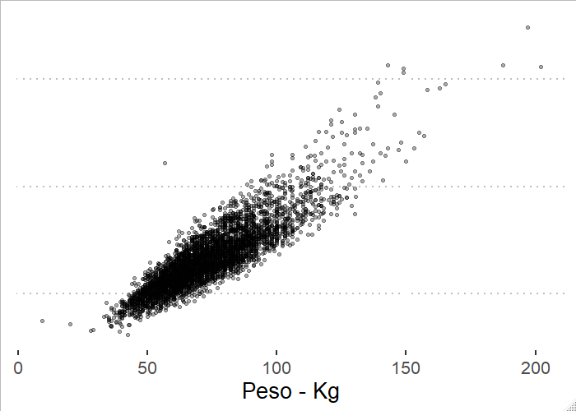





Recap: predictive models
$$f(x)$$
$$X_{i}$$
$$Y_{i}$$
$$Y=[y_{i}]$$
$$X_{i}$$

Slide 3
Outline
What does it mean for a measure to be distributed in a certain way?
How can we look at distributions in R and how can we sample from these distributions?
What are common distributions?
What role do distributions play for conducting statistical tests?

Slide 4
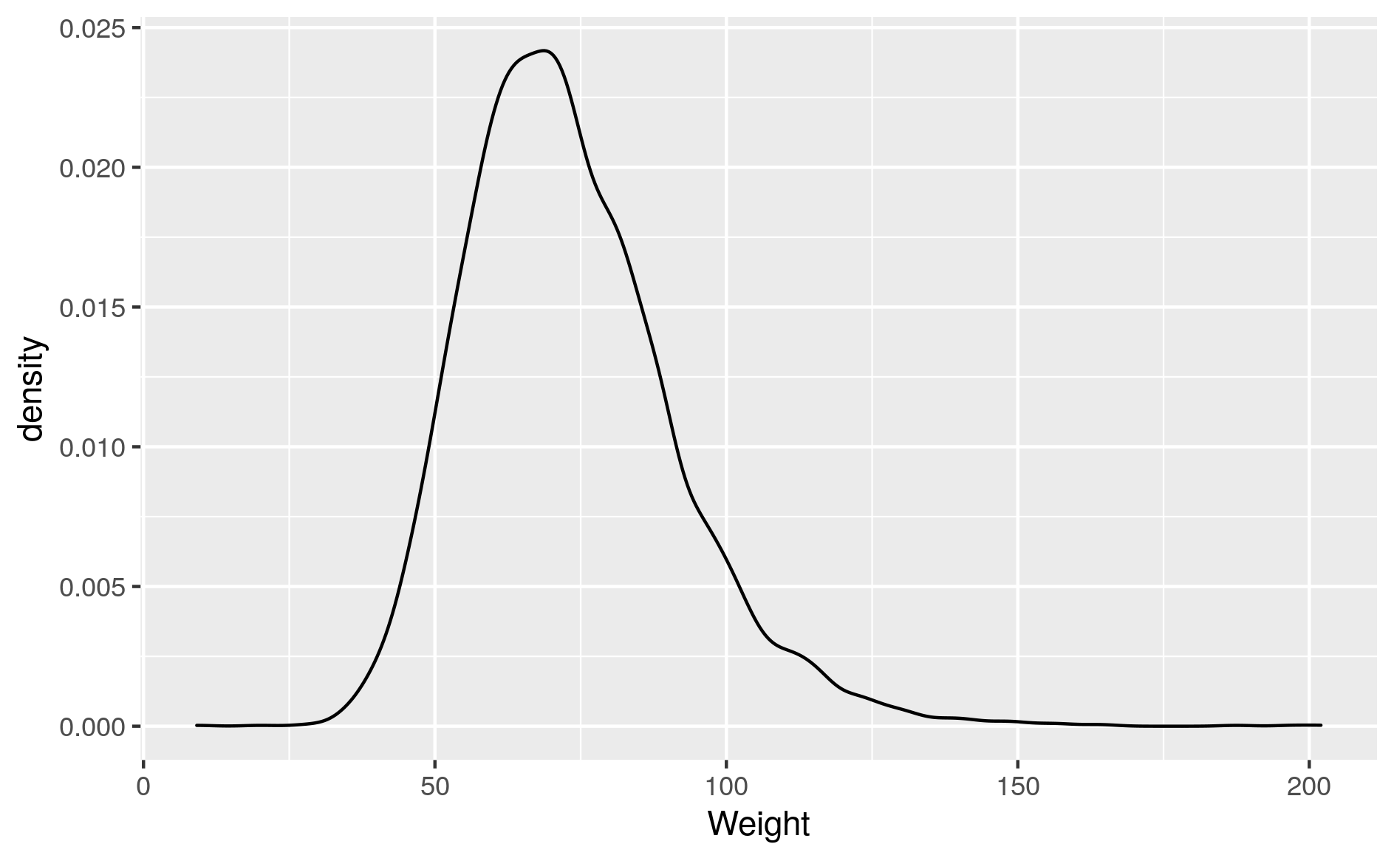
Distribution of a single measure
Based on the observed data
Estimate of frequency of each outcome
Density for continuous variables
Weight density distribution of brown fat data set

Slide 5
Distribution of a single measure
Characterized by the spread i.e. the variance σ²/standard deviation σ and the mean of the data μ
σ
μ
Weight density distribution of brown fat data set

Slide 6
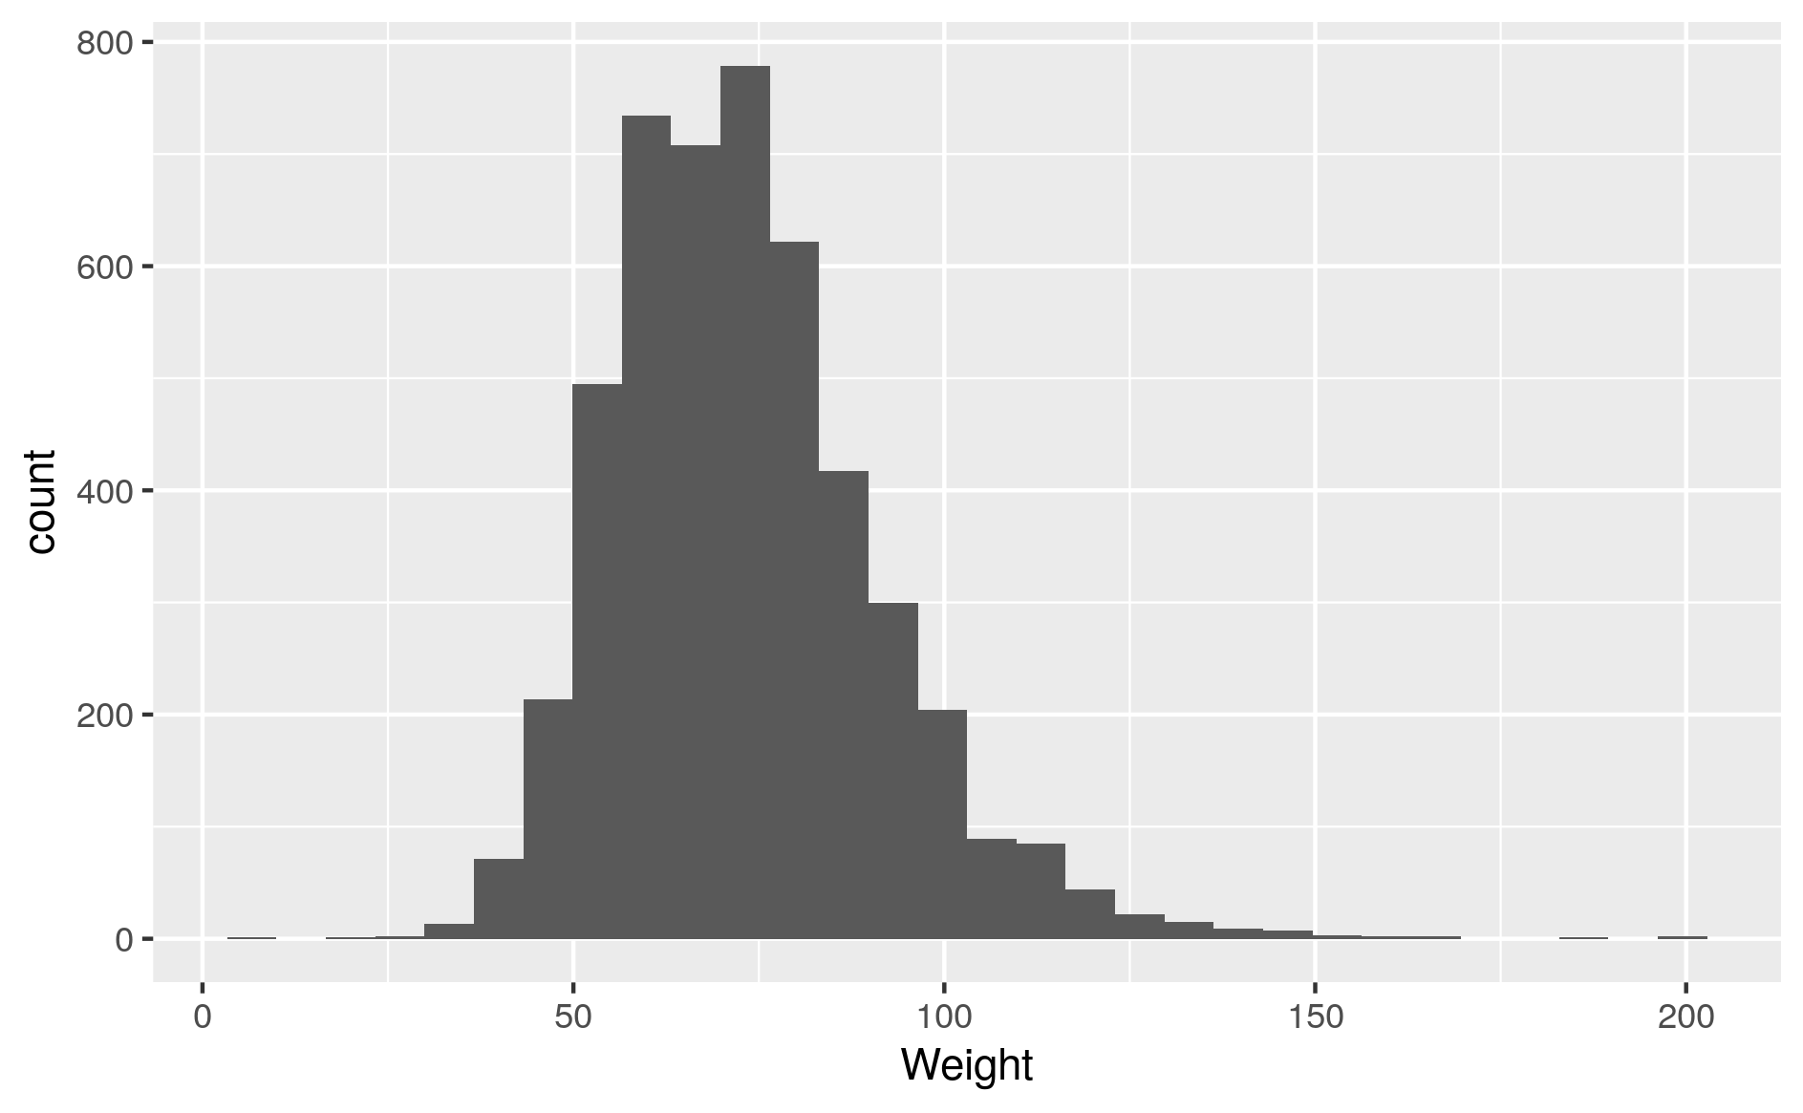
Plotting distributions
Density plot: geom_density
Smoothed density estimate
Histogram: geom_histogram
Discrete bins
Optional: number of bins
Weight histogram of brown fat data set

Slide 7
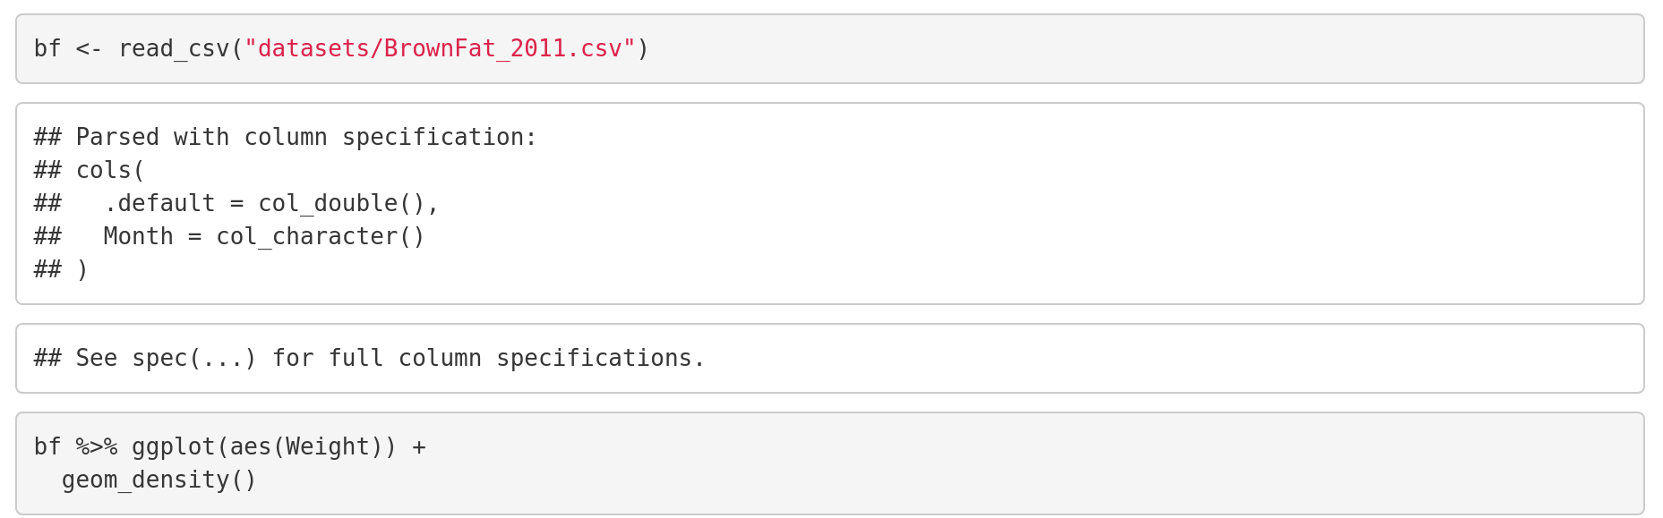
Let’s try it out

Slide 8
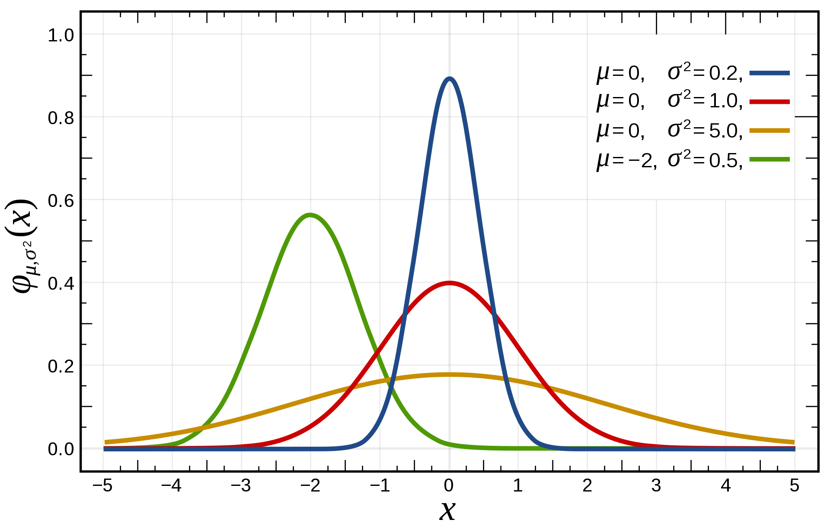
The Normal distribution
x ~ N(μ, σ²) with two parameters
mean μ – the center
variance σ² – the spread
Standard normal distribution μ = 0, σ = 1

Slide 9
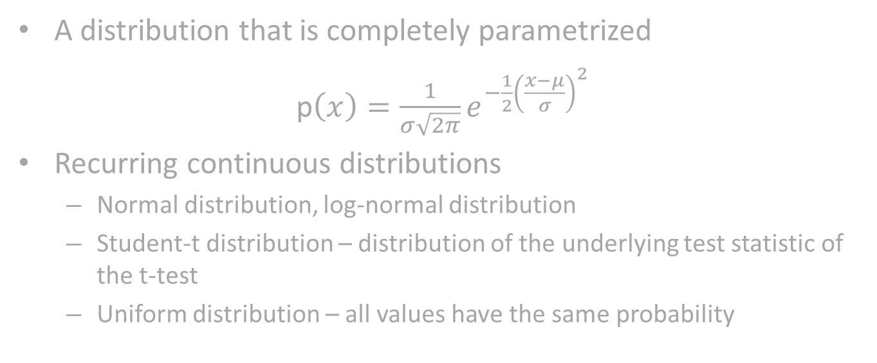
Theoretical distributions
A distribution that is completely parametrized
p$\left(x\right)=\frac{1}{σ\sqrt{2π}}e^{−\frac{1}{2}{\left(\frac{x−μ}{σ}\right)}^{2}}$
Recurring continuous distributions
Normal distribution, log-normal distribution
Student-t distribution – distribution of the underlying test statistic of the t-test
Uniform distribution – all values have the same probability

Slide 10
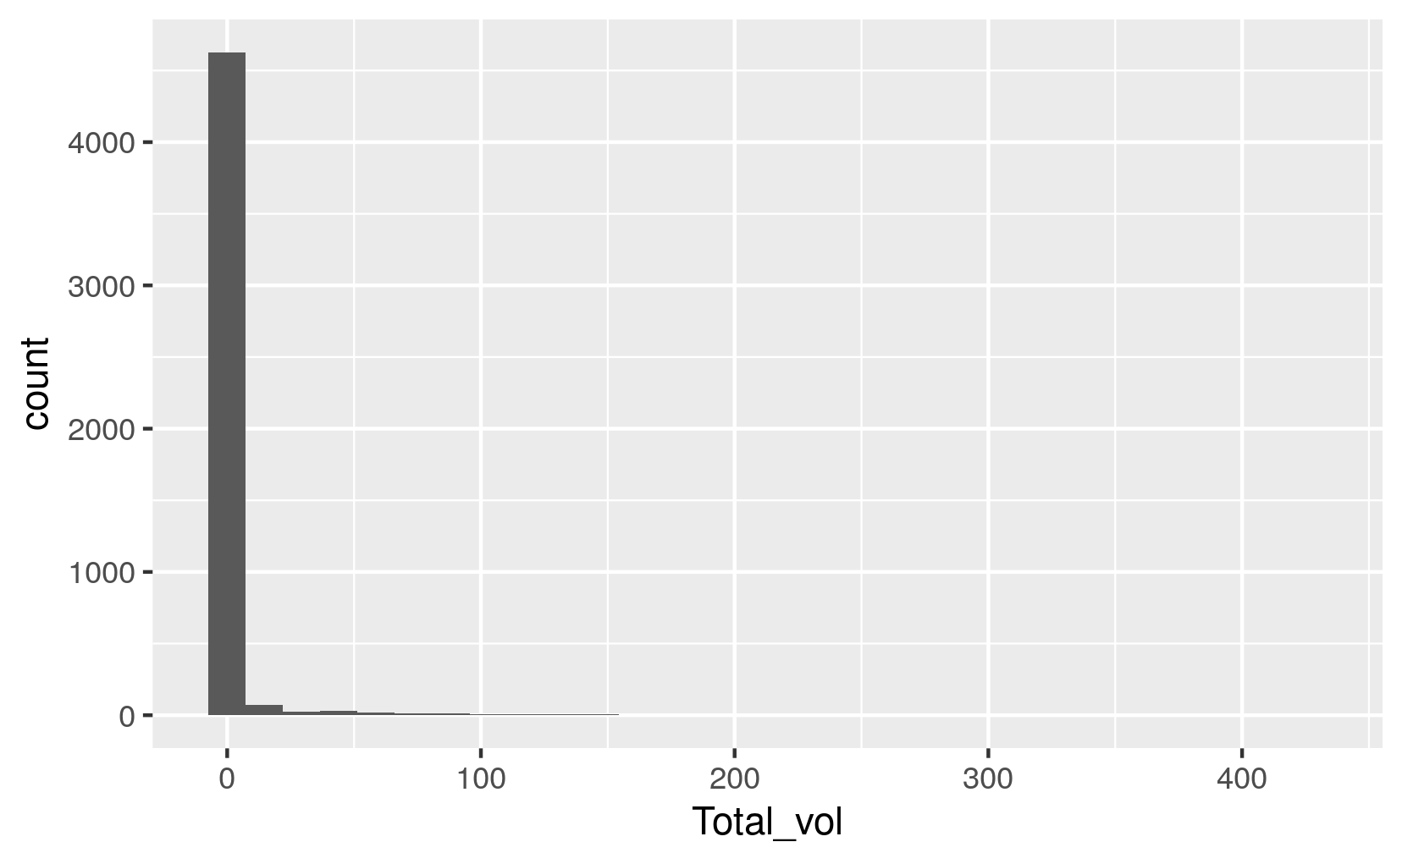
Skewed distributions
Most of the values concentrated at the origin
Not quite clear what’s going on
Can we transform the data?
Total volume of brown fat density distribution

Slide 11
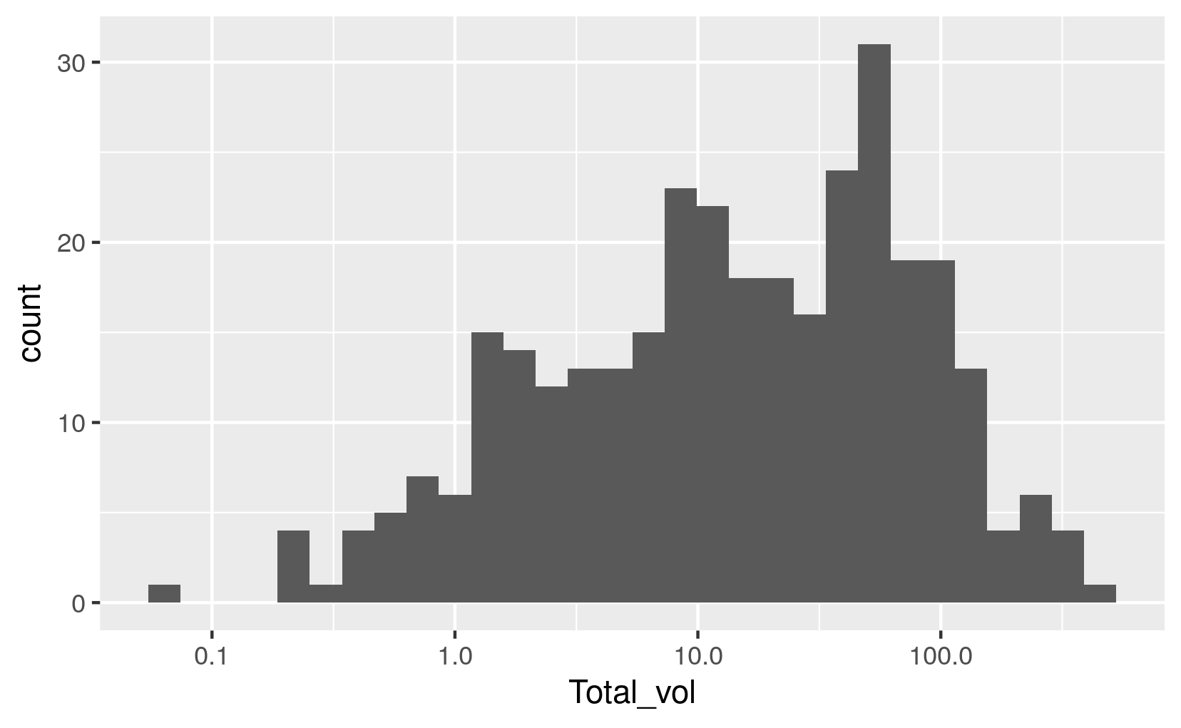
Data transformation
Log transformation of the measurements
Data points are much more spread out
Look normal distributed

Slide 12
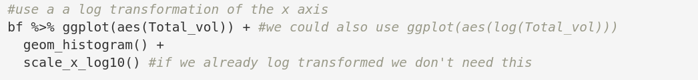
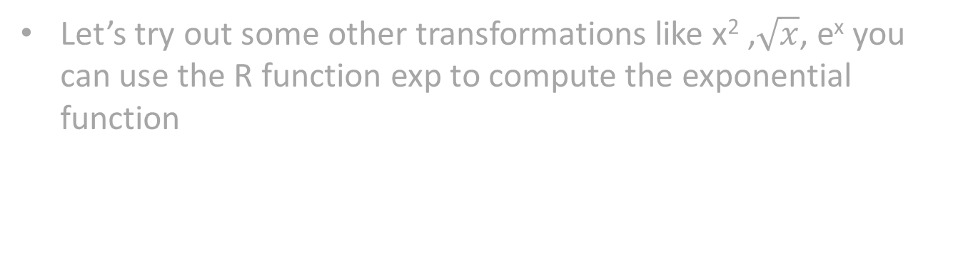
Log transformation in R
Let’s try out some other transformations like x² ,$\sqrt{x}$, e^{x} you can use the R function exp to compute the exponential function

Slide 13
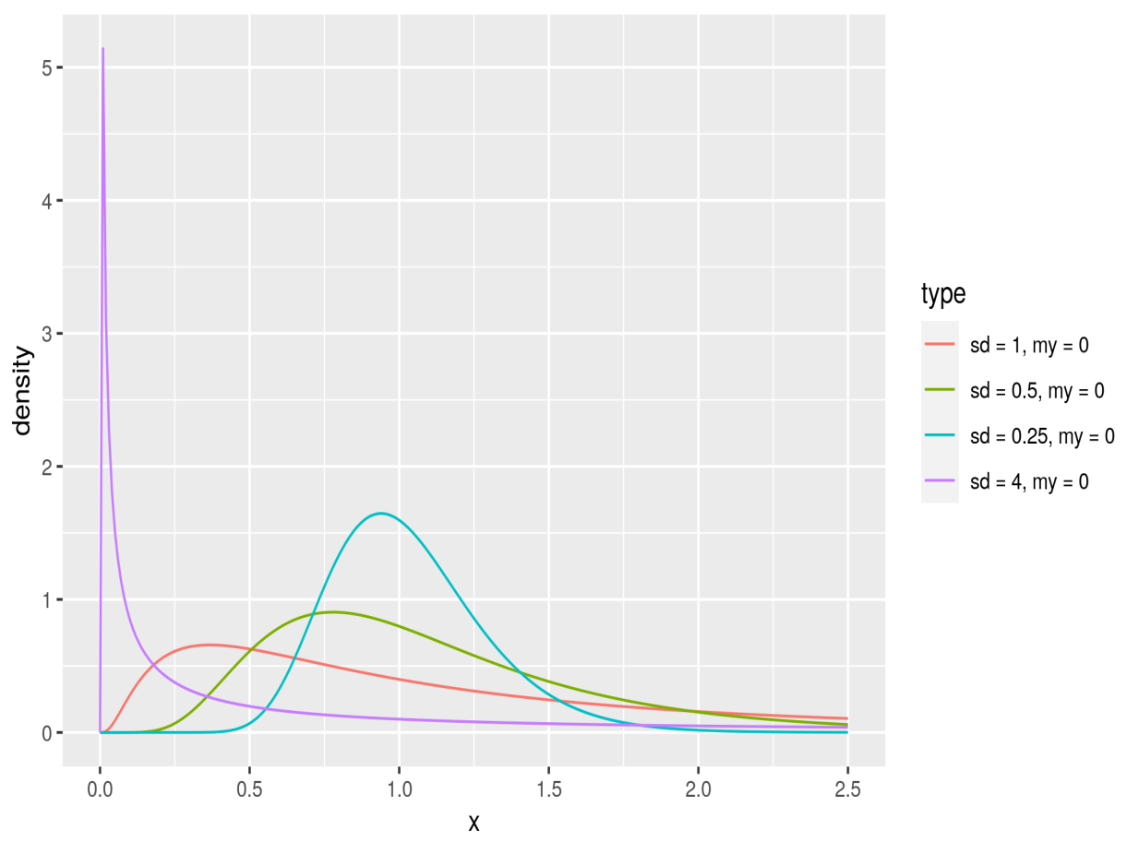
Log-normal distribution
Often the logarithm of a variable is normal distributed
log(x) ~ N(μ, σ²)
X ~ lognormal(μ, σ²)
R: dlnorm

Slide 14
Biology is often discrete
Counting the number of bacteria
The sequence of DNA {A, G, C, T}
#DNA Sequencing reads mapping to a transcript in a RNAseq experiment

Slide 15
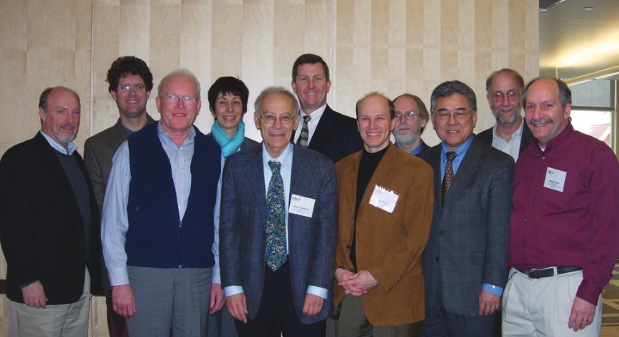
Binary distributed data
What is the gender distribution? – #male vs. #female
How many pyrimidine vs. purine bases in a stretch of DNA?
Outcome of a diagnostic test for prostate cancer
Mathematical Biosciences Institute Report 08/09

Slide 16
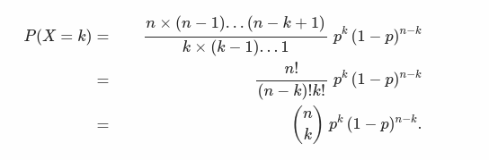
Calculating probabilities
The Mathematical Biosciences Institute faculty
Sample X = MMMMMMMMMF
What is the probability that this may have occurred by chance?
Probability of one man in a one person sample: p = 0.5
One man and one woman: p·(1-p) + (1-p) · p
Generalizing:

Slide 17
Let’s try it out
Use the formula to calculate the probability of such a panel in R
Hint: you can use the choose(n, k) function to calculate n over k
Mathematical Biosciences Institute Report 08/09

Slide 18
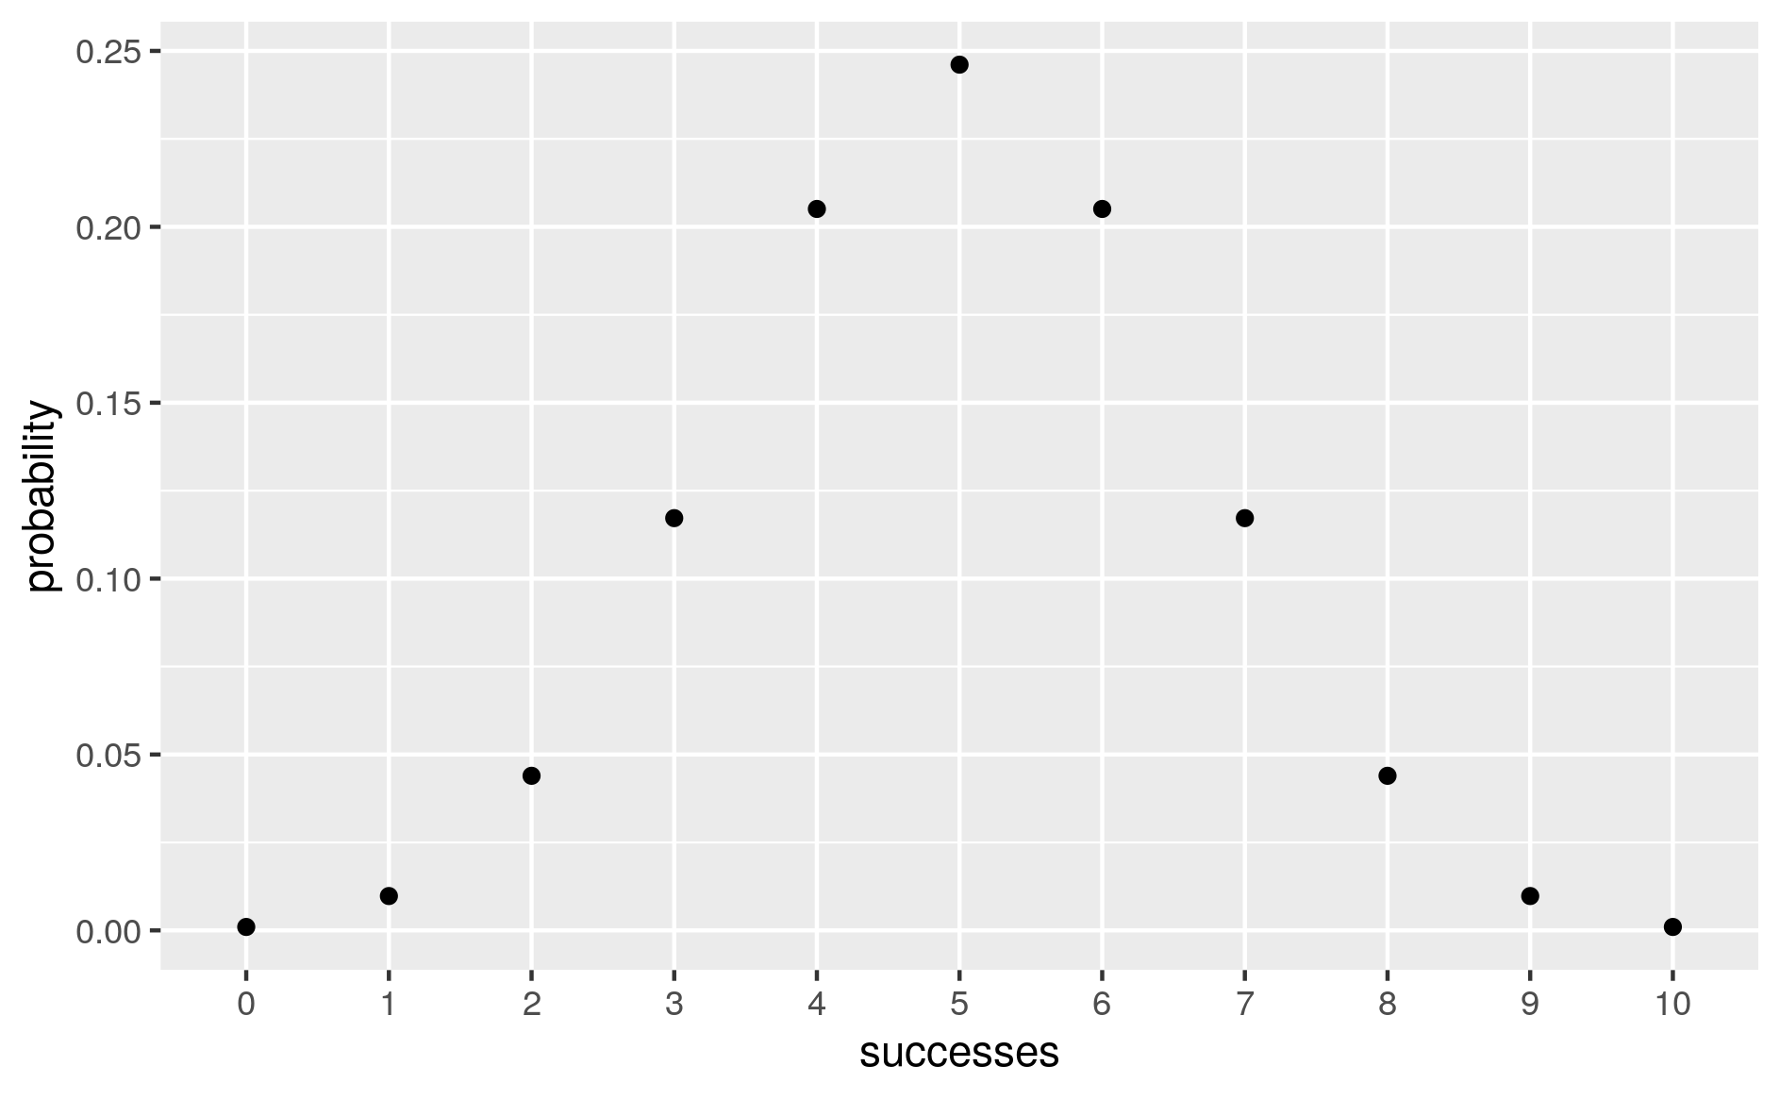
The binomial distribution
X ~ B(n, p)
We say X is binomial distributed or X follows a binomial distribution
n – number of trials, p – probability of success

Slide 19
Discrete distributions
Counting the number of bacteria on a surface – Poisson distribution (poisson)
A sequence of DNA {A, G, C, T} – multinomial distribution (multinom)
#DNA Sequencing reads mapping to a transcript in a RNAseq experiment – negative binomial distribution (nbinom)

Slide 20
Distributions in R
Family of functions:
d*, probability density distribution, e.g. dbinom, dnorm
r*, sampling from that distribution, e.g. rbinom, rnorm
p*, cumulative density distributiom, e.g. pbinom, pnorm

Slide 21
Random samples
One of the great things in R is that you can draw a random sample from a lot of common distributions
Useful for simulations to conduct statistical tests
In R prefixed by r* e.g. rnorm, rbinom

Slide 22
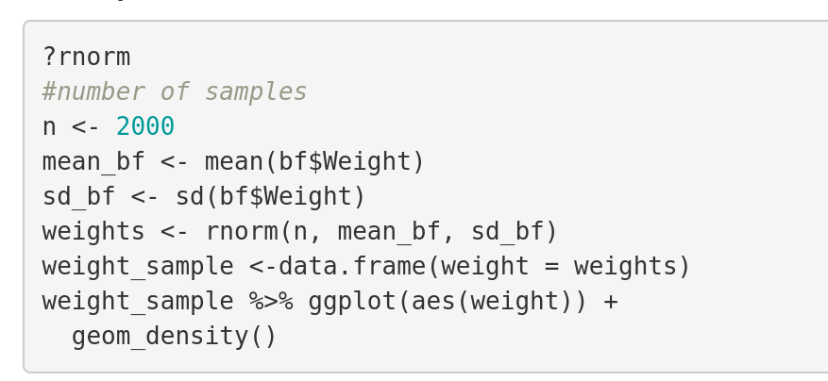
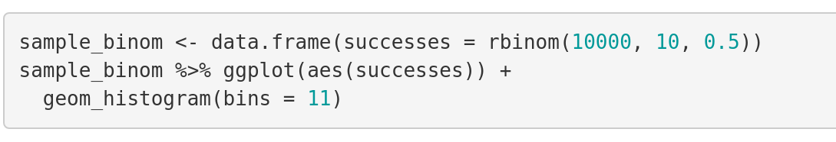
Let’s try it out

Slide 23
Null distribution
An assumption about how the data is distributed if we don’t expect any effect aka the null hypothesis
Every test statistic has a null distribution e.g. the t-statistic
Alternative hypothesis: the data is distributed in a different way (the alternative distribution) with some confidence
Usually not interesting what sort of alternative distribution
Common assumption: the data is normal distributed e.g. for all linear models we assume that the data (the residuals) are normal distributed

Slide 24
Gender balance
In our own little study we have 9 women but only one man
How likely is this to occur by chance?
Our assumption: gender ~ B(10, 0.5)
Alternative hypothesis gender does not follow this binomial distribution

Slide 25
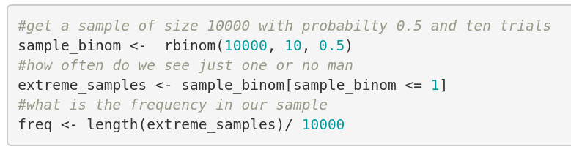
A statistical test for gender imbalance
Approach: take a large sample from the null distribution
Compare to our own data sample
Derive how likely the actual outcome is in our simulation

Slide 26

Monte Carlo simulation
Powerful technique referred to as Monte Carlo sampling
Some times null distribution unknown and very complex: but we only need to be able to sample from the null
Permutation test: Randomly permute the labels in a sample
Enumerating all permutations is impossible -> Use a random sample of size n

Slide 27
Monte Carlo sampling
Much broader application in stats then what we show here
Importantly: the p-value is constrained by #samples in our simulation
No p-value < 1/#samples

Slide 28

Further reading

