Slide 1
Asteroids in GNU Kawa (Scheme)
by Avi Weinstock

Slide 2
Introduction
Project to learn Scheme/Lisp
Uses GNU Kawa, a dialect of Scheme that compiles to JVM bytecode, and allows use of Java libraries
Uses JOGL, the Java bindings for OpenGL, which very closely match the C OpenGL interface

Slide 3
Lisp-style macros
Unique feature of Lisps
“Programs that write programs”
Operate on tree-structures, rather than text, which makes making complex transformations reasonably clean
Very general: any pattern that's simpler/easier to write a function to generate than to generate/expand manually can be written as a macro
Executed at compile-time, so can be used to optimize things

Slide 4
Motivation for file-as-string-constant
OpenGL Shaders are written in GLSL, and loaded with calls to glShaderSource/glCompileShader
Typically involves a trade-off:
    Shaders in seperate files, for ease-of-editing, at the expense of loading/errorchecking at runtime
    Shaders as string constants in the source, to avoid having the files as extra dependencies, at the cost of being harder to edit
Solvable in Lisp by having a macro read the file at compile-time, and have it treated as a string constant by the compiler

Slide 5
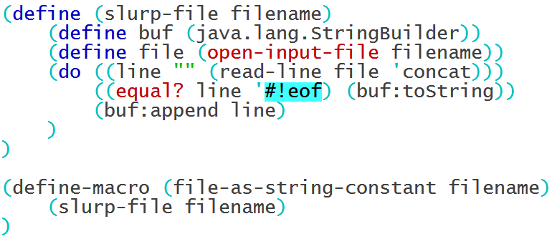
Code for file-as-string-constant
(define (slurp-file filename)
(define buf (java.lang.StringBuilder))
(define file (open-input-file filename))
(do ((line (read-line file 'concat)
(read-line file 'concat)))
((equal? line '#!eof) (buf:toString))
(buf:append line)
)
)
(define-macro (file-as-string-constant filename)
(slurp-file filename))

Slide 6
Unrolled matrix multiplication
Matrix multiplication is an operation that typically needs to be used in inner-loops for graphics, and hence needs to be fast
One way to optimize, if the sizes of both matrices are constant, is to “unroll” the loops, duplicating the body of the loop for each iteration
This avoids the overhead of a loop counter, but requires manually writing out a fairly repetitive pattern
This problem is compounded if fast matrix-multiply routines are needed for differently sized pairs of operands

Slide 7
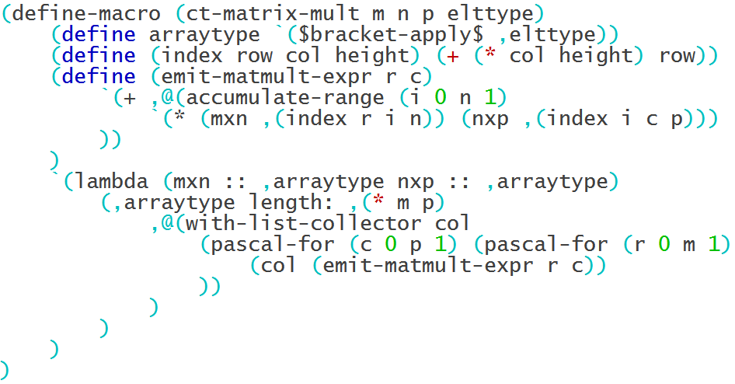
Code for ct-matrix-mult

Slide 8
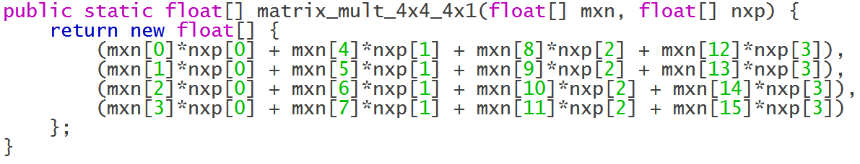
Comparison of unrolled matrix multiplication definitions
Java
Scheme

Slide 9
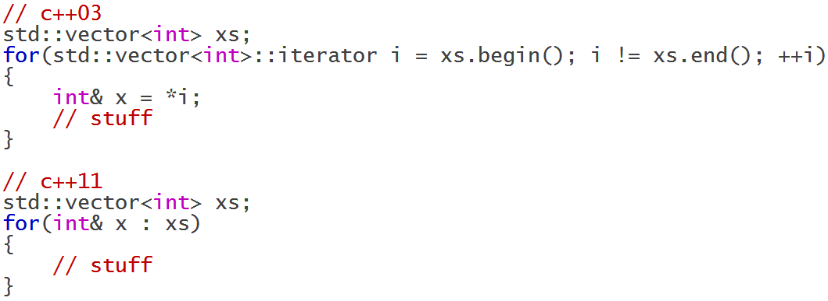
Nonstandard looping constructs
One notable feature introduced in C++11 is the for-each loop, which simplifies iterating over data structures:

Slide 10
Nonstandard looping constructs
Macros allow the creation of a wide variety of similarly helpful constructs:
  java-iterate: for-each over Java collections, with the option to remove elements
  with-min-ms-per-iteration: enforces a minimum time to pass between each iteration of the loop body
  with-overlapping-slices: iterate over consecutive slices of an array, potentially overlapping
  accumulate-range: C-style for loop over integers that collects a list of the value of the body at each iteration
Although I didn't use any for this project, loops that automatically parallelize their contents are also in this catagory

Slide 11
Demonstration

Slide 12
Questions

Slide 13
Thanks to:
Professor Goldschmidt
Professor Moorthy
RCOS
Sean O' Sullivan

