Slide 1

Mini Project III- Clustering
By
Andrew Weng
Hugo Perdomo

Slide 2
Project Workflow
Data Exploration
Data Preparation
Create clusters
Plotting data and analyze results

Slide 3
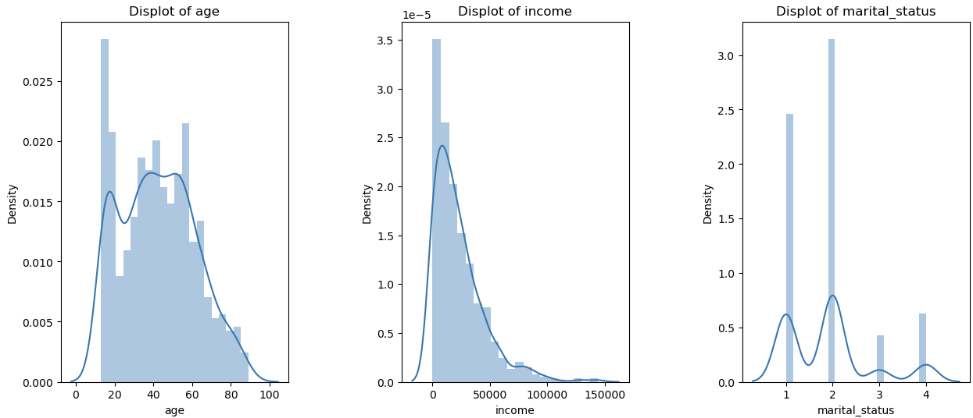
Data Demographics

Slide 4
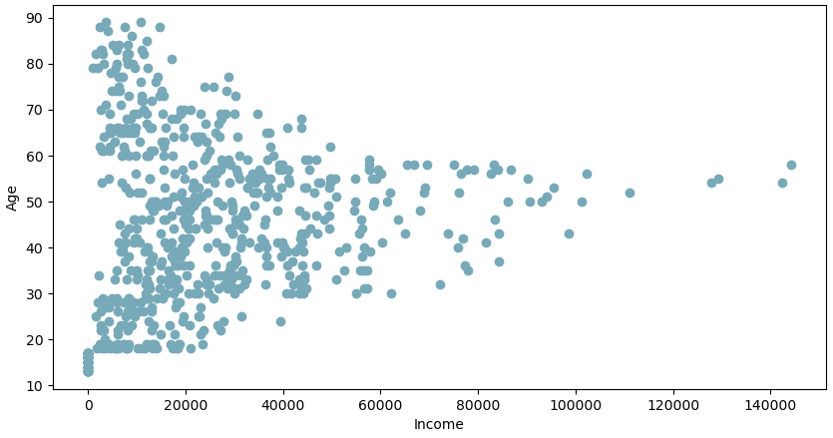
Age vs Income Distribution

Slide 5
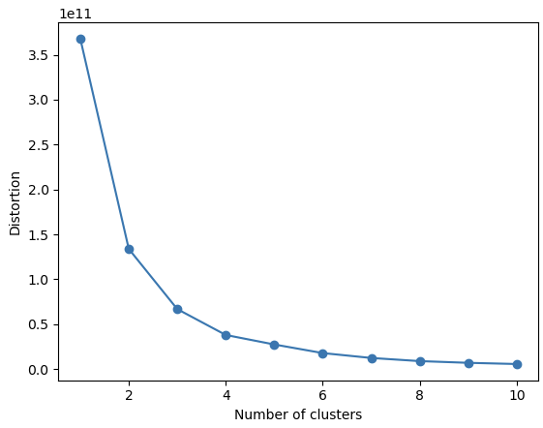
Data Distortion

Slide 6
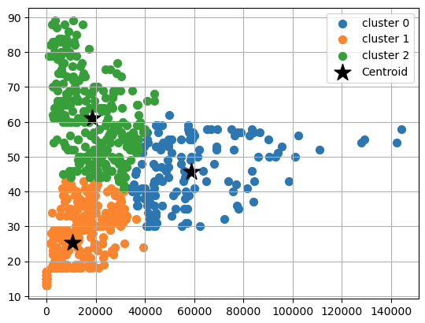
Age and Income Cluster

Slide 7
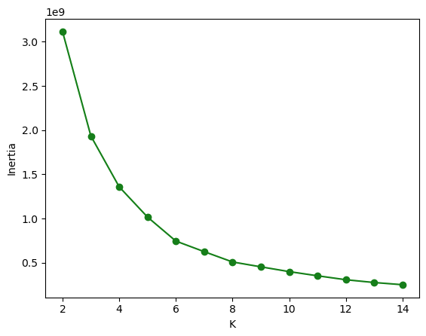
Data Distortion Credit Balance vs Total Balance

Slide 8
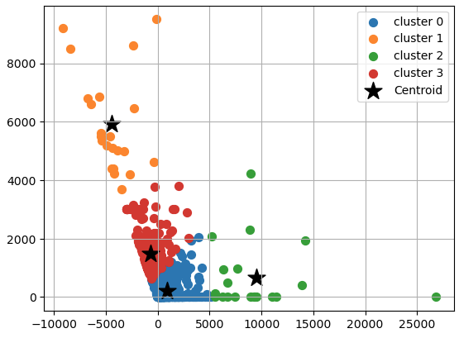
Credit Balance vs Total Balance

Slide 9
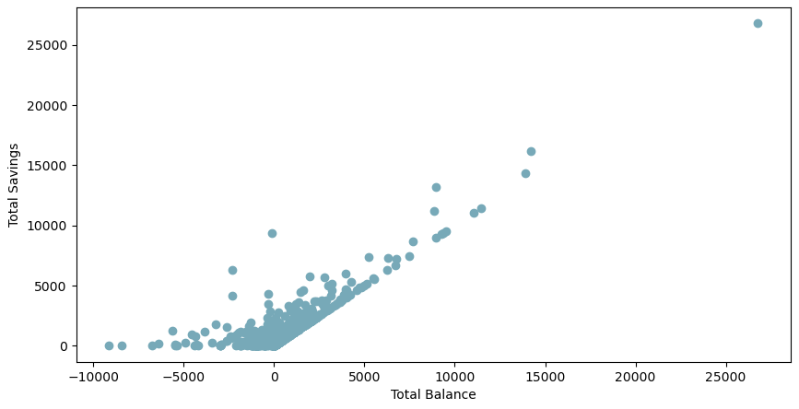
Savings

Slide 10
Savings

Slide 11
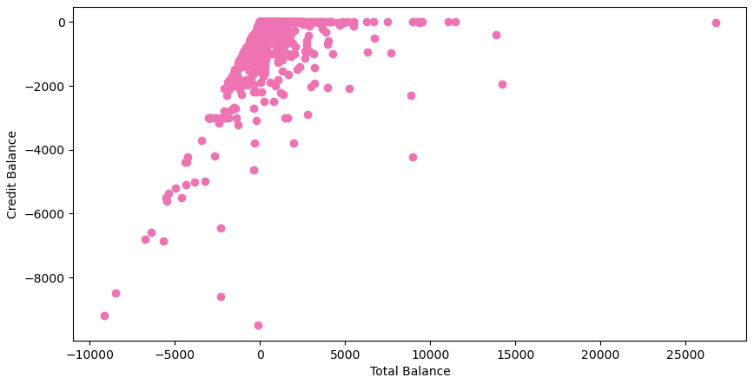
Credit Balance

Slide 12
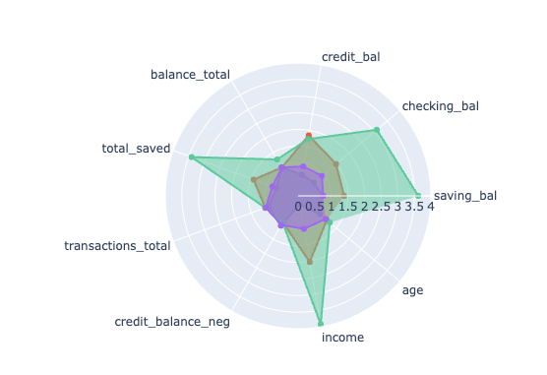

Clusters Comparison

Slide 13
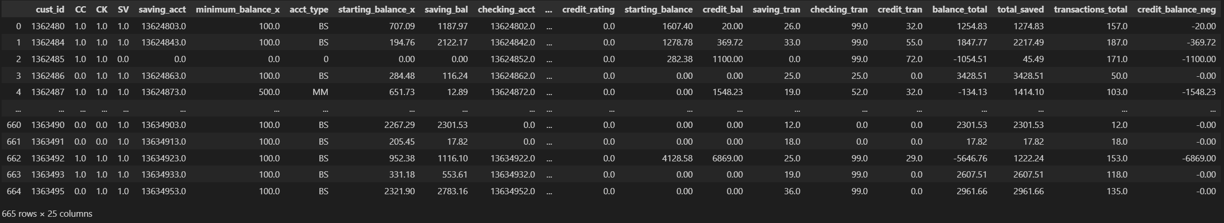
Result Table

Slide 14
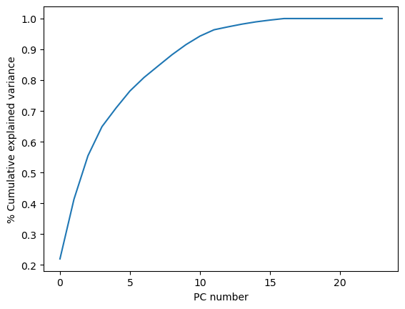
Cumulative Explained Variance Graph

Slide 15
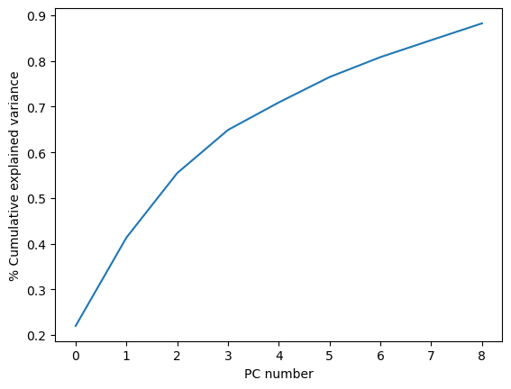
Cumulative Explained Variance Graph

Slide 16
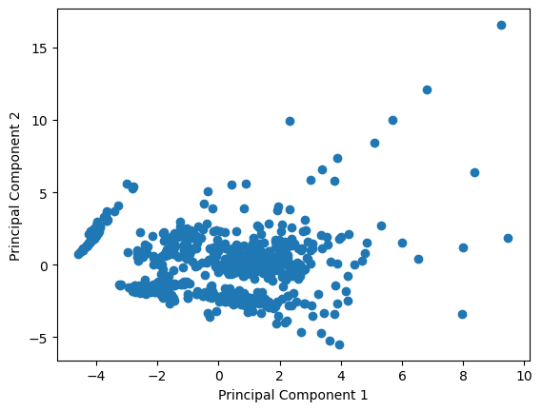
PCA

Slide 17

Thank you! Questions?

