Slide 1

Andreas Wenger – Stocard GmbH
@WengerAndi
github.com/awenger/multiplatform-kalkulator

Slide 2
/whoami
Android developer at Stocard
Some experience with nodejs
1+ Year of Kotlin experience
@WengerAndi

Slide 3
/whoareyou

Slide 4
/why
Share code
Don't repeat yourself (DRY)
Consistent code base

Slide 5
/platform specific
UI
Platform specific apis/functionality

Slide 6
/common
Stdlib
  Basic types
  Collections + functional operators (filter/map)
  Higher order functions (apply/with)
  Exceptions
Testing
Common kotlin libraries
Kotlin code

Slide 7
/js|jvm|native
Platform specific libraries
Platform specific code

Slide 8

JVM
Native
Common
JS

Slide 9
/init
gradle
settings.gradle
build.gradle
<lib>-common/build.gradle
<lib>-native/build.gradle
<lib>-jvm/build.gradle
<lib>-js/build.gradle
apply plugin: 'kotlin-platform-common'
dependencies {
compile "[..]:kotlin-stdlib-common:[...]”
}
apply plugin: 'kotlin-platform-<platform>'
dependencies {
compile "[..]:kotlin-stdlib-<platform>:[...]”
expectedBy project(':<lib>-common')
}

Slide 10

/sample
Input
Output

Slide 11
/Kotlin/JS
dynamic type
  Disables type checking
  Just like javascript
external modifier
  Definition of external (non-kotlin) interfaces

Slide 12
/rest[ish] api
restify
GET /calculator to observe the state
POST /calculator/inputs/ to add input
curl 'http://localhost:8082/calculator'
{"inputLine":"","resultPreview":""}
curl -XPOST 'http://localhost:8082/calculator/inputs/' \
-H 'content-type: application/json' -d '{"input":"1"}'
curl -XPOST 'http://localhost:8082/calculator/inputs/' \
-H 'content-type: application/json' -d '{"input":"+"}'
curl -XPOST 'http://localhost:8082/calculator/inputs/' \
-H 'content-type: application/json' -d '{"input":"1"}'
curl 'http://localhost:8082/calculator'
{"inputLine":"1 + 1","resultPreview":"2"}

Slide 13
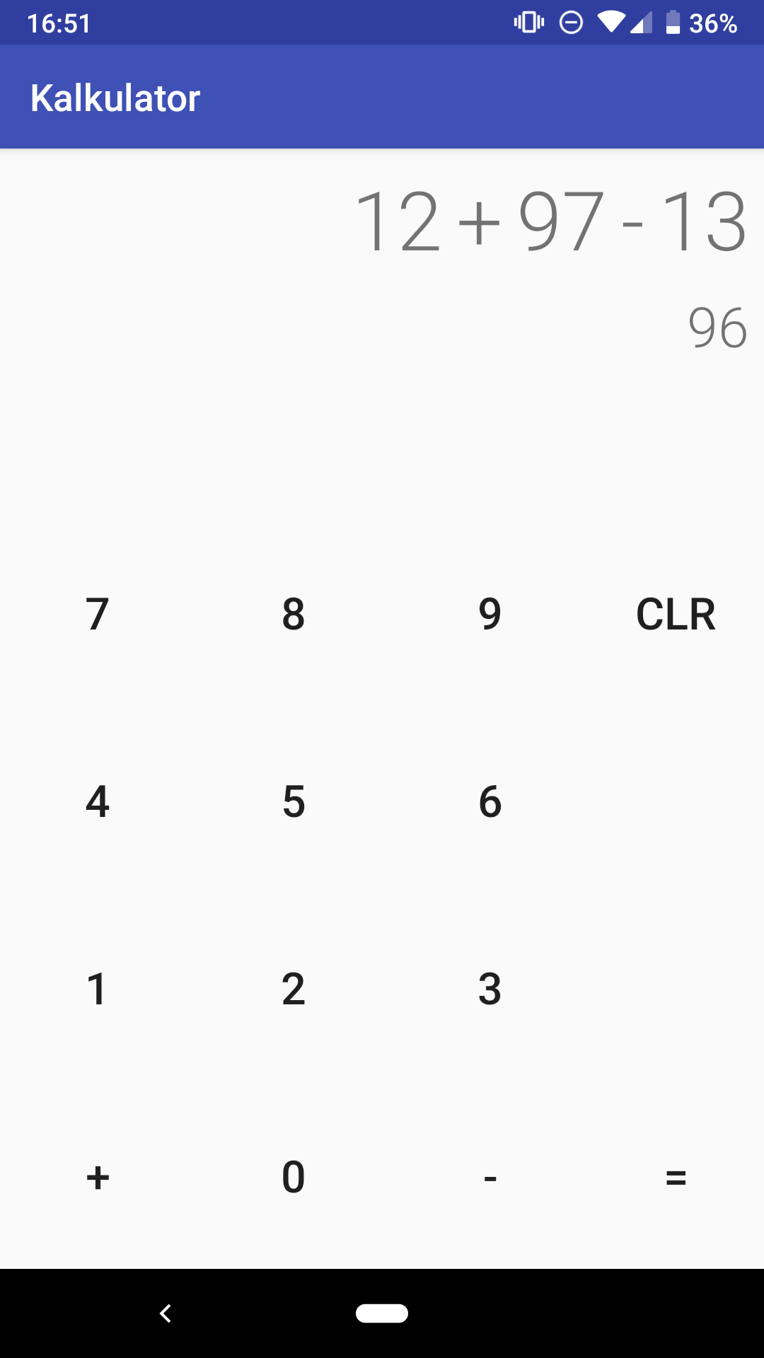
/app -type android
Single Activity
No logic
Embedded as lib
maven

Slide 14
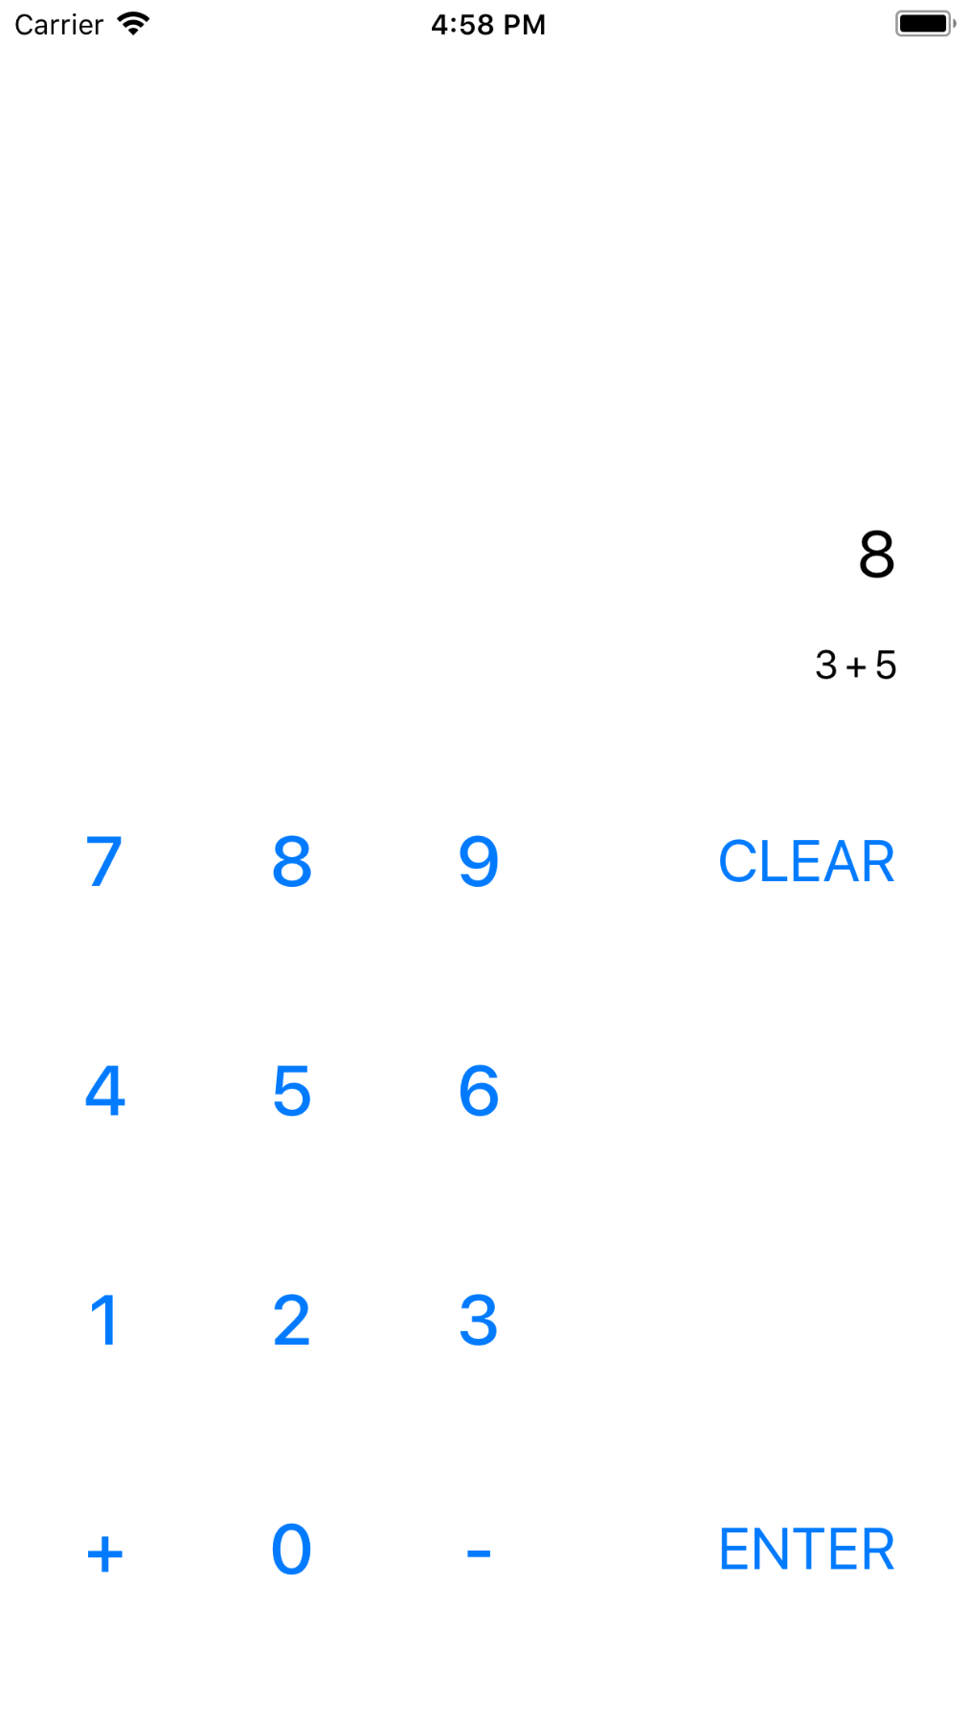
/app -type iOS
Single ViewController
No Logic
Embedded as Framework

Slide 15
/expect-actual
Missing functionality in commons
provides platform specific implementation
expect class HttpClient {
fun get(url: String): Response
}
expect fun String.toUtf8EncodedByteArray() : ByteArray
actual class HttpClient {
fun get(url: String): Response {
// delegate to OkHttp
}
}
actual fun String.toUtf8EncodedByteArray() : ByteArray =
this.toByteArray(Charsets.UTF_8)

Slide 16
/test
Common module
Platform specific modules
Kotlin/JS via Jasmine, Mocha, Jest
  Setup is a bit cumbersome
  blog.kotlin-academy.com/testing-common-modules-66b39d641617
Kotlin/JVM via Junit
Kotlin/Native via ?

Slide 17
/more
kotlinx.coroutines
  github.com/Kotlin/kotlinx.coroutines
  Native support? #246
kotlinx.serialization
  JSON, CBOR, Protobuf (de-)serialization
kotlin-frontend
  github.com/Kotlin/kotlin-frontend-plugin
  npm dependencies
Setup
  github.com/JetBrains/kotlin-native/blob/master/MULTIPLATFORM.md

Slide 18
/projects
KotAcademy application
  github.com/MarcinMoskala/KotAcademyPortal
  backend/web/android/wear/desktop
KotlinConf App
  github.com/JetBrains/kotlinconf-app
  backend/web/android/iOS

