Slide 1
Figure 1
Two observations motivate PASA-KV
a, FastWAM target layers have markedly different Policy SR under the same joint K/V objective and 10k-exposure budget; lower SR indicates a stronger attack. b, Tail-AV scores all 30 layers and highlights L29/L02/L03 as its Top-3 targets. Response-group colors are retrospective diagnostic labels, not selector inputs.
Notes:
Source: supplied PASA-KV paper PDF, page 2. The figure artwork is embedded as SVG vector content; in PowerPoint it can be converted to shapes for element-level editing.

Slide 2
Figure 2
Layerwise evidence for selective attack and intervention
a, Thirty budget-SR trajectories; thick lines show group medians. b, Selected attack targets differ from Rescue peaks. c, Independent K/V footprints relative to each target's 5k value; faint lines show all 30 targets, bold lines representative layers, and dashed lines group means.
Notes:
Source: supplied PASA-KV paper PDF, page 5. The figure artwork is embedded as SVG vector content; in PowerPoint it can be converted to shapes for element-level editing.

Slide 3
Figure 3
Distinct and layer-dependent K/V pathways
a, First-order action-facing readout view with fixed action query. b-e, Audited counterfactual cases: L21 is K-dominant, L29 V-dominant, L17 joint-beneficial, and L20 illustrates joint non-dominance. Full counterfactual protocol and spatial heatmaps appear in the appendix.
Notes:
Source: supplied PASA-KV paper PDF, page 6. The figure artwork is embedded as SVG vector content; in PowerPoint it can be converted to shapes for element-level editing.

Slide 4
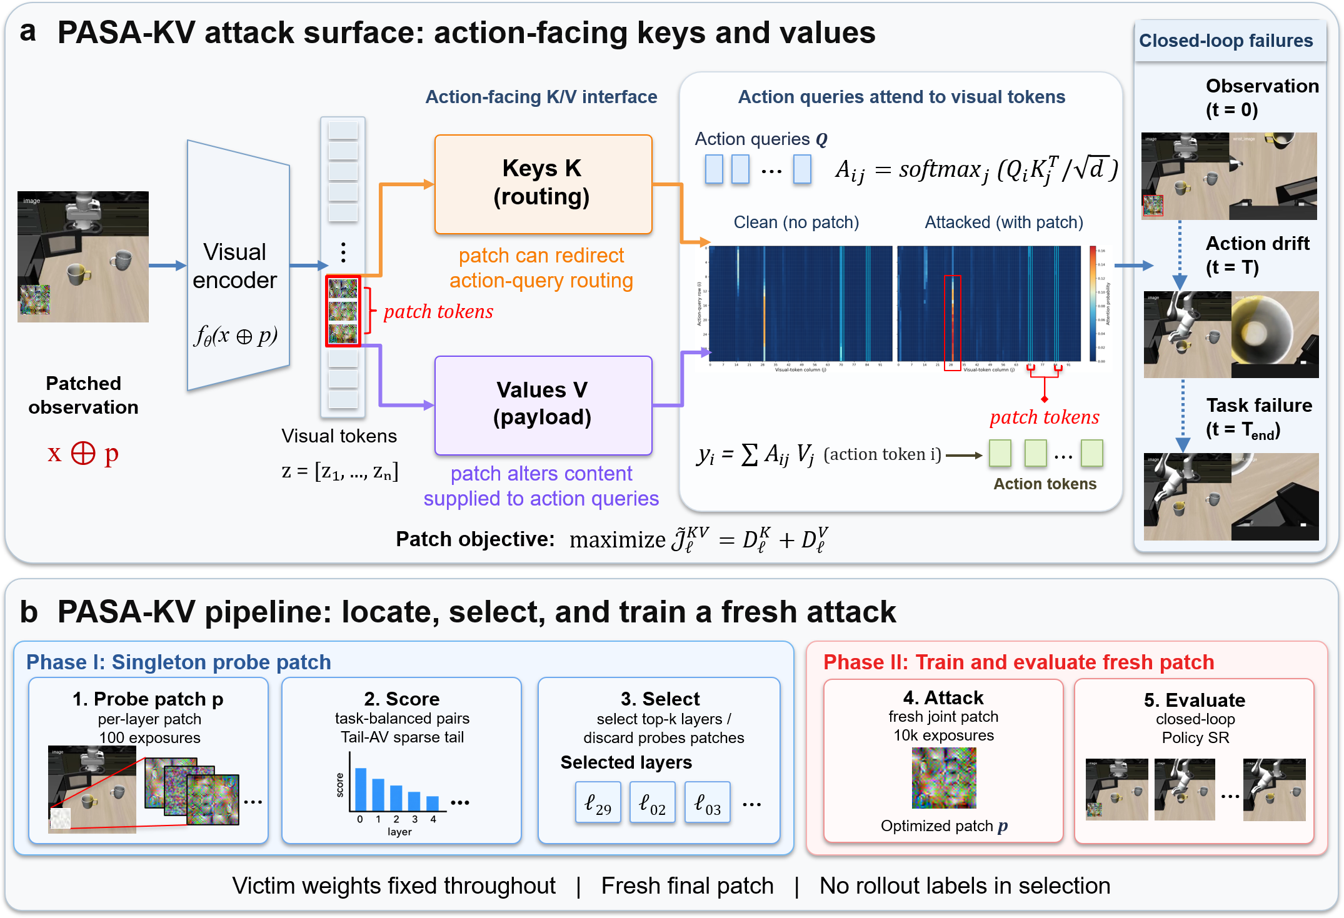
Figure 4
PASA-KV pipeline
a, A patch perturbs action-facing visual K/V: keys affect routing, while values affect aggregated content, which can induce action drift and closed-loop failure. b, Per-layer 100-exposure probes and Tail-AV select Top-k layers; probe patches are discarded before fresh joint K/V training for 10k exposures and closed-loop evaluation.
Notes:
Source: supplied PASA-KV paper PDF, page 8. The source figure was supplied as a PNG and is embedded as an editable image object; slide text remains editable.

Slide 5
Figure 5
Probe100 provides later-vulnerability ordering evidence
Each point is one FastWAM layer. The x-axis is the canonical 100-exposure Tail-AV score and the y-axis is later AttackStrength = 1 - SR/100 from independently trained layerwise patches. Spearman correlations are 0.521 at 10k and 0.508 at 20k; these are rank associations, not causal fits.
Notes:
Source: supplied PASA-KV paper PDF, page 11. The figure artwork is embedded as SVG vector content; in PowerPoint it can be converted to shapes for element-level editing.

Slide 6
Figure 6
Action discrepancy and control diagnostics
a, FastWAM baseline discrepancy versus Eval500 SR. b, FastWAM Top-3 local and trajectory RMS under one-shot or persistent exposure. c, LingBot history-conditioned K/V and action discrepancy. d, Cosmos Top-5 input-extent and solver sensitivity.
Notes:
Source: supplied PASA-KV paper PDF, page 12. The figure artwork is embedded as SVG vector content; in PowerPoint it can be converted to shapes for element-level editing.

Slide 7
Figure 7
FastWAM patch geometry on LIBERO-10
Tasks T0-T9 share (x, y, w, h) = (5, 160, 50, 50) on the 224 x 224 primary view. The secondary view is unpatched. Images illustrate placement, not outcomes.
Notes:
Source: supplied PASA-KV paper PDF, page 18. The figure artwork is embedded as SVG vector content; in PowerPoint it can be converted to shapes for element-level editing.

Slide 8
Figure 8
Complete selector-score component rankings
Complete 30-layer rankings for Tail-AV, Attention-only-tail, Value-only-tail, and Mean-AV computed from the same canonical Probe100 evidence. Colors denote retrospective response groups; rings mark each ranking's Top-3. The groups are diagnostic overlays, not selector inputs.
Notes:
Source: supplied PASA-KV paper PDF, page 22. The figure artwork is embedded as SVG vector content; in PowerPoint it can be converted to shapes for element-level editing.

Slide 9
Figure 9
Complete spatial action-attention changes
Signed Delta A = A^p - A^0 for the prespecified L21/L29/L17/L20 cases under K, V, and K+V counterfactuals. Each map uses action-query rows and the 7 x 14 visual-token grid after full-key softmax.
Notes:
Source: supplied PASA-KV paper PDF, page 24. The figure artwork is embedded as SVG vector content; in PowerPoint it can be converted to shapes for element-level editing.

Slide 10
Figure 10
Complete spatial Tail-AV influence changes
Signed changes in A_ij ||V_j||_2 for the same four prespecified layers and counterfactual objectives. The full grid complements the compact mechanism figure in the main text.
Notes:
Source: supplied PASA-KV paper PDF, page 25. The figure artwork is embedded as SVG vector content; in PowerPoint it can be converted to shapes for element-level editing.

Slide 11
Figure 11
Visual-state replacement profiles
Each layer averages 30 target patches and four fixed samples. Shading marks L22-L28. Five-k/20k profile correlations are 0.983/0.991 with unchanged Top-3 sets, without implying equal absolute response.
Notes:
Source: supplied PASA-KV paper PDF, page 30. The figure artwork is embedded as SVG vector content; in PowerPoint it can be converted to shapes for element-level editing.

