Slide 1

Residual Neural Networks
Tutorials on alphago zero

Slide 2
Prerequisites
Basic Familiarity with Convolutional Neural Networks
Linear Algebra:
Basic concepts like vector operations, matrix operations, Inverse of a matrix, Projection, Rank
Multivariable Calculus:
Basic concepts like differentiation, integration
Probability:
Basic Probability Concepts

Slide 3
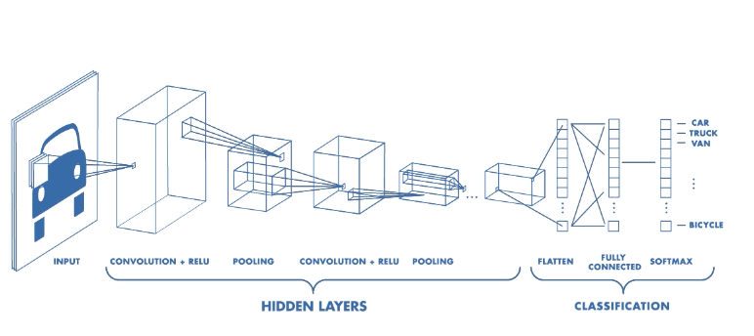
Recap: What is a CNN?
- “Convolutional Neural Networks are simply Neural Networks that use convolution in place of general matrix multiplication in at least one of their layers” (Deep Learning, Goodfellow et al)
Source: freecodecamp/medium

Slide 4
Recap: Four Major Building Blocks
Convolution Layer
Pooling Layer
Non-Linear Stage (e.g. ReLU)
Fully Connected Layer
Learn through BackPropagation

Slide 5
What is Wong with CNN?
Regular Networks had the issue of scalability and learning meaningful features
CNN helped by → local connectivity and weight sharing
However, adding many convolution layers introduce the issue of vanishing gradient → gradient doesn’t reach all the layers due to backpropagation (due to non-linearities)
Goal: Design a CNN that solves vanishing gradient

Slide 6

Residual Networks
Neural Network is a function approximator $y=f\left(x\right)$
During BP, a gradient signal has to go back through this $f\left(x\right)$ - which consists of non-linearities.
Consider ReLU = $\max\left(x,0\right)$ → during BP, if a signal passes through (matrix multiplication op) weights that are close to 0 or 0, it vanishes eventually.
SOLUTION: create shortcuts from layers to send signals without passing it through $f\left(x\right)$.
$y=f\left(x\right)+x$

Slide 7
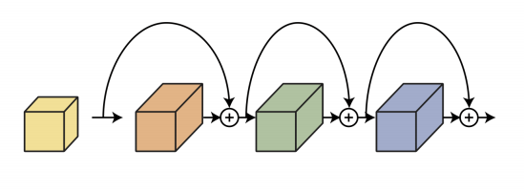
Residual Networks

Slide 8
Residual Networks
Hypothesis: the problem with deep CNN is an optimization problem (gradient loss), deeper models are harder to train
The deeper model should be able to perform at least as well as the shallower model.
Solution by construction = copy the learned layers from the shallower model and set additional layers to identity mapping (adding input without non-linear operation) → Residual Block

Slide 9
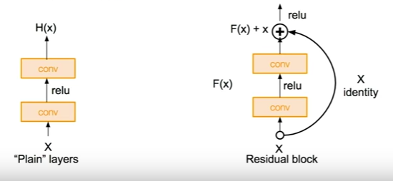
Residual Networks
- Use network layers to fit a residual mapping instead of directly trying to fit a desired underlying mapping

Slide 10
AlphaGo Zero Architecture
Input = 19 x 19 x 17 (board size (2D) x binary feature planes)
8 binary feature planes (X_{i}) consists of binary values → indicating the presence of current player’s stones.
Next 8 binary feature planes (Y_{i}) indicates the presence of the opponent.
Final feature plane (C) indicates which player’s turn it is.
Input feature = [X_{i}, Y_{i}, X_{i-1}, Y_{i-1}, … , X_{i-7}, Y_{i-7}, C]

Slide 11
AlphaGo Zero Architecture
Input features → Residual Tower
Residual Tower consists of:
A single convolution block
Either 19 or 39 residual blocks

Slide 12
AlphaGo Zero Architecture
Convolution Block Operations:
a convolution of 256 filters of kernel size 3 x 3 with stride 1
Batch normalization
A rectifier non-linearity

Slide 13
AlphaGo Zero Architecture
Residual Block Operations (sequential):
a convolution of 256 filters of kernel size 3 x 3 with stride 1
Batch Normalization
A rectifier non-linearity
a convolution of 256 filters of kernel size 3 x 3 with stride 1
Batch Normalization
A skip connection that adds input to the block
A rectifier non-linearity

Slide 14
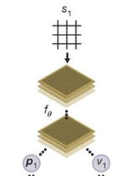
AlphaGo Zero Architecture
Output of the Residual Tower → two different ‘heads’:
Policy Head
Value Head

Slide 15
AlphaGo Zero Architecture
Policy Head Operations
A convolution of 2 filters of kernel size 1 x 1 with stride 1
Batch normalization
A rectifier non-linearity
A fully connected linear layer that outputs a vector of size (# no. moves)

Slide 16
AlphaGo Zero Architecture
Value Head Operations:
A convolution of 1 filter of kernel size 1 x 1 with stride 1
Batch normalization
A rectifier non-linearity
A fully connected layer to a hidden layer of size 256
A rectifier non-linearity
Fully connected linear layer to a scalar
A tanh non-linearity outputting a scalar in range [-1,1].

Slide 17
AlphaGo Zero Architecture
High Level View:
Input → Game Board Representation
Output → policy vector (containing probabilities corresponding to available actions) and value (a scalar prediction of the winner from the current state)

Slide 18
AlphaGo Zero
- In the next video:
Residual Network + MCTS
= AlphaGo Zero

