Slide 1
Review for mid-term exam
Contents from Chapter 4.3 through Chapter 6
Chapter 4: Network layer
Chapter 5: Data link layer
Chapter 6: Wireless and mobile networks
See the list of topics from the review sheet.

Slide 2
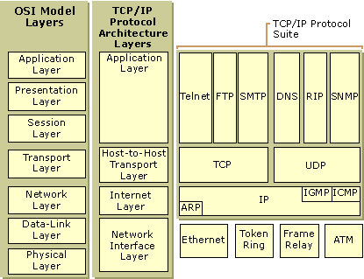
Internet Protocol (IP)
Remember the context:
http://softpanorama.net/Net/Images/tcp_ip_layers.gif

Slide 3
IP datagram format
IP protocol version
number
32 bits
total datagram
length (bytes)
header length
(bytes)
head.
len
type of
service
ver
length
for
fragmentation/
reassembly
“type” of data
flgs
fragment
offset
16-bit identifier
max number
remaining hops
(decremented at
each router)
time to
live
upper
layer
header
checksum
32 bit source IP address
upper layer protocol
to deliver payload to
32 bit destination IP address
options (if any)
e.g. timestamp,
record route
taken, specify
list of routers
to visit.
data
(variable length,
typically a TCP
or UDP segment)
how much overhead?
20 bytes of TCP
20 bytes of IP
= 40 bytes + app layer overhead

Slide 4
Review of TCP segment structure
32 bits
source port #
dest port #
sequence number
acknowledgement number
head
len
not
used
U
receive window
A
P
R
S
F
checksum
Urg data pointer
options (variable length)
application
data
(variable length)

Slide 5
IP layer functions
Fragmentation, resemble data
Addressing (IP addresses)
Subnet
Class-full address: Class A, Class B, Class C
CIDR: Classless InterDomain Routing
Gateway
DHCP: dynamic host configuration protocol
NAT: network address translation protocol
ICMP: Internet Control Message Protocol
IPv4 and IPv6, Tunneling
Routing (link-state routing and distance vector routing)
Multi-casting

Slide 6



DHCP client-server scenario
DHCP
server
223.1.1.0/24
223.1.1.1
223.1.2.1
223.1.1.2
arriving DHCP
client needs
address in this
network
223.1.1.4
223.1.2.9
223.1.3.27
223.1.2.2
223.1.1.3
Router as
a DHCP agent
223.1.2.0/24
223.1.3.1
223.1.3.2
223.1.3.0/24

Slide 7
DHCP client-server scenario
DHCP server: 223.1.2.5
DHCP discover
arriving
client
src : 0.0.0.0, 68
dest.: 255.255.255.255,67
yiaddr: 0.0.0.0
transaction ID: 654
DHCP offer
src: 223.1.2.5, 67
dest: 255.255.255.255, 68
yiaddrr: 223.1.2.4
transaction ID: 654
lifetime: 3600 secs
DHCP request
src: 0.0.0.0, 68
dest:: 255.255.255.255, 67
yiaddrr: 223.1.2.4
transaction ID: 655
lifetime: 3600 secs
DHCP ACK
src: 223.1.2.5, 67
dest: 255.255.255.255, 68
yiaddrr: 223.1.2.4
transaction ID: 655
lifetime: 3600 secs

Slide 8
ICMP: internet control message protocol
used by hosts & routers to communicate network-level information
error reporting: unreachable host, network, port, protocol
echo request/reply (used by ping)
network-layer “above” IP:
ICMP msgs carried in IP datagrams
ICMP message: type, code plus first 8 bytes of IP datagram causing error
Type Code description
0 0 echo reply (ping)
3 0 dest. network unreachable
3 1 dest host unreachable
3 2 dest protocol unreachable
3 3 dest port unreachable
3 6 dest network unknown
3 7 dest host unknown
4 0 source quench (congestion
control - not used)
8 0 echo request (ping)
9 0 route advertisement
10 0 router discovery
11 0 TTL expired
12 0 bad IP header

Slide 9
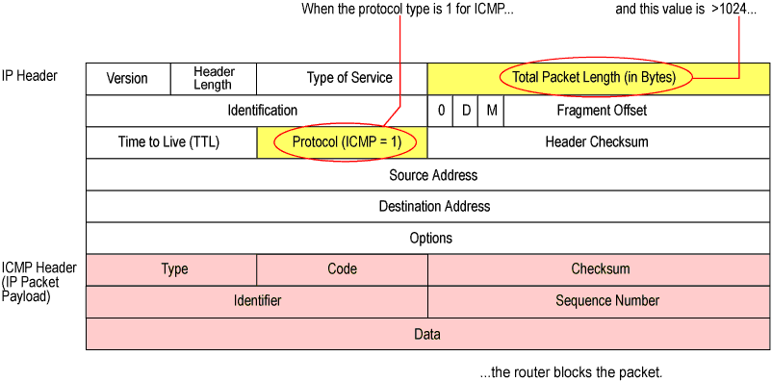
ICMP Packet Format

Slide 10
IPv6 datagram format
ver (4 bit): version number (6)
Priority (8 bit): identify priority among datagrams in flow
flow Label (20 bit): identify datagrams in same “flow.”
(concept of“flow” not well defined).
next header: identify upper layer protocol for data (same as in IPv4)
ver
pri
flow label
payload len
next hdr
hop limit
source address
(128 bits)
destination address
(128 bits)
data
32 bits

Slide 11
Transition from IPv4 to IPv6
not all routers can be upgraded simultaneously
no “flag days”
how will network operate with mixed IPv4 and IPv6 routers?
tunneling: IPv6 datagram carried as payload in IPv4 datagram among IPv4 routers
IPv4 header fields
IPv6 header fields
IPv4 payload
IPv4 source, dest addr
IPv6 source dest addr
UDP/TCP payload
IPv6 datagram
IPv4 datagram

Slide 12
Tunneling
A
B
IPv4 tunnel
connecting IPv6 routers
E
F
logical view:
IPv6
IPv6
IPv6
IPv6
A
B
C
D
E
F
physical view:
IPv6
IPv6
IPv4
IPv4
IPv6
IPv6
flow: X
src: A
dest: F
data
src:B
dest: E
src:B
dest: E
flow: X
src: A
dest: F
data
Flow: X
Src: A
Dest: F
data
Flow: X
Src: A
Dest: F
data
A-to-B:
IPv6
B-to-C:
IPv6 inside
IPv4
B-to-C:
IPv6 inside
IPv4
E-to-F:
IPv6

Slide 13
A Link-State Routing Algorithm
Dijkstra’s algorithm
net topology, link costs known to all nodes
accomplished via “link state broadcast”
all nodes have same info
computes least cost paths from one node (‘source”) to all other nodes
gives forwarding table for that node
iterative: after k iterations, know least cost path to k dest.’s
notation:
c(x,y): link cost from node x to y; = ∞ if not direct neighbors
D(v): current value of cost of path from source to dest. v
p(v): predecessor node along path from source to v
N': set of nodes whose least cost path definitively known

Slide 14
Dijsktra’s Algorithm
1 Initialization:
2 N' = {u}
3 for all nodes v
4 if v adjacent to u
5 then D(v) = c(u,v)
6 else D(v) = ∞
7
8 Loop
9 find w not in N' such that D(w) is a minimum
10 add w to N'
11 update D(v) for all v adjacent to w and not in N' :
12 D(v) = min( D(v), D(w) + c(w,v) )
13 /* new cost to v is either old cost to v or known
14 shortest path cost to w plus cost from w to v */
15 until all nodes in N'

Slide 15
Distance vector algorithm
iterative, asynchronous: each local iteration caused by:
local link cost change
DV update message from neighbor
distributed:
each node notifies neighbors only when its DV changes
neighbors then notify their neighbors if necessary
each node:
wait for (change in local link cost or msg from neighbor)
recompute estimates
if DV to any dest has changed, notify neighbors

Slide 16
Distance vector algorithm
key idea:
from time-to-time, each node sends its own distance vector estimate to neighbors
when x receives new DV estimate from neighbor, it updates its own DV using B-F equation:
D_{x}(y) ← min_{v}{c(x,v) + D_{v}(y)} for each node y ∊ N
under minor, natural conditions, the estimate D_{x}(y) converge to the actual least cost d_{x}(y)

Slide 17
Routing on the Internet
Autonomous Systems (AS): Internet is divided into a number of AS’es, each of which is more or less independent
Intra-AS routing: (within AS), a.k.a. Interior Gateway Protocols (IGP)
RIP
OSPF
Inter-AS routing: (between AS)
BGP (Border Gateway Protocols)

Slide 18
Data link layer protocols
Putting things in perspective:
application: supporting network applications
FTP, SMTP, HTTP
transport: process-process data transfer
TCP, UDP
network: routing of datagrams from source to destination
IP, routing protocols
link: data transfer between neighboring network elements
Ethernet, 802.111 (WiFi), PPP
physical: bits “on the wire”
application
transport
network
data link
physical

Slide 19
MAC protocols: taxonomy
Three broad classes in Medium Access Control (MAC) protocols:
channel partitioning
divide channel into smaller “pieces” (time slots, frequency, code)
allocate piece to node for exclusive use
random access
channel not divided, allow collisions
“recover” from collisions
“taking turns”
nodes take turns, but nodes with more to send can take longer turns

Slide 20
Channel partition
TDMA: time division multiple access
FDMA: frequency division multiple access
CDMA: code division multiple access
Or any combinations of the above

Slide 21
“Taking turns” MAC protocols
channel partitioning MAC protocols:
share channel efficiently and fairly at high load
inefficient at low load: delay in channel access, 1/N bandwidth allocated even if only 1 active node!
random access MAC protocols
efficient at low load: single node can fully utilize channel
high load: collision overhead
examples include token ring and token passing
“taking turns” protocols
look for best of both worlds!

Slide 22
Random access protocols
when node has packet to send
transmit at full channel data rate R.
no a priori coordination among nodes
two or more transmitting nodes ➜ “collision”,
random access MAC protocol specifies:
how to detect collisions
how to recover from collisions (e.g., via delayed retransmissions)
examples of random access MAC protocols:
slotted ALOHA
ALOHA
CSMA, CSMA/CD, CSMA/CA

Slide 23
Examples of random access protocols
Slotted ALOHA: nodes transmit at the beginning of a time slot; if collision, try again. Efficiency: ~0.36
Pure ALOHA: nodes transmit at any time; if collision, try again. Efficiency: ~0.18
CSMA: nodes listen before transmitting. Only if the medium is idle then nodes send data. If collision, try again.
CSMA/CD: same as CSMA with collision detection (CD) so that when a collision is detected, the data transmission stops. Efficiency: 1/(1+5a) where a = tau/T

Slide 24
Ethernet specifics:
Ethernet implements CSMA/CD using the binary backoff algorithm
ARP: address resolution protocol is used to find the host which has the needed IP address
sending adapter encapsulates IP datagram (or other network layer protocol packet) in Ethernet frame
preamble:
7 bytes with pattern 10101010 followed by one byte with pattern 10101011
used to synchronize receiver, sender clock rates
type
preamble
dest.
address
source
address
data (payload)
CRC

Slide 25
Characteristics of selected wireless links
200
802.11n
54
802.11a,g
802.11a,g point-to-point
5-11
802.11b
4G: LTE WIMAX
4
3G: UMTS/WCDMA-HSPDA, CDMA2000-1xEVDO
Data rate (Mbps)
1
802.15
.384
2.5G: UMTS/WCDMA, CDMA2000
.056
2G: IS-95, CDMA, GSM
Indoor
10-30m
Outdoor
50-200m
Mid-range
outdoor
200m – 4 Km
Long-range
outdoor
5Km – 20 Km

Slide 26
CDMA encode/decode
channel output Z_{i,m}
Z_{i,m}= d_{i}.c_{m}
data
bits
d₀ = 1
1
1
1
1
1
d₁ = -1
1
1
1
-
-
-
-
1
-
-
-
1
-
1
1
1
1
1
sender
1
1
slot 1
channel
output
slot 0
channel
output
1
1
1
1
1
code
1
1
-
-
-
1
-
1
1
1
-
-
-
1
-
1
1
1
slot 1
slot 0
M
D_{i} = Σ Z_{i,m}.c_{m}
m=1
M
received
input
1
1
1
1
1
1
1
1
d₀ = 1
-
-
-
-
1
-
-
-
1
-
1
1
1
1
1
1
d₁ = -1
1
slot 1
channel
output
slot 0
channel
output
1
1
1
1
1
code
1
1
-
-
-
1
-
1
1
1
-
-
-
1
-
1
1
1
receiver
slot 1
slot 0

Slide 27
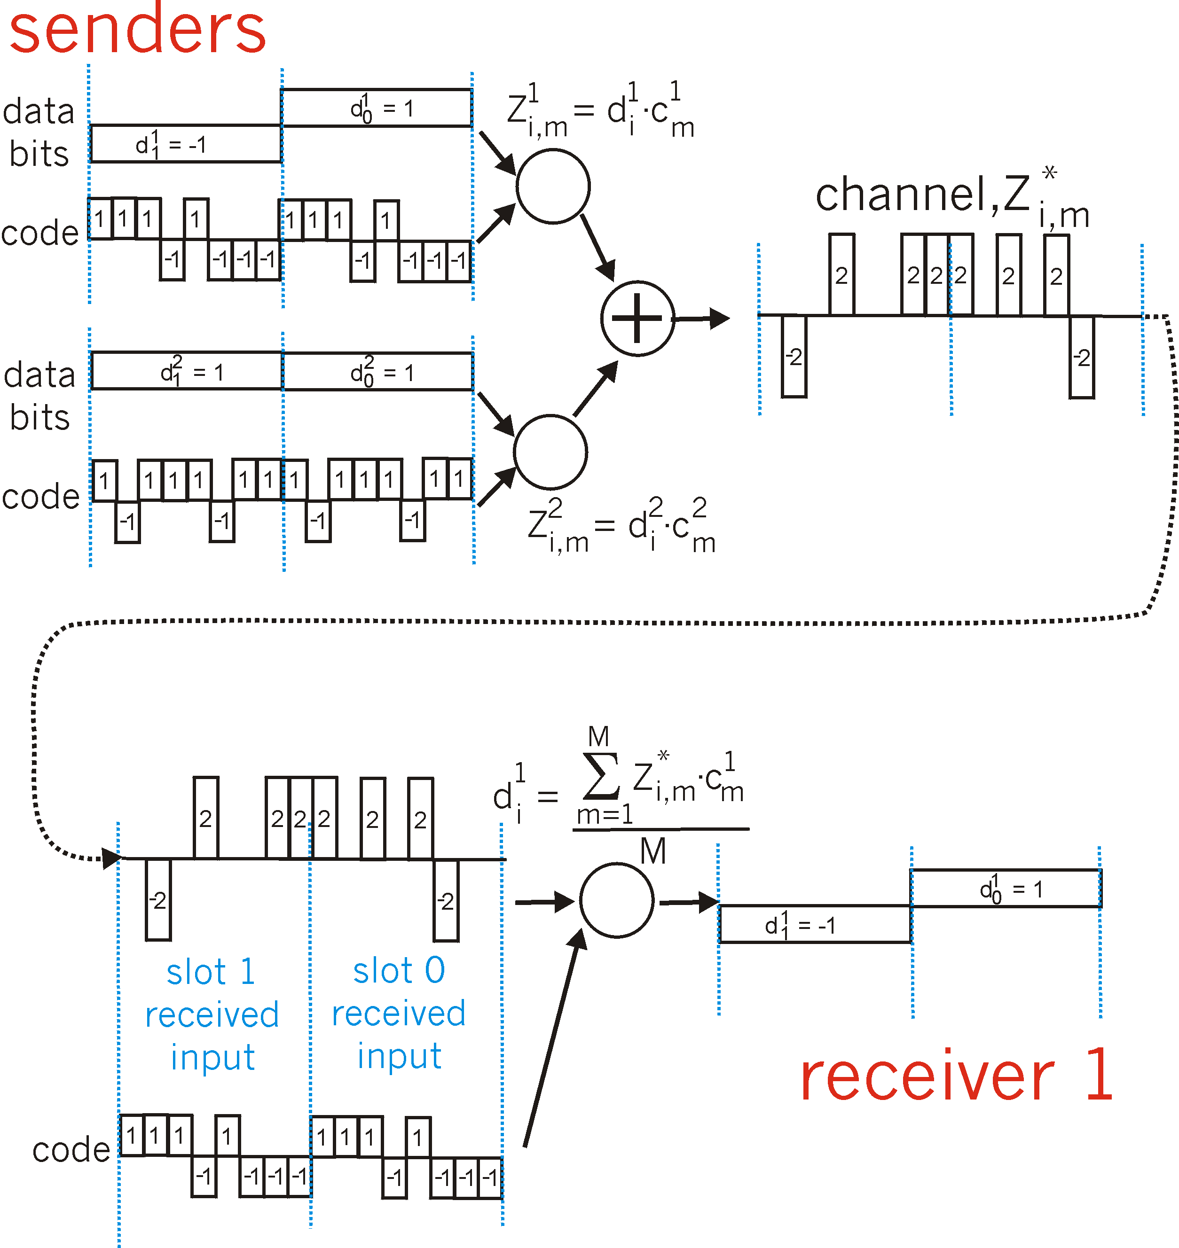
CDMA: two-sender interference
channel sums together transmissions by sender 1 and 2
Sender 1
Sender 2
using same code as sender 1, receiver recovers sender 1’s original data from summed channel data!

Slide 28
The complete sender protocol
When a station has a frame to transmit:
If initially the state senses the channel idle, it transmits its frame after a short period of time known as Distributed Inter-frame Space (DIFS).
Otherwise (sensing other transmission is on-going) the station chooses a random backoff value using binary exponential backoff and counts down this value when the channel is sensed idle. While the channel is sensed busy, the counter value remains frozen.
When the counter reaches zero, the station transmits the entire frame and then waits for an acknowledgment.
If an ack is received, the transmitting station knows that its frame has been received correctly. Continue Step 2 if more frames to send. If no ack is received, Continue Step 2 to resend the previous frame.

Slide 29
Collision avoidance mechanism
idea: allow sender to “reserve” channel rather than random access of data frames: avoid collisions of long data frames
sender first transmits small request-to-send (RTS) packets to base station (BS) using CSMA
RTSs may still collide with each other (but they’re short)
BS broadcasts clear-to-send CTS in response to RTS
CTS heard by all nodes
sender transmits data frame
other stations defer transmissions
avoid data frame collisions completely
using small reservation packets!

Slide 30
802.11 frame: addressing
2
2
6
6
6
2
6
0 - 2312
4
frame
control
duration
address
1
address
2
address
3
seq
control
address
4
payload
CRC
Address 4: used only in ad hoc mode
Address 1: MAC address
of wireless host or AP
to receive this frame
Address 3: MAC address
of router interface to which AP is attached
Address 2: MAC address
of wireless host or AP
transmitting this frame

Slide 31
802.11 frame: more
frame seq #
(for RDT)
duration of reserved
transmission time (RTS/CTS)
2
2
6
6
6
2
6
0 - 2312
4
frame
control
duration
address
1
address
2
address
3
seq
control
address
4
payload
CRC
2
2
4
1
1
1
1
1
1
1
1
Protocol
version
Type
Subtype
To
AP
From
AP
More
frag
Retry
Power
mgt
More
data
WEP
Rsvd
frame type
(RTS, CTS, ACK, data)

Slide 32

Components of cellular network architecture
MSC
connects cells to wired tel. net.
manages call setup (more later!)
handles mobility (more later!)
cell (BSS)
covers geographical region
base station (BS) analogous to 802.11 AP
mobile users attach to network through BS
air-interface: physical and link layer protocol between mobile and BS
Mobile
Switching
Center
Public telephone
network
Mobile
Switching
Center
wired network

Slide 33
Cellular networks: the first hop
Two techniques for sharing mobile-to-BS radio spectrum
combined FDMA/TDMA: divide spectrum in frequency channels, divide each channel into time slots
CDMA: code division multiple access
time slots
frequency
bands

Slide 34
IEEE 802.11, 15, 16 compared
Parameters | EEE802.16d (802.16-2004 Fixed WiMAX) | IEEE802.16e (802.16-2005 Mobile WiMAX) | 802.11 (WLAN, aka WiFi) | 802.15.1 (Bluetooth)
Frequency Band: | 2-66 GHz | 2-11 GHz | 2.4-5.8 GHz | 2.4GHz
Range: | ~31 miles | ~31 miles | ~100 meters | ~10 meters
Maximum Data rate: | ~134 Mbps | ~15 Mbps | ~55 Mbps | ~3Mbps
Number of users: | Thousands | Thousands | Dozens | Dozens
http://www.javvin.com/protocolWiMAX.html

Slide 35
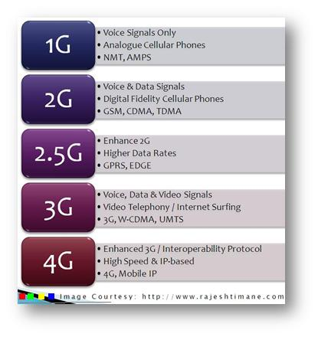
A brief comparison of different G’s
http://techtectology.blogspot.com/2011/11/4g-vs-3g-vs-25g-vs-2g-vs-1g.html

Slide 36
Mobile IP
RFC 3344
has many features we’ve seen:
home agents, foreign agents, foreign-agent registration, care-of-addresses, encapsulation (packet-within-a-packet)
three components to standard:
indirect routing of datagrams
agent discovery
registration with home agent

Slide 37
Mobile IP: indirect routing
foreign-agent-to-mobile packet
packet sent by home agent to foreign agent: a packet within a packet
dest: 128.119.40.186
dest: 79.129.13.2
dest: 128.119.40.186
Permanent address: 128.119.40.186
Care-of address: 79.129.13.2
dest: 128.119.40.186
packet sent by correspondent

Slide 38
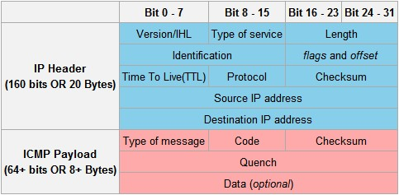
ICMP: Internet Control Message Protocol review
A combination of “type of message” and “code” specifies the meaning
of this ICMP packet. Among others
-- Type 9 is for “route advertising”
-- See a complete list from Wikipedia at
http://en.wikipedia.org/wiki/Internet_Control_Message_Protocol#Header

Slide 39
Mobile IP: agent discovery
agent advertisement: foreign/home agents advertise service by broadcasting ICMP messages (typefield = 9)
H,F bits: home and/or foreign agent
R bit: registration required

Slide 40
Flags in ICMP mobile extension
H: home agent bit
F: foreign agent bit
R: registration required bit
M,G: encapsulation bits (minimal or GRE encapsulation)
B: busy
r: reserved
T: reverse tunneling

Slide 41


Mobile IP: registration example
visited network: 79.129.13/24
home agent
HA: 128.119.40.7
foreign agent
COA: 79.129.13.2
mobile agent
MA: 128.119.40.186
ICMP agent adv.
COA: 79.129.13.2
….
registration req.
registration req.
COA: 79.129.13.2
HA: 128.119.40.7
MA: 128.119.40.186
Lifetime: 9999
identification: 714
encapsulation format
….
COA: 79.129.13.2
HA: 128.119.40.7
MA: 128.119.40.186
Lifetime: 9999
identification:714
….
registration reply
HA: 128.119.40.7
MA: 128.119.40.186
Lifetime: 4999
Identification: 714
encapsulation format
….
registration reply
HA: 128.119.40.7
MA: 128.119.40.186
Lifetime: 4999
Identification: 714
….
time

Slide 42
Synthesis: a day in the life of a web request
journey down protocol stack complete!
application, transport, network, link
putting-it-all-together: synthesis!
goal: identify, review, understand protocols (at all layers) involved in seemingly simple scenario: requesting www page
scenario: student attaches laptop to campus network, requests/receives www.google.com

Slide 43




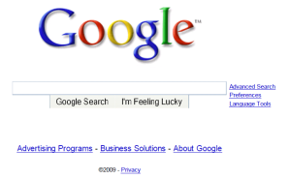
A day in the life: scenario
browser
DNS server
Comcast network
68.80.0.0/13
school network
68.80.2.0/24
web page
web server
Google’s network
64.233.160.0/19
64.233.169.105

Slide 44
A day in the life… connecting to the Internet
DHCP
DHCP
UDP
IP
Eth
Phy
connecting laptop needs to get its own IP address, addr of first-hop router, addr of DNS server: use DHCP
DHCP
DHCP
DHCP
DHCP
DHCP request encapsulated in UDP, encapsulated in IP, encapsulated in 802.3 Ethernet
DHCP
DHCP
UDP
IP
Eth
Phy
DHCP
DHCP
DHCP
DHCP
router
(runs DHCP)
Ethernet frame broadcast (dest: FFFFFFFFFFFF) on LAN, received at router running DHCP server
Ethernet demuxed to IP demuxed, UDP demuxed to DHCP

Slide 45
A day in the life… connecting to the Internet
DHCP
DHCP
UDP
IP
Eth
Phy
DHCP server formulates DHCP ACK containing client’s IP address, IP address of first-hop router for client, name & IP address of DNS server
DHCP
DHCP
DHCP
encapsulation at DHCP server, frame forwarded (switch learning) through LAN, demultiplexing at client
DHCP
DHCP
UDP
IP
Eth
Phy
DHCP
DHCP
DHCP
router
(runs DHCP)
DHCP
DHCP client receives DHCP ACK reply
Client now has IP address, knows name & addr of DNS
server, IP address of its first-hop router

Slide 46
A day in the life… ARP (before DNS, before HTTP)
DNS
UDP
IP
Eth
Phy
before sending HTTP request, need IP address of www.google.com: DNS
DNS
DNS
DNS
ARP
ARP query
DNS query created, encapsulated in UDP, encapsulated in IP, encapsulated in Eth. To send frame to router, need MAC address of router interface: ARP
ARP
ARP reply
Eth
Phy
router
(runs DHCP)
ARP query broadcast, received by router, which replies with ARP reply giving MAC address of router interface
client now knows MAC address of first hop router, so can now send frame containing DNS query

Slide 47
A day in the life… using DNS
DNS
UDP
IP
Eth
Phy
DNS
DNS server
DNS
UDP
IP
Eth
Phy
DNS
DNS
DNS
DNS
DNS
DNS
DNS
DNS
Comcast network
68.80.0.0/13
IP datagram forwarded from campus network into comcast network, routed (tables created by RIP, OSPF, IS-IS and/or BGP routing protocols) to DNS server
router
(runs DHCP)
IP datagram containing DNS query forwarded via LAN switch from client to 1st hop router
demux’ed to DNS server
DNS server replies to client with IP address of www.google.com

Slide 48
A day in the life…TCP connection carrying HTTP
HTTP
HTTP
TCP
IP
Eth
Phy
SYNACK
SYN
SYNACK
SYN
SYNACK
SYN
SYN
to send HTTP request, client first opens TCP socket to web server
router
(runs DHCP)
TCP SYN segment (step 1 in 3-way handshake) inter-domain routed to web server
TCP
IP
Eth
Phy
SYNACK
SYN
SYNACK
SYN
SYNACK
SYNACK
SYN
web server responds with TCP SYNACK (step 2 in 3-way handshake)
web server
64.233.169.105
TCP connection established!

Slide 49
A day in the life… HTTP request/reply
HTTP
HTTP
TCP
IP
Eth
Phy
web page finally (!!!) displayed
HTTP
HTTP
HTTP
HTTP
HTTP
HTTP
HTTP
HTTP
HTTP request sent into TCP socket
router
(runs DHCP)
IP datagram containing HTTP request routed to www.google.com
HTTP
HTTP
TCP
IP
Eth
Phy
HTTP
HTTP
HTTP
web server responds with HTTP reply (containing web page)
HTTP
web server
64.233.169.105
IP datagram containing HTTP reply routed back to client

