Slide 1

[NF-FG]
[Node description]
Universal Node
REST server
Local DB manager
DoubleDecker client
Node resource manager
Compute controller
Network controller
DPDK
driver
Docker
driver
VM
driver
Native
driver
OF contr.
LSI #1
OF contr.
LSI #N
OF contr.
LSI #0
Switch Manager
libvirt
xDPd
driver
OvS
driver
ERFS
driver
Name resolver
VNF1
VNF2
VNF3
VNF4
VNF5
LSI - graph 1
LSI - graph N
OvS
LSI - 0
Virtual Link among LSIs
OpenFlow connection
Network function port(s)
(between an LSI and a VNF)
Network control
Compute control
Notes:
architecture.pdf

Slide 2
Match | Action
Port 1 | Output port 3
Port 3 | Output port 1
Port 2 | Output port 4
Port 4 | Output port 2
dummy
port1
port2
3
4
LSI – dummy_graph
1
2
3
4
Match | Action
Port 1 | Output port 3
Port 3 | Output port 1
Port 2 | Output port 4
Port 4 | Output port 2
LSI - 0
1
2
eth0
eth1

Slide 3
eth0
eth1
dummy
port1
port2

Slide 4
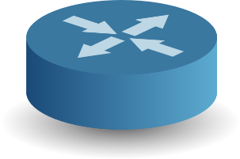

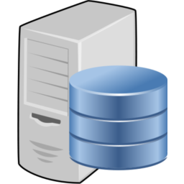
IPsec tunnel
Public IP
y.y.y.y
10.0.1.1
Network
10.0.1.0/24
Network
10.0.2.0/24
Public IP
x.x.x.x
10.0.2.1

Slide 5

Out of Band
In Band
Universal Node
Universal Node
Local orchestrator
Local orchestrator
LSI - 0
LSI - 0
10.0.0.1
10.0.0.1
eth0
eth1
eth2
eth0
eth1
[NF-FG]
[NF-FG]
Internet
Internet
Global orchestrator
Global orchestrator
Legend
Orchestration Port (layer 3)
10.0.0.1
Management IP address of the UN
Notes:
orchestrator_in_band_and_out_of_band

