Slide 1
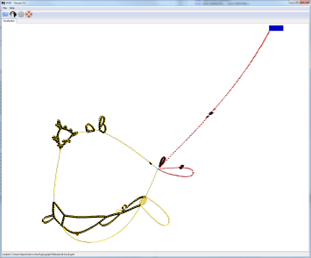
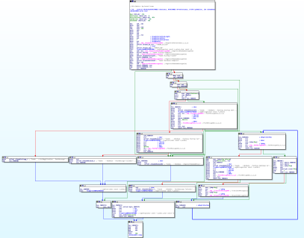
VERA
(Server)
IDA Pro
(client)
Socket Connection
Windows w/ OpenGL
VM / or Analysis Machine

