Slide 1


Quick Manual (Q&A)
2024.07
Samsung Advanced Technology Academy

Slide 2
Contents
1.
PC Specification
2.
Supported IDE Tool
3.
Server Compiler
4.
Allowed Library

Slide 3
1. PC Specification
Which specifications of PC are supported?
OS : Win10 & Next Versions
IExplorer : IE 11 or upper / Microsoft Edge (Latest Versions)
※ Please change language to English at control panel in the non English-speaking countries.
Q) Most of our engineers use Linux machine and have Windows on virtual machines.
Will it be problematic to pass the test on virtual machine?
→ A) Virtual machine in the Linux PC would be prohibited. Please use MS Windows PC.
Q) Is it possible to use under IE 10?
→ A) Some script errors possibly occur with under IE10. Please install over IE 11.
If necessary, Users can use lower IE version by IE F12 button.

Slide 4
2. IDE Tool (1/3)
Which IDE Tools are supported?
C/C++ : Visual Studio 2017 Express / Visual Studio 2013 Express
Java : Eclipse 2018-9
Python : PyCharm 2020.3.5
※ Please install English version IDE in the non English-speaking countries.
Q) Is it possible to use other versions of IDE tools?
→ A) Below versions are allowed, but please use the recommended version preferably.
Visual Studio : 2005, 2008, 2010, 2012, 2013, 2017 Express(Recommended)
Eclipse : Helios , Indigo, Kepler, Juno, Luna, Mars, Neon, 2018-9(Recommended)
PyCharm : 2030.3.5(Recommended)
Q) Is it possible to use other IDE tools except Visual Studio, eclipse and pycharm?
→ A) No, only Visual Studio, Eclipse and PyCharm are allowed.

Slide 5
2. IDE Tool (2/3)
Q) How to set path of IDE Tools?
→ A) Please follow below guide to set path of IDE tools in the SCS App.
Visual Studio : Set the path of the highest version automatically.
Eclipse : SCS App will search a default path(C:\eclipse\eclipse.exe, D:\eclipse\eclipse.exe).
If exist, set the path as a default.
PyCharm : SCS App will search a default path
(C:\Program Files\JetBrains\PyCharm Community Edition ####.#.#\bin).
If exist, set the path as a default.
※ Users can change a path of IDE tools by Setting menu in the SCS App.

Slide 6
2. IDE Tool (3/3)
Q) Is it possible to open or save a file in the IDE Tools?
→ A) “Open” and “Save As” are not allowed. (only “Save” allowed)
All necessary files would be created automatically when a IDE tool is running.
Visual Studio : project.c, project.cpp, sample_input.txt files are created automatically.
Eclipse : Solution.java, sample_input.txt files are created automatically.
PyCharm : Project_py.py file is created automatically.
※ Please copy & paste stub code and sample_input from SCS system to the IDE tool.

Slide 7
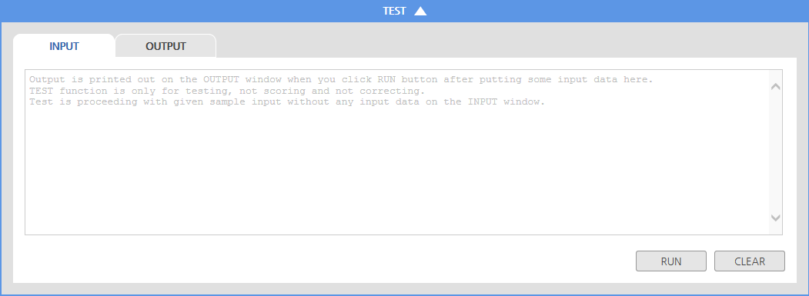
3. Server Compiler
What is the version of Server Compiler?
C / C++ : C (gcc-10.3) / C++14 (gcc-10.3)
Java : OpenJDK 8
Python : PyPy-7.3.4
Q) There are certain incompatibilities between server gcc compiler and Microsoft compiler used
in Visual Studio. How should I deal with these incompatibilities?
→ A) Users can check an answer by Test Run functionality after solving a problem in the Visual Studio or Eclipse. It can be tested by gcc or jdk in the server before submitting an answer.

Slide 8
4. Allowed Library
Which standard libraries are allowed in the server?
Advanced : All standard libraries are allowed
Professional: The standard library is available except for the standard input/output functions.
Expert : Library usage is strictly restricted except (C/C++ : <malloc.h)
※ The standard library constraints may vary for each test.
So, please make sure to read the test description carefully.
※ For Pre-employment test, all libraries can be used
Q) Any caution to report answers after using IDE Tool of PC?
→ A) Please note the following when submitting answers
. Make sure not to use file input/output.
. Frequently save source codes onto the test system to prevent any loss of documents.
. If you declare a package in Java, runtime error occurs.

Slide 9
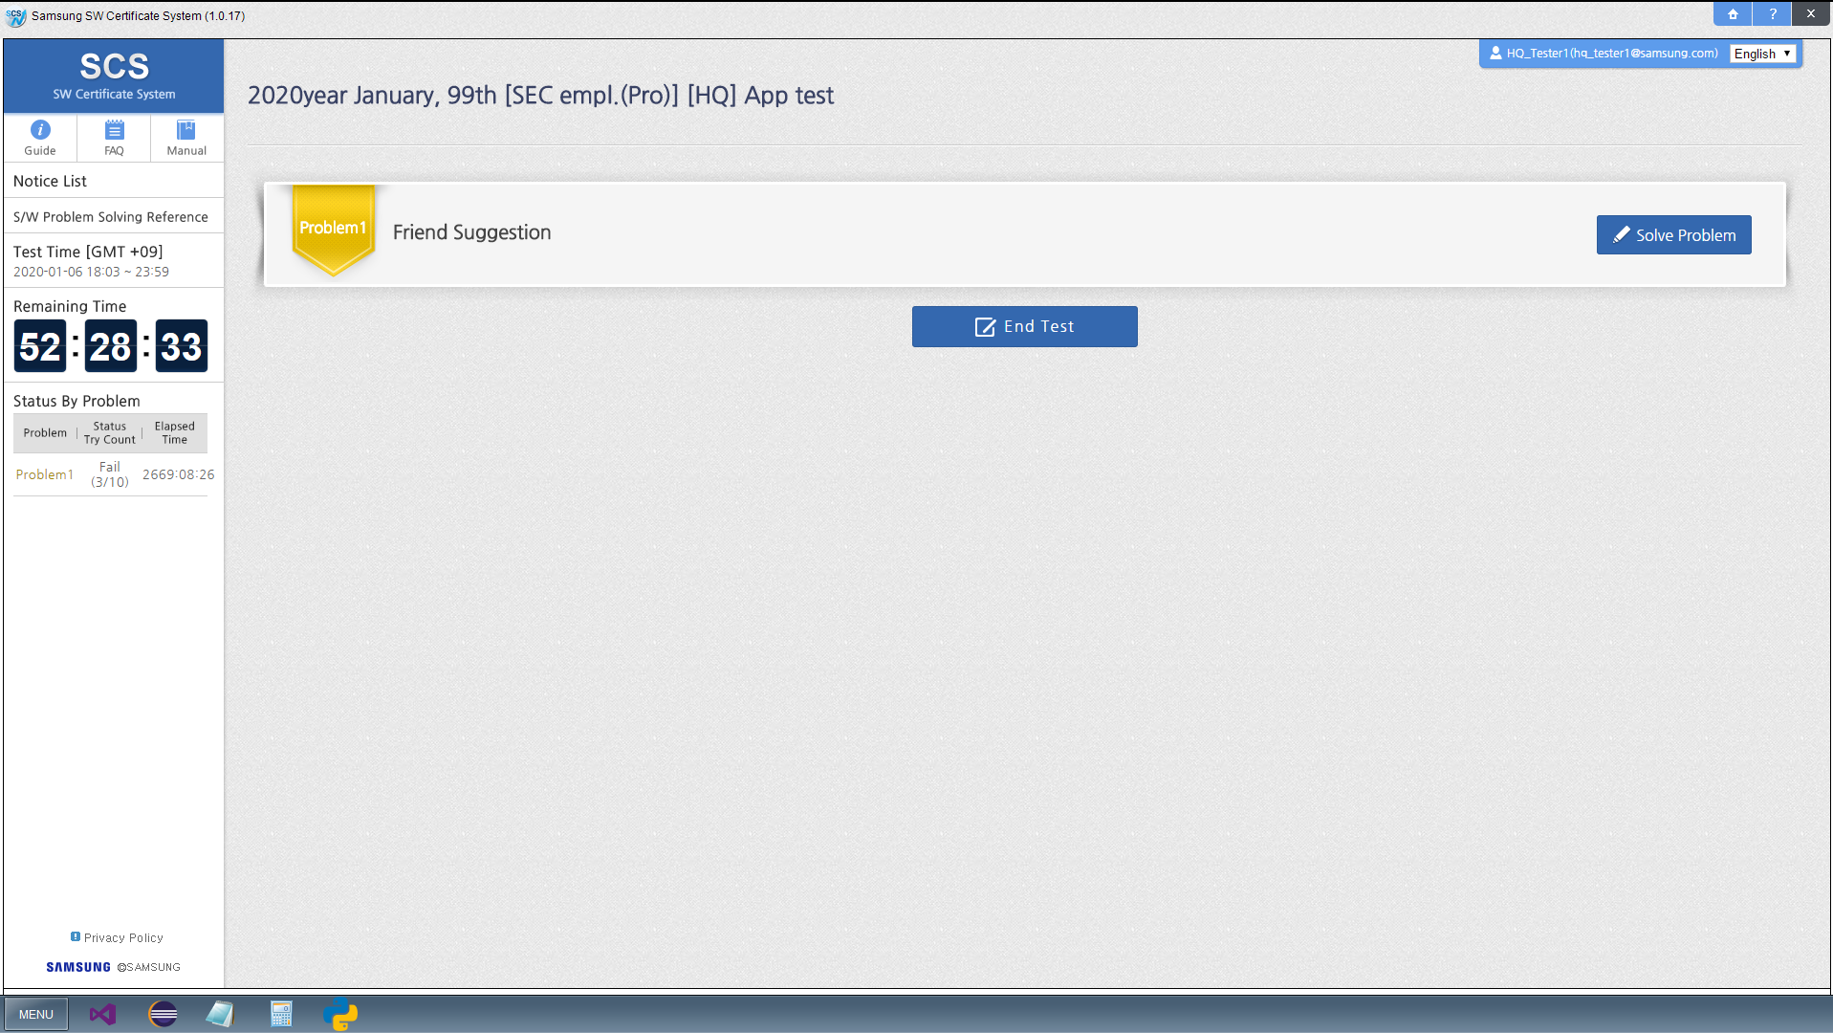
You can see all Guide & FAQ in the main screen.
1
2
3

Slide 10
Thank You

