Slide 1
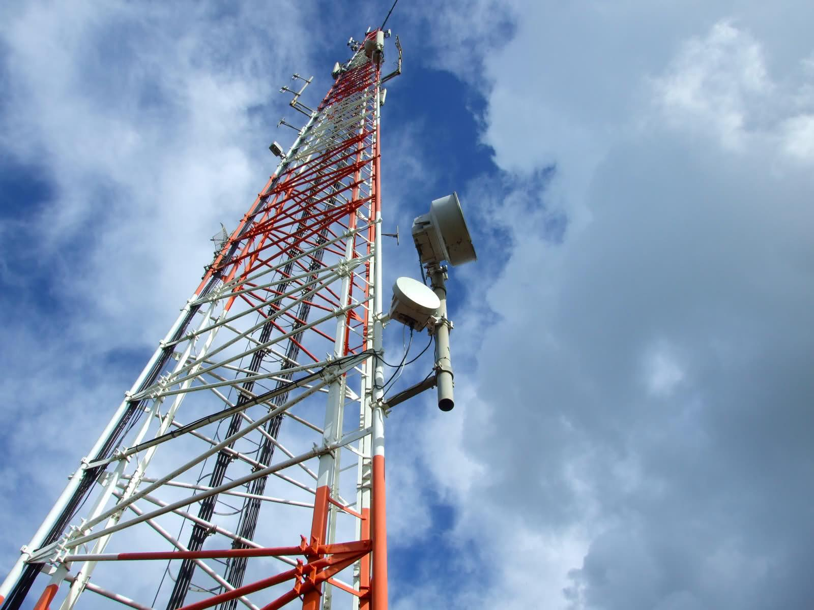
Broadcasting System
Team 6
Eric Kamada, Pavithran Pathmarajah,
Simon Ly, Tarun Jain

Slide 2
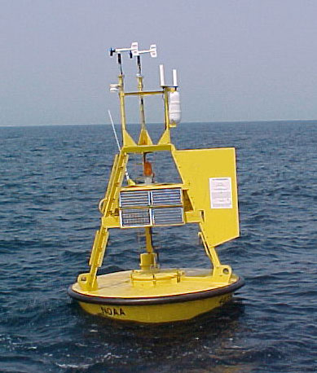
Broadcasting System
Broadcast systems are integral to open water buoys
These Buoys relay crucial information to those who need it
Warning people of the constantly changing and potentially dangerous ocean conditions
Notes:
Needed to help guide refugees across the waters safely

Slide 3


Assumptions
Buoy
Constantly outputting a radio transmission
Have a radio transmitter and a radio receiver
Weather and Current modules
Minimal hardware
Users
Willing to change frequencies for near buoys
Have an AM/FM radio
Notes:
Each Buoy is constantly outputting a transmission so another nearby buoy does not pick up the frequency as empty and try to use it
Each buoy has a transmitter to output a transmission, and a receiver to test for open frequencies
There is a module to provide weather and water current information (if not what’s the point of this system)
Assuming the hardware on board the buoy is not extremely powerful, closest experience we have is Altera boards and VHDL.
Altera boards can run compiled C++, so we choose C++ for our project, vs Java which requires an existing JVC to run
Not much experience in C++
Assume the refugees have an AM/FM Radio
They are willing to flip thorough channels to find our buoy

Slide 4
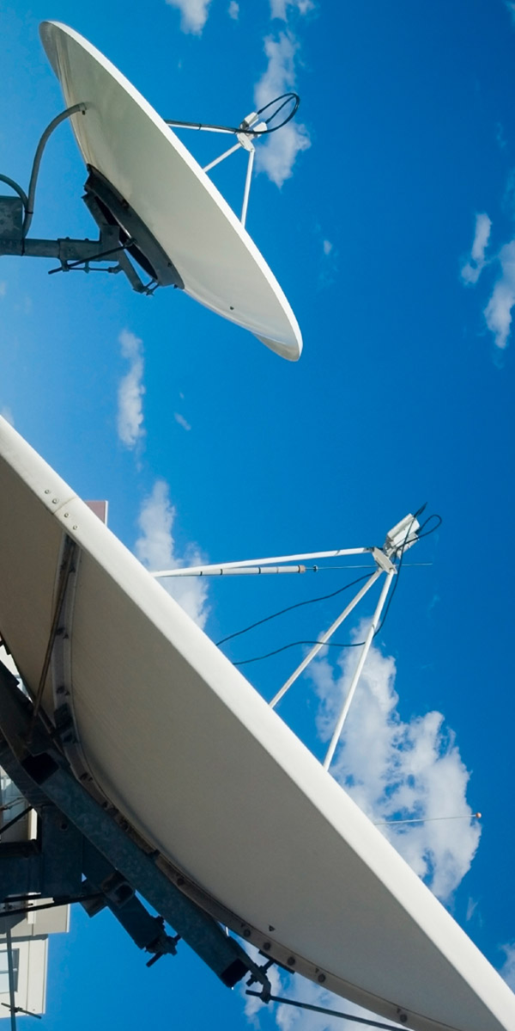
Scope
Conducts sensor and frequency diagnostics
Broadcasts weather and ocean current data from onboard modules via an FM/AM signal
Communicates through an AdHoc network in scenarios where the broadcast system fails.
Recognizes hazardous conditions through the network of weather and ocean current modules to immediately alert users
Notes:
The module will find a free frequency at start up, psedo Randomly. As-well as check if it’s broadcasting system works correctly every 50 broadcasts
Broadcast data received from modules across am and fm waves
If the broadcasting system does not work a message will be sent via adhoc, in hopes of reaching someone who could come fix the buoy
Using the priority que will override any output with that emergency/high priority message

Slide 5

Our Implementation

Slide 6
The breakdown
Data In
System Start
Weather Queue
Current Queue
Data Processing
Signal Broadcasting
System Status
Frequency Selection
Selector
Hardware Test
Hardware
Test
Encoder
Program Start
Ad-Hoc
Output
Broadcast
Notes:
T

Slide 7
Data Processing
Able to handle a constant flows of data
The data is organized into priority queues
New data can override old data
Data is flagged with one of two values
Weather Queue
Data In
Water Current Queue
Notes:
Will be receiving constant data input form weather and current modules, Data in is a method which is called by those other modules
The dataIn has 3 parameters, type: Weather or water Current, Priority: High or Low, Message: A String
The data is put into two priority queues
If updated data is put into the queue older data by time stamp will be deleted. The main purpose of the queue is just to hold info while the encoder encodes messages
High priority messages automatically put to top of the queue

Slide 8
Signal Broadcasting
Selector
Dynamic frequency selection
Oscillates between weather and water current data
Data is encoded to prepare it for transmission
Encoded message is then sent to the broadcaster
Encoder
Broadcast
Notes:
On start up an AM Frequency is chosen pseudo randomly, and then checked to see if it is in use. If not then it is locked into by the module. Then the process is repeated for FM
If frequencies were checked from the beginning of the range to the end of the range then the likely hood of having overlapping frequencies in between two buoys id greater. Since a buoy can only pick up if a frequency is in use if the broadcast from another buoy overlaps the buoy which is just starting (inefficient layout fi they are overlapping). Thus by picking at random, even if two buoys are outside of range of each other, but their frequencies overlap will be less likely to cause interference for each other since they are less likely to choose the same channel
The selector is the main loop which oscillates between pulling data from either the weather or current queue, encoding the data then transmitting it on the broadcaster
First the selector checks both queues to see if they have a high priority flag if not then it does its regular selection
The encoder converts the string to human voice (robotic void), this was not implemented for it was out of scope of the time we had
The broadcaster takes the audio signal and then broadcasts it on both AM and FM frequencies selected on start up, the AM/FM broadcast system was out of scope since we did not have time nor the physical hardware to broadcast.

Slide 9
System Status
Module checks to see if broadcast system is functional
Module will communicate to nearby Buoys via AdHoc if a problem arises
Hardware Test
AdHoc Communications

Slide 10

Thanks for listening

