Slide 1
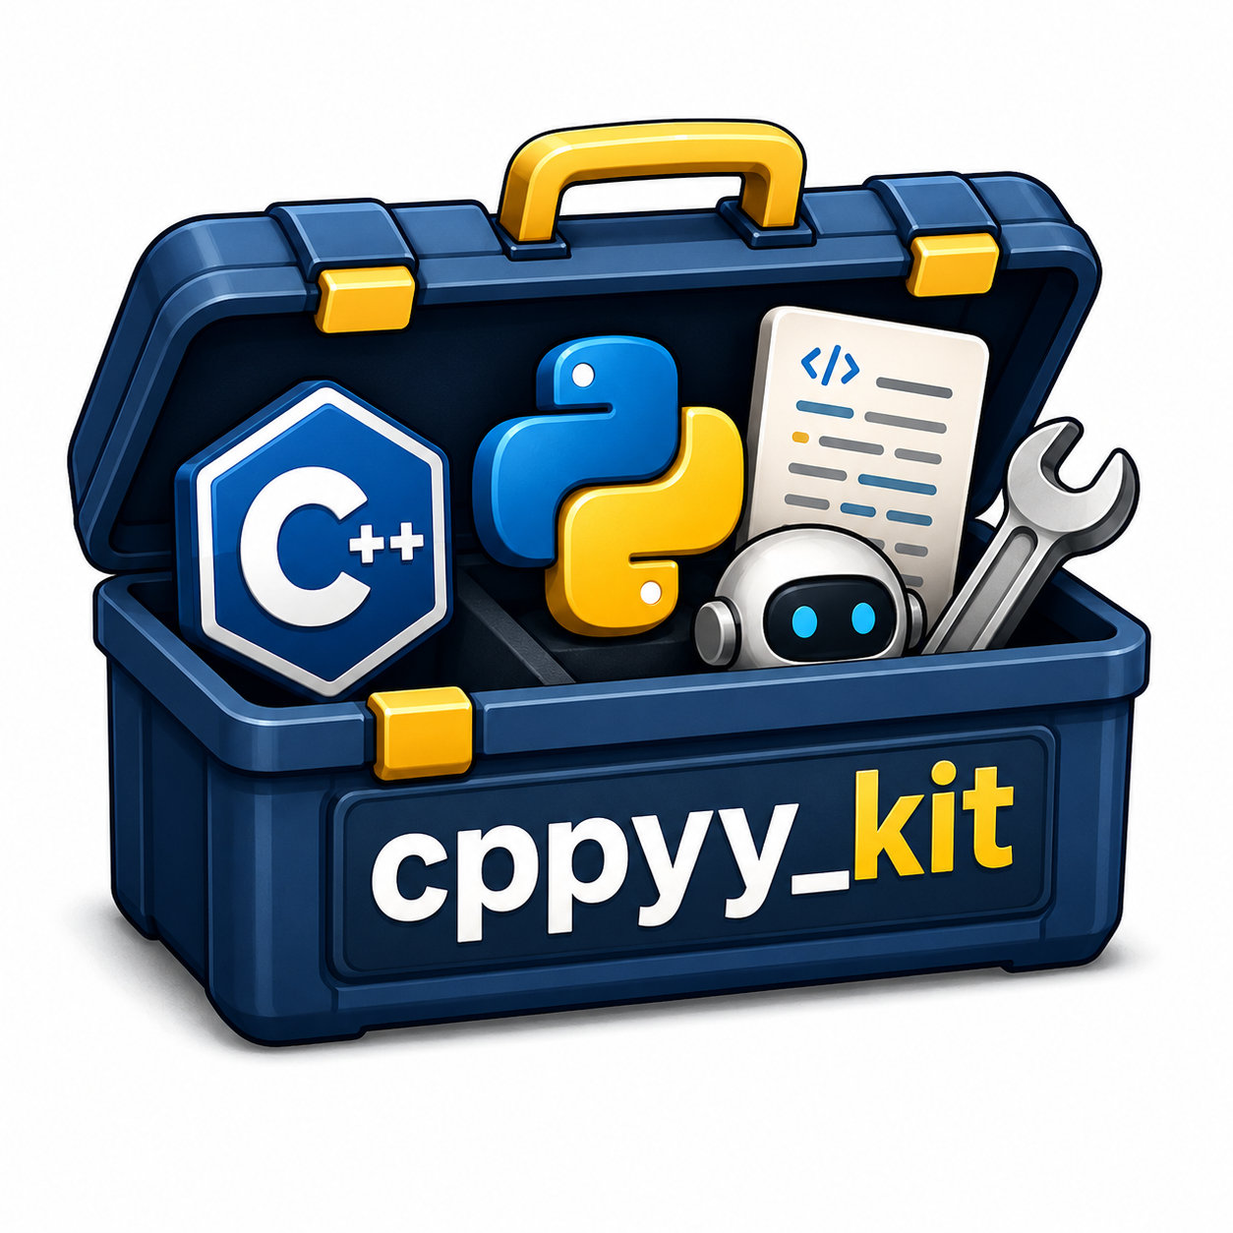
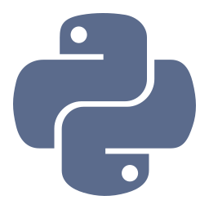
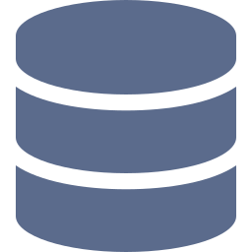


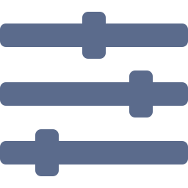

It was supposed to be a small Python script
A cppyy_kit deep dive
ROSCon UK 2026
Python
MCAP
library
ROS
controller
webcam
Notes:
A working spoken script for a roughly 45-minute deep dive. The story follows one prototype as we keep asking it to do more.

Slide 2



Where does the interesting bit start?
Python
MCAP
library
ROS
controller
webcam
wait
get ready
reach
pause
reach
recording time
Tell me when the hand starts moving
Cut some of that out before you spend your afternoon training a robot to wait patiently.
Keep it active while it is moving
Do not get excited about every tiny twitch
Notes:
So, say you're putting together a robot dataset. You've collected some recordings. You want to train a policy. Before that, you have a very reasonable question: where does the interesting bit actually start? The robot waits. Someone gets ready. Then it reaches for something. Then there's another pause. You'd quite like to cut some of that out before you spend your afternoon training a robot to wait patiently.

Slide 3
A small motion rule
Python
MCAP
library
ROS
controller
webcam
speed
Enter speed
hold time
Start moving above this
tiny twitch, ignored
Exit speed
Stop below this
enter speed
Hold time
exit speed
Movement must last before we believe it
mask
Without the hold time we have built a very efficient noise detector.
active = 1 while moving
Notes:
You don't need to solve all of robot learning today. You just want a little heuristic: tell me when the hand starts moving, keep it active while it's moving, and don't get excited about every tiny twitch. We have one speed to start moving and another to stop. We also want the movement to last a little while before we believe it. Otherwise we've built a very efficient noise detector.

Slide 4






Six stops for one small script
Python
MCAP
library
ROS
controller
webcam
This loop is annoying me
Someone gave us a humanoid bag
A library we have not wrapped
Could we just put it in ROS?
Someone asks for a controller
Can we make it follow this?
7 min
8 min
4 min
6 min
7 min
5 min
Then the same tool, asked for a little more each time.
Notes:
That's where we'll start. A small computation that's taking longer than we'd like. Then we'll do the usual thing that happens to a small robotics script: ask it to read a bag, run it in ROS, and eventually wonder whether it could be a controller. We'll finish by pointing a camera at something and moving it around. Timing budget: Python 7, MCAP 8, native library 4, ROS 6, controller 7, webcam 5.

Slide 5
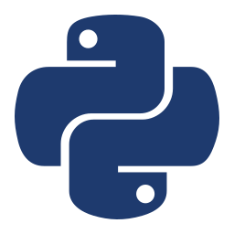
1. This loop is annoying me
Python, 7 minutes
Timestamps go in, hand positions go in, and a mask comes out telling us which samples count as moving.
Python
MCAP
library
ROS
controller
webcam
Notes:
Here's our little motion detector. Timestamps go in, hand positions go in, and a mask comes out telling us which samples count as moving.

Slide 6
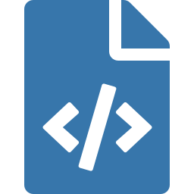

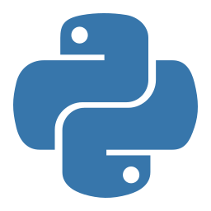

Agent writes, tests, times
Python
MCAP
library
ROS
controller
webcam
skeleton task.py
implementation
tests + timing
checks, example data, entry point
the missing logic
pass / fail and milliseconds
agent
+ prompt
No cppyy mentioned yet
agent runner
# 1. baseline: plain Python
$ pixi run python scripts/run_agent_eval.py implement --run rehearsal_01_python
# 2. fresh session, kernel guide supplied
$ pixi run python scripts/run_agent_eval.py accelerate --run rehearsal_01_native --baseline rehearsal_01_python
Notes:
I've supplied the boring bits in task.py: the input checks, the example data, and the entry point. The agent writes the missing logic. At this point I haven't told it anything about cppyy. Run the baseline prompt. Show the resulting function and its test result.

Slide 7
NumPy plus a sequential loop
Python
MCAP
library
ROS
controller
webcam
29 ms
NumPy
displacement and speed
Python loop
when does movement start and end?
for 250,000 samples, NumPy plus a sequential loop
Routes we could explore
Numba
Cython
pybind11
cppyy
I want to see what happens when the next request involves a C++ library or a native ROS interface.
Notes:
The agent gave us a sensible Python implementation. It already uses NumPy for the displacement and speed calculations. There's still a sequential loop deciding when a movement starts and ends. For 250,000 samples, that took about 29 milliseconds. We have options. We could try Numba, use Cython, or build a C++ extension with pybind11. I'm choosing cppyy because I also want to see what happens when our next request involves a C++ library or a native ROS interface.

Slide 8
The whole idea
Python
MCAP
library
ROS
controller
webcam
kernel.py
import numpy as np
from cppyy_kit import cpp
from cppyy_kit.numpy_types import ConstNDArray
@cpp(nogil=True)
def sum_sq(data: ConstNDArray[np.float64]) -> float:
"double s = 0; for (std::size_t i = 0; i < data_size; ++i) s += data[i]*data[i]; return s;"
assert sum_sq(np.array([1, 2, 3], dtype=np.float64)) == 14.0
3
2
1
4
1
2
3
4
The string is the C++ body
ConstNDArray[np.float64] gives a const double* and data_size
nogil=True on the decorator
Compiled once, cached for reuse. The buffer is borrowed for the call
Notes:
For the moment, here's the whole idea in a tiny example. That string is the C++ body. The decorator compiles it, and we call it from Python. ConstNDArray[np.float64] supplies a const double* and the total element count as data_size. It borrows the buffer for the call and caches the compiled kernel for reuse.

Slide 9
The buffer contract
Python
MCAP
library
ROS
controller
webcam
NumPy array
Checks
borrowed pointer
C++ kernel
const double*
data_size
dtype
native byte order
alignment
C-contiguous
mismatch
Python wrapper normalises
rejected
A mutable output uses NDArray[T].
The kernel borrows the buffer for the call.
Notes:
The array must have the specified dtype, native byte order, alignment and C-contiguous layout. The decorator rejects a mismatch; any normalization belongs in the Python wrapper. It borrows the buffer for the call. A mutable output uses NDArray[T].

Slide 10
About twenty times faster
Python
MCAP
library
ROS
controller
webcam
python_native.py
12 tests
mask = np.zeros(n, dtype=np.int32)
if n < 2:
return mask
_motion_mask_kernel(t, xyz.reshape(-1), n, enter_speed, exit_speed,
hold_seconds, mask)
return mask
supplied tests passed
match
independent random checks matched
NumPy + Python loop
29.3 ms
cppyy native call
1.48 ms (~20x)
Notes:
In the original evaluation, twelve supplied test cases passed and independent random checks matched. The warmed computation went from about 29.3 milliseconds to 1.48. About twenty times faster on this input. We did pay for compilation and startup. We'll show that separately.

Slide 11

2. Someone gave us a humanoid bag
MCAP, 8 minutes
An open humanoid manipulation recording. Our question is still quite modest: when are the hands moving?
Python
MCAP
library
ROS
controller
webcam
Notes:
I went looking for an open humanoid manipulation recording and found this G1 pillow episode. It comes from HIW-500, by BitRobot, Unitree, and Hugging Face. Our question is still quite modest: when are the hands moving? How much does that answer change if I adjust the speed threshold?

Slide 12
A real recording
Python
MCAP
library
ROS
controller
webcam
HIW-500 G1 pillow episode
by BitRobot, Unitree and Hugging Face
2,735 observations
MCAP
ROS String
JSON
ee_state
NumPy arrays
analyze.py
payload = json.loads(decoded.data)
state = payload["ee_state"]
timestamps.append(message.log_time)
states.append(state)
timestamps = np.asarray(timestamps, dtype=np.int64)
t = (timestamps - timestamps[0]).astype(np.float64) / 1e9
Subtract while the timestamps are still integers, then convert to seconds.
The detector uses the time the data was recorded.
Notes:
First discovery: the hand poses we want are inside JSON, inside a ROS String. So the loader gives us arrays of recorded timestamps and left/right hand states. There are 2,735 observations. That subtraction happens while the timestamps are still integers. Then we convert to seconds. I'd quite like our motion detector to use the time the data was recorded.

Slide 13
41 thresholds, two hands
Python
MCAP
library
ROS
controller
webcam
sweep.py
41 thresholds x 2 hands
import numpy as np
from solutions.mcap_native import load_poses, sweep
ns, t, states = load_poses("data/hiw_pillow_episode_0002.mcap")
thresholds = np.linspace(.02, .20, 41)
counts, active_seconds = sweep(t, states, thresholds, hold_seconds=.02)
print(counts[0]) # [89, 82] at 0.02 m/s
left
right
0.02 to 0.20 m/s
0 events
89 left / 82 right
with the original 120 ms hold time
with a 20 ms hold, lowest speed threshold
Notes:
Now we ask the agent to take our rule and sweep 41 speed thresholds for both hands. And here's a useful surprise from actually trying it. With the original 120-millisecond confirmation time, we got zero events. At 20 milliseconds, the lowest speed threshold gave us 89 events for the left hand and 82 for the right.

Slide 14
Have we discovered 171 successful grasps?
Python
MCAP
library
ROS
controller
webcam
Even the labels disagree
Episode name
sofa
floor
not equal
Subtask labels
bed
chair
89 left hand + 82 right hand = 171 events
Welcome to working with somebody else's data. We keep the source labels visible and inspect the recording.
Have we discovered 171 successful grasps?
We have discovered 171 things our motion rule calls events.
Notes:
So, have we discovered 171 successful grasps? We have discovered 171 things our motion rule calls events. Let's look at some of them before we put those labels into a training dataset. Even the annotations gave us something to discuss: the episode name mentions a sofa and floor, while the subtask labels mention a bed and chair. Welcome to working with somebody else's data.

Slide 15
Query is fast, decoding dominates
Python
MCAP
library
ROS
controller
webcam
Load + decode bag
191 ms
Query in Python
24.8 ms
Query in C++
1.14 ms (~22x)
Reload the whole file every time: decoding still dominates.
Arrays already loaded, tuning the rule: the faster query helps straight away.
Notes:
The recorded query went from about 24.8 milliseconds in Python to 1.14 in C++. About twenty-two times faster. Loading and decoding the bag still took about 191 milliseconds in that run. So if I reload the whole file every time, that part still dominates. If I've already got the arrays and I'm experimenting with the rule, the faster query is useful straight away.

Slide 16

3. Could we add a library we have not wrapped?
Native library, 4 minutes
Nearby observations with enough confidence and enough separation in recorded frames, plus their centroid.
Python
MCAP
library
ROS
controller
webcam
Notes:
Suppose our next experiment needs nearby Cartesian observations, but only those with sufficient confidence and enough separation in recorded frames. We also want the centroid of the selected observations.

Slide 17
A library without a new kit
Python
MCAP
library
ROS
controller
webcam
Python side
Native adapter
Output arrays
validate arrays
allocate outputs
run the experiment
pinned nanoflann header
retained index, owned copy of points
traversal + filter + centroid
neighbors
squared distances
counts, centroids
Pin and check the header
Build a small native adapter
Load its declarations
Retain the index between queries
1
2
3
4
demo.py
from index import Index
with Index(points, frame_ids, confidence) as index:
result = index.query(query_points, query_frames, k=8, frame_gap=128,
min_confidence=.6, max_distance=.25)
print(result["centroids"])
Python controls the experiment. C++ keeps the index and does the traversal.
Notes:
The nanoflann recipe does that without creating a nanoflann kit. It pins and checks the header, builds a small native adapter, loads its declarations, and retains the index between queries. Python validates arrays and allocates outputs. C++ owns a copy of indexed storage, traverses the actual nanoflann tree, filters candidates and writes neighbors, squared distances, counts and centroids into output arrays.

Slide 18
Custom rule plus traversal
Python
MCAP
library
ROS
controller
webcam
Composed query with selection rule
50,000
SciPy + Python selection
31.49 ms
synthetic positions, 2,000 queries
Native composed call
3.19 ms
3.19 ms
Direct searches
warmed composed native call
SciPy
2.32 ms
513 s
Native, incl. centroid
1.95 ms
one complete agent run
Notes:
The 4 October experiment used 50,000 synthetic positions and 2,000 queries. The warmed composed native call took 3.19 milliseconds. The adaptive SciPy search plus Python selection and centroid calculation took 31.49 milliseconds. Direct unfiltered searches were close: 1.95 milliseconds native, including the centroid, and 2.32 for SciPy without it. A complete agent run took 513 seconds.

Slide 19

4. Could we just put it in ROS?
ROS, 6 minutes
A subscriber that keeps the latest 256 observations and runs the same query on that window.
Python
MCAP
library
ROS
controller
webcam
Notes:
Of course we can put it in ROS. There's a subscriber already written in node.py. It decodes the message, keeps the latest 256 observations, and runs the same query on that window.

Slide 20

The same query in a ROS node
Python
MCAP
library
ROS
controller
webcam
callback
counts per window
ros2 bag play
/roscon/poses
JSON decode
window of 256
rolling_query (native)
at 4x speed
node.py
Recorded time, not wall time
history.append((t, state))
times = np.ascontiguousarray([item[0] for item in history])
states = np.ascontiguousarray([item[1] for item in history])
counts, seconds = rolling_query(times, states, thresholds)
Playing a bag faster should not persuade the heuristic that the robot grew faster arms.
Counts describe the current window.
Notes:
Now our computation has a regular job: finish its work before the next round of data gives it more to do. We're playing the recording at four times its original speed. The replay adapter puts the original timestamps and a sequence number into each standard ROS message. Our speed calculation still uses recorded time. Playing a bag faster shouldn't persuade the heuristic that the robot grew faster arms.

Slide 21
Two terminals, same ROS domain
Python
MCAP
library
ROS
controller
webcam
terminal 1: the node
$ ROS_DOMAIN_ID=78 pixi run -e ros python solutions/ros_native.py
terminal 2: the bag
$ ROS_DOMAIN_ID=78 pixi run -e ros ros2 bag play -i data/poses_replay.mcap mcap --rate 4 --delay 1 --topics /roscon/poses --disable-keyboard-controls
2,735 / 2,735
Median callback
Smaller speedup than the bare loop: JSON decoding, checking and window assembly remain.
2.84 ms
messages received in order, matching event counts
0.50 ms
Notes:
For a two-terminal demonstration, start the node first. Both terminals need the same ROS domain. Both original playback trials received all 2,735 messages, in order, and produced matching event counts. The median callback went from about 2.84 milliseconds to 0.50. There's still JSON decoding, checking, and assembling the window around the accelerated computation. That's why the whole callback gets a smaller speedup than the loop by itself.

Slide 22

5. At this point, someone asks for a controller
Controller, 7 minutes
Could we write a ros2_control controller in Python? Let's try it.
Python
MCAP
library
ROS
controller
webcam
Notes:
We've got Python talking to native code. We have ROS running. So naturally someone asks: could we write a ros2_control controller in Python? Let's try it.

Slide 23
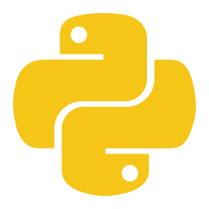
A ros2_control controller in Python
Python
MCAP
library
ROS
controller
webcam
controller_manager
controller.py
dt = period.seconds()
self.t += dt
references = [0.3 * math.sin(self.t), 0.2 * math.cos(self.t)]
positions = []
for i in range(ck.n_state_interfaces(self)):
position = ck.read_state(self, i)
command = position + dt * 20.0 * (references[i] - position)
ck.write_command(self, i, command)
positions.append(position)
self.samples.append((self.t, references, positions))
return ck.return_type.OK
update(period)
TrackingController
Python, derives ck.ControllerInterface
read
write
claimed state / command interfaces
Lifecycle methods and interface declarations are supplied. The agent fills in update().
GenericSystem mock hardware
Notes:
The skeleton in controller.py derives from ck.ControllerInterface. That's the native controller interface, exposed through control_kit. The lifecycle methods and interface declarations are supplied. The agent fills in the update. This example runs inside a real controller_manager, with mock hardware. We read two joint positions, follow a moving reference, and write the commands back through the claimed interfaces.

Slide 24
A thousand updates a second
Python
MCAP
library
ROS
controller
webcam
996 Hz
989 Hz
3.89 ms
203
0.016 rad
agent run, 3 seconds
independent run
p99 interval
intervals above 1.5 ms
tracking error, second half
Interval scale (ms)
late intervals above 1.5 ms
0
1.0 target
1.5
3.89 p99
The average rate is only part of the story. Look at the timing distribution too.
Notes:
In the original controller evaluation, we asked for a thousand updates a second. The agent's three-second run achieved about 996 Hz. The independent run, while other checks were active, was about 989 Hz. Its tracking error in the second half was about 0.016 radians. Now, before anyone makes this slide their robot's new control architecture: look at the timing distribution too. That independent run had a 3.89-millisecond p99 interval, and 203 intervals longer than 1.5 milliseconds.

Slide 25

6. Can we make it follow this?
Webcam, 5 minutes
Click on a little patch and follow it as I move it around.
Python
MCAP
library
ROS
controller
webcam
Notes:
Here's the webcam. I want to click on a little patch and follow it as I move it around. A small image-processing task where we can see what the code is doing.

Slide 26
Find the most similar patch
Python
MCAP
library
ROS
controller
webcam
template: 11 x 11 px
search window: +/- 8 px
Cast to int before subtracting
1
Use a wide accumulator
2
Exact integer scoring, row-major tie breaking, clipping
3
candidate position, scored by sum of squared differences
tracker.cpp
1
const int difference = static_cast<int>(previous[previous_row + x + dx])
- static_cast<int>(current[current_row + cx + dx]);
score += static_cast<unsigned long long>(difference * difference);
2
Notes:
The missing bit searches for the most similar patch in the next frame: an 11-by-11 template, with a search of eight pixels in each direction. Inside the search, we're comparing pixel values and adding up squared differences. Convert the pixel values before subtracting them, and use a wide accumulator.

Slide 27


From synthetic to live frames
Python
MCAP
library
ROS
controller
webcam
0.026 ms
546 ms
0.20 ms
warm search, synthetic
kernel build
per search, 30 live frames
Where it stops helping
LIVE DEMO
Big jumps
Click a textured patch and move it slowly. Then show what happens when it loses the patch.
Occlusion
Drift
Notes:
The original synthetic search measured about 0.026 milliseconds once warm. Building its kernel took about 546 milliseconds. The actual headless webcam check tracked 30 frames at about 0.20 milliseconds per search. It's a small local tracker, so big jumps and occlusion can lose it, and it can drift. That's useful to show too: we can see where this particular algorithm stops helping and start changing it.

Slide 28
A script with responsibilities
Python
MCAP
library
ROS
controller
webcam
Our small script acquired a few responsibilities.
live tracker
controller
ROS callback
+ C++ library
dataset tool
loop
Notes:
We asked a script to find some movement. Then it became a dataset query. We added a native library and a custom selection rule. Then we wanted the motion query in a ROS callback. Then we tried a controller. Finally, we gave it an image-processing job we could poke at live.

Slide 29
Why cppyy?
Python
MCAP
library
ROS
controller
webcam
Speed up one loop
Keep adding things
Many tools
C++ libraries already doing useful work
Native ROS APIs
Controller interfaces to try from Python
Numba
Cython
pybind11
cppyy_kit: cached kernels, kit setup, explicit guidance for the agent
Successful agent runs took roughly 42 to 220 seconds across the five stages.
Notes:
That's what interests me about cppyy. If I only need to speed up a numerical loop, I've got several tools I can try. But I often want to keep adding things: a C++ library that's already doing useful work, a native ROS API, or a controller interface I'd like to experiment with from Python. cppyy_kit gives us the cached kernels and kit setup to work with those pieces. The agent gets explicit guidance, and we get to spend more of the session asking what the robot data means and what the program should do next.

Slide 30



Try it
Python
MCAP
library
ROS
controller
webcam
install and guides
# install Pixi first, then:
$ pixi init cppyy-example -c https://prefix.dev/awesomebytes -c robostack-jazzy -c conda-forge
$ cd cppyy-example
$ pixi add "cppyy-kit>=0.4.1" ros-jazzy-bt-kit numpy
# guides for your agent
$ pixi run python -m cppyy_kit guide accelerate
$ pixi run python -m cppyy_kit guide bring-library
$ pixi run python -m cppyy_kit guide existing-cpp
Take a bit of Python you wish was quicker. Ask your agent to implement it, test it, measure it. Then move the busy part into one native call.
GitHub repo and README
github.com/awesomebytes/cppyy_kit
Native-component tutorial
docs/tutorials/native_component.md
Getting started
awesomebytes.github.io/cppyy_kit/getting-started
Notes:
For now, take a bit of Python you wish was quicker. Ask your agent to implement it, test it, and measure it. Then give it the cppyy_kit guide and try moving the busy part into one native call. See whether the result is useful for your problem. And if your next thought is 'could we also add...', that's the bit I'd like to explore with you.

Slide 31
Thanks, questions?
Python
MCAP
library
ROS
controller
webcam
github.com/awesomebytes/cppyy_kit
Dataset: HIW-500 G1 pillow episode, by BitRobot, Unitree and Hugging Face
ROSCon UK 2026
Notes:
Questions. The dataset is the HIW-500 G1 pillow episode from BitRobot, Unitree and Hugging Face.

