Slide 1
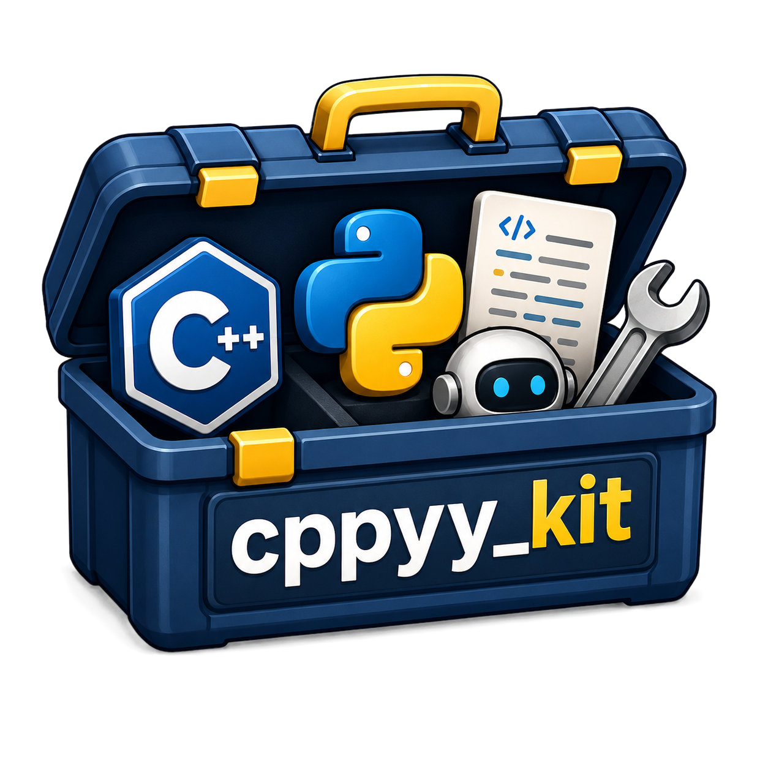
TITLE
SAM PFEIFFER | OCTOBER 2026

Slide 2

cppyy_kit - accelerating robotics python code beyond rclcppyy
SAM PFEIFFER | ROSCON UK 2026

Slide 3


SAM PFEIFFER
PhD in arranging 1️⃣'s and 0️⃣'s in robots
🤖 I've worked with plenty of robots and ROSes 🌹
🐍 I love Python due to how easy is to get anything up and running with it.
I work at

Slide 4
SAM PFEIFFER
PhD in arranging 1️⃣'s and 0️⃣'s in robots
🤖 I've worked with plenty of robots and ROSes 🌹
🐍 I love Python due to how easy is to get anything up and running with it.
I work at

Slide 5


Slide 6
Talk outline
1. cppyy and cppyy_kit
2. C++ libraries and ROS from Python
3. Nav2 and ros2_control demos
4. Live coding with an agent
5. From working experiment to compiled application

Slide 7
What is cppyy_kit?
A toolkit for using C++ from Python, with reusable setup and integration helpers.
Call existing C++ libraries from Python.
Write C++ functions alongside your Python code.
Reuse compiled functions and common integration helpers.
AI coding assistant friendly.
Notes:
cppyy_kit is a toolkit built around cppyy to make using C++ from Python easier in practice. There are two main things I want to do with it: use a C++ library that already exists, and write a small C++ operation inside a Python application when that is useful.
There is also practical support for coding assistants: packaged task guides, kit API references and environment diagnostics give an agent context it can inspect. In our webcam experiment, we combined those tools with a persistent marimo session and Viser, so the agent could revise processing while the camera, models and viewer stayed alive. That session is a repository example built around the kit.
cppyy provides the underlying access to C++. The kit adds reusable setup, compiled-function caching, and helpers for arrays, callbacks and keeping native objects alive. The individual kits apply those pieces to libraries such as PCL, OpenCV and robotics frameworks.
The idea is that I can keep Python as the language where I describe and change the application, and use C++ for the libraries or operations I need. To understand why this works, let's first look at cppyy itself.
Source: repository README.md. This is a description of the toolkit, not a promise that every C++ API works without adaptation.

Slide 8
Let's understand cppyy
Automatic Python–C++ bindings at runtime, with C++ JIT compilation when needed.
Use C++ classes, functions and templates from Python.
Load an existing library or compile C++ as you experiment.
Let C++ call Python through callbacks and overrides.
Notes:
The official documentation describes cppyy as a generator that creates Python–C++ bindings at runtime. It lets Python call C++, and it also lets C++ call back into Python.
What I like is the interactive part. I can load a library and its declarations, use its classes, or define some C++ and call it from the same Python session. Templates can be instantiated as needed, rather than deciding every binding in advance. Python callbacks and overrides also let us supply behaviour to a C++ framework.
Underneath, cppyy uses Cling, a C++ interpreter built on Clang/LLVM. The native code is compiled; the Python interface is created dynamically. We still have to manage dependencies and object lifetimes, and compilation has a cost. cppyy_kit builds on this mechanism to make recurring integration work easier.
Definition paraphrased from the official documentation: https://cppyy.readthedocs.io/en/latest/

Slide 9
Calling C++ from Python: a conventional extension
sum_example/ → native module → Python API → application
CMakeLists.txt
kernel.hpp
kernel.cpp
cmake_minimum_required(VERSION 3.18)
project(sum_example LANGUAGES CXX)
find_package(Python COMPONENTS
Interpreter Development.Module REQUIRED)
find_package(pybind11 CONFIG REQUIRED)
pybind11_add_module(_native
bindings.cpp kernel.cpp)
#pragma once
#include <cstddef>
double sum_sq(const double* x, std::size_t n);
#include "kernel.hpp"
double sum_sq(const double* x,
std::size_t n) {
double total = 0;
for (std::size_t i = 0; i < n; ++i)
total += x[i] * x[i];
return total;
}
bindings.cpp
api.py (optional convenience)
demo.py
#include <pybind11/pybind11.h>
#include <pybind11/numpy.h>
#include "kernel.hpp"
namespace py = pybind11;
PYBIND11_MODULE(_native, m) {
m.def("sum_sq", [](py::array_t<
double, py::array::c_style> x) {
return sum_sq(x.data(), x.size());
});
}
import numpy as np
from _native import sum_sq as native_sum
def sum_sq(values):
x = np.ascontiguousarray(
values, dtype=np.float64)
return native_sum(x)
from api import sum_sq
print(sum_sq([1., 2., 3.]))
# 14.0
cmake -S . -B build && cmake --build build
PYTHONPATH=build python demo.py
Notes:
Say I already have a C++ function and want to call it from Python. One familiar route is a small extension project. Here is the build description, the function, the binding, and the Python code that uses it. The binding exposes our function and accepts a contiguous NumPy array. The optional Python wrapper converts convenient input, like a list, into that array. Then we build, make the module importable, and run the application.
These are one possible file layout, not six mandatory files. We can merge the header and implementation, omit the convenience wrapper, or use nanobind instead. For distribution we could package and install the extension instead of setting PYTHONPATH. Changes to the C++ require rebuilding the extension.
The code is intentionally the same sum-of-squares operation as before. Focus on the surrounding setup. Both approaches still need their dependencies and a compatible compiler environment.
Verified in this checkout: pixi run cmake -S roscon_uk_2026/slides/examples/extension_project -B build/slide_extension -DCMAKE_BUILD_TYPE=Release; pixi run cmake --build build/slide_extension -j2; pixi run env PYTHONPATH="$PWD/build/slide_extension" python roscon_uk_2026/slides/examples/extension_project/demo.py. Output: 14.0. The shorter commands on the slide assume an activated environment and the example folder as the current directory.

Slide 10
Plain cppyy
With cppyy_kit
Declare C++, then call through cppyy.gbl.
Annotate the array. Call a Python function.
import cppyy
import numpy as np
cppyy.cppdef("""
double sum_sq(const double* x, size_t n) {
double total = 0;
for (size_t i = 0; i < n; ++i)
total += x[i] * x[i];
return total;
}
""")
x = np.array([1., 2., 3.])
print(cppyy.gbl.sum_sq(x, x.size))
import numpy as np
from cppyy_kit import cpp
from cppyy_kit.numpy_types import NDArray
@cpp
def sum_sq(x: NDArray[np.float64]) -> float:
"""
double total = 0;
for (size_t i = 0; i < x_size; ++i)
total += x[i] * x[i];
return total;
"""
x = np.array([1., 2., 3.])
print(sum_sq(x))
Output: 14.0
Output: 14.0
Notes:
Here is one small function: sum the squares of an array. Both examples receive the same three doubles and print fourteen.
On the left, cppyy compiles the C++ declaration. We call the function through cppyy.gbl and pass the buffer and its length explicitly.
On the right, the C++ computation is the same. The @cpp decorator uses the array annotation to build the entry point and supplies x_size. We call sum_sq(x) directly. The kit also manages the compiled-function cache for later runs.
The docstring contains C++ source; the decorator is not translating Python into C++. For this particular arithmetic operation NumPy already has native operations. This example shows the interface, not a speed comparison or a reason to replace NumPy. We will use a larger library example to discuss cache savings.
Both complete snippets are saved under roscon_uk_2026/slides/examples/. Body text uses Roboto; code uses DejaVu Sans Mono to preserve alignment.

Slide 11
Same computation, less setup to maintain
A compiled Python extension
One Python file with @cpp
CMakeLists.txt
kernel.hpp
import numpy as np
from cppyy_kit import cpp
from cppyy_kit.numpy_types import NDArray
@cpp
def sum_sq(x: NDArray[np.float64]) -> float:
"""
double total = 0;
for (size_t i = 0; i < x_size; ++i)
total += x[i] * x[i];
return total;
"""
x = np.array([1., 2., 3.])
print(sum_sq(x))
cmake_minimum_required(VERSION 3.18)
project(sum_example LANGUAGES CXX)
find_package(Python COMPONENTS
Interpreter Development.Module REQUIRED)
find_package(pybind11 CONFIG REQUIRED)
pybind11_add_module(_native
bindings.cpp kernel.cpp)
#pragma once
#include <cstddef>
double sum_sq(const double* x, std::size_t n);
kernel.cpp
bindings.cpp
#include "kernel.hpp"
double sum_sq(const double* x, std::size_t n) {
double total = 0;
for (std::size_t i = 0; i < n; ++i)
total += x[i] * x[i];
return total;
}
#include <pybind11/pybind11.h>
#include <pybind11/numpy.h>
#include "kernel.hpp"
namespace py = pybind11;
PYBIND11_MODULE(_native, m) {
m.def("sum_sq", [](py::array_t<
double, py::array::c_style> x) {
return sum_sq(x.data(), x.size());
});
}
api.py (optional)
demo.py
import numpy as np
from _native import sum_sq as native_sum
def sum_sq(values):
x = np.ascontiguousarray(
values, dtype=np.float64)
return native_sum(x)
from api import sum_sq
print(sum_sq([1., 2., 3.]))
Configure → build → import → run
Run Python. The kit handles the native function.
Notes:
Same operation, now with cppyy_kit. The C++ body stays beside the Python function. The annotation describes the array, and the kit exposes the pointer and its size to the C++ body. I call sum_sq like a Python function.
This reduces project and binding setup for this kind of experiment. Compilation still happens and the runtime still needs its compiler infrastructure. The decorator does not remove dependency installation. The native extension remains a useful deployment choice.
The contracts differ slightly in these examples: the extension convenience API accepts lists and converts them; the decorated example explicitly supplies a contiguous float64 NumPy array. Both compute 14.0 for the shown values. Do not imply that the decorator adds the optional list conversion.
Full sources are in slides/examples/extension_project and slides/examples/with_cppyy_kit.py.

Slide 12
Localisation: score candidate robot positions
import sys
import numpy as np
from cppyy_kit import cpp
from cppyy_kit.numpy_types import NDArray
Array = NDArray[np.float64]
@cpp(headers=['Eigen/Core', 'stdexcept'],
include_paths=[f'{sys.prefix}/include/eigen3'],
link_args=['-fopenmp'], nogil=True)
def score(positions: Array, landmarks: Array, ranges: Array,
scores: Array, threads: int = 4) -> None:
"""
using Vec = Eigen::Vector2d;
if (positions_size != 2*scores_size || landmarks_size != 2*ranges_size
|| threads < 1)
throw std::invalid_argument("Invalid dimensions or thread count");
#pragma omp parallel for num_threads(threads) schedule(static)
for (long i = 0; i < static_cast<long>(scores_size); ++i) {
Eigen::Map<const Vec> position(positions + 2*i);
double error = 0.0;
for (size_t j = 0; j < ranges_size; ++j) {
Eigen::Map<const Vec> landmark(landmarks + 2*j);
double residual = (position - landmark).norm() - ranges[j];
error += residual * residual;
}
scores[i] = -error;
}
"""
Notes:
This slide shows the complete executable function, including imports, Eigen include path, array annotations and input-length checks. The next slide repeats exactly the same code and adds callouts. Pause on this first slide so the audience can read the full example.
We know some landmark XY positions and have measured the distance from the robot to each landmark. The candidate robot positions are called particles. The function scores how well each candidate explains those measurements.
The slide contains imports, the decorator, the function signature, validation, and the complete C++ body. Array aliases NDArray[np.float64]. Each input contains contiguous double-precision values. positions and landmarks contain XY pairs, ranges has one measurement per landmark, and scores has one output per particle. The kit passes array pointers and element counts such as positions_size. Inputs must remain unchanged during the call, and scores must not overlap them.
headers brings in Eigen and stdexcept. sys.prefix locates Eigen's include directory in the active Pixi environment. link_args=['-fopenmp'] tells GCC to enable OpenMP compilation and linking. The kit uses the compiled library from the first call for these explicit build options. Later processes reuse its cache. nogil=True releases the Python interpreter lock only during the native body; argument conversion still holds it. Warm up before interactive use because first use initializes and compiles.
The C++ using declaration names Eigen::Vector2d as Vec. Eigen::Map creates a vector view over two existing coordinates without copying them. positions + 2*i points to candidate i. For each landmark, subtract the vectors and take norm() to predict the distance. Subtract the measured range to get a residual. Square each residual and add it to error. Return the negative total in scores[i], so higher scores mean a better fit. With equal Gaussian range noise this is proportional to log likelihood, up to a scale and additive constant.
The pragma distributes candidates across native workers; the threads argument defaults to four. schedule(static) assigns fixed chunks. Each worker writes different output elements and reads shared inputs. The inner accumulation is serial. OpenMP worker parallelism and GIL release are separate: native workers compute while other Python threads can continue.
The code checks input lengths and a positive thread count before entering the parallel region. Empty particle input performs no work. A candidate has score zero when there are no measurements. The example computes the range-scoring step, with XY candidates; the larger localisation pipeline supplies and updates those candidates.
The compact display version is executable at roscon_uk_2026/slide_assets/particle_scores/slide_example.py. It was verified against numpy_scores with rtol 1e-12 and atol 1e-10 using demo.inputs(). Call score(positions, landmarks, ranges, scores) for four workers, or supply threads explicitly. The benchmark uses the same arithmetic and options in demo.py. There, a separate OpenMP preprocessor guard verifies compiler configuration as well.
The benchmark verified actual worker counts and Python-thread progress. A larger single-worker call with nogil enabled allowed 41 heartbeat ticks in about 46 ms; the comparable call holding the GIL allowed zero. The following timing slide compares Python, NumPy and native implementations. Reproduction commands and measurement conditions are in roscon_uk_2026/slide_assets/particle_scores/README.md.

Slide 13
Localisation: score candidate robot positions
import sys
import numpy as np
from cppyy_kit import cpp
from cppyy_kit.numpy_types import NDArray
Array = NDArray[np.float64]
@cpp(headers=['Eigen/Core', 'stdexcept'],
include_paths=[f'{sys.prefix}/include/eigen3'],
link_args=['-fopenmp'], nogil=True)
def score(positions: Array, landmarks: Array, ranges: Array,
scores: Array, threads: int = 4) -> None:
"""
using Vec = Eigen::Vector2d;
if (positions_size != 2*scores_size || landmarks_size != 2*ranges_size
|| threads < 1)
throw std::invalid_argument("Invalid dimensions or thread count");
#pragma omp parallel for num_threads(threads) schedule(static)
for (long i = 0; i < static_cast<long>(scores_size); ++i) {
Eigen::Map<const Vec> position(positions + 2*i);
double error = 0.0;
for (size_t j = 0; j < ranges_size; ++j) {
Eigen::Map<const Vec> landmark(landmarks + 2*j);
double residual = (position - landmark).norm() - ranges[j];
error += residual * residual;
}
scores[i] = -error;
}
"""
Release the GIL: Python threads can continue.
Split candidates across native workers.
Eigen views: use the existing coordinates.
Distance error → square → sum. Higher score wins.
Notes:
The code is identical to the previous slide. Only the four callouts have appeared. First point to nogil=True: Python threads can run during the native body. Then point to the OpenMP pragma: it distributes candidates among the requested workers, four by default. These are separate mechanisms. Next explain Eigen::Map as a view over the input coordinates. Finally explain predicted distance minus measured range, squaring and accumulation, and the negative error score.
We know some landmark XY positions and have measured the distance from the robot to each landmark. The candidate robot positions are called particles. The function scores how well each candidate explains those measurements.
The slide contains imports, the decorator, the function signature, validation, and the complete C++ body. Array aliases NDArray[np.float64]. Each input contains contiguous double-precision values. positions and landmarks contain XY pairs, ranges has one measurement per landmark, and scores has one output per particle. The kit passes array pointers and element counts such as positions_size. Inputs must remain unchanged during the call, and scores must not overlap them.
headers brings in Eigen and stdexcept. sys.prefix locates Eigen's include directory in the active Pixi environment. link_args=['-fopenmp'] tells GCC to enable OpenMP compilation and linking. The kit uses the compiled library from the first call for these explicit build options. Later processes reuse its cache. nogil=True releases the Python interpreter lock only during the native body; argument conversion still holds it. Warm up before interactive use because first use initializes and compiles.
The C++ using declaration names Eigen::Vector2d as Vec. Eigen::Map creates a vector view over two existing coordinates without copying them. positions + 2*i points to candidate i. For each landmark, subtract the vectors and take norm() to predict the distance. Subtract the measured range to get a residual. Square each residual and add it to error. Return the negative total in scores[i], so higher scores mean a better fit. With equal Gaussian range noise this is proportional to log likelihood, up to a scale and additive constant.
The pragma distributes candidates across native workers; the threads argument defaults to four. schedule(static) assigns fixed chunks. Each worker writes different output elements and reads shared inputs. The inner accumulation is serial. OpenMP worker parallelism and GIL release are separate: native workers compute while other Python threads can continue.
The code checks input lengths and a positive thread count before entering the parallel region. Empty particle input performs no work. A candidate has score zero when there are no measurements. The example computes the range-scoring step, with XY candidates; the larger localisation pipeline supplies and updates those candidates.
The compact display version is executable at roscon_uk_2026/slide_assets/particle_scores/slide_example.py. It was verified against numpy_scores with rtol 1e-12 and atol 1e-10 using demo.inputs(). Call score(positions, landmarks, ranges, scores) for four workers, or supply threads explicitly. The benchmark uses the same arithmetic and options in demo.py. There, a separate OpenMP preprocessor guard verifies compiler configuration as well.
The benchmark verified actual worker counts and Python-thread progress. A larger single-worker call with nogil enabled allowed 41 heartbeat ticks in about 46 ms; the comparable call holding the GIL allowed zero. The following timing slide compares Python, NumPy and native implementations. Reproduction commands and measurement conditions are in roscon_uk_2026/slide_assets/particle_scores/README.md.

Slide 14
Particle scoring: from Python loops to parallel C++
20,000 candidate positions × 32 landmarks · same inputs and scoring operation
Implementation
Median / call
Speedup
Python lists + math.hypot
39.182 ms
1.0×
NumPy: broadcasting
4.957 ms
7.9×
NumPy: one landmark at a time
1.344 ms
29.2×
Eigen C++: 1 worker
0.904 ms
43.3×
Eigen C++: 4 workers
0.450 ms
87.1×
Speedup = Python median ÷ implementation median. Python is the 1× baseline.
60 calls per method after 5 warmups · randomized order · Core Ultra 9 285H
Input conversion and startup excluded. Native output preallocated; Python / NumPy allocate output.
Notes:
Yes, the same calculation works without NumPy. The Python version uses lists of XY pairs, Python floats, two loops and math.hypot from the standard library. For each candidate it computes the range residual for each landmark, squares it, accumulates the error and returns its negative. math.hypot is itself implemented in native code; the repeated iteration, arithmetic and object handling around it remain Python operations. This version requires no NumPy. Its source is plain_python.py.
All implementations use the same 20,000 positions and 32 landmarks. Input creation and conversion to lists happen before timing. We compare the returned scores against the NumPy reference using rtol 1e-12 and atol 1e-10. Python floats and the NumPy/C++ buffers use double precision here. hypot uses a more robust distance algorithm than a direct square-root of summed squares, so this is equivalent scoring within the checked tolerance, not a claim of identical instructions.
Median per call means the middle of 60 measured complete Python calls, after five warmups per method. The order of the methods is shuffled in each round. The speedup column divides the Python median by each implementation's median, so the slowest measured method is 1×. It measures throughput of this scoring operation, not startup time or whole-application speed.
Python takes about 39 ms, broadcast NumPy about 5 ms, streamed NumPy about 1.34 ms, one native worker about 0.90 ms, and four native workers about 0.45 ms in this run. Plain Python could be enough for an occasional query, but this workload alone exceeds a 33.3 ms frame budget for 30 Hz processing. NumPy already makes a large difference; the native loop and parallel workers reduce the time further. These are measurements of the shown implementations on this laptop, not maximum possible performance for each language.
The broadcast NumPy version uses in-place ufuncs to limit allocation. The streamed version processes one landmark at a time and avoids the full candidate-by-landmark matrix. Native code reuses a preallocated output array; Python and NumPy allocate their results and temporaries. The native version also releases the GIL. OpenMP runs with explicit thread counts, OMP_DYNAMIC=FALSE and OMP_WAIT_POLICY=PASSIVE; OPENBLAS_NUM_THREADS=1. CPU frequency, core assignment and other system activity are uncontrolled. These are fresh measurements, so do not combine them with the previous fixed-order benchmark numbers. Raw p95 values remain in the data file; the slide shows only medians and speedup.
Previously verified: OpenMP creates the requested workers; a Python heartbeat continues during the nogil call. A separate scaling run up to 16 workers showed that four workers fit this small demo well. Sixteen helped the larger 500,000-particle case. Those measurements remain in thread_scaling.json.
Startup and memory are separate. Previous startup measurements with an existing Cling PCH gave about 937 ms for a first cache-building process and 272 ms median for cached processes, with peak process RSS around 233 MiB. They are in startup.json and the README, not included in this timing table.
Reproduce from the repository checkout: pixi run env OMP_DYNAMIC=FALSE OMP_WAIT_POLICY=PASSIVE OPENBLAS_NUM_THREADS=1 python roscon_uk_2026/slide_assets/particle_scores/comparison.py
Sources and every measured sample: roscon_uk_2026/slide_assets/particle_scores/plain_python.py, comparison.py and comparison.json. Full notes: that directory's README.md.

Slide 15
cppyy_kit helpers
Task
API
Keep objects alive
keep_alive(owner, obj)
callback(fn, owner=owner)
Check array types and layout
NDArray[T] ConstNDArray[T]
Release the GIL / use asyncio
@cpp(nogil=True)
nogil(fn) await run_async(fn)
Reuse compiled code
cppdef_cached(...) warmup(...)
Probe compilation without risking the live session
probe_cppdef(code, ...)
Release resources before exit
register_teardown(cleanup)
shutdown()
Library kits also configure include paths, shared libraries and precompiled headers.
Notes:
These are helpers provided by cppyy_kit. The library kits use them to handle common integration tasks.
keep_alive(owner, obj) stores a reference on owner. Use it when C++ needs an object or its backing buffer to remain alive. callback(fn, owner=owner) creates a native function wrapper and retains the Python callable and wrapper. The caller still chooses the owner and must ensure it outlives native use. These functions do not track arbitrary C++ pointer ownership or prevent buffer resizing.
NDArray[T] and ConstNDArray[T] describe typed array arguments to @cpp. They check dtype, byte order, alignment and contiguous layout. NDArray requires writable storage; ConstNDArray can accept read-only storage. Compatible arrays are borrowed for the call. The function still checks its required dimensions and output size. Typed Python sequences are copied.
@cpp(nogil=True) releases the GIL during the compiled function body. nogil(fn) does the same for a supported nullary native callable. await run_async(fn) runs that callable in an executor thread with the GIL released. Python callbacks reacquire the GIL. None of these creates parallel computation workers; the OpenMP pragma in our earlier example does that.
cppdef_cached caches a compiled implementation. @cpp uses the function cache as well. warmup calls selected operations during initialization to pay their first-use costs there. Precompiled headers reuse header parsing. New signatures and templates may still require JIT compilation. The API ellipses on this slide indicate additional required arguments; they are not complete runnable calls.
probe_cppdef compiles supplied code in a subprocess and returns success or diagnostics. A failed Cling parsing transaction can crash its process, so this can protect a live interpreter while checking a declaration. Passing the probe does not validate every future native operation.
register_teardown(cleanup) registers a cleanup function. shutdown runs registered functions at most once, in reverse registration order, before Python and Cling teardown. These hooks are used for native resources such as ROS contexts.
Other helpers include load_libraries for shared libraries, require for installed or pinned downloaded headers, pretty_cpp_error for exception text, unwrap_expected for supported optional values, HandleRegistry for Python state referenced through integer handles, and environment/capability reports. See cppyy_kit/__init__.py, cppyy_kit/nogil.py, cppyy_kit/_cpp.py and docs/COMMON_PATTERNS.md. The next slide lists the library kits.
When to use probe_cppdef: before compiling unfamiliar headers or glue in a persistent notebook or live process, call probe_cppdef(code, headers=..., include_paths=..., libraries=...). It starts a separate Python interpreter, sets up the supplied paths/libraries, calls cppyy.cppdef, and returns (ok, message). A crash or timeout becomes a failed probe with diagnostics. The default timeout is 60 seconds. It is callable by ordinary developer code or by an agent; it is not agent-specific and is not automatically applied to every @cpp function. Passing the probe checks that declaration in the subprocess, not future executions, data validity, or compatibility with all state in the main interpreter. It is process isolation for this check, not a security sandbox.

Slide 16
The kits: C++ libraries, ready to use from Python
Choose the library you need. Reuse its setup, bridges and Python helpers.
rclcpp_kit
ompl_kit
ROS 2 C++: nodes, messages, TF and bags
OMPL: motion planning and validity callbacks
pcl_kit
moveit_kit
PCL: point-cloud filtering and conversion
MoveIt: robot models, kinematics and planning
cv_kit
nav2_kit
OpenCV: images and C++ image buffers
Nav2: write navigation plugins in Python
dbow_kit
control_kit
DBoW2: visual place recognition
ros2_control: write controllers in Python
bt_kit
wbc_kit
BehaviorTree.CPP: trees and Python actions
Crocoddyl: custom action models
cppyy_kit provides the shared tools; each kit adds library-specific integration.
Notes:
We have seen one function. Now what if I want to use a library I already know? That is where the kits come in. I do not want to rediscover the include paths, shared libraries, pointer conversions and callback glue for every experiment.
This list is the ten library kits in this repository. PCL handles point clouds. OpenCV handles images. DBoW2 supports visual place recognition. BehaviorTree.CPP gives us task trees with Python actions. OMPL exposes planning with Python validity checks. MoveIt covers robot models, kinematics and planning. nav2_kit supports navigation plugins with behavior implemented in Python, including our face-first controller plugin. control_kit supports loadable ros2_control controllers with behavior implemented in Python, including our controller examples. wbc_kit is specifically the Crocoddyl integration for custom action models. rclcpp_kit supplies ROS C++ objects, nodes, TF and rosbag2 helpers. rclcppyy is a related library offering an rclpy-style interface over rclcpp; it is distinct from rclcpp_kit, and we can discuss it next.
I would scan the list, rather than read every description aloud. The point is that the pattern repeats across different robotics libraries: Python drives the experiment and C++ does the library work. Each kit has its own API and supported operations. These are specific integrations, not a claim to wrap every feature of every upstream project.
The catalog and package links are in README.md, Choose a library. The WHY.md, REPORT.md and API guides in each kit describe the supported operations. In particular wbc_kit refers to Crocoddyl; our separate whole-body-controller demos should not be confused with that package's entire API.
For both plugin integrations, the kit supplies a small native C++ adapter inside the host process. It implements the C++ plugin interface and forwards lifecycle and control calls to the Python implementation. This connection adds no bridge node, extra process or message transport. Python implements the controller or navigation behavior. The adapter is small, but that does not make Python execution hard real-time: GIL contention, allocations and garbage collection can affect timing.

Slide 17
rclcppyy: Python ROS code, C++ ROS objects
An rclpy-style interface with explicit routes into rclcpp
Keep messages in C++
Python application
Pass compatible native objects into C++ libraries and custom kernels.
↓
Use native ROS facilities
rclcpp objects / messages
Intra-process communication, C++ components and native callbacks.
↓
Choose the execution path
C++ library / kernel
Python for orchestration; selected native paths for the processing work.
Keep the native representation through the pipeline; convert where the next API requires it.
Notes:
A quick reminder of rclcppyy, because it connects the Python experiments to the ROS system. It is built on cppyy and cppyy_kit and provides explicit ways to use rclcpp from Python, including an rclpy-style API for supported operations.
The important part for these examples is object representation. With a native execution path, a ROS message is an actual generated C++ message object. Python can pass that object to compatible C++ functions without rebuilding its fields as a separate Python message. We can keep data and intermediate results in C++ across a pipeline. A library requiring a different layout or type still needs its conversion. This is not a blanket zero-copy claim.
Native sessions also expose rclcpp facilities such as intra-process communication, standard rclcpp_components and selected callbacks implemented in C++. That lets us compose native processing while Python configures and inspects it. Intra-process ownership transfer depends on topology, QoS and ownership; middleware loan support depends on RMW and message type. Ordinary rclpy already supports services, actions, lifecycle nodes, QoS and callback groups, so those are not the distinction here.
Be explicit about the selected mode. The current default compatible activation retains stock rclpy entities and publishing. It does not automatically turn every Python node into a C++ node or promise a speedup. The direct C++ mode provides a bounded supported API with native entities and messages; the managed native session exposes native composition and raw access. The diagram illustrates these native routes.
If discussing performance verbally: the recorded local Jazzy/CycloneDDS UInt64 relay comparison reported about 2.925 times closed-loop throughput and 0.228 times relay CPU versus stock rclpy. These are historical measurements for that specific protocol, not image throughput or a general speed promise. They were not rerun for this slide. Other cases differ: actions primarily reduced CPU with little completion-throughput change, and a service-server p99 latency measurement was worse. Keep any public numerical claim tied to its protocol and original evidence. For this reminder slide, the main point is access to native objects and facilities.
rclcpp_kit is the kit supplying low-level ROS C++ helpers; rclcppyy is the related higher-level ROS Python-facing library. Our control_kit and nav2_kit plugins also use in-process native adapters, but those adapters are not bridge nodes.
Sources: ../rclcppyy/README.md; ../rclcppyy/docs/backend-selection.md; ../rclcppyy/docs/RCLCPPYY_RESTART_HANDOFF.md; roscon_uk_2026/RCLCPPYY_TALK_SUMMARY.md. The summary records the benchmark provenance and qualifications. This is a short lead-in to using the native message representation in perception and composed pipelines.

Slide 18
rclcppyy: lower CPU cost across ROS operations
Less CPU work across the benchmarks; throughput gains depend on the operation.
ROS operation
CPU time saved
Throughput
Pub/sub relays
77–81%
2.9–3.0×
Services: client / server
68–78%
1.4–2.6×
Actions: client / server
35–74%
~1.0×
Remote parameters: get / atomic set
75–84%
4.0–6.3×
Local parameters: declare / get / set
31–49%
—
Timers / executor
74%
—
Actions illustrate the distinction: less CPU time, similar completion throughput.
Recorded direct C++ paths vs stock rclpy · local x86-64 · Jazzy / CycloneDDS
Notes:
The broad result is lower CPU cost across several types of ROS work, not just one pub/sub relay. Throughput improves substantially for pub/sub, services and remote parameter operations. Actions use less CPU but complete at almost the same rate. That is still useful: lower overhead leaves CPU available for the rest of the robot.
Spend only a few seconds on the table. Say: Pub/sub is around three times the throughput with roughly eighty percent less relay CPU. Services also improve. Actions mainly save CPU. Remote parameter calls show the largest throughput ratios in this set. These are measurements for the individual benchmark workloads, not a single average or a promise for every node.
Each range combines distinct operations in that row; it is not a confidence interval. CPU savings are (1 - direct/stock CPU ratio) times 100. Throughput is direct/stock, with stock equal to one. A dash means no throughput ratio is reported in the source summary, rather than zero throughput. CPU is accumulated time in the measured window, not instantaneous utilisation.
Exact measurements from Current CPU Evidence:
- Pub/sub relay: CPU ratio 0.228, throughput 2.925. With MessageInfo: CPU 0.190, throughput 2.981. Slide savings 77–81%. These CPU numbers cover the relay. Including the driver, CPU ratios are 0.329 and 0.288, corresponding to 67–71% savings. The relay protocol is one outstanding UInt64 message, a fixed transform, identical two-process topology and QoS.
- Service client: CPU 0.218, throughput 2.634. Service server callback: CPU 0.319, throughput 1.443. Rounded savings 68–78%. Server p99 latency ratio 1.096 means about 10% worse tail latency, despite the CPU benefit.
- Action client: CPU 0.2606, result throughput 1.0160. Action server: CPU 0.6475, result throughput 1.0107. Savings round to 35–74%; completion throughput is effectively unchanged for this quick summary. The action server remains above conventional AOT C++ CPU, so beating stock rclpy does not imply matching compiled C++.
- Remote parameter get: CPU 0.1583, throughput 6.3175. Remote atomic parameter set: CPU 0.2492, throughput 4.0148. Savings round to 75–84%.
- Local parameter declare/get/set CPU ratios: 0.6943 / 0.6090 / 0.5148, giving 31–49% savings. Accessing local parameter .value instead has CPU ratio 1.1073, about 11% more CPU than stock; it is an explicitly listed exception.
- Public timer/executor CPU ratio: 0.260 versus stock, about 74% saved. Its deadline p99 ratio is 1.104 against the raw control, a different baseline. Scheduling-phase issues make that latency unsuitable for a simple speed headline. No timer throughput claim is made here.
These are recorded local x86-64 Jazzy/CycloneDDS characterizations from different benchmark workloads and revisions. They are not rerun for this slide, and raw relay/service results have not been independently reconstructed here. The project keeps broad release-level performance claims gated pending dedicated-runner and other evidence. Default compatible activation retains stock rclpy behavior; these numbers concern explicitly selected native/direct paths. Do not average the ratios across workloads or present the ranges as universal savings.
The serialized message-facade experiment was slower and remains frozen; it is not credited as direct-path acceleration. Historical fusion data is also separate. The table summarizes the current operation-level CPU evidence, with the main measured exceptions visible on the slide.
Sources: ../rclcppyy/docs/RCLCPPYY_RESTART_HANDOFF.md, Current CPU Evidence; ../rclcppyy/docs/relay-boundary-benchmark.md; service-client-benchmark.md; service-callback-benchmark.md; action-client-benchmark.md; action-server-benchmark.md; timer-executor-benchmark.md. The handoff lists raw action and parameter artifacts with hashes. roscon_uk_2026/RCLCPPYY_TALK_SUMMARY.md contains the talk-specific overview and interpretation.

Slide 19
Designed to be usable by coding agents
Give the agent a small API, useful context and a way to check its work.
Less integration glue to generate
Reuse lifetime, callback and array helpers instead of generating that glue again.
The right context to read
Task guides and kit API references explain supported calls, setup and ownership.
Concrete examples to adapt
Runnable examples show the input, operation and expected result.
A short feedback loop
Run on real data, inspect outputs, compare results and measure performance.
You describe the task. The agent reads the kit, writes a small experiment and verifies it.
Notes:
I want this to be easy for a coding agent to use as well as for me. That does not mean putting a chatbot inside the package. It means giving an external assistant a small interface, enough accurate context, and a short path to a result it can check.
First, less scaffolding. We just saw that a C++ operation can sit in a Python function, and that a kit prepares the common library setup and useful bridges. An agent can start from those interfaces instead of generating a new binding project for each experiment. That reduces the amount of code it needs to create and maintain. We have not measured a general reduction in tokens or tool calls, so present that as a design advantage, not a quantified benchmark.
Second, the context is discoverable. The package includes task guides for accelerating Python, bringing in a library, and working with existing C++ software. Installed kits expose their overview and API reference. These explain actual supported calls, dependencies, data conversion and lifetime rules. The agent can read that local context rather than guess an API from the library name. Environment inspection helps diagnose the compiler and headers. The guide and status CLI commands are ways an agent retrieves this information; the commands themselves are not the point of this slide.
Third, give it examples that run. A useful example includes input data or a way to create it, the library operation and an expected result. The agent can adapt that small example and retain its checks. The repository also provides an acceleration skill that describes profiling, choosing work to move into C++, and comparing outputs and performance. These instructions work with external coding assistants; they do not depend on a particular model.
Fourth, close the loop. Let the agent run the operation on the data we actually care about, show the result, compare against a reference and measure the cost. For instance: use PCL to downsample this cloud, show before and after, and report the point count and processing time. We can inspect that together and change the request. Matching output is separate from speed, and startup is separate from a warmed call.
This leads into the later interactive-session demonstration. In our repository's marimo and live-viewer examples, the agent can revise processing while keeping the data, models and viewer alive. That preserves useful state between iterations. The installed package provides the interfaces and guidance; the persistent webcam/notebook arrangements are concrete demos built with those pieces. The goal is to collect useful code, example inputs, observed outputs and checks that a later implementation can reuse.
Suggested spoken transition: An LLM can already write a binding project. What I want here is to give it fewer moving parts and a faster feedback loop with the real data. It can read how the kit works, try a small operation, and show me whether it did the right thing.
Evidence and implementation: CPPYY_KIT_WITH_AI.md; docs/GUIDES.md; cppyy_kit/agent_guides/; per-kit WHY.md and API guides; skills/cppyy-accelerate/SKILL.md; roscon_uk_2026/next_steps/agent_session/NOTEBOOK.md. Guides and examples support the workflow; their presence is not a guarantee that generated code is correct.
The previous slide gives concrete runtime support behind this claim: keep_alive and callback(owner=...) retain required objects, typed array arguments validate the buffer boundary, compiled caches reuse work, and shutdown hooks order resource release. These helpers are useful to humans and coding agents alike. They handle documented cases and do not infer every C++ ownership contract automatically.

Slide 20
TIAGo Pro: software running in the demos
1 Add Python DWB critic
2 Replace left-arm controller
RViz
Nav2 Goal
Interact
force handle
Robot / TF
Nav2 processes
bt_navigator
planner / smoother / behaviors
controller_server → DWB
map / costmaps / lifecycle
ros_gz_bridge
cmd_vel →
← odom / TF
← RGB-D
← laser scans
← clock
Gazebo server process
VelocityControl → base
gz_ros2_control
controller_manager
Arm / head / torso / grippers
Joint / wrist FT broadcasters
Position commands → joints
Force UI process
RViz feedback → force [N]
ROS force commands →
Gazebo GUI: separate viewer
Simulation-truth map → odom TF
Physics + simulated sensors
/joint_states → robot_state_publisher → RViz
robot_state_publisher: joints → TF
Notes:
These are the two demo profiles on one reference diagram. Navigation runs Nav2; the admittance profile runs the force UI and swaps the left-arm controller. The Gazebo server, bridge, robot_state_publisher, RViz and Gazebo GUI are shared infrastructure. In the navigation profile, the new Python policy is hosted inside controller_server by the nav2_kit DWB adapter. In the arm profile, the Python law is hosted inside Gazebo by the control_kit ControllerInterface adapter. The base is driven by Gazebo VelocityControl via ros_gz_bridge, not a ros2_control base controller. Joint states reach robot_state_publisher directly over ROS. Simulation-truth localization supplies map to odom. Source: next_steps/tiago_pro_jazzy/playground.launch.py, native_model.py, navigation/nav.launch.py and next_steps/robot_demos/run.py.

Slide 21
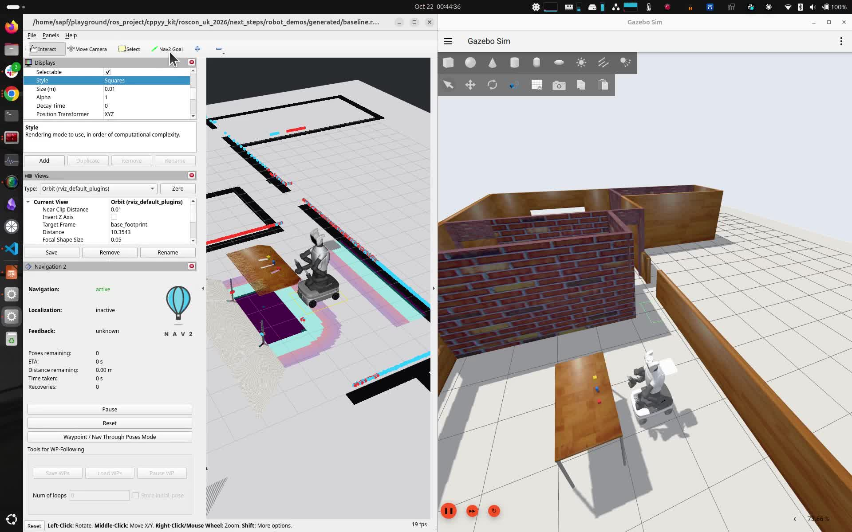
Navigation: the base can move sideways
./roscon_uk_2026/run_robot_demo.sh baseline
Notes:
The base is holonomic. The original DWB profile can move sideways to reach this goal. That is valid motion, but it is not what I want with a forward-facing depth camera.
Record the robot initially facing north, then an RViz Nav2 Goal at approximately map x=-1.85, y=1.35, yaw=0. Wait for Navigation to show active before clicking. Keep the same view and goal for the next clip.
Latest local baseline verification: 0.722 m travelled, of which 0.561 m had measured motion outside a 30-degree forward cone. Evidence: next_steps/robot_demos/evidence/baseline.json. Both profiles enable the same depth observation source. The forward profile also enables footprint scoring and adjusts velocity sampling, so this is a behavior comparison, not an isolated plugin benchmark.
Run from the repository root:
./roscon_uk_2026/run_robot_demo.sh baseline
Stop with Ctrl-C and wait for Demo stopped. before the next launch.

Slide 22
Nav2 example: what we write
navigation/nav.launch.py
Add the kit export call and policy parameters to the existing launch file.
forward_camera_policy.py
Write a Python class with configure(), prepare() and score().
nav2_kit
Supplies the C++ DWB adapter, build/cache and pluginlib registration.
Launch configures Nav2 → DWB calls the Python policy inside controller_server
Notes:
Run run_robot_demo.sh forward --gazebo-gui. The existing simulator launch handles Gazebo, RViz, sensors, maps and stock navigation. We only show the added kit setup and the Python policy. The setup shown next belongs in the existing nav.launch.py. The policy shown is a fixed-default teaching version of the recorded policy; the repository version also validates configurable options. Source: nav2_kit/demos/forward_camera_policy.py.

Slide 23
Nav2: register the adapter and select our policy
In the existing ROS launch file, before starting Nav2:
import os
from nav2_kit.python_critic import install_python_critic_plugin
prefix = install_python_critic_plugin("./plugin_overlay")
os.environ["AMENT_PREFIX_PATH"] = prefix + ":" + os.environ["AMENT_PREFIX_PATH"]
Add to controller_server → ros__parameters → FollowPath:
# Append ForwardCamera to the existing critics list.
ForwardCamera.class: nav2_kit_python::PythonCritic
ForwardCamera.scale: 1.0
ForwardCamera.python_module: forward_camera_policy
ForwardCamera.python_class: ForwardCameraPolicy
ForwardCamera.python_path: /absolute/path/to/your/policy
min_vel_x: 0.0 # Include turn-in-place candidates.
Notes:
These are additions to an existing working DWB configuration, not a replacement Nav2 launch. The kit compiles/exports its shared library and pluginlib metadata. Its prefix must be inherited by controller_server. Keep the existing ROS environment in AMENT_PREFIX_PATH. The python_path is the directory containing forward_camera_policy.py. Append ForwardCamera to FollowPath.critics. The source demo also adds ObstacleFootprint and uses holonomic samples that include zero translation. Keep the robot-specific velocity, acceleration, collision, sensor and map settings in the normal Nav2 configuration. Defaults for lookahead and python_options come from the adapter. The next slide uses fixed policy constants so no policy options are needed.

Slide 24
Nav2: write the Python policy
import math
def angle(x):
return math.atan2(math.sin(x), math.cos(x))
class ForwardCameraPolicy:
def configure(self, options):
self.cone = math.pi / 6 # 30 degrees
def prepare(self, yaw, path_heading, goal_distance):
self.yaw, self.heading = yaw, path_heading
self.near_goal = goal_distance <= 0.25
def score(self, vx, vy, wz, final_heading):
moving = math.hypot(vx, vy) > 0.0001
if moving and abs(math.atan2(vy, vx)) > self.cone:
return None
if self.near_goal:
return 0.0
if moving and abs(angle(self.heading - self.yaw)) > self.cone:
return None
return 80.0 * angle(self.heading - final_heading)**2
Notes:
Complete fixed-default teaching policy. Save as forward_camera_policy.py in the configured python_path. It has the same scoring behavior as the recorded demo at default parameters; the repository version adds option parsing and validation. configure runs at setup. prepare runs once per DWB cycle. score runs on candidate trajectories; None rejects one. Velocities are base-frame velocities. The camera cone prevents sideways/backward translation. The path-heading check requires turning first. Near the goal the stock RotateToGoal critic controls final orientation. This Python class runs inside controller_server through the kit adapter.

Slide 25
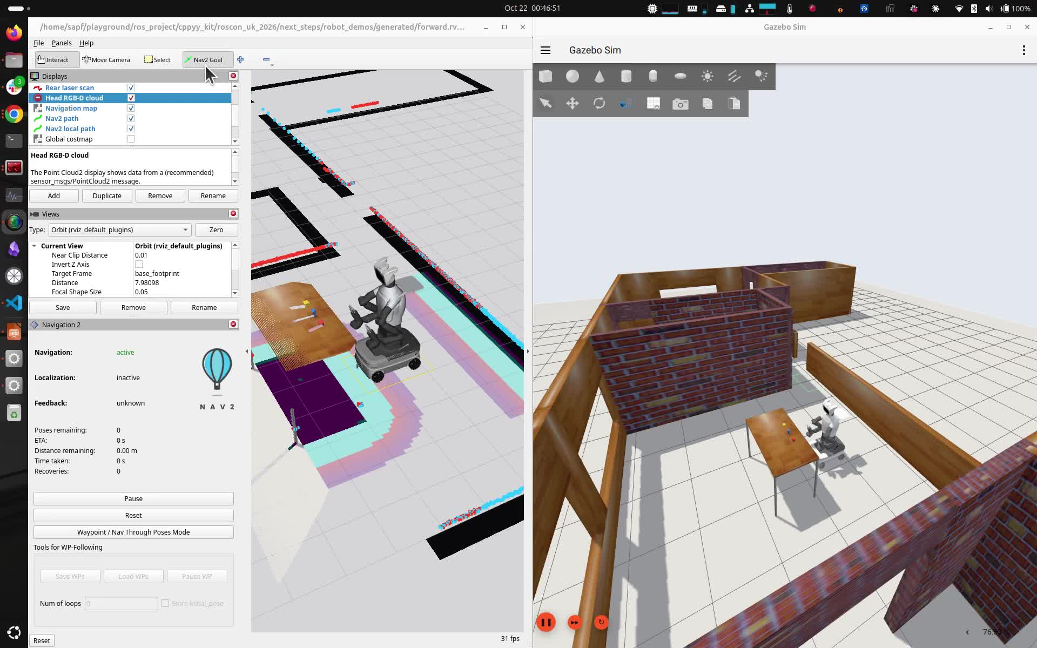
Navigation: turn first, then move forward
./roscon_uk_2026/run_robot_demo.sh forward
Notes:
Now run the forward profile and send the same goal. Point out the turn before translation. The base is still holonomic, with small lateral corrections permitted inside the forward cone.
Latest local run: goal succeeded; 109 moving commands, zero outside the configured 30-degree cone; 0.708 m measured travel and 0.010 m outside the cone due to simulated motion rather than command direction. Final position error 0.098 m, within the configured 0.1 m tolerance. Evidence: next_steps/robot_demos/evidence/forward.json.
Keep the head facing forward. Record enough of the final turn to show that goal orientation still works.
Run from the repository root:
./roscon_uk_2026/run_robot_demo.sh forward
Stop with Ctrl-C and wait for Demo stopped. before the next launch.

Slide 26
Python controller: what we write
Existing launcher + controller parameters
Export the kit adapter; select the Python module, class and joints.
hold_position.py
A complete small controller: capture joint positions and keep commanding them.
control_kit
Supplies ControllerInterface, plugin export, lifecycle and joint-interface access.
Manager loads the adapter → the adapter calls our Python class in the same process
Notes:
The next two slides explain the kit integration using a complete minimal position-holding example. It is a different control law from the recorded admittance demo. The same adapter hosts both. The recorded demo selects python_admittance_controller.CartesianAdmittance instead and passes its arm-specific options. The force UI, URDF parsing, Eigen math and measurements are application logic, not code required to make a Python controller loadable. Existing controller-manager or Gazebo startup is assumed. The adapter acquires the GIL and allocates Python objects; this does not provide a hard-real-time guarantee.

Slide 27
ros2_control: register the adapter and select our class
In the launcher, before starting Gazebo / controller_manager:
import os
from control_kit.python_control import install_python_controller_plugin
prefix = install_python_controller_plugin("./plugin_overlay")
os.environ["AMENT_PREFIX_PATH"] = prefix + ":" + os.environ["AMENT_PREFIX_PATH"]
Controller parameters (hold.yaml):
hold:
ros__parameters:
type: control_kit_python/PythonController
joints: [joint_1, joint_2] # Your position-controlled joints.
python_module: hold_position
python_class: HoldPosition
python_path: /absolute/path/to/your/controller
Notes:
Only the added kit registration and controller parameters are shown. Existing robot bringup provides URDF, hardware, controller manager and its update rate. Save the YAML as hold.yaml and the next Python class as hold_position.py. Replace the joints with the real ordered position interfaces and python_path with its directory. The kit writes pluginlib XML, builds/caches the reusable adapter and exports an ament overlay. Start Gazebo or controller_manager from the environment inheriting that prefix. The next slide gives the standard spawner command. For joints already claimed by another controller, first load this controller inactive and use a strict switch request to deactivate the stock controller and activate this one together. The demo launcher already performs that switch and restoration for admittance.

Slide 28
ros2_control: a complete Python controller
class HoldPosition:
def configure(self, joints, options):
pass
def activate(self, measured_positions):
self.reference = list(measured_positions)
def update(self, measured_positions, dt):
return self.reference
def set_target(self, values):
return False # This example holds its activation pose.
Load and activate through the standard controller manager:
ros2 run controller_manager spawner hold -p hold.yaml
Notes:
This is the complete class in slides/examples/robot_plugins/hold_position.py. configure is required by the adapter; this controller has no configuration. activate captures the current positions. update returns the position commands in the configured joint order. set_target returns False because this example deliberately holds its activation pose. No Python ROS node, executor or custom per-controller CMake project is needed. The spawner configures and activates it when the interfaces are free. Standard controller switching applies when another controller owns them. In the recording that follows, the same adapter loads CartesianAdmittance: its update computes a force-driven hand offset and invokes a cached Eigen kernel for joint commands. That application code remains in control_kit/demos. The recording is not this position-holding law.

Slide 29
ros2_control: Python admittance controller
python_admittance_controller.py
continued → update, limits and deactivation
"""Cartesian virtual-force admittance for the embedded Python controller bridge.
set_target([fx, fy, fz]) applies a virtual force in newtons, expressed in the
configured base_link frame. It does not read a physical force sensor.
"""
import json
import math
import os
import time
from pathlib import Path
import numpy as np
from arm_kinematics import Chain
class CartesianAdmittance:
def configure(self, joint_names, options):
self.joints = list(joint_names)
defaults = {"mass": 2.0, "damping": 30.0, "stiffness": 80.0,
"max_displacement": 0.03, "max_cartesian_speed": 0.06,
"joint_speed": 0.10, "tracking_gain": 4.0, "damping_lambda": 0.04,
"force_timeout": 0.3, "max_force": 20.0}
for key, default in defaults.items():
value = float(options.get(key, default))
if not math.isfinite(value) or value <= 0:
raise ValueError(f"{key} must be finite and positive")
setattr(self, key, value)
self.lower = np.array(options["lower_limits"], dtype=np.float64)
self.upper = np.array(options["upper_limits"], dtype=np.float64)
if (self.lower.shape != (len(self.joints),) or self.upper.shape != self.lower.shape
or not np.isfinite(self.lower).all() or not np.isfinite(self.upper).all()
or np.any(self.lower >= self.upper)):
raise ValueError("Finite ordered joint limits must match the joint count")
self.base_link, self.tip_link = options["base_link"], options["tip_link"]
self.chain = Chain(options["urdf_path"], self.joints, self.base_link, self.tip_link)
self.evidence_path = options.get("evidence_path")
self.active = False
def _positions(self, values):
q = np.ascontiguousarray(values, dtype=np.float64)
if (q.shape != self.lower.shape or not np.isfinite(q).all()
or np.any(q < self.lower) or np.any(q > self.upper)):
raise ValueError(
"Feedback requires finite positions within the configured joint limits"
)
return q
@staticmethod
def _bound(vector, limit):
norm = np.linalg.norm(vector)
if norm > limit:
vector *= limit / norm
return vector
def activate(self, measured_positions):
q = self._positions(measured_positions)
self.reference = self.chain.fk(q).copy()
self.target = self.reference.copy()
self.offset = np.zeros(3)
self.velocity = np.zeros(3)
self.force = np.zeros(3)
self.force_age = self.force_timeout
self.force_stamp = -math.inf
self.callback_count = 0
self.native_elapsed_ns = 0
self.native_max_ns = 0
self.last_measured = q.copy()
self.peak_displacement = 0.0
self.peak_command_step = 0.0
self.active = True
def set_target(self, values):
force = np.array(values, dtype=np.float64)
if force.shape != (3,) or not np.isfinite(force).all():
raise ValueError("Virtual force requires three finite values in newtons")
if not self.active:
raise ValueError("Activate the admittance controller before applying force")
self.force = self._bound(force, self.max_force)
self.force_age = 0.0
self.force_stamp = time.monotonic()
def update(self, measured_positions, dt):
if not self.active:
raise ValueError("Admittance controller is inactive")
q = self._positions(measured_positions)
if not math.isfinite(dt) or not 0 < dt <= 0.1:
raise ValueError("dt must be finite and between 0 and 0.1 seconds")
# Integrate M*x'' + D*x' + K*x = F. Substeps bound integration error
# when simulation updates arrive less frequently than the nominal loop.
steps = max(1, math.ceil(dt / 0.002))
h = dt / steps
for _ in range(steps):
force = (self.force if self.force_age < self.force_timeout
and time.monotonic() - self.force_stamp < self.force_timeout
else np.zeros(3))
acceleration = (
force - self.damping*self.velocity - self.stiffness*self.offset
) / self.mass
self.velocity += h * acceleration
self._bound(self.velocity, self.max_cartesian_speed)
self.offset += h * self.velocity
if np.linalg.norm(self.offset) > self.max_displacement:
self._bound(self.offset, self.max_displacement)
normal = self.offset / self.max_displacement
self.velocity -= max(0.0, float(self.velocity @ normal)) * normal
self.force_age += h
self.target[:3, 3] = self.reference[:3, 3] + self.offset
started = time.perf_counter_ns()
command = self.chain.step(q, self.target, self.lower, self.upper, dt,
self.tracking_gain, self.damping_lambda, self.joint_speed)
elapsed = time.perf_counter_ns() - started
self.native_elapsed_ns += elapsed
self.native_max_ns = max(self.native_max_ns, elapsed)
self.last_measured[:] = q
if not np.isfinite(command).all():
raise ValueError("Native IK returned a nonfinite command")
self.callback_count += 1
self.peak_displacement = max(
self.peak_displacement, float(np.linalg.norm(self.offset))
)
self.peak_command_step = max(self.peak_command_step, float(np.max(np.abs(command-q))))
return command.tolist()
def deactivate(self):
self.active = False
self.force[:] = 0.0
if self.evidence_path:
pose = self.chain.fk(self.last_measured).copy()
rotation = self.reference[:3, :3].T @ pose[:3, :3]
angle = math.acos(float(np.clip((np.trace(rotation) - 1) / 2, -1, 1)))
Path(self.evidence_path).write_text(json.dumps({
"pid": os.getpid(), "module": __name__, "class": type(self).__name__,
"callback_count": self.callback_count, "base_link": self.base_link,
"tip_link": self.tip_link, "peak_displacement_m": self.peak_displacement,
"peak_command_step_rad": self.peak_command_step,
"native_kernel": "cppyy_kit.cppdef_cached:demo_arm_kinematics",
"native_step_mean_us": (
self.native_elapsed_ns / max(1, self.callback_count) / 1000
),
"native_step_max_us": self.native_max_ns / 1000,
"final_measured_displacement_m": float(
np.linalg.norm(pose[:3, 3] - self.reference[:3, 3])
),
"final_measured_orientation_error_rad": angle,
}, indent=2) + "\n")
Notes:
This is the complete source of control_kit/demos/python_admittance_controller.py. Only blank lines are removed to fit one slide; read the left column then the right. It uses the same PythonController adapter shown on the previous slide. configure creates the example-local Chain and validates limits. activate captures the hand pose. set_target receives virtual force [Fx,Fy,Fz] in newtons from the RViz handle. update integrates M*x_ddot + D*x_dot + K*x = F in bounded substeps, expires old force requests, and bounds velocity and displacement. The target retains the initial hand orientation. Chain.step calls the cppyy_kit-cached C++ Eigen implementation in control_kit/demos/arm_kinematics.hpp: forward kinematics, geometric Jacobian and damped least-squares IK produce limited joint-position commands. Chain belongs to this example, not a kit-supplied admittance algorithm. The final counters and deactivate block record demo evidence. This is admittance (force to motion), rather than a torque-output impedance controller. Python runs inside the controller manager and uses the GIL; this demo does not establish hard-real-time scheduling.

Slide 30
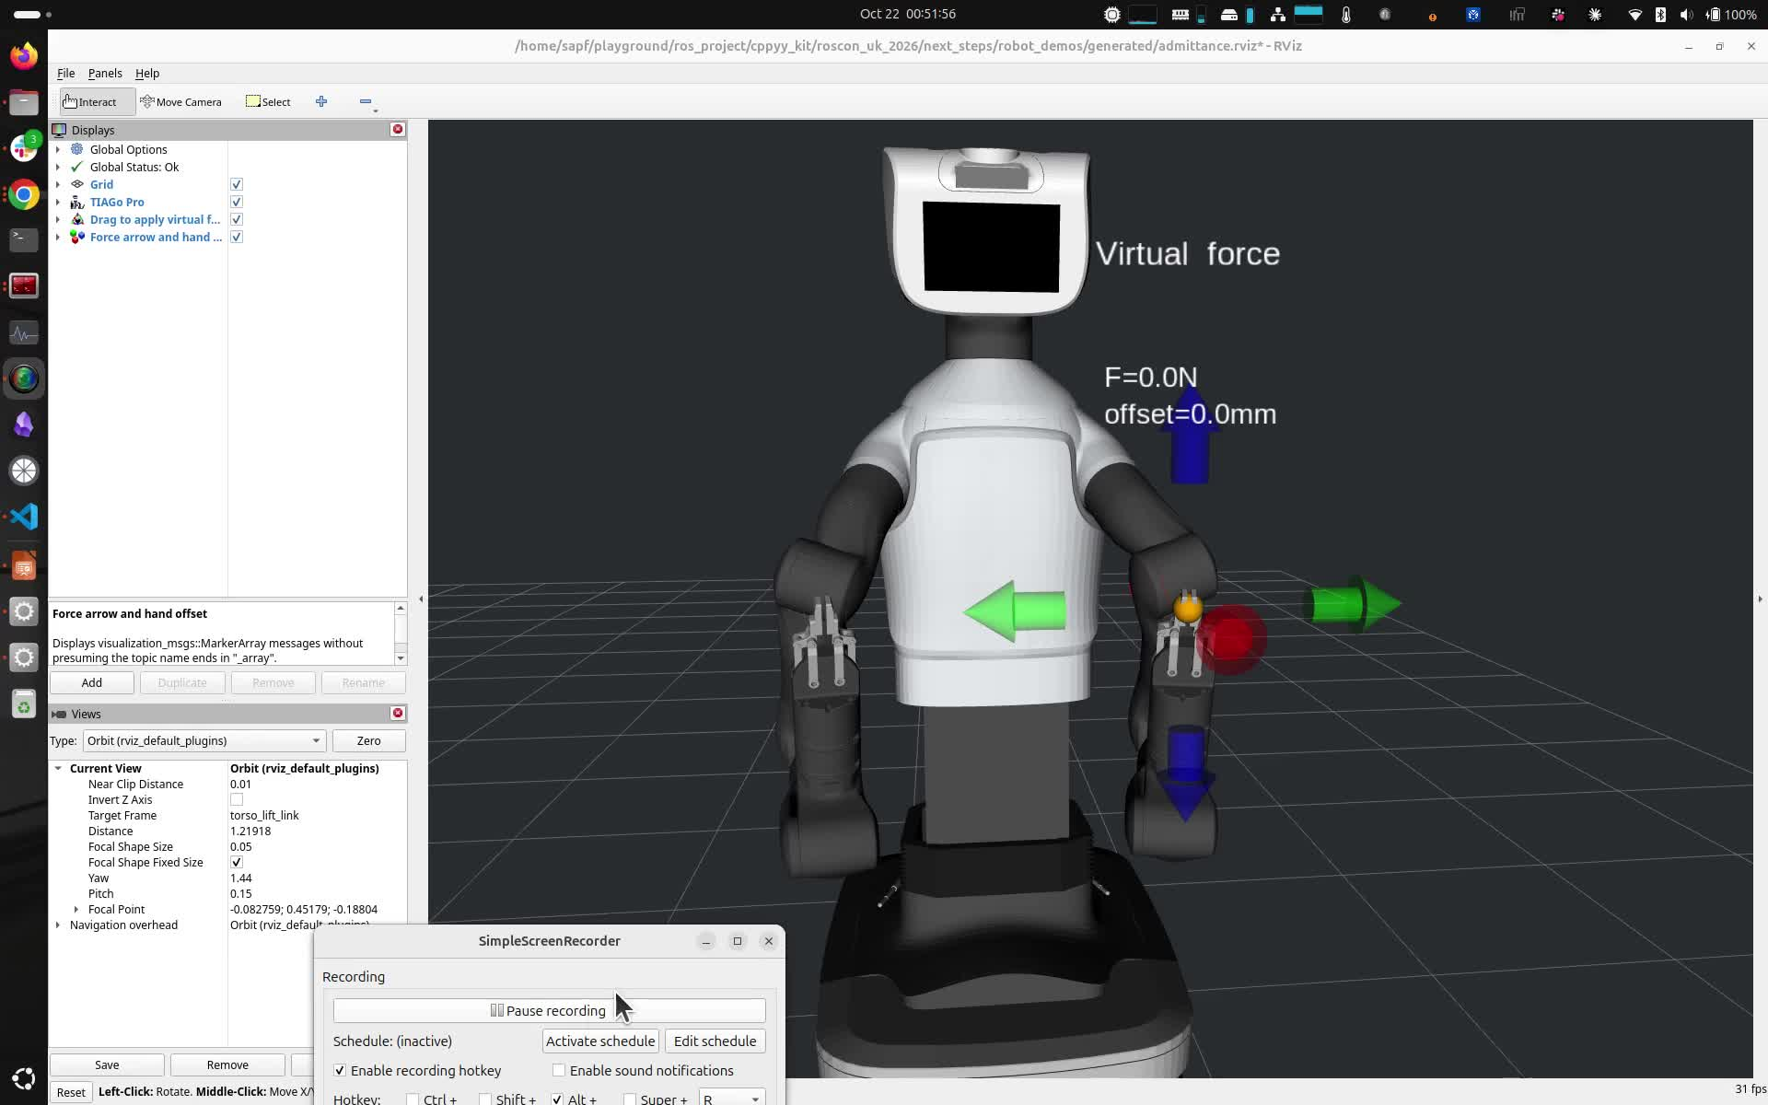
Same Python interface: arm admittance
./roscon_uk_2026/run_robot_demo.sh admittance
Notes:
The recorded controller is CartesianAdmittance, an application built on the same control_kit Python interface as the minimal HoldPosition example. The kit supplies the loadable adapter. The demo supplies the force UI, mass-spring-damper law and cached Eigen kinematics. Drag applies virtual force; release zeros it and the spring returns the hand. Source files: control_kit/demos/python_admittance_controller.py, arm_kinematics.py, arm_kinematics.hpp and admittance_rviz.py. Run ./roscon_uk_2026/run_robot_demo.sh admittance --gazebo-gui. Full code remains in the repository rather than source-listing slides.

Slide 31
We can generate code. How do we check the idea?
An agent can write the extension and its build files.
I want a shorter loop with the actual data.
Ask for a change
See it running
Check and refine
Keep the interpreter, camera and models alive.
Change the processing while the stream continues.
Notes:
Say: So far we have used Python to put our own behavior inside existing ROS components. But an agent can also write a conventional C++ extension and its build files. So where do I still find this useful? I want to try an idea against the data, see the result and change it. Let us keep the camera, models and viewer running and work inside that session. This is my proposed workflow advantage, not a measured comparison with agent-generated bindings. About 40 seconds.

Slide 32
One live interpreter, two views
LEFT: agent terminal
Inspect state; edit processing cells
RIGHT: Viser viewer
Image, results and controls
marimo: persistent Python interpreter
Camera + processing state + models added as needed
Python processing + cppyy_kit C++ kernels
Edit processing → inspect the live result → keep the accepted code
Notes:
Start from live_notebook.py: it owns one webcam, a pass-through processor and a Viser viewer. The perception task is implemented live. The audience sees the agent terminal on the left and the viewer on the right. Keep the marimo tab open in the background. Add models only when the chosen task needs them; retain loaded model objects through processing edits. The agent uses marimo pair/code mode to save accepted cell edits. Do not recreate the camera or viewer to change processing.
From the repository root:
roscon_uk_2026/next_steps/webcam_session/toolbox/rendering/notebook.sh edit roscon_uk_2026/next_steps/webcam_session/toolbox/rendering/live_notebook.py --host 127.0.0.1 --port 2721 --no-token --no-sandbox
Open http://127.0.0.1:2721, run the cells, keep that tab open, and display http://127.0.0.1:8768 beside the agent. Check capture and viewer health before the talk. This starting notebook has been syntax-checked, not camera-rehearsed in this editing turn. Use the prepared model environments if models are needed. The model/viewer/interpreter infrastructure is separate from cppyy_kit.

Slide 33
Live coding: build it against the webcam
LEFT: AGENT TERMINAL
RIGHT: LIVE VIEWER
Choose a task from the scene.
Implement it in the live session.
Inspect the result.
Refine the behavior.
Camera keeps running.
Results appear on the stream.
Controls help us explore.
Accepted edits stay in the notebook.
Ask → implement → observe → adjust
Notes:
Switch to the real desktop. This is a live-coding task, not a tour of an earlier webcam experiment. Begin with the camera stream and choose one bounded task from the current scene: detect or track an item/person, count a visible gesture, or explore geometry if depth is useful. Let the prompt and visible output drive the next refinement. Use existing model APIs where appropriate and cppyy_kit for an operation where native code is useful. Inspect cell errors and capture/processing counters. Keep the camera, viewer and any loaded model instances alive. Save accepted processing edits in the notebook.
Do not narrate earlier webcam features, rain or gestures as the planned sequence. There is no prerecorded-video fallback. If webcam delivery or the live setup is not workable, switch to the marimo notebook with the TIAGo MCAP and detect the blocks on the table. That remains an interactive notebook/agent task using recorded input. Use the hidden MCAP slide for the command and data context. Aim for about six minutes, choosing the task and refinement to fit the available time.

Slide 34
Add native code where the task needs it
Example: depth → points with @cpp(nogil=True)
for (std::size_t i = 0; i < depth_size; ++i) {
const float z = depth[i];
if (!mask[i] || !(z > near && z < far)) continue;
xyz[3*count] = (double(i % width) - cx) * z / fx;
xyz[3*count+1] = (double(i / width) - cy) * z / fy;
xyz[3*count+2] = z;
pixels[count] = i;
++count;
}
Choose the native operation from the live task.
Models: PyTorch / OpenCV / MediaPipe. UI: marimo + Viser.
Notes:
Use this as a compact illustration of the sort of native step cppyy_kit can provide, not as a claim that the chosen webcam task will use depth. The snippet is the C++ loop from next_steps/webcam_session/geometry.py, inside @cpp(nogil=True). It selects valid masked depth pixels, computes XYZ using camera intrinsics, and retains source pixel indices for colors. If the live task uses a different operation, show that actual code instead. The model libraries, marimo and Viser are separate tools. Buffer shape/type contracts, ownership and GIL handling still matter. A monocular relative-depth model does not produce metric geometry merely because the camera is calibrated.

Slide 35
The interactive process has a cost
Cling and its compiler state stay in the process.
Eigen via vanilla cppyy
367 MiB
Eigen via prepared kit cache
203 MiB
Compiled Python extension
~37 MiB
Process RSS after first call · separate Eigen experiment · this laptop
First use can trigger more compilation.
Measure startup, warmed work, memory and behavior separately.
Notes:
Do not pretend interactive native execution is free. These are the median process RSS values after first call from three runs on this machine in the separate Eigen harness, measured 20 October 2026. They are not webcam memory figures or a universal compiler overhead. The original results are 367.1 MiB vanilla cppyy, 203.4 MiB prepared kit cache, 36.9 MiB pybind11, 36.7 MiB nanobind and 37.0 MiB Rust/PyO3. Importing cppyy added about 164 MiB in that harness. Cache preparation reduces repeated compilation but does not remove Cling. Further types or call paths can cause deferred work. Python callback/GIL behavior, buffer ownership and native crashes also matter. The notebook is a useful way to discover and check an idea; deployment requirements should decide what runs afterward. Source: slide_assets/runtime_costs/README.md and its raw measurements. About 35 seconds.

Slide 36
Give the implementation agent more than a prompt
Inputs and expected results
Saved frames, reviewed outputs and tolerances
Failure cases
Occlusion, target loss, false detections and changing conditions
Working reference
Accepted code, dependencies and data contracts
Deployment requirements
Hardware, latency, memory and verification criteria
Implement → compare against the reference → evaluate on held-out cases
Notes:
The interactive work gives us a reference implementation, example inputs, reviewed outputs, failure cases and a clearer contract. Those are useful inputs to a dedicated implementation agent or team. Ask it to implement for the target hardware and evaluate against the reference and held-out cases. Review outputs before using them as expected answers or training labels. The implementation may use a conventional C++ library, Rust or another suitable tool; we are not demonstrating automatic whole-notebook translation. The useful link is the shared behavior and evaluation data. For the webcam, preserve appropriate samples from the task; for the fallback MCAP, retain selected frames/clouds and the detection settings.

Slide 37
Thanks!
Questions?
Discussion?
https://awesomebytes.github.io/cppyy_kit/

Slide 38
Fallback: find the blocks in robot data
Same interactive workflow. The input is a robot MCAP.
Recorded RGB + depth
Blocks on the table
marimo + agent
Inspect and edit
Detection result
Image + point cloud
Find a block → select by color → inspect its 3D cluster
Refine the region and check the result on the recorded data.
Notes:
Hidden fallback slide: show only if switching away from the webcam. This is interactive analysis of recorded robot sensor data, not a prerecorded demonstration video.
From the repository root:
roscon_uk_2026/next_steps/agent_session/notebook.sh edit roscon_uk_2026/next_steps/agent_session/notebook.py --host 127.0.0.1 --port 2718 --no-token --no-sandbox
Open http://127.0.0.1:2718 and run cells. Source: next_steps/agent_session/NOTEBOOK.md. The notebook reads data/table_scene, including table_scene_0.mcap. It retains RGB and the transformed point array while analysis and presentation rerun. There are red and yellow cubes and a blue cylinder. Use color and shape language appropriate to that scene; do not call the cylinder a block.
Ask the agent to inspect the recorded scene, identify the blocks, select a requested color, show its image region and corresponding 3D cluster, and refine the selection. The saved notebook opens with a refined red-object selection. State that starting state honestly; broaden the region/selection if needed, then make a visible change. The known refined ROI is [0.75, 0.10, 0.90] to [1.02, 0.30, 1.08] in base_link metres, voxel size 0.004 m and minimum cluster size 20. These are recording-specific parameters. Have the agent inspect current controls and code, not blindly assume those settings generalize. Keep the notebook browser open and discover its session through pair notebook list on port 2718. Check this fallback before the talk, and leave it available in a separate tab.

Slide 39
After
Before

Slide 40
After
Before

