Slide 1

Git and Github
By Tuyen Nguyen

Slide 2
CREATE a GitHub account

Slide 3
Installing Git
https://git-scm.com/downloads

Slide 4
Configure git
Mac -> go to terminal
Window -> launch git bash
git --version
git --help
git help [command]

Slide 5
Configure git
git config --global user.name “your username”
git config --global user.email “your email”
git config --global core.editor “your favorite editor”

Slide 6
WHAT IS GIT? WHAT CAN WE DO WITH IT?

Slide 7
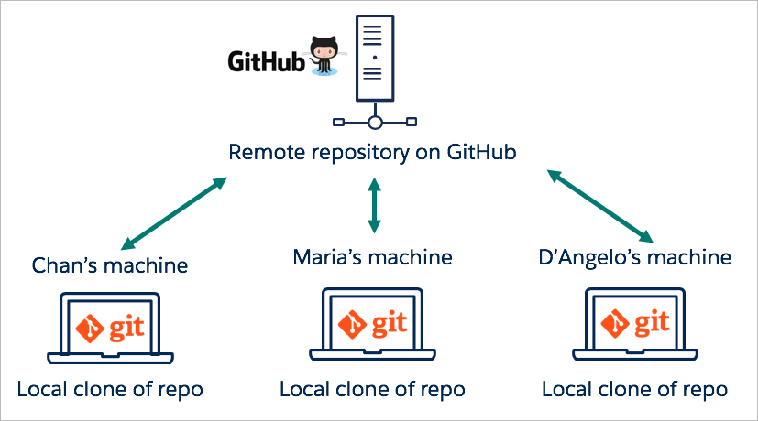
1. GIT – A repository
GitHub allows you to store your documents online so that you and others can have access to it.

Slide 8
GIT CLONE: make a new copy
git clone https://github.com/tnguyen7s/ai-cloud-club-semo.git

Slide 9
2. Git – A version control
- Git allows you to take snapshots of your document as the document evolves through time.
You can revisit any snapshot that you have made, see how your documents have evolved, go back to the state when your document has not made a particular change
If you made some changes to your code but later notice that the change breaks your application somehow => Git helps you to go back to the moments right before the change was made/ revisit all the changes that you have made, allows you to debug your code

Slide 10
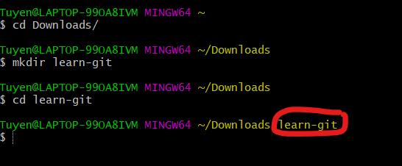
Create your project working directory
1. mkdir learn-git
<mkdir: make a new directory>
2. cd learn-git
<cd: change to the specified directory>
Now you are in the learn-git directory

Slide 11
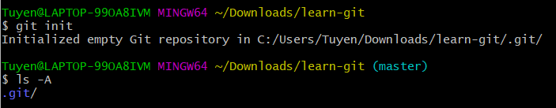
Use git TO track a folder
git init
<git init: tells Git to start to tracking your working directory.
Git creates a directory .git -> enable Git to store version files in there>
ls -A
<ls: list files and child directories>
<-A: to list hidden files>

Slide 12
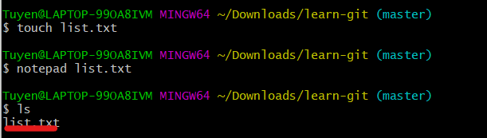
Create a file in bash
touch list.txt
<touch: create a file in your directory>
notepad list.txt
< notepad: open the file in notepad>

Slide 13
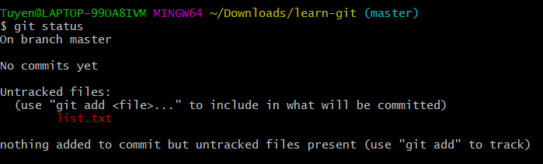
git status
git status: provide information about:
The branch you are on (will discuss later what it is; in this example, you are on the master branch)
Files that are untracked (in our example, newly created list.txt is untracked)
Changes that are in the staging area.
Changes that have been committed

Slide 14
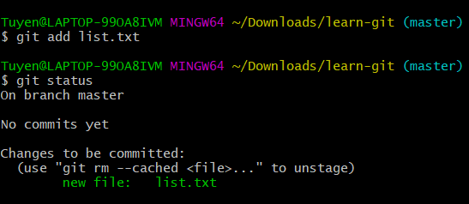
GIT ADD
git add: adding the change (change is a new file in this case) to the staging area
=> Tell Git to include this change in the next commit.

Slide 15
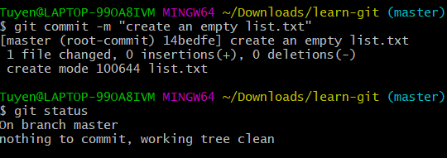
Git commit
git commit: to commit the changes available in the staging area (from “git add”) to your local repository
-m “your message”: allows you to explain what you have done to a file or a set of files, the changes that you have made

Slide 16
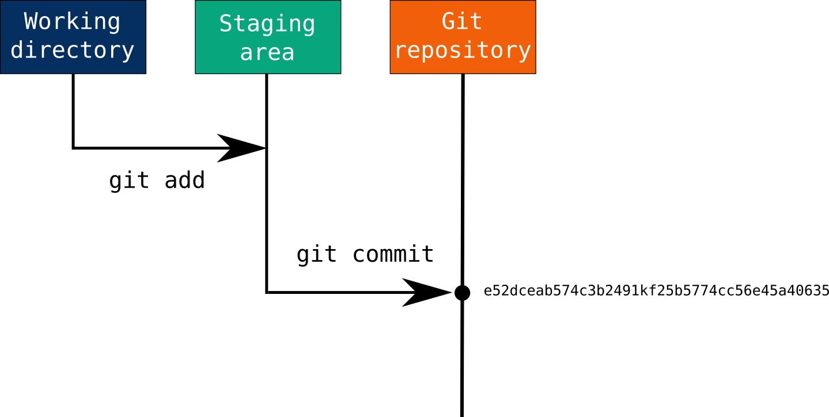
One or multiple “git add” to bring one or multiple changes to a staging area
User wants to commit all the changes
“Git commit” to save those changes in the staging area to the local Git repository
“git push” to push your local repository to the remote repository

Slide 17
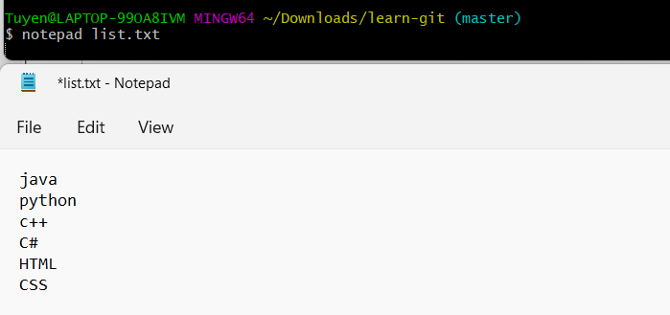
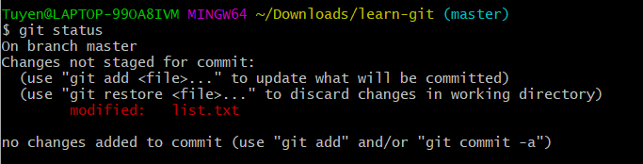
MORE practice with GIT ADD AND GIT COMMIT
Open list.txt file via notepad and add some items to the list
“git status” returns that list.txt is modified but not staged for commit
=> So, let’s stage the changes we made

Slide 18
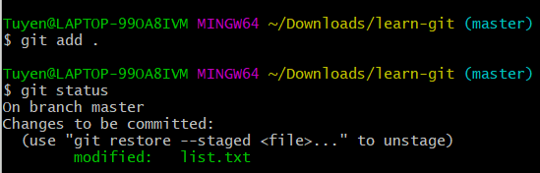
GIT ADD to stage the changes
“git add .” brings all (“.” is a “all” wildcard) changes to the staging area, ready to be committed
=> So now lets commit the changes

Slide 19
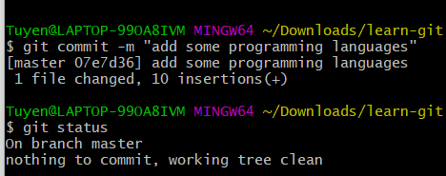
Git commit your changes
You have committed your changes (1 file changed, 10 insertions), nothing to commit

Slide 20
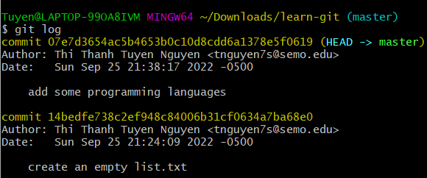
Explore git log
Git log: tells you about all commits that you have made, including author, date, note about your change, the branch where the change is made
Each commit associates to a long hash, which is the hash computed from the file at the time you commit

Slide 21
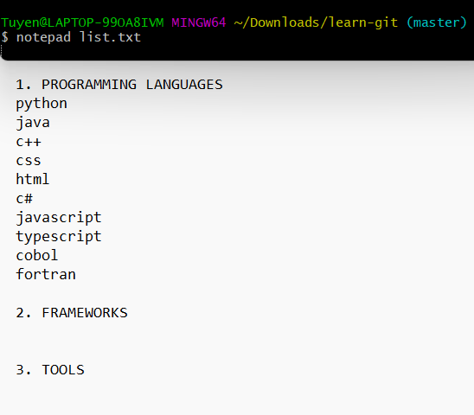
LET’S START exploring git diff
Open the file list.txt via notepad again and add some structure to it (adding some the section headings)

Slide 22
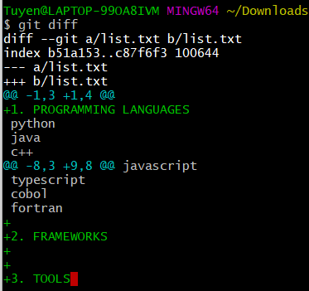
Git diff
Git diff: to compare your working copy and the copy in your repo
Those that we just added to our txt file are colored in green

Slide 23
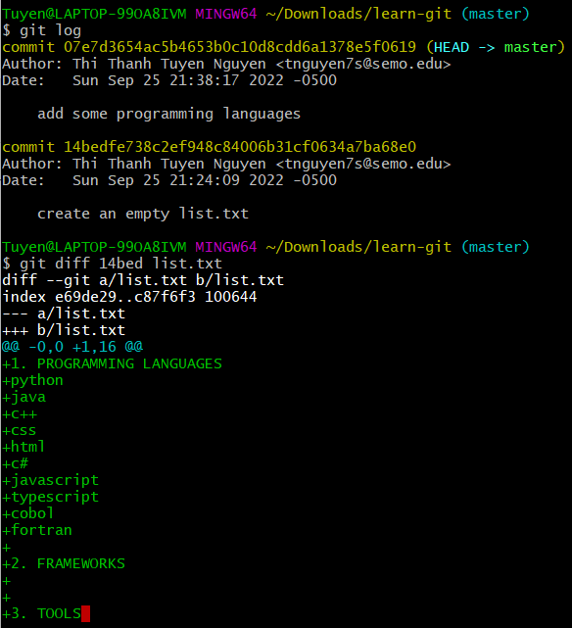
MORE GIT DIFF
We can also compare between the working copy with the copy at any point of time that we made the commit using the following formula:
git diff <5 digits of the commit’s hash> <filename>
In our case, we are comparing our working file with our first commit, at the start, when our empty file is created.

Slide 24
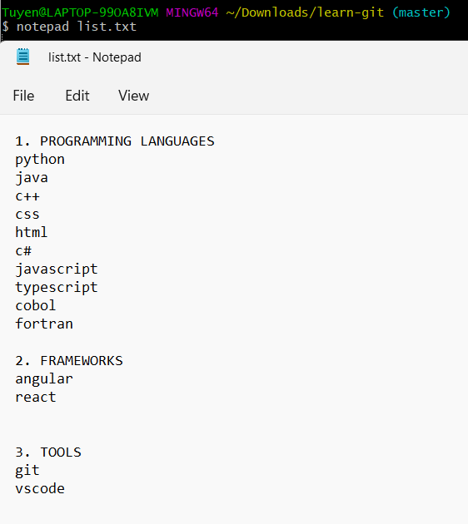
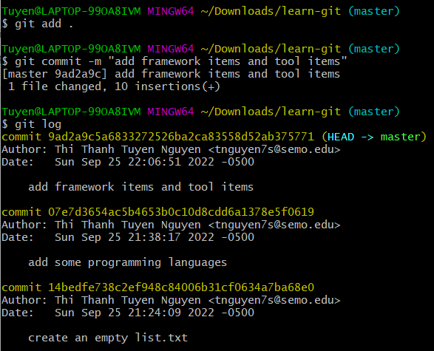
MORE GIT ADD AND GIT COMMIT
Now, we have made three commits

Slide 25
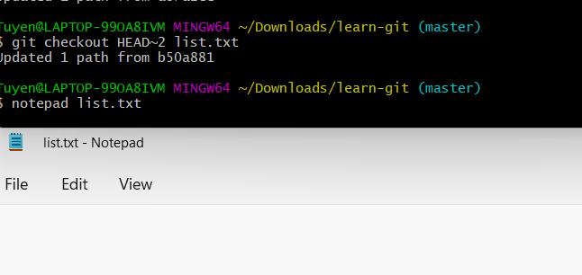
HEAD
Let’s type “git checkout HEAD~2 list.txt” and open your list.txt via note pad again

Slide 26
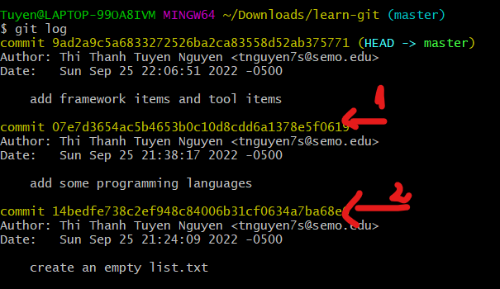
HEAD
Git allows you to revisit your file at the moment when you made the first commit (HEAD 2)
Aren’t surprised if your file is empty. We can go back.

Slide 27
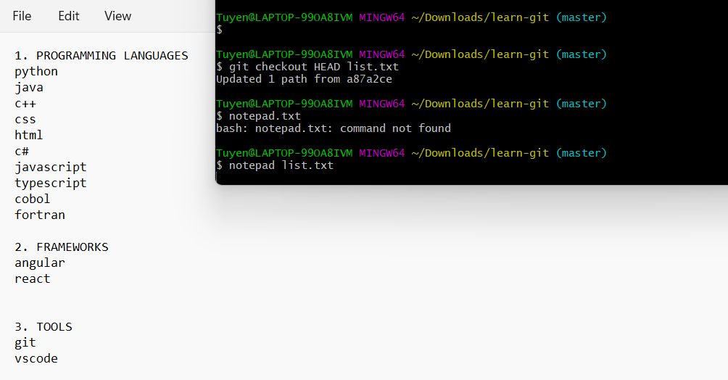
HEAD
Note: no number is associated to the HEAD to checkout to the latest commit.

Slide 28
Git reset
git add list.txt
SOS!!! You have brought a change to the staging area using “git add” and later realize that you don’t want to save that change anymore
Remedy: git reset list.txt
Git reset to return to the state right before when you staged your document. The change is no longer in the staging area, but still in the working document.

Slide 29
Git reset
What if you have not just staged, but also committed the changes already with “git commit”, and you don’t want to commit that change anymore:
Remedy: git reset HEAD~1 --soft
Or git reset HEAD~1 --mixed
Or : git reset HEAD~1 --hard

Slide 30
Git reset
--soft: remove the commit, but the changes are still on the staging area, thus the changes are still on the working file
01
-- mixed: remove the commit, remove changes from the staging area, changes are still on the working file
02
-- hard: remove the commit, remove the changes from your working file as well.
03

Slide 31
Git for coordination
Enable many people to work on the same document
- Everyone can make their own changes, and Git will keep records of who make the changes.

Slide 32
GIT BRANCH
git branch <name of the branch>
git checkout <the name of the branch>
-> the same file can be developed using branches in parallel

Slide 33
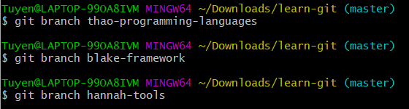
Git branch
Three branches have been created. Multiple people can work on different parts of the project

Slide 34
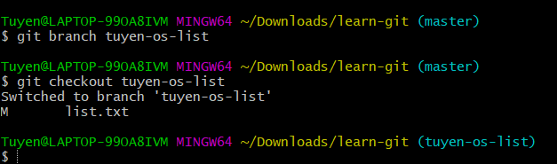
Git checkout <branch name>
I am creating a copy of the repo and putting it into a separate branch.
Then I check out to that branch so that I can collaborate within my own branch, without interfere others or mess up the master branch

Slide 35
Git merge
As you are confident about the change you have made on the child branch, you can merge the child branch to the main branch.
Git merge <name of the branch to be merged to the master branch>

Slide 36
How git is helpful?
Git can also detect conflicts when two separate branches made different change to the same line of code in the file when you try to merge your branch to the main branch (such as one deletes the line and one edit the line). Git then notice the developers to resolve the conflict.

