Slide 1
Common regression mistakes
By Tuyen Nguyen

Slide 2
Review regression analysis
Linear relationship between one explanatory variable and the outcome/dependent variable while holding other variables constant.
The best fit line
Minimize sum of squared residuals
Regression coefficient quantifies the relationship
Significance of regression coefficient or significance of the association is tested using hypothesis testing (central limit theorem, confidence interval, p-value)
R^2 quantifies how much the variation of the dependent variable is explained by our model
Multivariate regression analysis

Slide 3
Regression analysis is the hydrogen bomb of the statistics arsenal
“The Nurses’ Health Study ran by the Harvard Medical School and the Harvard School of Public Health found a negative association between estrogen supplements and heart attacks”
“ By 2001, some 15 million women were being prescribed estrogen in the belief that it would make them healthier. “
“10, 000 many women died prematurely or suffered strokes or breast cancer because they were taking a pill that their doctors had prescribed to keep them healthy”

Slide 4
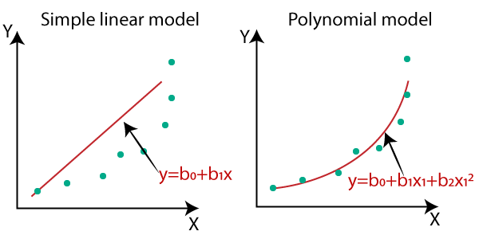
Using regression to analyze a nonlinear relationship
The regression coefficient that we attempt to calculate the slope of “the line of best fit”
A line that is not straight has different slope at different places

Slide 5
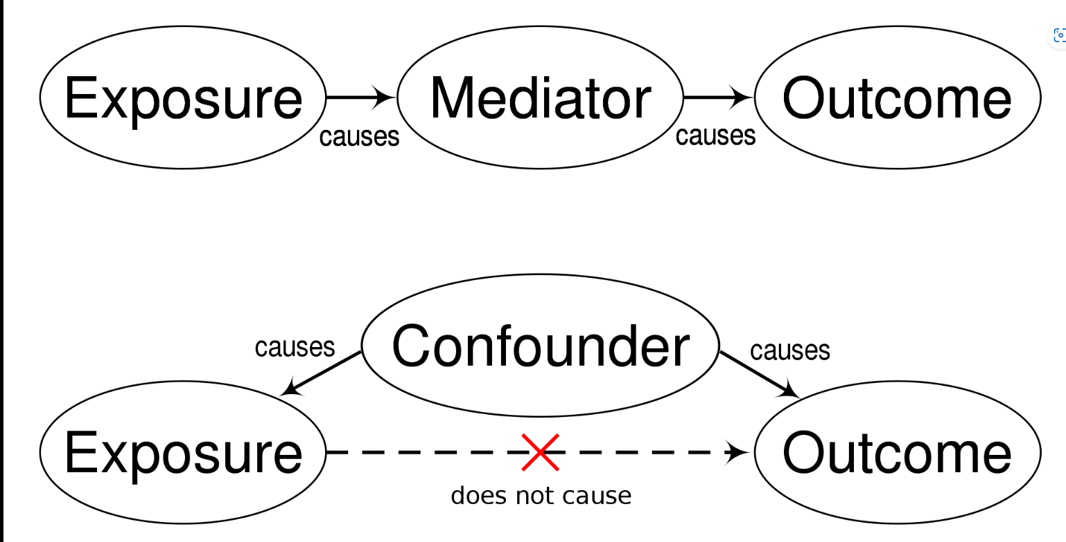
Correlation does not equal causation (spurious causation)

Slide 6
Reverse causality
Sometimes, an association between two variables is not obvious to determine which variable explains which.
Ex: The higher the investment in education is, the higher the economic growth is. There are three possible cases:
Investment in education possibly grows the economy
The growth of economy give the gov money to invest in the education
Both

Slide 7
Reverse causality
Why its important to determine the direction of causality?
X Because we must not include a variable that is affected by the outcome variable y as an explanatory variable in our regression equation.
Ex: Must not use unemployment rate in predicting GDP since boosting GDP is required to lowering unemployment rate

Slide 8
Reverse causality
Why its important to determine the direction of causality?
X Because we must not include a variable that is affected by the outcome variable y as an explanatory variable in our regression equation.
Ex: Must not use unemployment rate in predicting GDP since boosting GDP is required to lowering unemployment rate

Slide 9
Omitted variable bias
Is when we leave out an important variable, and other variable in the equation picks up that effect
Example: a regression analysis shows that golfers have higher incidence of getting diseases such as Heart Disease, Cancer. Is this correct?
People play golf as they get older
Since we leave out the age variable, the “playing golf” variable picks up the effect of age on getting diseases.
That’s why playing golf have positive association with getting disease meanwhile it should be a negative association

Slide 10
Highly correlated explanatory variables (multicollinearity)
X Don’t include two or more variables that are highly correlated with each other.
Since the analysis will not be able discern the true association between each of the independent variables and the outcome variable that we try to explain.
=> Only use one or create a composite variable

Slide 11
Extrapolating beyond the data
our results are valid only for a population that is similar to the sample on which the analysis has been done

Slide 12
Data Mining (Too many variables)
There is a chance that a junk variable included in the regression equation may turn up as statistically significant.
But there is 5% chance or 1% chance (depend on the significance level that we choose) that the association is wrong.
If we suspect about the association or could not explain, resample and reapply our new sample to the model.

Slide 13
Despite all of the possible problems that comes with regression analysis, if done carefully and properly, “Regression analysis enables us to find key patterns in large data sets, and those patterns are often the key to important research in medicine and the social sciences.”

Slide 14
Two things to focus on
what variables ought to be included in a regression equation, what might be missing
how the eventual results can and should be interpreted

