Slide 1
IsoLogic
Isolation & PPE Quick Guide
A Python-Based Clinical Decision Tool
Ashley S. West
Health Information Systems & Development

Slide 2

The Problem
Healthcare workers must quickly determine isolation precautions
Guidelines are long and policy-based
Staff may rely on memory under pressure
Inconsistent decisions increase infection transmission risk
No quick bedside decision-support tool

Slide 3
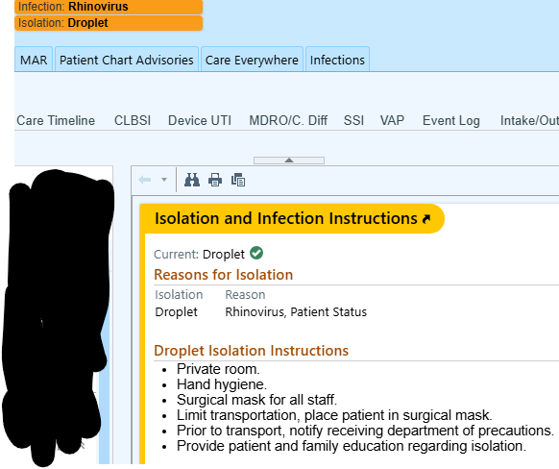
The Solution
This Python program will:
Provide a menu of common infectious conditions
Automatically determine:
Isolation category
Required PPE
Room requirements
Cleaning reminders
1
2
Standardizes decisions.
Reduces variability.
Improves safety.

Slide 4
How It Works (Programming Structure)
The program will use:
Functions
loops
If / / else statements
Input validation
Python dictionaries to store infection rules
Formatted output display

Slide 5

Why Fund This Project?
Supports infection prevention compliance
Reduces decision fatigue
Models real-world healthcare workflow
Scalable to future web-based tools
Real clinical relevance + achievable scope
Bridging Healthcare & Technology Through Practical Programming

Slide 6
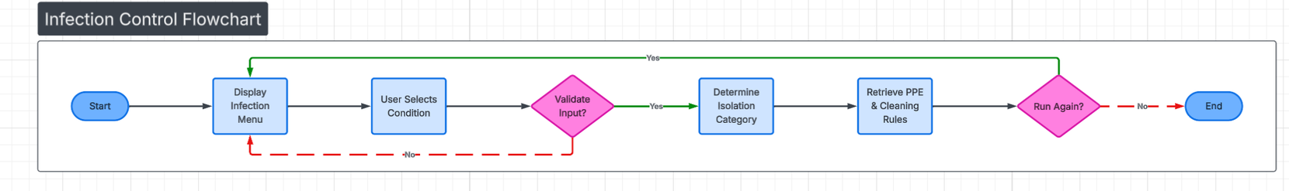
Flowchart
Infection
PPE
Transport

Slide 7
Program Demo & Tech Overview
Built using Python
Uses functions, loops, dictionaries, and conditional logic
Menu-driven user interface
Includes input validation and error handling
Developed incrementally using GitHub version control
Designed to simulate a real healthcare decision-support workflow
https://github.com/awest2390/ISOLOGIC

Slide 8
Conclusion
Why This Project Deserves Support
By combining healthcare knowledge with structured programming logic, this tool models how simple decision-support systems can improve safety, consistency, and efficiency in clinical environments.
Investing in this project means investing in safer, smarter healthcare workflows.

Slide 9
References
Centers for Disease Control and Prevention (CDC). Isolation Precautions Guidelines.
https://www.cdc.gov
Python Software Foundation. Python Documentation.
https://docs.python.org/3/
GitHub Documentation.
https://docs.github.com/
OpenAI. ChatGPT used for brainstorming, code review assistance, formatting guidance, and project planning.
https://chat.openai.com/

Slide 10
THANK YOU
https://github.com/awest2390/ISOLOGIC

